Slide 1
Understanding histone citrullination as an epigenetic modulator
Noah P. Shriever¹ & Maria A. Christophorou¹.
¹ Epigenetics, The Babraham Institute, Cambridge UK.
Notes:
Hello, thank you for attending my flash talk. I am a 1st year PhD student in Maria Christophorous lab at the babraham institute. My project is aiming to understand histone citrullination as an epigenetic modulator

Slide 2
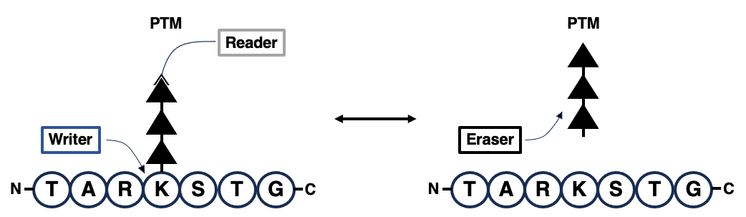
Histone H3 tail Post Translational Modifications (PTMs)
Notes:
Chromatin structure is highly dynamic, allowing accessibility to DNA during processes such as replication and transcription.
A central mechanism of chromatin regulation is through histone post-translational modifications (PTMs).
The presence of PTMs is governed by proteins that deposit or remove them (epigenetic writers or erasers), while their downstream functions are carried out by proteins that bind them (epigenetic readers) and mediate a downstream response.
Histone PTMs function either individually, or in combination with adjacent marks (histone code hypothesis).
Histone citrullination is an established modulator of transcription and chromatin accessibility, but it is unknown whether citrulline-specific epigenetic readers exist.
The N-terminal tail of histone H3 is subject to a plethora of PTMs and includes a number of citrullination sites, as well as neighbouring lysine residues. Previous studies have demonstrated that the presence of citrullines affects the recruitment of readers to nearby trimethyl-lysines, suggesting that citrulline marks operate within the histone code (Sharma et al., 2012; Clancy at al., 2017).

Slide 3
Hypothesis
Histone citrullination is part of the histone code
There are citrulline-specific epigenetic readers
The presence of citrullination modulates the binding of writers, erasers or readers to neighboring lysine PTMs

Slide 4
Specific aims
To identify proteins that specifically bind citrulline marks on the histone H3 tail
To identify trimethyl-lysine and acetyl-lysine binding proteins, whose binding is modulated by neighbouring citrullinations
To understand the biological functions of citrulline-modulated epigenetic regulators

Slide 5
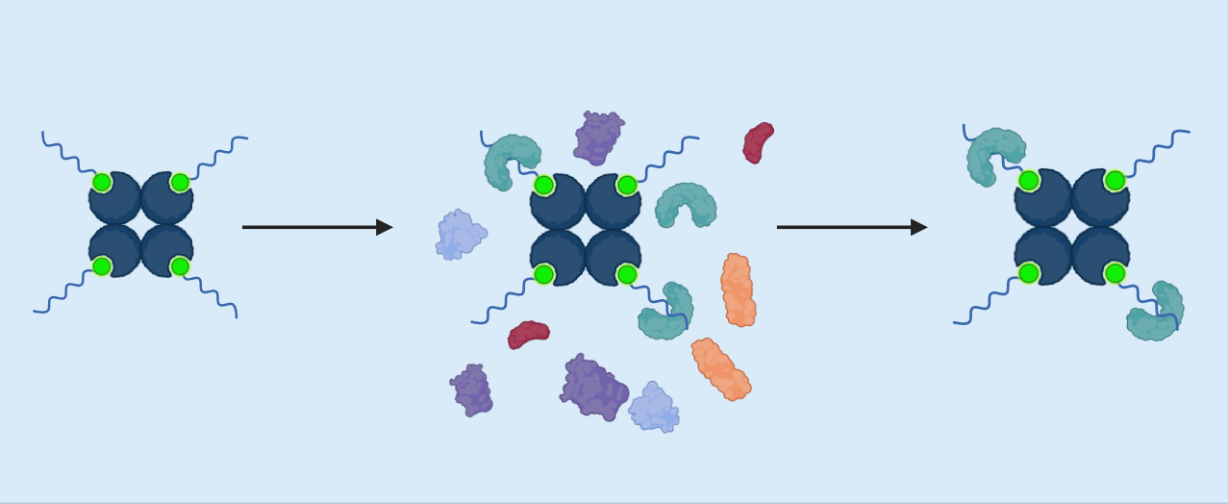
Approach to identify citrulline-specific readers and modulators
Streptavidin-biotinylated peptide complex
+ Whole cell lysate
Prey proteins bound to peptide bait
Wash
Notes:
Synthetic biotinylated peptides will be used as baits for the isolation of binders to differentially modified H3 tails.
E14 mouse embryonic stem cell lysates were incubated with biotinylated peptides coupled to streptavidin beads and the bound proteins were analysed via western blot and Mass Spectrometry.

Slide 6
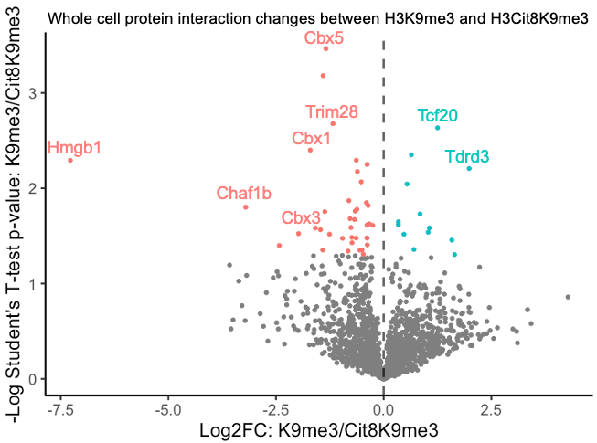
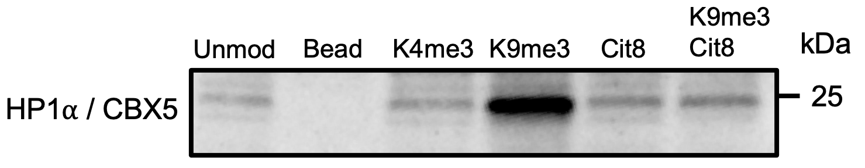
Proteins identified H3K9me3 vs H3Cit8K9me3
Synthesized peptide | Reasoning
Unmodified H3 tail | Control
H3K4me3 | Negative control
H3Cit8 | Citrulline readers
H3K9me3 | Control
H3Cit8K9me3 | Modulator of epigenetic regulator recruitment
Significance
H3K9me3
H3Cit8K9me3
Sharma, P., Azebi, S., England, P., Christensen, T., Møller-Larsen, A., Petersen, T., Batsché, E. and Muchardt, C. (2012). Citrullination of Histone H3 Interferes with HP1-Mediated Transcriptional Repression. PLOS Genetics 8, e1002934.
Enrichment
Notes:
the particular pulldown I am going to be talking about is looking at K9me3 and Cit8
We compared the unmodified to cit8 to try and identify citrulline specific readers, but the one I am going o talk about is the k9me3 with and without Cit8
Volcano plot shows depletion of typical K9ke3 readers such as… whilst presence of cit8 results in enrichment of activating reafers such as …
We validated the effect of cit8 on CBX5 binding by western
This is reallt nice as this data supports the paper from Sharma and collaegues and gives us some confidence in the data and the protocol

Slide 7
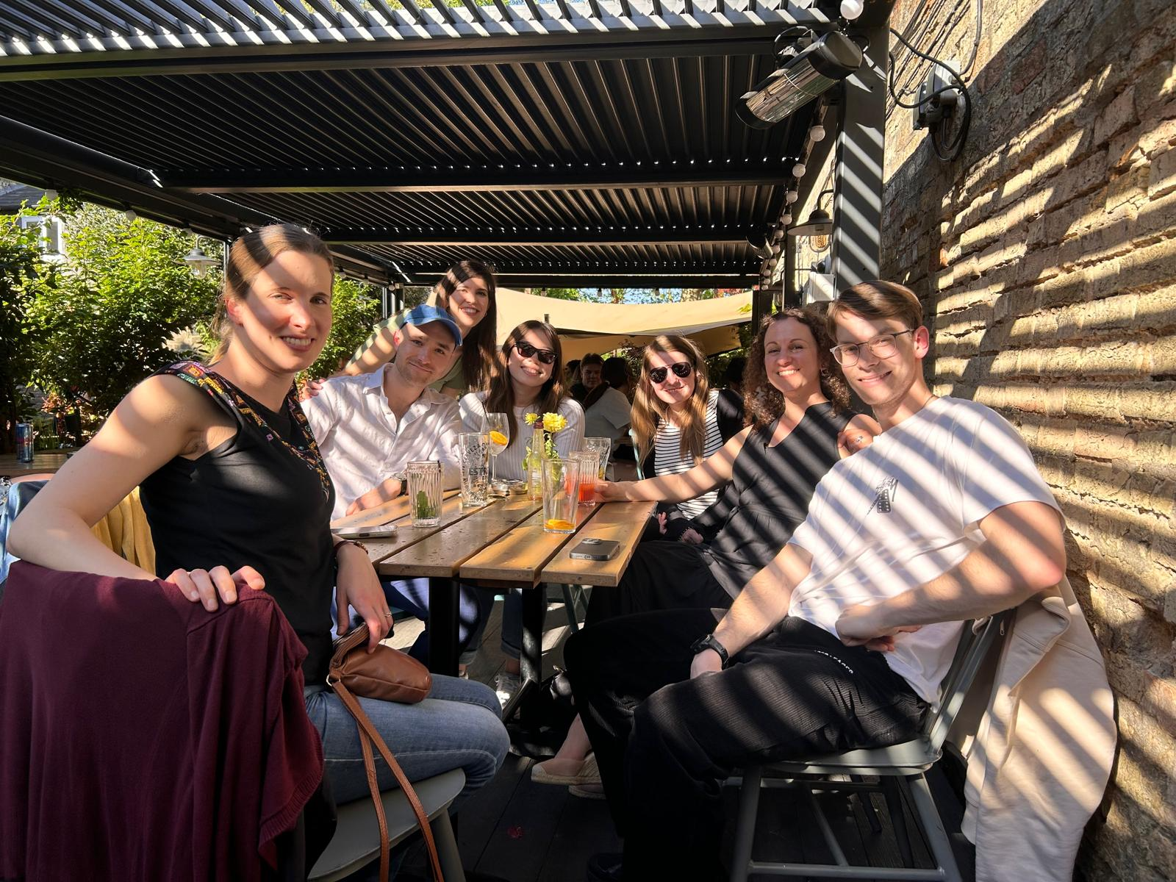



Acknowledgements
Christophorou group
Maria Christophorou
Daniel Moore
Johanna Grinat
Rocío Mora Molina
Jayalini Assalaarachchi
Petrina Tan
Past members
Robert Walmsley
Visiting researcher
Vicente Perez Garcia
BI Mass spectrometry facility
David Oxley
Lu Yu
Kranthi Yadav G
Cell Guidance Systems
Simon Rudge
Michael Jones

