Slide 1
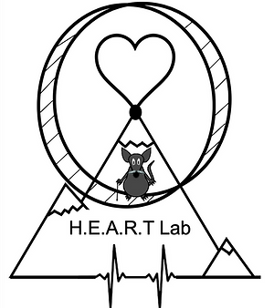

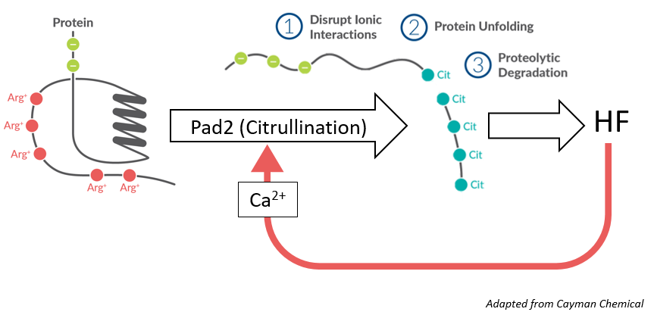
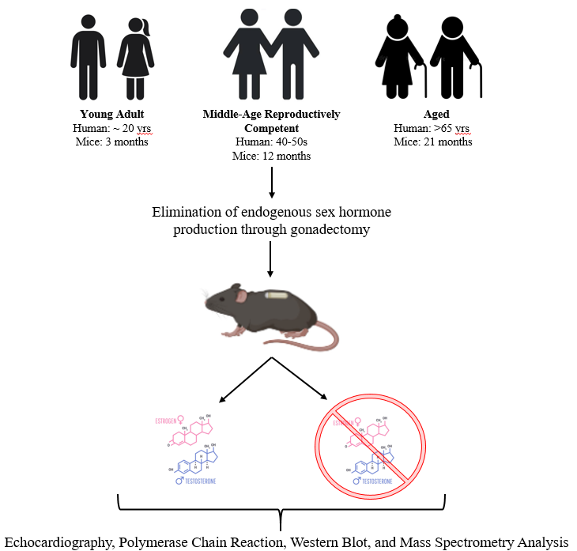


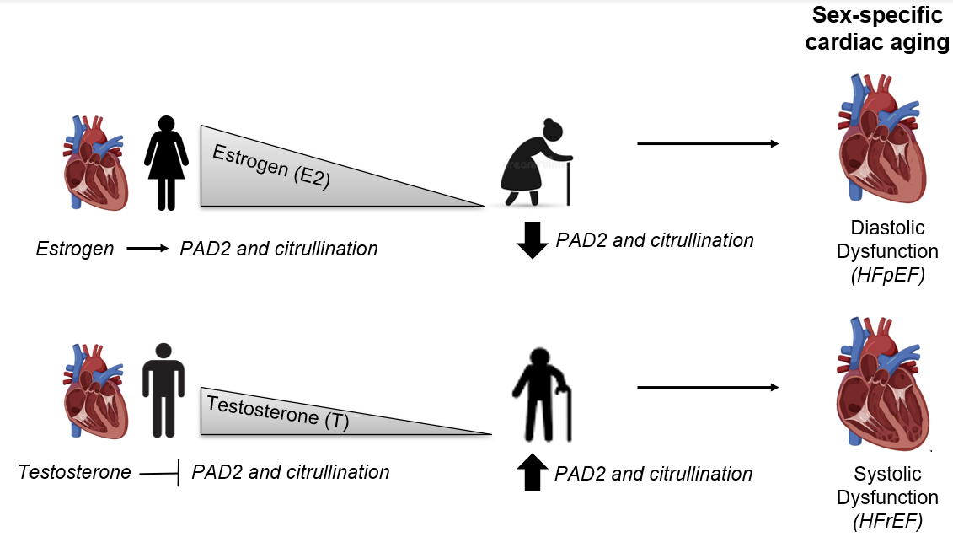
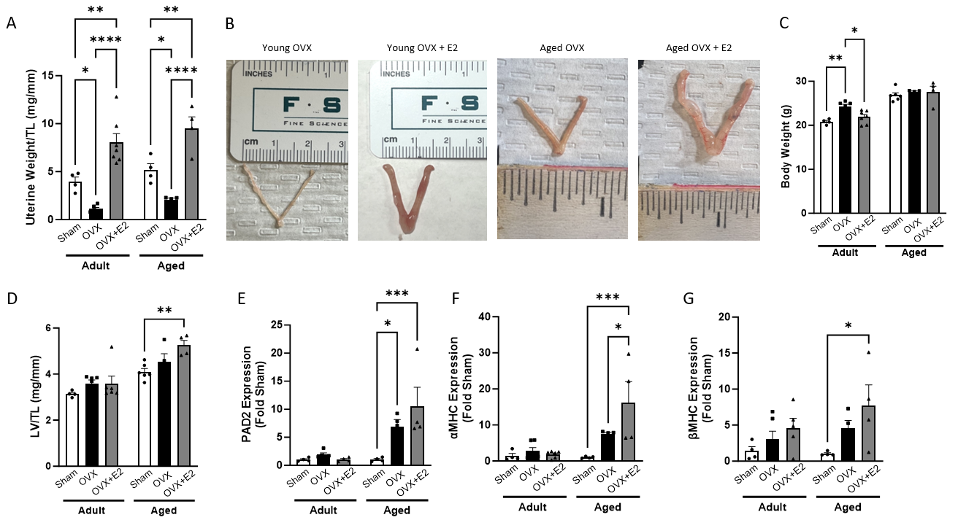
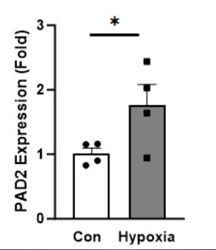
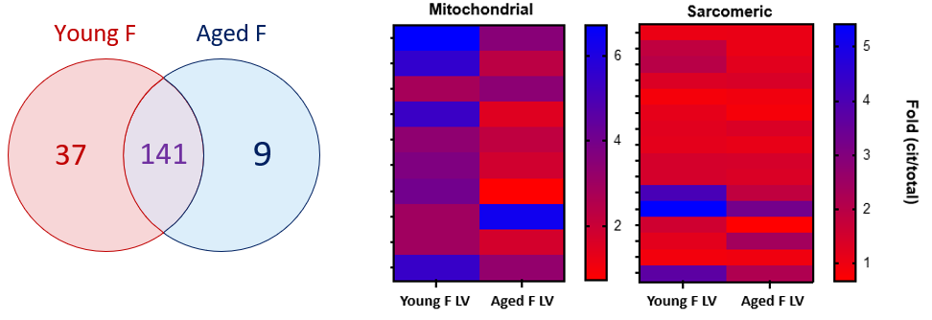





Cardiac PAD2 Expression and Myocardial Citrullination Decline with Age in Female Mice Independent of Estrogen
Samantha K. Shorthill¹, Aykhan F. Yusifov¹, Joshua P. Thornburg¹, Finley R. Klinger¹, Benjamin D. McNair¹, Brian D. Cherrington², Kathleen C. Woulfe³, Danielle R. Bruns^{1,2}
¹Kinesiology & Health, University of Wyoming, Laramie, WY, ²Zoology and Physiology, University of Wyoming, Laramie, W, ³University of Colorado-Denver; Division of Cardiology, Aurora, CO
ABSTRACT
INTRODUCTION
METHODS
Cardiac aging is sexually dimorphic, with women more likely than men to develop diastolic dysfunction (heart failure with preserved ejection fraction, HFpEF) for which no therapies exist. Loss of cardioprotective estrogen (E2) during menopause increases risk of HFpEF in women through unclear mechanisms. Expression of peptidylarginine deiminase 2 (PAD2) is positively regulated by E2, suggesting a potential novel mechanism linking PAD2, diastolic function, and E2 in the aging female heart. We hypothesized that PAD2 expression and protein citrullination decline with age in the female heart due to loss of E2, contributing to diastolic dysfunction. Global deletion of PAD2 exacerbated the HFpEF phenotype in aging females, with worse diastolic function than age matched controls. PAD2 expression and protein citrullination decreased with age in the female heart. Mass spectrometry detected citrullination of sarcomeric and metabolic proteins, with overall lower levels of citrullinated proteins in aged female hearts compared to young. To confirm direct regulation of PAD2 by E2, a cohort of young and aged mice underwent ovariectomy (OVX) with or without E2 replacement. Contrary to our hypothesis, no changes in PAD2 expression were observed in young females and PAD2 expression increased with OVX and OVX+E2 in aged females. Given the previous reports of hypoxia regulating PAD activity, we quantified expression of the transcriptional regulator hypoxia inducible factor-1α (HIF-1α). HIF-1α was upregulated by OVX and OVX+E2, suggesting a mechanism by which PAD2 is regulated by hypoxia. Together, we establish that protein citrullination and PAD2 in the female heart change with age, perhaps contributing to diastolic dysfunction. Elucidation of the mechanisms underlying PAD2 expression and function of citrullinated myocardial proteins remains to be determined and may benefit development of therapies for diastolic dysfunction in the aging female heart.
Diastolic Function (HFpEF)
Citrullination Mechanism
Adult Female
Human: ~ 20 years
Mice: 3 months
Aged Female
Human: > 65 years
Mice: 18-21 months
Ovariectomy
0.5 µМ E2
Systolic Function (HFrEF)
Our Working Model
PAD2?
Mass Spectrometry
Molecular Analysis
Echocardiography
Shorthill et al. Canadian Journal of Physiology and Pharmacology. 2024
RESULTS
OVX
OVX + E2
Adult
Exogenous E2 replacement was successful. E2 positively regulates PAD2 in the uterus
Uterus
Aged
Citrullinated Proteins
Young F
141
Aged F
LV
Cardiac PAD2 is not regulated by E2 but may be regulated by hypoxia/HIF1α
37
9
Cardiac myocyte specific deletion of PAD2 exacerbated HFpEF phenotype in middle-aged female mice
Cardiac PAD2 expression decreases with age in females. Mitochondrial & sarcomeric proteins are citrullinated less in the aged female hearts
CONCLUSIONS
ONGOING PROJECTS
ACKNOWLEDGEMENTS
Cardiac PAD2 expression and citrullination decrease with age in the female heart
Estrogen does not regulate PAD2 in the heart
HIF-1α & hypoxia are potential regulators of cardiac PAD2
Hypoxia
Acknowledgments
HEART Lab Members
Liz Quigley
Joey Flock
Ari Tourtellot
? → Cardiac PAD2
Middle Aged
(12 months)
~ 40-50 human years

