Slide 1

Conference on New Techniques and Technologies for official Statistics NTTS 2019
Brussels, 12–14 March 2019
Re-identification risk with mobile phone data in Official Statistics
Tiziana Tuoto - Istat Italy
Joint work with: Fabrizio de Fausti, Roberta Radini, Luca Valentino

Slide 2
In this presentation:
Motivating factors
The data
The risk scenarios
First results
Next steps and take-home message
Re-identification risk with mobile phone data in Official Statistics
NTTS 2019 - Brussels, 12 March 2019

Slide 3
Motivating factors: the MIT research
In Unique in the crowd: The privacy bounds of human mobility (2013), De Montjoye, Hidalgo, Verleysen & Blondel claim that mobility traces observed via Mobile Phone data are highly unique, so re-identification is easy using little outside information, that is 4 time space points allow us to uniquely identify the 95% of mobile phone users.
Furthermore, by decreasing the spatial and temporal resolution, the power of identification decays very slowly
Re-identification risk with mobile phone data in Official Statistics
NTTS 2019 - Brussels, 12 March 2019

Slide 4
Motivating factors: GDPR and public awareness on privacy risk
The utility of Mobile Phone Data - MPD - should be balanced by the risk for privacy violation of personal data.
Even if MPD are provided without direct identifiers (e.g. name, surname, personal tax code, SIM) we cannot state they are anonymous, it is possible to isolate a subject in a MPD database or to link the MPD to subjects in different databases.
So, according to the GDPR, MPD should be considered as personal data
we need an evaluation of the risk of re-identifying a person, even if personal data has been de-identified, encrypted or pseudo-anonymised.
Re-identification risk with mobile phone data in Official Statistics
NTTS 2019 - Brussels, 12 March 2019
Notes:
Hence, to allow using MPD in a privacy preserving framework, a data protection impact assessment should be evaluated. This means to describe the planned processing operations, to assess the risks to privacy, to plan the measures to address those risks.
This problem can be overcome by adopting anonymization procedures (already adopted by Wind) to prevent re-identification or indirect identification.
The indirect identification of personal data may take place whenever it is possible to isolate some or all records which identify an individual in the data set (singling out of a record), or to link, at least, two records concerning the same individual in the same database or in two different databases (“linkability” of two records).
The indirect identification of personal data is also possible when it can deduce, with significant probability, the value of an attribute from the values of a set of other attributes (inference of attributes).

Slide 5
The data: Call Detail Records (CDRs)
In the CDRs, we have:
the anonymous (encrypted) SIM (Subscriber Identity Module) who makes the calls,
the type of CDRs: call-in and text mess/SMS
time of the event: day, hour, minute, second of call start and call duration
the localisation: a passive localisation corresponding to the antenna/sector code to which the calling device and the call end antenna has been linked
Re-identification risk with mobile phone data in Official Statistics
NTTS 2019 - Brussels, 12 March 2019

Slide 6
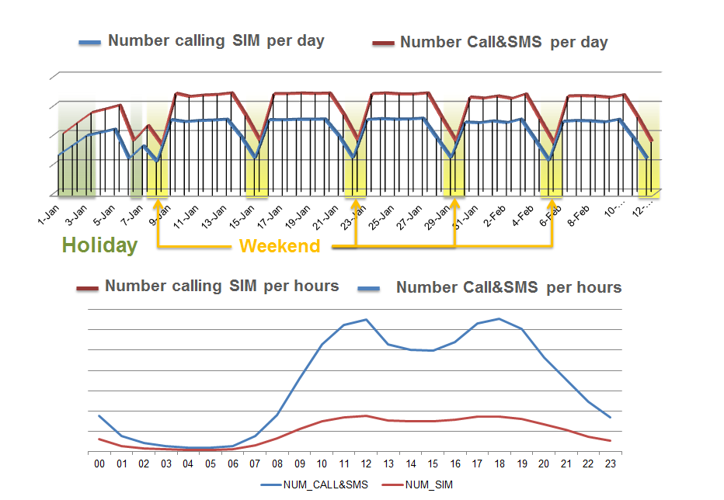
The data at a glance

Slide 7
The risk of re-identification for mobile phone data
The re-identification or indirect identification of personal data may take place whenever it is possible to isolate some or all records which identify an individual in the data set (singling out of a record), or to link, at least, two records concerning the same individual in the same database or in two different databases (“linkability” of two records).
To measure the re-identification risk we need to identify a risk scenario:
1. the attacker/intruder and how he/she acts;
2. the external/background knowledge the attacker has.
Re-identification risk with mobile phone data in Official Statistics
NTTS 2019 - Brussels, 12 March 2019

Slide 8
Risk scenarios
We consider 2 possible attacks:
Attack 1: the “nosey neighbour adversary”, that is the attacker has private information on single person and want to identify a specific person in MPD to obtain further details on his/her habits.
Attack 2: the “journalist adversary”, that is the attacker has information on the entire population, a micro or aggregate level and want to isolate or link these info with the MPD.
We explicitly consider an attack where the external knowledge is represented by the microdata available at the Istat premises.
Re-identification risk with mobile phone data in Official Statistics
NTTS 2019 - Brussels, 12 March 2019

Slide 9
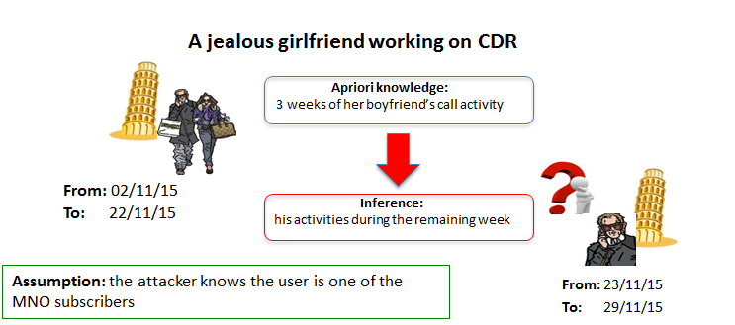
Scenario #1
27/01/19
17/02/19
18/02/19
24/02/19
Re-identification risk with mobile phone data in Official Statistics
NTTS 2019 - Brussels, 12 March 2019

Slide 10
The risk of re-identification for mobile phone data
We should evaluate the risk of re-identification for each dataset for each single use when integrated with Istat microdata.
The calculation can be cumbersome and time consuming: a full evaluation requires actual data integration between MPD and Istat microdata.
We decide to avoid this issue by evaluating a maximum for the probability of re-identification, i.e. the probability in the worst case.
Re-identification risk with mobile phone data in Official Statistics
NTTS 2019 - Brussels, 12 March 2019

Slide 11
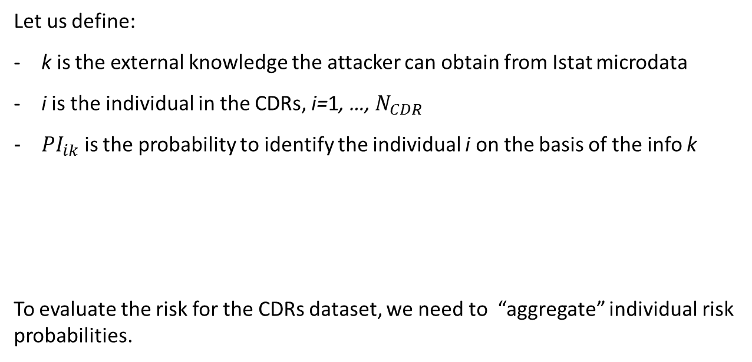
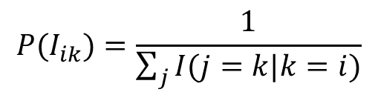
A short formalization
Let us define:
k is the external knowledge the attacker can obtain from Istat microdata
i is the individual in the CDRs, i=1, …, $N_{CDR}$
${PI}_{ik}$ is the probability to identify the individual i on the basis of the info k
To evaluate the risk for the CDRs dataset, we need to “aggregate” individual risk probabilities.
$${P(I}_{ik})=\frac{1}{\sum_{j}{I(j=k|k=i)}}$$
Re-identification risk with mobile phone data in Official Statistics
NTTS 2019 - Brussels, 12 March 2019

Slide 12
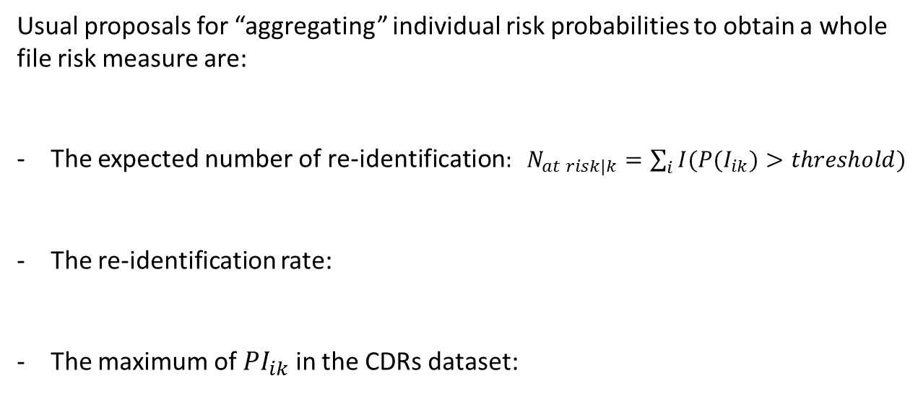


A short formalization
Usual proposals for “aggregating” individual risk probabilities to obtain a whole file risk measure are:
The expected number of re-identification$: N_{at risk|k}=\sum_{i}{I({P(I}_{ik})>threshold)}$
The re-identification rate:
The maximum of ${PI}_{ik}$ in the CDRs dataset:
$${RI}_{k}=\frac{N_{at risk}}{N_{CDRs}}$$
$${RI}_{k}={\max_{i∈CDR}{{PI}_{ik}}}_{}$$
Re-identification risk with mobile phone data in Official Statistics
NTTS 2019 - Brussels, 12 March 2019

Slide 13
Which information at NSIs? The “home and work” attack
The k external knowledge is given by the ”home and work” locations, that is the place of usual residence and the place of work/study, we can derive by the population register and the Integrated Statistical Registers:
two time-space points
during workingdays, one space point in 8pm-7am nighttime, one space point in 7am-8pm daytime.
B
A
Re-identification risk with mobile phone data in Official Statistics
NTTS 2019 - Brussels, 12 March 2019

Slide 14
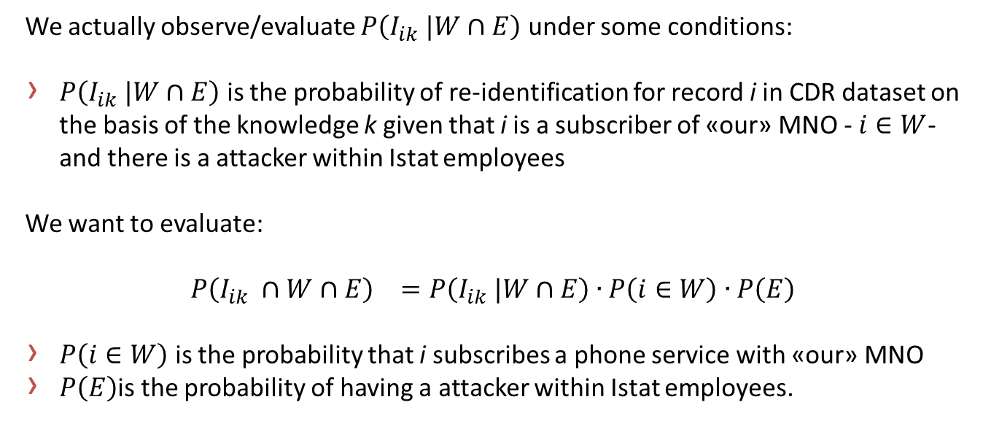
What we actually observe
We actually observe/evaluate $P\left(I_{ik} |W∩E\right)$ under some conditions:
$P\left(I_{ik} |W∩E\right)$ is the probability of re-identification for record i in CDR dataset on the basis of the knowledge k given that i is a subscriber of «our» MNO - $i∈W$- and there is a attacker within Istat employees
We want to evaluate:
$${P\left(I_{ik} ∩W∩E\right)}_{}=P\left(I_{ik} |W∩E\right)∙{P\left(i∈W\right)∙P\left(E\right)}_{}$$
$P\left(i∈W\right)$ is the probability that i subscribes a phone service with «our» MNO
$P\left(E\right)$is the probability of having a attacker within Istat employees.
Re-identification risk with mobile phone data in Official Statistics
NTTS 2019 - Brussels, 12 March 2019

Slide 15
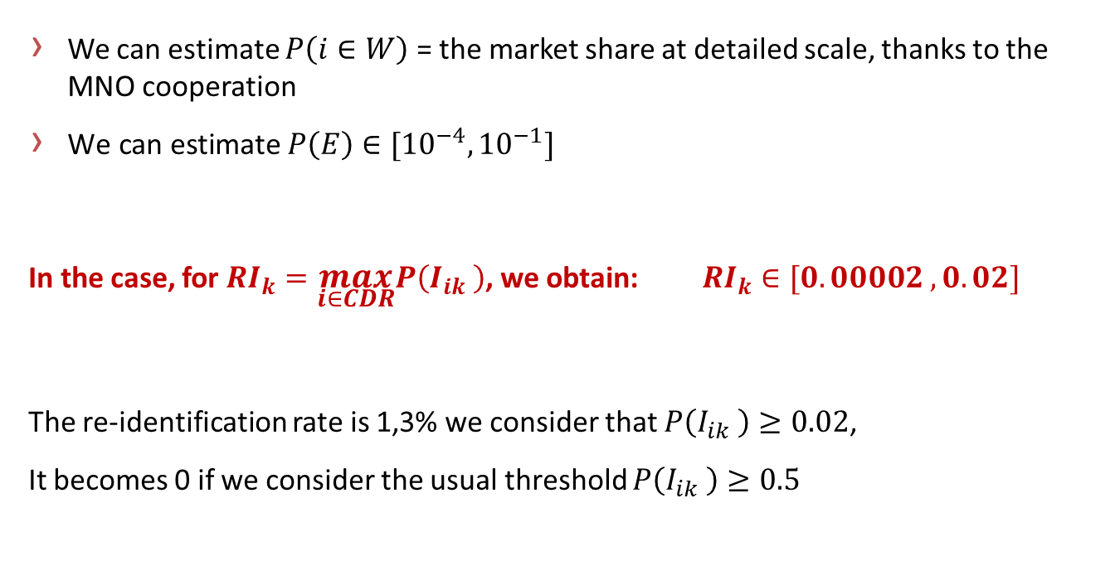
First results
We can estimate $P\left(i∈W\right)$ = the market share at detailed scale, thanks to the MNO cooperation
$\text{We} \text{can} \text{estimate} P\left(E\right)∈[{10}^{−4},{10}^{−1}]$
In the case, for ${RI}_{k}=\max_{i∈CDR}P\left(I_{ik} \right)$, we obtain: ${RI}_{k}∈[0.00002 ,0.02]$
The re-identification rate is 1,3% we consider that $P\left(I_{ik} \right)≥0.02$,
It becomes 0 if we consider the usual threshold $P\left(I_{ik} \right)≥0.5$
Re-identification risk with mobile phone data in Official Statistics
NTTS 2019 - Brussels, 12 March 2019

Slide 16
Concluding remarks
We evaluated a maximum, in the worst case scenario, to avoid micro-integration with Istat data.
Further factors should be espicitely considered:
Location of the devices, so far two different techniques have been tested
Time gap between Istat data and mobile phone data
Re-identification risk with mobile phone data in Official Statistics
NTTS 2019 - Brussels, 12 March 2019

Slide 17
Next steps and take-home message
Next steps:
Investigate the proper time-space granularity to guarantee risk reduction in several situations
Privacy by design
Take-home message:
Results on privacy risk at NSI premises seem encouraging and comforting
Caution if you have a jealous girlfriend!
Re-identification risk with mobile phone data in Official Statistics
NTTS 2019 - Brussels, 12 March 2019

