Slide 1
Metadata driven monitoring of electronic data capture: the Ethiopian experience
New Techniques and Technologies for Statistics 2019
Brussels 11 - 15 March 2019
M. Bruno, G. Drovandi, P. Giacomi, M. Grassia - Istat
A. Whitesell, J. Handley - Census Bureau

Slide 2
Outline
The Italian support to the 4th Ethiopian Population and Housing Census
Metadata driven monitoring of electronic data capture:
CSPro 7 data collection process (strengths & weaknesses)
Dashboard to monitor field operations
Data collection architecture
Cspro2sql
Dashboard
Metadata driven monitoring of electronic data capture – NTTS 2019

Slide 3
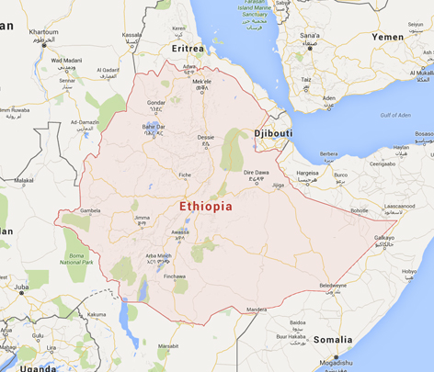
The Italian support to the 4th Ethiopian Population and Housing Census - 1
Ethiopia - Summary statistics
Region |  | Eastern Africa
Capital city |  | Addis Ababa
Surface area (sq km) | 2015 | 1.104.300
Population (projected estimate) | 2017 | 104.957.000
GDP: Gross domestic product (million current US$) | 2017 | 59.917
GDP growth rate (annual %) | 2017 | 9,6
Metadata driven monitoring of electronic data capture – NTTS 2019
Notes:
Modernization Programme
Since the second half of 2014 Istat has implemented its internal Modernisation Programme, in accordance with both some actions supported by UNECE - High-level Group on the Modernisation of Official Statistics and the European Statistical System commitment to Vision 2020
Istat’s Modernisation Programme was officially approved by the Governing Board on January 28th, 2016
Modernization Programme: objectives
The main objectives of the modernization programme are to enrich the supply and quality of the information produced, while improving the effectiveness and efficiency of overall activity. This goal means being aware that the statistics released have to meet the needs of an ever-changing society and the new requests for information, bearing in mind that Istat is producer, researcher and guarantor of the quality of official statistics, besides playing a guiding role for a proper and competent use of statistics.
This objective will be achieved in compliance with a series of constraints and conditions, some of which may be considered as intermediate objectives. For example, information has to be produced and disseminated without any additional costs and charges for respondents. Moreover, at a time of great attention to the use of public resources, it is necessary to avoid that Istat’s operational expenses may result in additional burdens for the State budget.
Summarizing:
The modernization aims to:
- enrich the supply and quality of statistical information and services
- encourage the development and exploitation of methodological, technological, and organisational innovation- To increase and reorient the skills of human resources
- reduce respondent burdens
- further improve the efficiency and quality of production processes, while taking into account budget constraints

Slide 4
The Italian support to the 4th Ethiopian Population and Housing Census - 2
Capacity building in statistics – Population Census Project
Financing Body | Italian Agency for development Cooperation | Implementation Agency | Italian National Institute of Statistics
Partner Institution | Central Statistical Agency (CSA)
Starting date | June 2016 | Duration | 24 months
Overall objective | To contribute to the improvement of the statistical information available in Ethiopia through the implementation of the 4th Population and Housing Census that will make available updated information on the structure and composition of the Ethiopian population
Main expected results/ (activities) | To reinforce the statistical capacity of CSA through the increase of the average professional level and qualifications of the staff involved in the PHC preparation. Technical assistance and training for improving the Census Methodology, setting up a System for data collection monitoring, Data center configuration
Metadata driven monitoring of electronic data capture – NTTS 2019
Notes:
Modernization Programme
Since the second half of 2014 Istat has implemented its internal Modernisation Programme, in accordance with both some actions supported by UNECE - High-level Group on the Modernisation of Official Statistics and the European Statistical System commitment to Vision 2020
Istat’s Modernisation Programme was officially approved by the Governing Board on January 28th, 2016
Modernization Programme: objectives
The main objectives of the modernization programme are to enrich the supply and quality of the information produced, while improving the effectiveness and efficiency of overall activity. This goal means being aware that the statistics released have to meet the needs of an ever-changing society and the new requests for information, bearing in mind that Istat is producer, researcher and guarantor of the quality of official statistics, besides playing a guiding role for a proper and competent use of statistics.
This objective will be achieved in compliance with a series of constraints and conditions, some of which may be considered as intermediate objectives. For example, information has to be produced and disseminated without any additional costs and charges for respondents. Moreover, at a time of great attention to the use of public resources, it is necessary to avoid that Istat’s operational expenses may result in additional burdens for the State budget.
Summarizing:
The modernization aims to:
- enrich the supply and quality of statistical information and services
- encourage the development and exploitation of methodological, technological, and organisational innovation- To increase and reorient the skills of human resources
- reduce respondent burdens
- further improve the efficiency and quality of production processes, while taking into account budget constraints

Slide 5
The Italian support to the 4th Ethiopian Population and Housing Census - 3
Capacity building in statistics – Population Census Project
Coordination with other Partners / Agencies | UNFPA DIFID / ONS USAID / US Census Bureau
Resources | Istat provided technical assistance, training on the job and statistical training addressed to CSA staff for a total of 33 working weeks
Main deliverables | Web based monitoring system (CSPro Dashboard) fully integrated (via CSPro2sql software) with the primary data collection system CSPro2sql & Dashboard User Guide; Prototype of a web-based application for record linkage; Guidelines for the design and implementation of the Post-Enumeration Survey in Ethiopia (including instructions for the use of the Web-based application for record linkage).
Metadata driven monitoring of electronic data capture – NTTS 2019
Notes:
Modernization Programme
Since the second half of 2014 Istat has implemented its internal Modernisation Programme, in accordance with both some actions supported by UNECE - High-level Group on the Modernisation of Official Statistics and the European Statistical System commitment to Vision 2020
Istat’s Modernisation Programme was officially approved by the Governing Board on January 28th, 2016
Modernization Programme: objectives
The main objectives of the modernization programme are to enrich the supply and quality of the information produced, while improving the effectiveness and efficiency of overall activity. This goal means being aware that the statistics released have to meet the needs of an ever-changing society and the new requests for information, bearing in mind that Istat is producer, researcher and guarantor of the quality of official statistics, besides playing a guiding role for a proper and competent use of statistics.
This objective will be achieved in compliance with a series of constraints and conditions, some of which may be considered as intermediate objectives. For example, information has to be produced and disseminated without any additional costs and charges for respondents. Moreover, at a time of great attention to the use of public resources, it is necessary to avoid that Istat’s operational expenses may result in additional burdens for the State budget.
Summarizing:
The modernization aims to:
- enrich the supply and quality of statistical information and services
- encourage the development and exploitation of methodological, technological, and organisational innovation- To increase and reorient the skills of human resources
- reduce respondent burdens
- further improve the efficiency and quality of production processes, while taking into account budget constraints

Slide 6
Data collection process:
CSPro 7 & Dashboard
Metadata driven monitoring of electronic data capture – NTTS 2019
Notes:
Modernization Programme
Since the second half of 2014 Istat has implemented its internal Modernisation Programme, in accordance with both some actions supported by UNECE - High-level Group on the Modernisation of Official Statistics and the European Statistical System commitment to Vision 2020
Istat’s Modernisation Programme was officially approved by the Governing Board on January 28th, 2016
Modernization Programme: objectives
The main objectives of the modernization programme are to enrich the supply and quality of the information produced, while improving the effectiveness and efficiency of overall activity. This goal means being aware that the statistics released have to meet the needs of an ever-changing society and the new requests for information, bearing in mind that Istat is producer, researcher and guarantor of the quality of official statistics, besides playing a guiding role for a proper and competent use of statistics.
This objective will be achieved in compliance with a series of constraints and conditions, some of which may be considered as intermediate objectives. For example, information has to be produced and disseminated without any additional costs and charges for respondents. Moreover, at a time of great attention to the use of public resources, it is necessary to avoid that Istat’s operational expenses may result in additional burdens for the State budget.
Summarizing:
The modernization aims to:
- enrich the supply and quality of statistical information and services
- encourage the development and exploitation of methodological, technological, and organisational innovation- To increase and reorient the skills of human resources
- reduce respondent burdens
- further improve the efficiency and quality of production processes, while taking into account budget constraints

Slide 7
Census data collection process - CSPro 7
CSEntry
Supervisor
CSEntry
CSEntry
CSPro 7 (Census Bureau)
CSWEB
Metadata driven monitoring of electronic data capture – NTTS 2019

Slide 8
Census data collection process - CSPro 7
CSEntry
Supervisor
CSEntry
CSEntry
CSPro 7 (Census Bureau)
Strenghts:
metadata driven
used in several countries
no coding needed
no licence fees
CSWEB
Metadata driven monitoring of electronic data capture – NTTS 2019

Slide 9
Census data collection process - CSPro 7
CSEntry
Supervisor
CSEntry
CSEntry
CSPro 7 (Census Bureau)
Weakness:
microdata is stored in plain text files
difficult to monitor fieldwork activities
…
CSWEB
Metadata driven monitoring of electronic data capture – NTTS 2019

Slide 10
Census data collection process - CSPro 7
CSPro 7 (Census Bureau)
Weakness:
microdata is stored in plain text files
difficult to monitor fieldwork activities
…
CSWEB
Metadata driven monitoring of electronic data capture – NTTS 2019

Slide 11
Census data collection process - CSPro 7
CSPro 7 (Census Bureau)
Weakness:
microdata is stored in plain text files
difficult to monitor fieldwork activities
…
CSWEB
Metadata driven monitoring of electronic data capture – NTTS 2019

Slide 12
Census data collection process
We want to address the following questions:
How to make field operations smoother?
How to increase quality of survey data?
We need to move microdata to a relational database and
a dashboard to monitor fieldwork activities
MICRO DATA
MONITOR
Metadata driven monitoring of electronic data capture – NTTS 2019

Slide 13
Census data collection process - Dashboard
CSEntry
Supervisor
CSEntry
CSEntry
CSPro 7 (Census Bureau)
CSWEB
Metadata driven monitoring of electronic data capture – NTTS 2019

Slide 14
Census data collection process - Dashboard
CSEntry
Supervisor
CSEntry
CSEntry
Dashboard (Istat)
CSWEB
MICRO DATA
Metadata driven monitoring of electronic data capture – NTTS 2019

Slide 15
Census data collection process - Dashboard
CSEntry
Supervisor
CSEntry
CSEntry
Dashboard (Istat)
CSWEB
MICRO DATA
MONITOR
GIS DB
Metadata driven monitoring of electronic data capture – NTTS 2019

Slide 16
Data architecture: data flow
STAGE 1
STAGE 2
STAGE 3
CSWEB
MICRO DATA
MONITOR
GIS DB
CSPro plain file
Separated
columns
Report tables
Metadata driven monitoring of electronic data capture – NTTS 2019

Slide 17
Data architecture: data flow
STAGE 1
STAGE 2
STAGE 3
CSWEB
MICRO DATA
MONITOR
GIS DB
CSPro plain file
Separated
columns
Report tables
Metadata driven monitoring of electronic data capture – NTTS 2019

Slide 18
Data architecture: data flow
STAGE 1
STAGE 2
STAGE 3
CSWEB
MICRO DATA
MONITOR
GIS DB
CSPro plain file
Separated
columns
Report tables
Metadata driven monitoring of electronic data capture – NTTS 2019

Slide 19
Data architecture: roles
CSPro 7
(Census Bureau)
CSWEB
Dashboard (Istat)
MONITOR
MICRO DATA
GIS DB
Metadata driven monitoring of electronic data capture – NTTS 2019

Slide 20
Architectural components
In order to implement the data collection process described above you need:
CSPro data dictionary: the data dictionary contains all the questionnaire metadata (e.g. variables, classifications, relations between variables)
Cspro2sql: parsing the content of the data dictionary, cspro2sql generates the scripts to create the microdata database and to load microdata collected using CSPro
Dashboard: a web application implemented using open source Java frameworks. The dashboard displays the reports generated by cspro2sql
Metadata driven monitoring of electronic data capture – NTTS 2019

Slide 21
Architectural components: cspro2sql
Cspro2sql: parsing the content of the data dictionary, cspro2sql generates the scripts to create the microdata database and to load microdata collected using CSPro
https://github.com/mauroIstat/CSPro2Sql
Metadata driven monitoring of electronic data capture – NTTS 2019

Slide 22
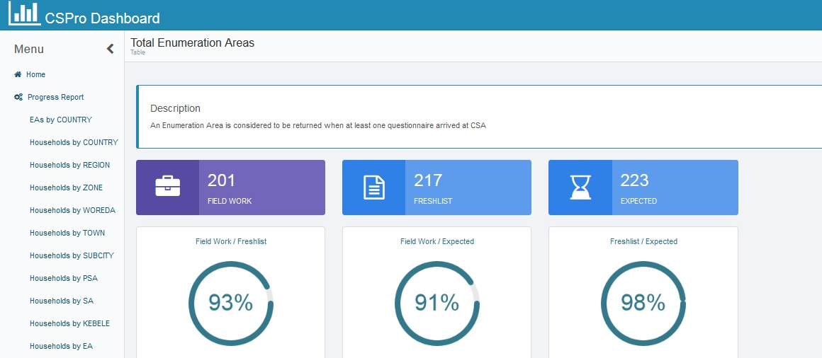
Architectural components: dashboard
Dashboard: a web application implemented using open source Java frameworks. The dashboard displays the reports generated by cspro2sql
https://github.com/drovandi/CSProDashboard
Metadata driven monitoring of electronic data capture – NTTS 2019

Slide 23
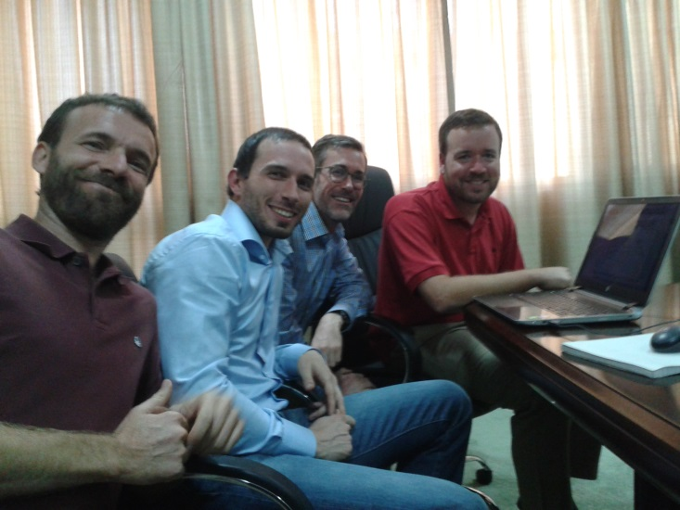
… a success story
Improved statistical capacity of CSA in performing census survey
Sustainable goals achieved
Census process standardization
A set of tools that can be used/modified in several surveys by CSA staff
Easy software enhancements over the time
Win-Win cooperation
Learning from each other how to build reusable solutions for different countries
Metadata driven monitoring of electronic data capture – NTTS 2019

Slide 24
Thank you!
mbruno@istat.it
Generalized Process for Business Statistics – SORS, 6/11/2017

