Slide 1
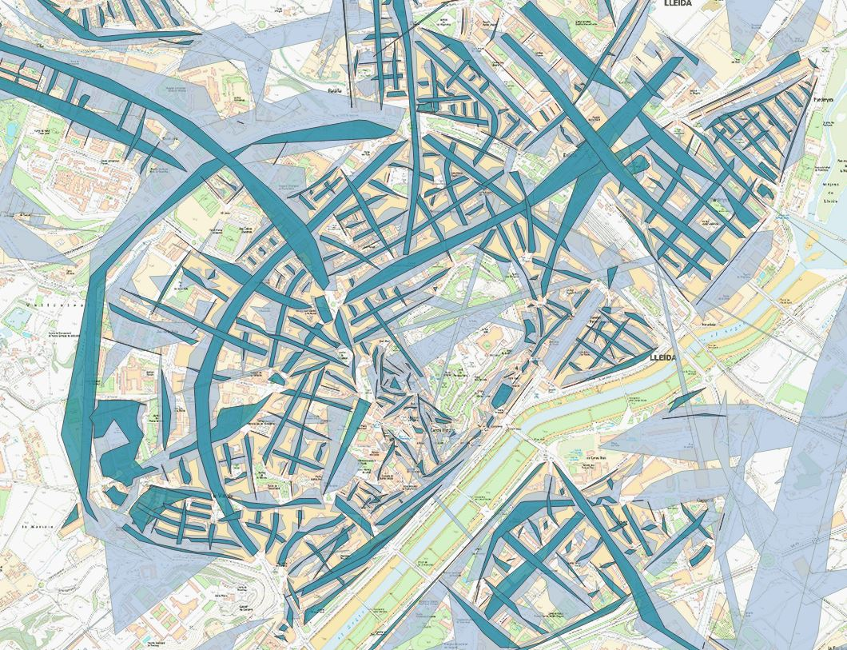
Implementation of the Statistical Territory Register
Cristina Rovira, Eduard Suñé, Anna Bernaus,
Daniel Ibáñez, Roser Condal, Mireia Farré
www.idescat.cat
NTTS 2019 CPS02-003

Slide 2
CONTENTS
1. RET: objectives and sources
2. Geocoding
3. Validation
4. Quality control
5. Conclusions
NTTS 2019 CPS02-003

Slide 3
1. RET: objectives and sources (I)
Objectives
Production System
3 basic subsystems based on administrative records
  to geocode microdata
  to validate postal addresses
Statistical Population Register (REP)
Statistical Territory Register (RET)
Sources
  Municipal database of addresses in Catalonia (only street numbers). Cartographic and Geological Institute of Catalonia (Cartographic WS)
  Plots of land and property. General Directorate of Land Registry (Property Register DB)
Statistical Entities Register (REE)
NTTS 2019 CPS02-003
Notes:
Idescat, the Statistical Institute of Catalonia, is constructing a statistical production system, mainly based on administrative records made up of three subsystems: the Statistical Population Register (REP), the Statistical Entities Register (REE) and the Statistical Territory Register (RET).
The Statistical Territory Register is a spatial information subsystem whose purpose is the geolocation and validation of the postal addresses associated with the statistical units in the other subsystems.
The data source for geocoding and validation is the addresses database of the Cartographic and Geological Institute of Catalonia, and the data source used for validation is the Property Register Database that gives the register number of each property.

Slide 4
1. RET: objectives and sources (II)
Vertical Address
Horizontal Address
Street
Address Code (Primary Key)
Yes
Geocoding
Cartographic WS
¿ E
RET
No
Property Register
Validation
NTTS 2019 CPS02-003
Notes:
Postal addresses are described by a set of fields. Type of street, street and number defines the horizontal part. If we add other fields, like staircase, floor and door to complete the address, we obtain the vertical part. In this presentation, street includes avenues, squares, roads, etcetera.
First, we geocode the horizontal part of postal addresses using a web service to get its physical location.
Next, the complete address (horizontal and vertical parts) is validated against the Property Register which returns a register number of each property.
Finally, both geocode position and the register number are added to the Statistical Territory Register and an “address code” is created which is propagated across the other statistical subsystems.
The principal difficulty in these processes is that the fields that make up a complete address are different in the sources being processed and in the validation database.

Slide 5
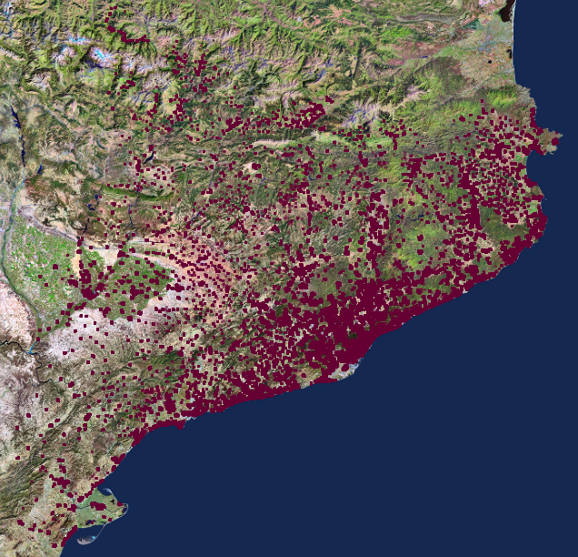
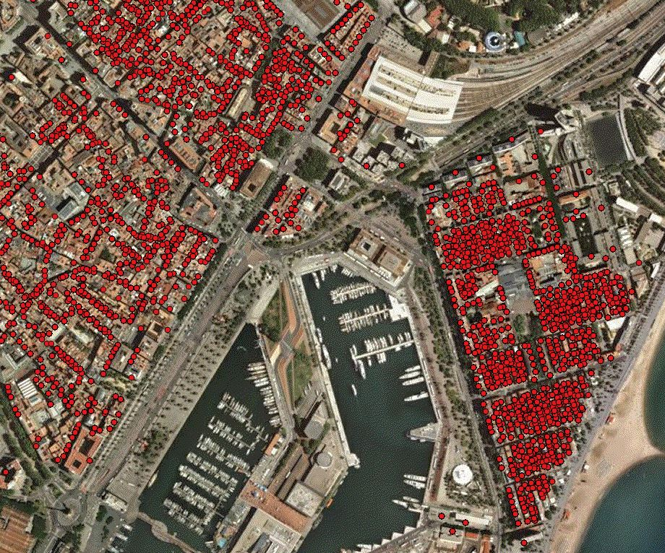
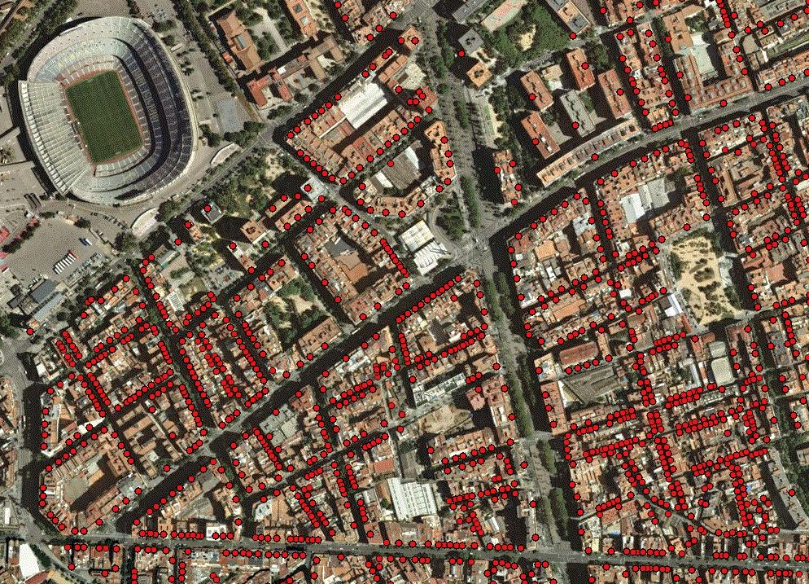
2. Geocoding
Statistical Territory Register (RET)
Cartographic WS
Horizontal part of postal address
Addresses DB
Postal address, point, precision indicator
≈ 96% of addresses geocoded
NTTS 2019 CPS02-003
Notes:
As for the geocoding process, the horizontal part of a postal address is processed through a Web Service created by the Cartographic Institute which returns the position and also accuracy indicators for that address.
In general, very high percentages, around 96%, of geocoded data have been obtained which allows us to disseminate statistical outputs at any level of spatial aggregation, only restricted by the statistical disclosure control.
In the set of pictures, we can see, in the left side, the layer of points relating to the population of Catalonia and two views of Barcelona. The one in the middle shows the port and the last one is the area round the Barcelona Football Club stadium.

Slide 6
3. Validation
Correspondences
Horizontal | Vertical
Street
Staircase
Address
Cartographic WS
Property Register
Door
Floor
Horizontal | (x,y) | Vertical | Property Register Reference
RET
Property Register
NTTS 2019 CPS02-003
Notes:
As we said before, the principal difficulty in these processes is that the fields that make up a complete address are different in the Statistical Territory Register and in the Property Register.
So, there is a requirement to construct tables of correspondences for each field making up an address, except for the “street number”, because it is always a numerical field.
Finding equivalent values from the Statistical Territory Register in the Property Register, using the tables of correspondences, allows us to validate the complete address.
When the search for that address is successful, the postal address is considered to be valid. A search in the tables of correspondences is carried out using indicators which identify the part of an address at which the search has failed. The main reasons of the failure are whether there is no entry in the table of correspondences or because the final search in the Property Register has returned a negative result. This management process is required for the appropriate maintenance of the tables of correspondences.
We now briefly describe how the tables of correspondences were constructed for each field.

Slide 7
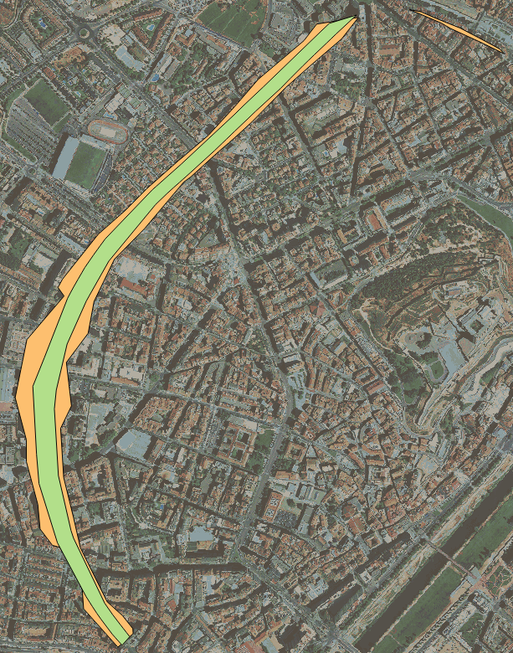
3. Validation. Horizontal Address (STREET)
FALSE POSITIVE
Only
string similarity
RET |  |  | Property Register |  |  | Jaro Winkler similarity
Street code | Type of street | Name of street | Street code | Type of street | Name of street
2512002980 | PG | GRAN PASSEIG RONDA | 2512000296 | PS | SEGON DE RONDA | 64
2512002980 | PG | GRAN PASSEIG RONDA | 2512000119 | PS | RONDA GRAN | 62
2512002980 | PG | GRAN PASSEIG RONDA | 2512001634 | PS | DE LA TORRE PATRIOT | 52
2512002980 | PG | GRAN PASSEIG RONDA | 2512000313 | PS | RONDA | 47
2512002980 | PG | GRAN PASSEIG RONDA | 2512001074 | PS | ESTUDIANTS | 45
TRUE POSITIVE
String similarity + spatial relations
RET |  |  | Property Register |  |  | Jaro Winkler similarity | % of intersection area
Street code | Type of street | Name of street | Street code | Type of street | Name of street
2512002980 | PG | GRAN PASSEIG RONDA | 2512000119 | PS | RONDA GRAN | 62 | 96.69
2512002980 | PG | GRAN PASSEIG RONDA | 2512000313 | PS | RONDA | 47 | 0.74
2512002980 | PG | GRAN PASSEIG RONDA | 2512001634 | PS | DE LA TORRE PATRIOT | 52 | 0.00
2512002980 | PG | GRAN PASSEIG RONDA | 2512001074 | PS | ESTUDIANTS | 45 | 0.00
2512002980 | PG | GRAN PASSEIG RONDA | 2512000296 | PS | SEGON DE RONDA | 64 | 0.00
NTTS 2019 CPS02-003
Notes:
Related to horizontal addresses, there are approximately 100,000 streets in Catalonia, of which about 50% have the same name in both sources. For the other 50%, we could have used a metric between street names, but that could have produced false positives.
In the top table, we can clearly see that the street “SEGON DE RONDA” in the Property Register is the most similar to the street “GRAN PASSEIG DE RONDA” in the Statistical Territory Register, if we just consider the similarity between names.
Fortunately, we can construct the concave or convex hull of the set of points for each street to assess the geometrical relationships between the set of polygons obtained for both sources. It is obvious that the polygons for the same street should overlap to a great degree and have a very similar azimuth.
In the lower table we can see that on the basis of the degree of overlap, the previous example is effectively determined and the equivalent of GRAN PASSEIG DE RONDA is the Property Register street RONDA GRAN, with a 96% overlap.
So the table of equivalences has been constructed using both criteria, that is to say, similarity between names and extent of overlap, under manual inspection.

Slide 8
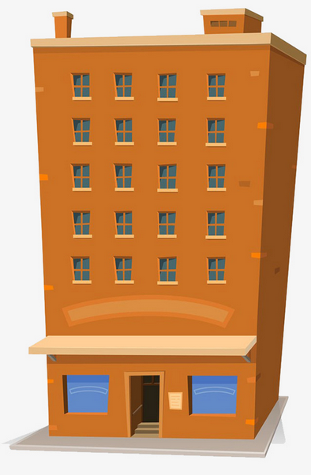

3. Validation. Vertical Address (FLOOR)
Sorting patterns have been defined to establish the equivalence RET - Property Register
SA AT, A1 | Order 6 Order 5 | GROUP 4
+2 +1 | Order 4 Order 3 | GROUP 3 | Order 4 Order 3 | A02, AT2, PSA, SAT A01, A1, PAT, ATC, A00, PA, ATI, A03
n … 03, 3 02, 2 01, 1 | Numerical Order | GROUP 2 | Numerical Order | Pn … P03, P3 P02, P2 P01, P1
PR, PPL, PP ES, EN, ENT 0, BI, BJ, BE, B, B0… | Order 2 Order 1 Order 0 | GROUP 1 | Order 2 Order 1 Order 0 | PP, PRL, PPR, PPL, PAL ES, ENT, PEN PBE, PBI, BI, PBJ, PO, PBA, PLB, B1…
SM, SS S1, -1, SO, ST S2, -2 | Order -1 Order -2 Order -3 | GROUP -1 | Order -1 Order -2 Order -3 | SSO, SS, SST SOT, S01, PSO, S1, PS1 S02, PS2, S2
Property Register
RET
NTTS 2019 CPS02-003
Notes:
Of the fields which determine the vertical part of an address, the most problematic is the field FLOOR, which by its very nature orders a set of addresses vertically. Except for the group of intermediate floors, i.e. Group 2 in the image, in all other cases the height order was not apparent. As such, for the subgroup of intermediate floors, we assumed a natural order for the purposes of equivalence. For higher subgroups like attic floors, penthouse floors..., we established ad hoc orders and equivalences between the two sources. We did the same for lower subgroups, such as main floors, ground floors, basements, etcetera.
For example, the codes ES, EN and ENT from the Property Register were assigned “Order 1” in “Group 1”, equivalent to the ES, ENT and PEN codes in the Statistical Territory Register.
The slide shows a series of values for the field “FLOOR” in the two sources and their correspondences obtained using this ordering system.

Slide 9
3. Validation. Vertical Address (STAIRCASE and DOOR)
The address is broken down into numbers and words and a search is made for equivalences regardless of the order of the parts.
For fields not in the table of correspondences, a character similarity algorithm is used.
Examples of correspondences
STAIRCASE
DOOR
RET | Property Register
01 | 1
01 | A
01 | 01
A | 1
02 | B
D | 4
RET | Property Register
0001 | 01
0001 | A
001B | B1
B | 02
NTTS 2019 CPS02-003
Notes:
The next fields of the vertical address to validate were STAIRCASE and DOOR. To establish matches, the numerical and word parts were broken down and we searched for similarities regardless of the order of those parts. We show in the tables some examples. For cases not in the tables of correspondences, we used a character similarity algorithm.

Slide 10
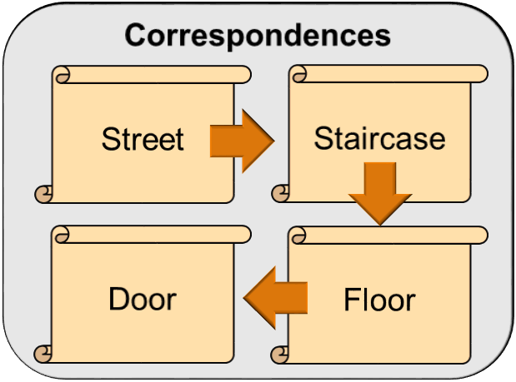
3. Validation. Full address
RET
Province | Municipality | Street code | Type of street | Name of street | Street number | Staircase | Floor | Door
25 | 120 | 02980 | PG | GRAN PASSEIG RONDA | 0124 | B | P07 | C
Property Register
Province | Municipality | Street code | Type of street | Name of street | Street number | Staircase | Floor | Door
25 | 120 | 00119 | PS | RONDA GRAN | 0124 | 2 | 07 | 03
 | Horizontal Address | Vertical Address
Barcelona | 96.7% | 89.8%
Catalonia | 89.7% | 76.0%
Results (% found)
NTTS 2019 CPS02-003
Notes:
We are now going to show a specific example of an address for validation. Note that with the exception of the street number, all fields are different across the two sources. To validate this address, we have to find the correspondences field by field to create another address which we can search for in the Property Register.
So far, we have found almost 97% of horizontal addresses for Barcelona, and 90% for vertical addresses. For Catalonia, the results are a little lower, 90% horizontal and 76% vertical.

Slide 11
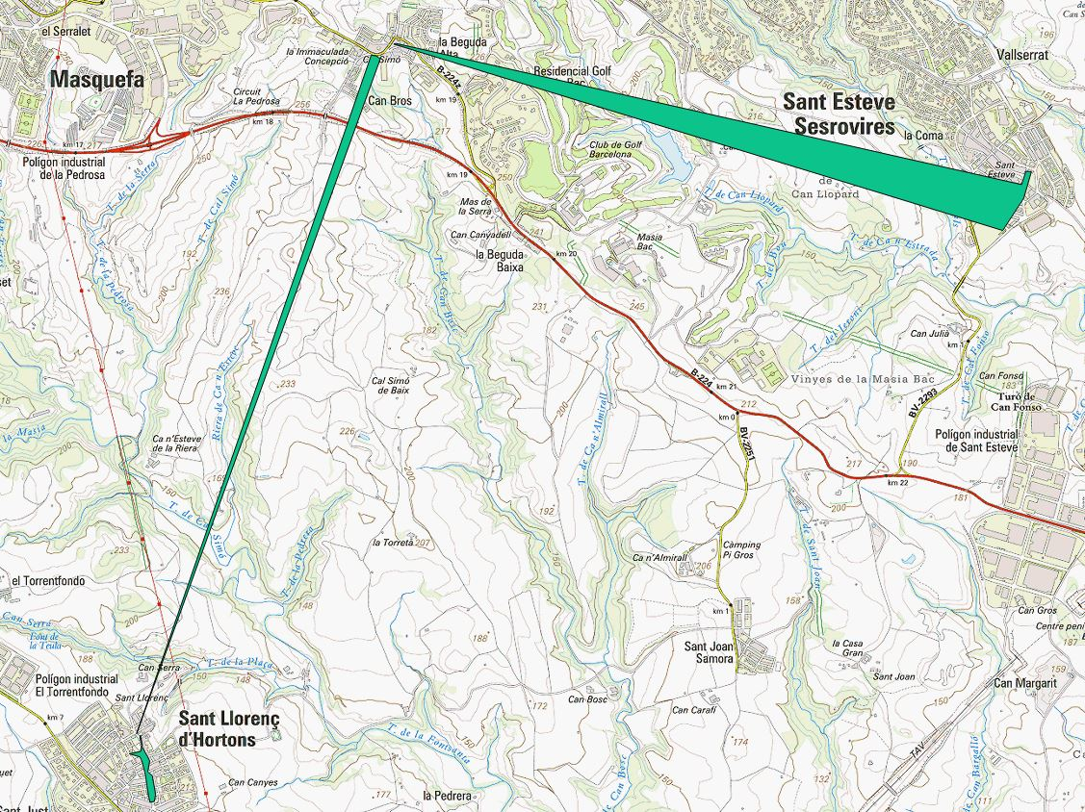
4. Quality control. Horizontal Address
Problem:
The construction of polygons using all the points on a street (street addresses) produces anomalous points (erroneous polygons).
Analysis:
In order to detect the maximum number of erroneous polygons, it is necessary to find an instrument to quantify the quality of this spatial data. The process used is as follows:
Use of some standard multivariate models
Development of indicators
Quality indicator proposal
Selection of a labelled sample (training and test sets)
1.150 polygons
Univariate study
Method of comparison: Area Under ROC curve (AUROC)
NTTS 2019 CPS02-003
Notes:
Next, let’s look at the quality control.
During the process of comparison between two sets, we observed that, as in the example, some Property Register polygons contained anomalous points. This led us to set quality indicators for the information given since those anomalous points may affect the overall quality of the Statistical Territory Register. This is part of the quality control of the horizontal address.
Finding the largest number of erroneous polygons cannot be solved by one specific rule, so we set about an analysis using supervised methods on the basis of a learning sample and a test sample. This allows us to carry out a univariate study and create multivariate models to set our indicators.

Slide 12
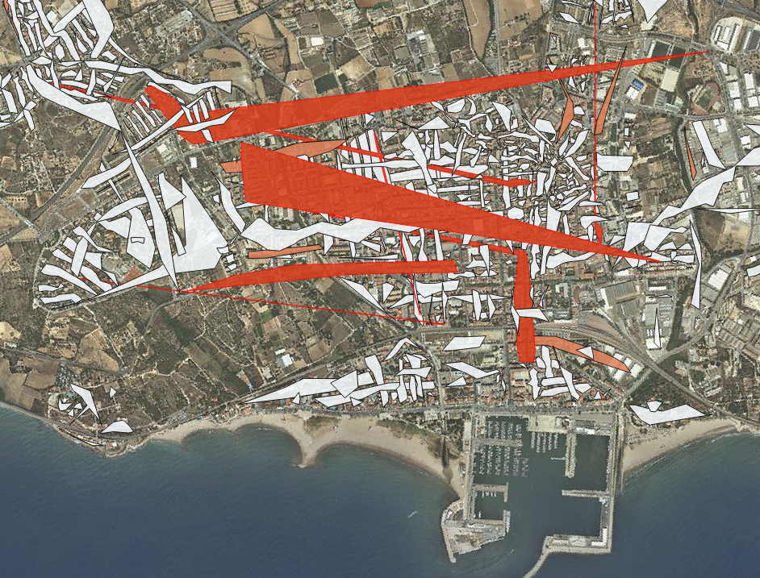
4. Quality control. Horizontal address
Use of some standard multivariate models
Development of indicators
Univariate study
Quality indicator proposal
Selection of a labelled sample
$${PQI}_{p}={{{CV}_{p}}^{2}·max\left\{{length}_{i}{−length}_{i+1}\right\}}_{{i=1…v}_{p}−1}$$
Where “i” iterates along the sides of the polygon according to its decreasing length and “CVp” is the variation coefficient of the side’s lengths.
This indicator allows us to classify and rank polygons by estimated quality and so identify possibly erroneous polygons.
NTTS 2019 CPS02-003
Notes:
The next step in the quality control process was the choice of one of those indicators to allow the classification and sorting of polygons by quality. This indicator combines the maximum difference and the variation coefficient of the lengths of polygon sides. Both variables used in this indicator refer to the polygon without taking into account the longest side.
Polygons with a value of the indicator above a certain threshold were most likely to be erroneous and as such to contain anomalous points. In Catalonia, around 3% of polygons contain at least one anomalous point, which are caused by inconsistency between position and assigned street code.
The red polygons in the picture have a higher probability of containing anomalous points.
Other procedures could be used to test consistency between position and numbering, and that is going to be done in the near future.

Slide 13
4. Quality control. Vertical Address
Comparison of Idescat's tables of equivalences with different sources:
Sources
Municipal Data Office of the Barcelona City Council
Coincident correspondences:
98.5% of cases
Non-coincident correspondences:
No combination with a relatively high frequency of occurrence has been found that is not identified by Idescat
Address Model of National Government
Data from income tax returns of the Tax Authority
NTTS 2019 CPS02-003
Notes:
With vertical addresses, the quality of the validation process requires specific control of the tables of correspondences. Since they have been built using Statistical Territory Register sources, we need to use external sources to monitor their quality.
The information was therefore compared to information from validation in a similar task undertaken by the Municipal Data Office of the Barcelona City Council. The result was that 98.5% of equivalences coincided and non-coincident equivalents were very infrequent.
Shortly, we are going to compare the validation processes using other sources, most notably the Address Model of the National Government and data from tax returns held by the Tax Authority.

Slide 14
5. Conclusions
The Statistical Territory Register of Catalonia incorporates different sources for the purpose of assigning and validating a territorial identifier for each of the statistical units.
The diversity of the descriptions of the postal addresses in the sources hinders the proper spatial identification of the units.
The use of spatial and geometrical methods has been a very powerful tool for establishing tables of equivalences between the sources, as well as validating, detecting errors and establishing quality indicators for the georeferenced addresses.
NTTS 2019 CPS02-003
Notes:
Finally, three conclusions.
Firstly, the Statistical Territory Register of Catalonia incorporates different sources for the purpose of assigning and validating a territorial identifier for each of the statistical units, that is to say, population, households, companies and entities and so on.
Secondly, the diversity of the descriptions of the postal addresses in the sources used makes it difficult to identify the spatial identification of the statistical units correctly.
Lastly, the use of spatial and geometrical methods has proved to be a very powerful tool for establishing tables of correspondences between the different sources, as well as validating, detecting errors and establishing quality indicators for the georeferenced addresses.

