Slide 1
Targeting a wider public
Storytelling with statistical data
Zsolt Czinkos <zsolt.czinkos@ksh.hu>
Hungarian Central Statistical Office
2019-03-13, NTTS 2019, Brussels

Slide 2
Why?
Statistical literacy is important. Statistical literacy is important. Statistical literacy...

Slide 3
Who?
Anyone.
Including me.
Notes:
Almost anyone.
People who read news.

Slide 4
Where?
The micro-universe of our devices.
A couple of seconds.
Notes:
Companies monetizing users activity, data. Make us produce more data, so they need to draw our attention.
Constantly beeping devices.
Instant messaging.
Very short attention span.
Homo distructus.

Slide 5
What?
“Come on, I won’t read that!”
Simple story in a few steps
in a visually appealing way.
Notes:
Survey. Student.
Not a simple slideshow, rather some visual transition.
Visual elements and actions should have a purpose: helping the user together the picture easily.

Slide 6
Feel or think something!
Please.
Notes:
God, how many apples. I love apples.
That shy please indicates that I am not sure if it works or not.

Slide 7
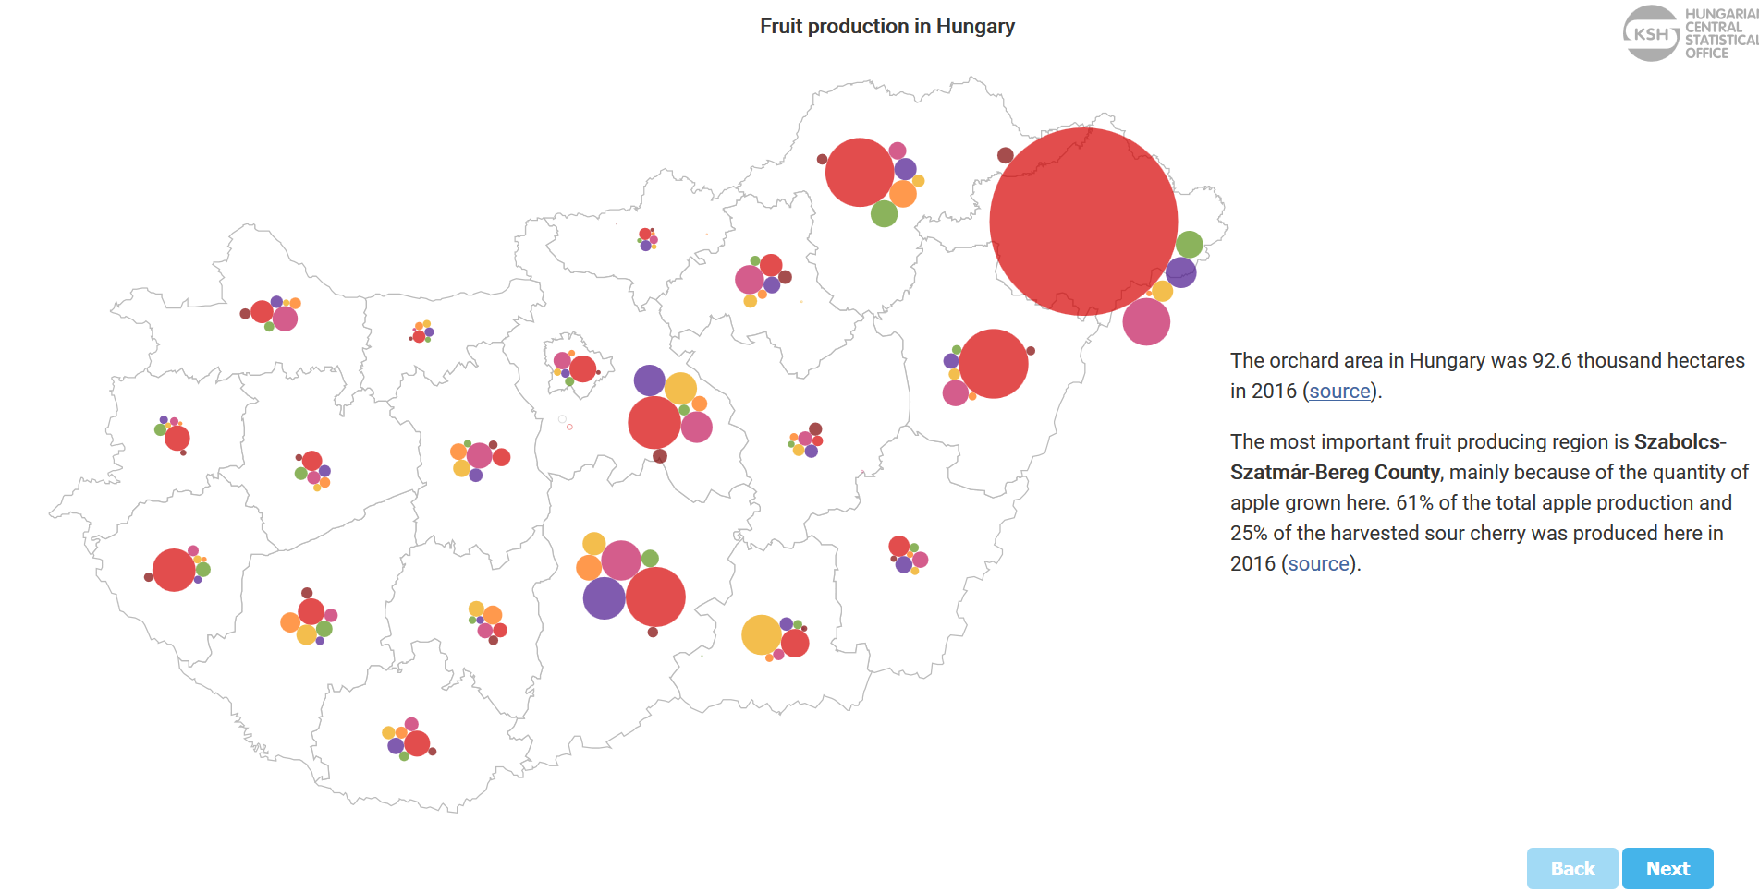
Fruit production in Hungary
http://www.ksh.hu/interaktiv/storytelling/gyumolcs/index.html?lang=en
Notes:
Used for marketing.

Slide 8
Any obstacles?
Not really.

Slide 9
;-)
Notes:
Just kidding.

Slide 10
What is a story?
Too complex?
Browser compatibility.
Responsive design.
Developer (me).
Notes:
I was lucky. I got data and story.
Isn't it too complex?
Web is changing. Tools changing. Expensive.
Software.
Developer is a liability. Expensive.
I was tweaking parameters and looking at these moving colorful dots.

Slide 11
Minimum viable product
Sometimes code decides.
D3.js, React, CSS, SVG
Notes:
Standing on the shoulders of giants.
Limited resources.
Dead ends.
Deadline is coming.
Code decides.

Slide 12
Easy deployment
<iframe src=" https://www.ksh.hu/inte..." width="727px" height="484px"></iframe>
Notes:
Basic idea was to make it easy to deploy.
Then news sites get a colorful illustration. We get publicity. Win win.
Embed the HTML code. It affects design. Should work in unknown page designs.

Slide 13
Is it worth it?
Expensive. Remember the developer.
10-30 thousands visitors within the first two days.
Notes:
New section.
Peaks in Google analytics. Visitors.
I consider this as a small first step towards people who would never visit our site.

Slide 14
Thank you!
zsolt.czinkos@.ksh.hu

