Slide 1
Towards an integrated view of modernisation models
Conference on New Techniques and Technologies for official Statistics - NTTS 2019 Brussels, 12–14 March 2019
Marina Signore
Istat

Slide 2
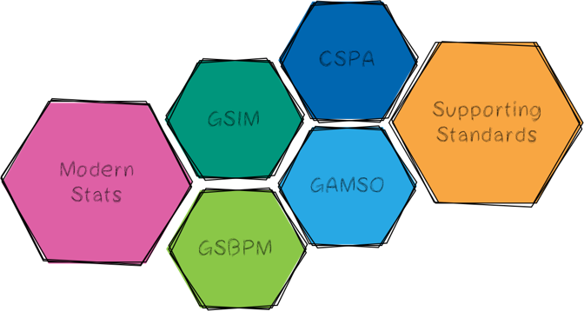
The Supporting Standards Group
The goal of the group is to find ways how to develop, enhance, integrate, promote, support and facilitate implementation of the range of standards needed for statistical modernisation.
Operational responsibility for the maintenance and development of:
GAMSO - Generic Activity Model for Statistical Organizations
GSBPM - Generic Statistical Business Process Model
GSIM - Generic Statistical Information Model

Slide 3
The Members
Member | Country | Organisation
Marina Signore - Chair | Italy | ISTAT
Catrin Karling | Sweden | Statistics Sweden
Juan Muñoz | Mexico | INEGI
Manuel Cuellar | Mexico | INEGI
Guillaume Duffes | France | INSEE
Márta Nagy-Rothengass |  | Eurostat
Mauro Scanu | Italy | ISTAT
Dan Gillman | United States | Bureau of Labor Statistics
Al Hamilton | Australia | Australian Bureau of Statistics
Anna Dlugosz | Poland | Statistics Poland
David Barraclough |  | OECD
Edgardo Greising |  | ILO
Janusz Dygaszewicz | Poland | Statistics Poland
Becky Collett | New Zealand | Statistics New Zealand
Jay Greenfield |  | DDI
Joachim Wackerow |  | GESIS (DDI)
Yulla Choi | South Korea | Statistics Korea
Kimberley Boyuk | Canada | Statistics Canada
Csaba Ábry | Hungary | Hungarian Central Statistical Office
Zoltán Vereczkei | Hungary | Hungarian Central Statistical Office
Boris Muratovic | Montenegro | Statistics Montenegro

Slide 4
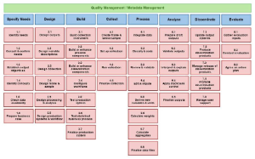
The models development
GSBPM
Revised version v5.1 – to be endorsed by CES in June 2019
Current version v5.0 - December 2013
First release v1.0 – March 2008
Revised version v1.2 – to be endorsed by CES in June 2019
Current version v1.1 - December 2013
First release v1.0 – December 2012
GAMSO
Updated version v1.2 – to be endorsed by CES in June 2019
Current version v1.1 - January 2017
First release v1.0 - March 2015
Notes:
4

Slide 5
Revision of GSBPM & GSIM in 2018
Periodic revision every 5 years to ensure the models remain relevant and reflect the changes in the statistical production environment
Take into account experiences from countries implementing the models
Increase clarity and improve consistency with other modernisation models
Ensure continuity with previous version. Strong business case before making any changes

Slide 6
Common purposes of the models
Improve communication by introducing a common language
Gain efficiency (rationalise processes, information, flow, assign responsibilities,..)
Support industrialisation process (re-use of methodologies, tool, software, sharing of solutions,…)
Build staff competencies around the standards (enhance capabilities)

Slide 7
Interrelationship among the models
GAMSO
Supporting activities
Output
The information flow
Input
Production process
Output
GSBPM

Slide 8
Integrated view of ModernStat Models
A wide range of models (GAMSO, GSBPM, GSIM, CSPA, MMM and Roadmap) are available
More difficult for countries to understand and implement each and all of them
The level of knowledge and implementation of the models varies in different countries and in the same organisation across different sectors
Countries ask for guidance in implementing the models (where to start from, what comes first,…)

Slide 9
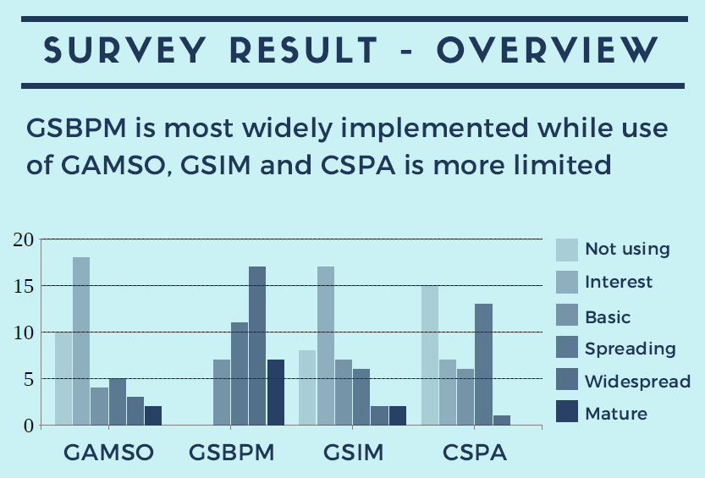
Integrated view of ModernStat Models
Survey on the use of ModernStats Models (2018)
Survey results shows that GSBPM has most widespread usage and that maturity level of “multiple model” is not high yet

Slide 10
Activities for 2019
Linking GSBPM and GSIM
Alignment of GSBPM and GAMSO
Core Ontology
ModernStats World Workshop
26 to 28 June 2019 , Geneva
Metadata Glossary

Slide 11
Linking GSBPM & GSIM
The two models are conceptually closely linked as GSIM information objects are input/output of GSBPM phase/sub-process. As usage of both models is growing, it is important to provide clear view on how they can be used together in an integrated way
The activity will map the information objects of GSIM to the corresponding sub-processes in GSBPM as input or output of individual steps
Input
GSIM Information Objects
(e.g. Data Set, Variable, Parameter Input)
GSBPM
Sub-process
Output
Transformed (or new) GSIM Information Objects
(e.g. Process Metric)

Slide 12
Aligning Overarching Processes in GSBPM with GAMSO
Overarching Processes (OPs) are processes that apply throughout the eight phases across statistical production process in GSBPM. After the release of GAMSO, several OPs that are performed at corporate level are removed from GSBPM as they are covered by GAMSO
There is a need for clarification and more explanation on OPs in GSBPM and GAMSO

Slide 13
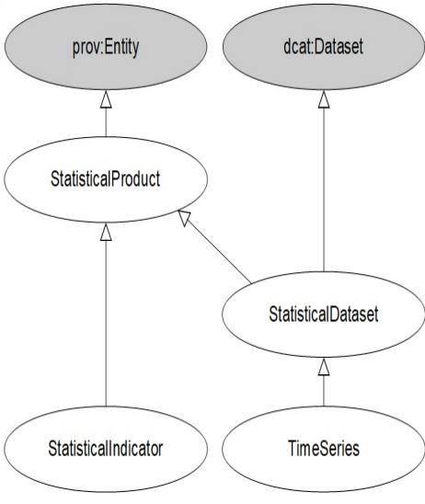
Core Ontology for Official Statistics
Common semantic foundation is becoming important to be able to develop models in a coherent way. Such foundation will allow model integration, interoperability, activation and globally unique identification
The activity will create a common semantic model and vocabulary for official statistics
It will provide precise definitions of the core ontology concepts and their properties and define their identification in relation to a clearly documented naming policy

Slide 14
Metadata Glossary
Intended to be a central, unified and definitive source for the terms and definitions in the ModernStats Models
Disambiguation between homographs (same spelling, slightly different meanings) and identification of synonyms (different spelling, same or similar meanings)
Planned output: alphabetically organized list or terms, their definitions, sources for the definitions, source of the term (in which standard(s) does it appear), explanatory text that further contextualizes the meaning, and references to other similar, broader, and narrower terms

Slide 15
Activities for 2019
Aim at setting up – de facto - a more integrated view of the modernisation standards
Linking GSBPM and GSIM
Alignment of GSBPM and GAMSO
Core Ontology
ModernStats World Workshop
26 to 28 June 2019 , Geneva
Metadata Glossary

