Slide 1

High-Level Group for the Modernisation of Official Statistics: Standards Based Modernisation of Official Statistics
NTTS 2019, 11 - 15 March 2019, Brussels, Belgium

Slide 2
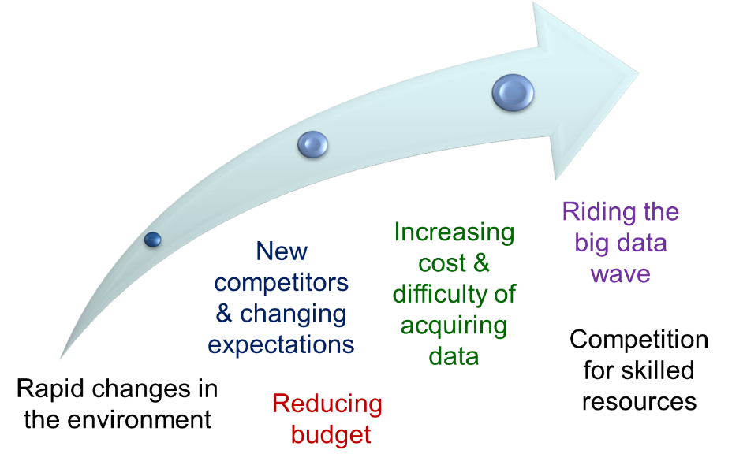

Official Statistics
NSOs are facing many challenges
Change how we work
Continuously changing environment
Become agile and adaptive
We have to be more efficient
Share and Standardize
Challenges too big to tackle on their own
Collaborate and Coordinate
Official Statistics needs leadership
Vision, Mission and Strategy
Notes:
60s

Slide 3
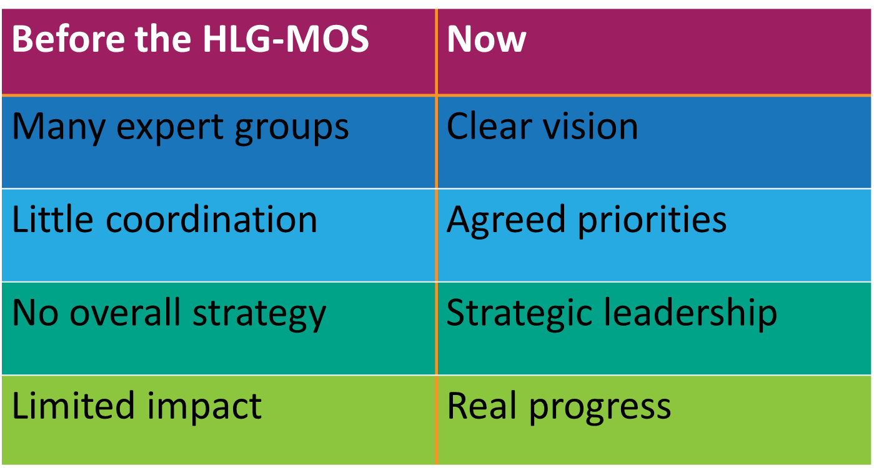

HLG-MOS
High-Level Group for the Modernisation of Official Statistics setup in 2010 under the Conference of European Statisticians (CES)
Statistical Modernisation Community – Statement of Intent (2015)
Since 2016 the community is branded as:
Notes:
30s

Slide 4




Work collaboratively to identify trends, threats, and opportunities & provide common platform to develop solutions in a flexible and agile way.
Actively engage
Be a trusted data authority
Adopt a service oriented approach
Have an agile adaptive culture
Developing innovative solutions
Demonstrating leadership and collaboration
Discussing challenges and opportunities openly
Ensuring that priorities are community driven
Supporting a flexible, result oriented and agile approach

Slide 5
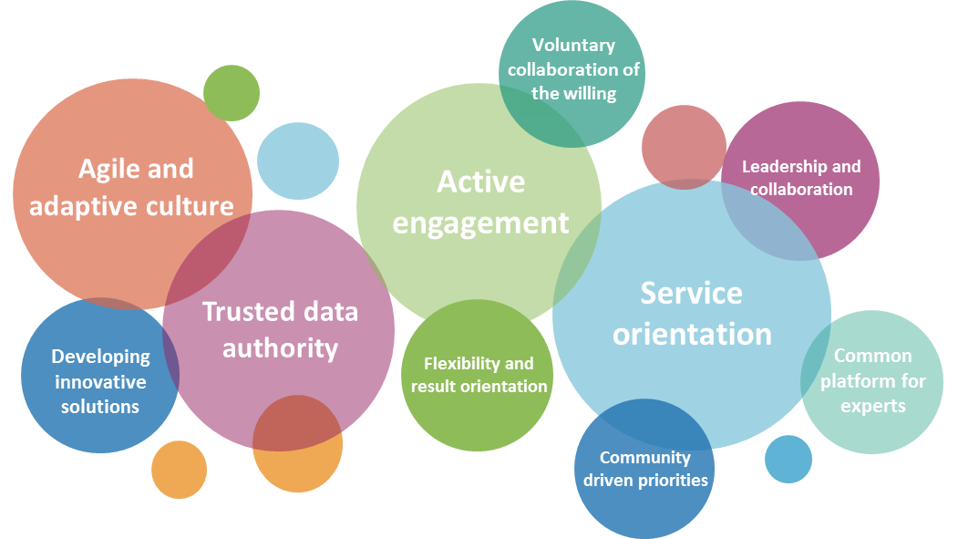
Priority & Emerging Topics
Active engagement
  Communicating our value
  Role in the data ecosystem
Trusted Data Authority
  National Data Strategy
  Data for better decision making
  Data protection
  Data access and ethics
Agile and adaptive culture
  Setting the vision
  Culture evolution

Slide 6













Collaboration of the Willing
Activities are voluntary and demand driven
Actively steered by group of committed Chief Statisticians
Four main principles:
    Openness
    Flexibility
    Participation
    Pragmatism
Everybody can join and participation at all levels
But: Strategic Vision and oversight by HLG-MOS the Executive Board

Slide 7

Collaborative Platform
Two modernisation projects per year
Four expert groups (with 10-20 Task Teams)
Several Modernisation Workshops
Four thematic workshops
HLG-MOS Wikis
Catalogues: Sharing Investments Intentions, Capability, and Statistical Services
Many Sprint Workshops, face-to-face, virtual meetings

Slide 8
ModernStats World Structure 2019
CES
Bureau
Data Collection WS
HLG-MOS Seminars & Sprints
HLG-MOS
Confidentiality WS
Modernisation WS
Executive Board
Data Editing WS
Innovation Topics
Blue Skies Thinking Network
Dissemination Communication
Modernisation updates
Sharing Tools
Supporting Standards
Organisational Capability
Machine Learning Project
Strategic Communication Project II
CSPA Catalogue
ModernStats World WS
GSBPM GSIM
Visions Mission
Sprint
Sprint
Culture Change
WS
CSPA Services
GAMSO GSBPM
Skills & Capability
Sprint
Sprints
CSPA Promotion
Ontology
HRMT Forum

Slide 9

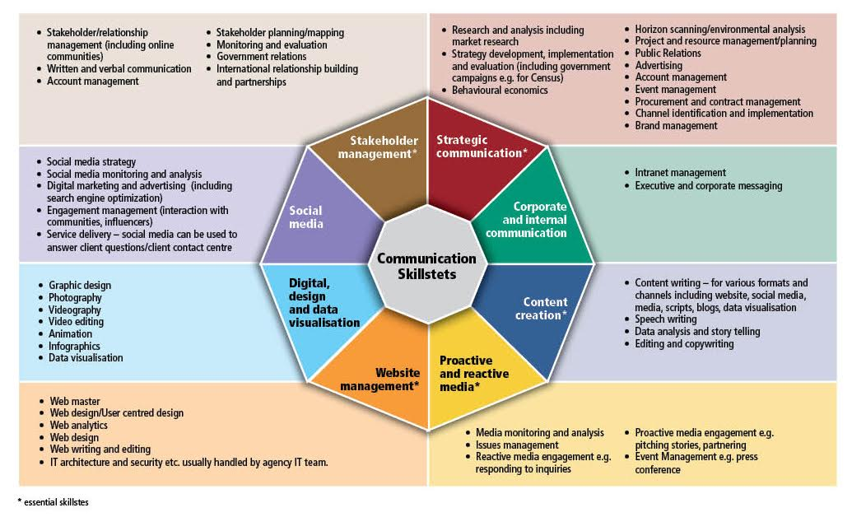








HLG-MOS Annual Projects
Strategic Communication Framework II
  Organizational Vision and Strategic Staff Engagement, Stakeholder Engagement management Strategies, Engagement in Government-wide
  Pt I: Communication issue management; maturity model; Skillsets & Branding
Machine Learning for Official Statistics
Pilot studies, Quality issues & Lessons Learned
2012-2018: GSIM, CSPA I&II, Big Data I&II, Linked Metadata, Data Integration I&II, Data Architecture I&II, Strategic Communication Framework I

Slide 10


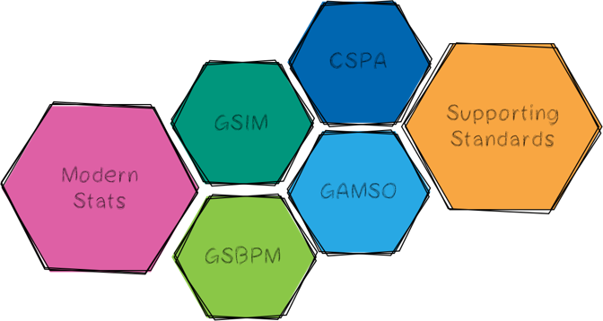

Current Groups

Slide 11


Developing Organisational Capability
Organisational aspects of collaboration and modernization how best to bring about the organisational changes necessary to support modernisation in statistical organisations
Skills and Capability framework
Forum for sharing
Setting Vision in NSOs
HRMT Workshops (2019: culture evolution)
Continues the work of the Modernization Group on Capabilities and Communication
Notes:
In 2018:
Organisational Resilience
Risk Management
Statistical Training Frameworks

Slide 12


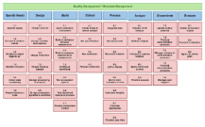
Supporting Standards
Develop, enhance, integrate, promote, support and facilitate implementation of the range of standards needed for statistical modernization
Linking GSBPM and GSIM
Core Ontology for Official Statistics
Alignment of overarching processes in GSBPM and GAMSO
Metadata Glossary
Notes:
In 2018:
GSBPM Revision
GSIM Revision

Slide 13

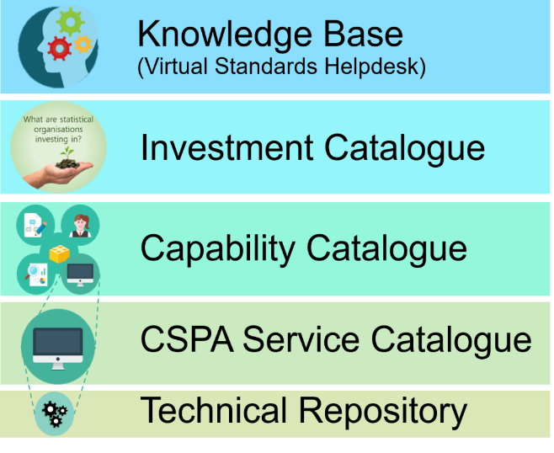
Sharing Tools
Activities related to the implementation of the Common Statistical Production Architecture (CSPA)
Digitising/Editing CSPA document
CSPA Service Catalogue
Communicating the Restated CSPA Concept
➔Add Requirements-Features concept
Notes:
In 2018:
CSPA Revision
Architecture Patterns and Adapters
CSPA Service Catalogue

Slide 14



Blue Sky Thinking Network
The ‘ideas factory’ for statistical modernization community. Provide an environment scan on selected topics (what, value, state-of-the-art, collaboration opportunities).
Machine Learning
HLG Hackathon ‘Telling Stories with SDG data’
Notes:
Core Team setup

Slide 15
HLG-MOS Outputs
Standards and Models
Guidelines and Best Practices
Catalogues and Repositories
Collaboration and Joint Products
Identifying Challenges and Way Forward
All Available from the UNECE HLG-MOS wikis

Slide 16
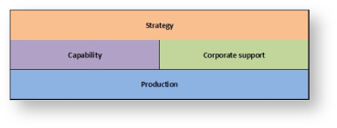
ModernStats Achievements:
Generic Statistical Business Process Model (GSBPM)
Generic Statistical Information Model (GSIM)
Common Statistical Production Architecture (CSPA)
Generic Activity Model for Statistical Organizations (GAMSO)
Generic Statistical Data Editing Models (GSDEMs)

Slide 17
Some of the other output
Common Statistical Data Architecture 1.0 (CSDA)
Data Integration Guidelines link
Common Metadata Framework link
Linked Open Metadata link
Strategic Communication Framework (soon)
Guidelines on Risk Management link
Guidelines for Managers link
Big Data Inventory link
Investment Catalogue link
CSPA Catalogue link

Slide 18
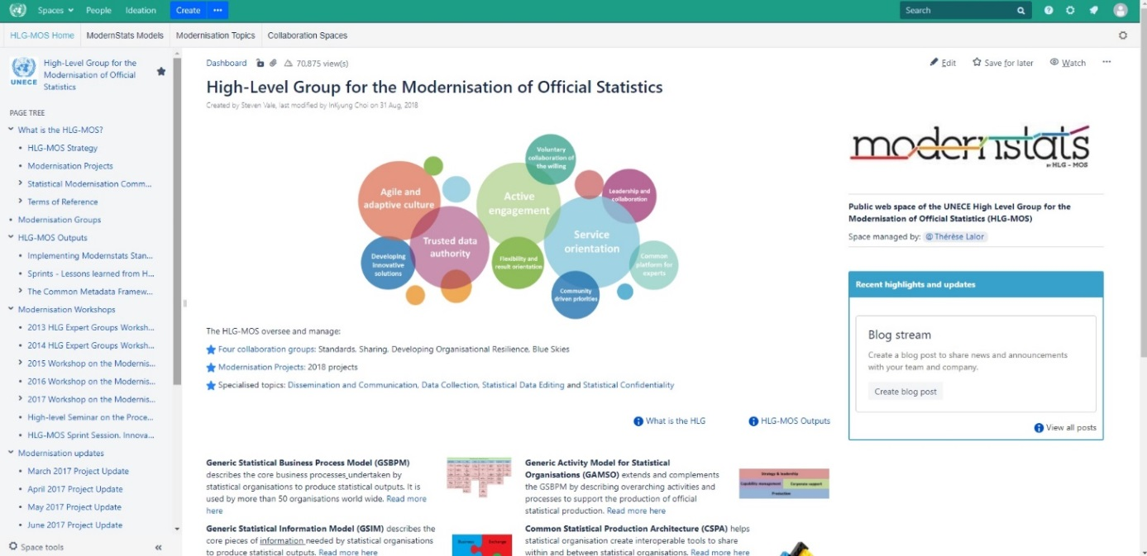
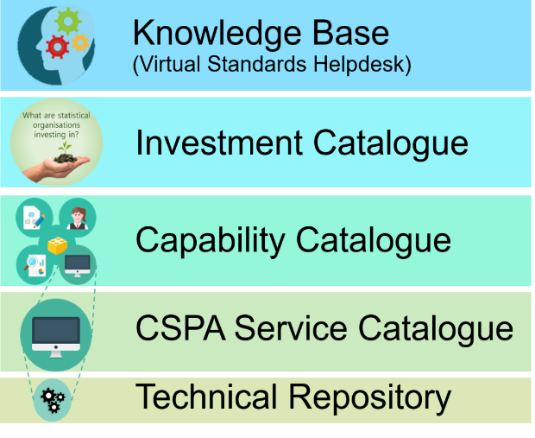
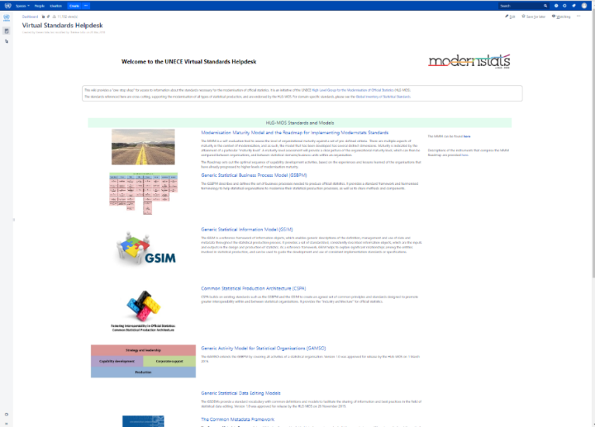
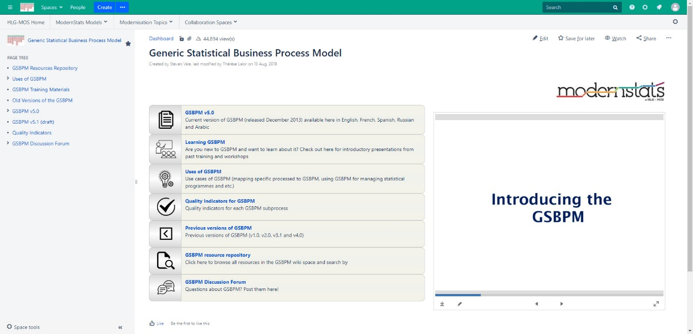
HLG-MOS Wikis

Slide 19
A (little) bit more on CSPA:
Common Statistical Production Architecture
A new way of developing statistical tools, with shareability as a design feature, not an afterthought:
  Framework for sharing and re-use of statistical services in and between NSOs
  Guidelines for a new way of designing, building and implementing the tools
Not prescriptive set of rules nor plug-and-play:
  CSPA compliant → Principles and Features to implement Requirements to increase Shareability
Notes:
Statistical community’s template architecture
Service oriented application and technology architecture

Slide 20
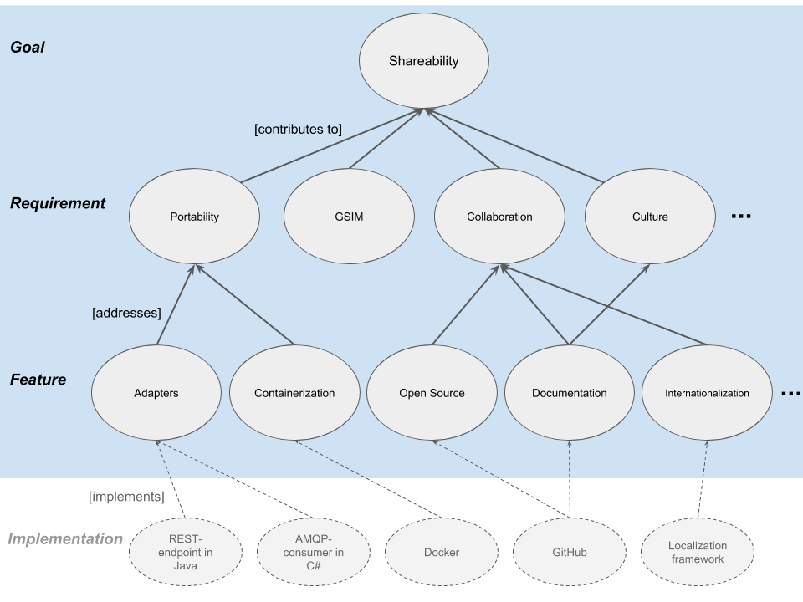
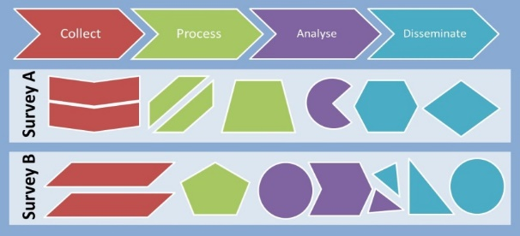
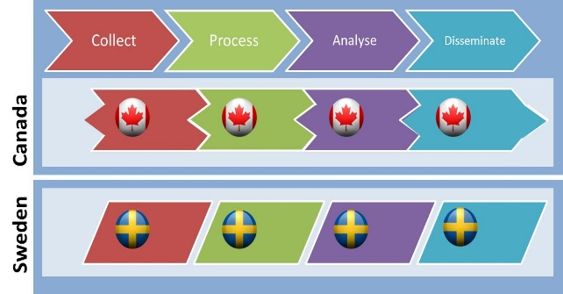
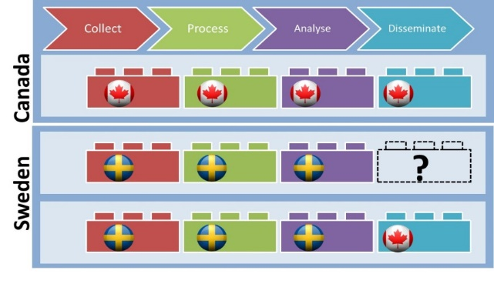
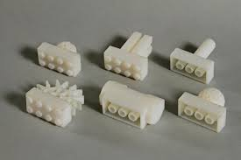
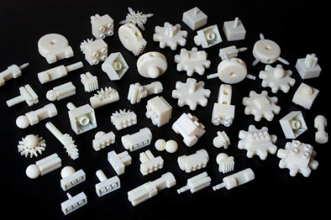
Rather
This →
Than
↓

Slide 21




Get Involved!
Join the Force!
Consult
Contribute
Collaborate

Slide 22
Annex: Links
HLG-MOS https://statswiki.unece.org/x/xIR8Aw
Modernisation Groups https://statswiki.unece.org/display/hlgbas/Modernisation+Groups
HLG Outputs https://statswiki.unece.org/x/7AQpBw
Modernisation Workshops https://statswiki.unece.org/x/bAhLBg
Modernisation Updates https://statswiki.unece.org/x/QY0HBg
Data Editing https://statswiki.unece.org/x/5wCvCg

Slide 23
Modernisation Workshops
Annual HLG-MOS Workshop in November (19-21 Novermber 2019, Geneva)
Annual ModernStats World Workshop (April 2019)
HRMT:
  Workshop on Culture Evolution (11-13 September, Geneva, Switzerland)
  Workshop on Human Resources Management and Training (12-14 September 2018, Oslo, Norway)
  Workshop on Implementing Efficiencies and Quality of Output (27 - 29 September 2017 Geneva, Switzerland)
  Workshop on Human Resources Management and Training: Developing Capabilities for the Future (7-9 September 2016, Krakow, Poland)
  Workshop on Risk Management practices in Statistical Organisations (25-26 April 2016, Geneva, Switzerland)
CSPA:
  2017 CSPA Workshop: CSPA for Digital Transformation (3-5 July 2017, Wiesbaden, Germany)
  2016 CSPA Workshop: Implementing CSPA (3 -5 October 2016, Geneva, Switzerland)
Other
  Workshop on Data Integration: Realising the Potential of Statistical and Geospatial Data (21-23 May 2019, Belgrade, Serbia)
  HLG Seminar on the Process Oriented Apprach (19-21 April 2017, Republic of Korea)
  Workshop on Integrating Geospatial and Statistical Standards (6 - 8 November 2017)
  HLG-MOS Sprint Session: Strategies to stay relevant 21 November 2017, Geneva, Switzerland

Slide 24
Four thematic workshops
Workshop on Statistical Data Editing 2020 (18-20 September 2018, Neuchâtel, Switzerland)
Communication and Dissemination of Statistics 12-14 June 2019, Gdańsk, Poland
Work Session on Statistical Confidentiality 29-31 October 2019, the Hague, The Netherlands
Statistical Data Collection Workshop 10-12 October 2018, Geneva
Key Goals: Sharing innovative practices, identifying challenges and topics for future work

Slide 25
CSPA Requirements
R1 Collaboration: replicate, expand & extend
R2 GSIM Alignment: logical/semantic
R3 GSBPM Alignment: serve GSBPM processes
R4 Metadata Driven: input/output configuration / parameters/ design
R5 Statistical Program alignment: domain context
R6 Secure data management: identities, roles and data classification (traceability, accountability, confidentiality)
R7 Integration to an existing organization: IT & training users
R8 Proper governance: service/release management
R9 Culture context: mindset/trust sharing
R10 Performance: minimal impact on other services
R11 Portability: between computing environments

Slide 26
CSPA Features
F1 Documentation
F2 Internationalization
F3 Open Source
F4 CSPA Adapters
F5 Using GSIM: common language
F6 Security solutions
F7 Metadata access
F8 Sandboxing for exploration
F9 Containerization
F10 Multiple instances
F11 Versioning
F12 Support for Centralized data
F13 Support for Decentralized data
F14 Service integration
F15 Big Data capable
F16 Virtualization
F17 Context aware
F18 Human interaction
F19 Resilience

Slide 27

Annex: HLG-MOS members & history
Australia
Canada - Chair
Ireland
Italy
Mexico
Netherlands
New Zealand
Republic of Korea
Slovenia
United Kingdom
Eurostat
OECD
UNECE
High-Level Group for the Modernisation of Official Statistics setup in 2010* under the Conference of European Statisticians (CES)
Statistical Modernisation Community – Statement of Intent (2015)
Since 2016 the community is branded as:
*originally as HLG for the Modernisation of Statistical Production and Services & HLG Group for strategic Developments in Business Architecture in Statistics (HLG-BAS)

Slide 28
Annex: Statement of Intent Endorsed
Australian Bureau of Statistics
Central Bureau of Statistics (Netherlands)
Central Statistics Office (Ireland)
Eurostat
Hungarian Central Statistical Office
INEGI (Mexico)
Istat (Italy)
OECD Statistics Directorate
Puerto Rico Institute of Statistics
Statistical Office of the Republic of Serbia
Statistical Office of the Republic of Slovenia
Statistics Canada
Statistics Korea
Statistics New Zealand
Statistics Poland
Statistics Sweden
Statistical Office of Montenegro
UNECE Statistical Division

Slide 29
Annex: HLG-MOS Groups
Developing Organizational Capabilities: 2019 onward
Developing Organizational Resilience Group: 2018 onward
Sharing Tools Group: 2017 onward
Supporting Standards Group: 2017 onward
Blue Sky Thinking Network: 2017 onward
Modernisation Committee Products and Sources: 2014-2016
MC Organisational Frameworks and Evaluation 2014-2016
MC Production and Methods 2014-2016
MC Standards 2014-2016
CSPA Implementation Group 2015

Slide 30
Annex: HLG-MOS Projects
2019: Strategic Communication Framework II & Machine Learning
2018: Strategic Communication Framework I & Data Architecture Project II
2017: Data Integration Project II & Data Architecture Project I
2016: Implementing ModernStats Standards & Data Integration Project I
2015: Big Data II & Common Statistical Production Architecture II
2014: Big Data I & Common Statistical Production Architecture I
2013: Frameworks and Standards for Statistical Modernization
2012: GSIM

