Slide 1
Small area estimation for the Dutch Investment Survey
Sabine Krieg and Joep Burger
Statistics Netherlands

Slide 2
Investment Survey
Annual survey
Large enterprises completely enumerated
Small enterprises
  Stratified sample (inclusion probability depends on size and economic activity)
  Sample size 20,000
Target variable (here investments in tangible fixed assets)
  Often zero (no investments)
  Non-zeros skewed-distributed

Slide 3
Research question(s)
How to estimate investments for municipalities (around 400 in NL)?
  Small area estimator (SAE) more accurate than direct estimator (HT or GREG)?
  Which specification of SAE works well?
  How to select this specification?

Slide 4
Artificial population
In practice: only sample is known
Here: artificial population, based on samples of 5 years
Step 1: select specification, based on the sample only
Step 2: compare with population values

Slide 5
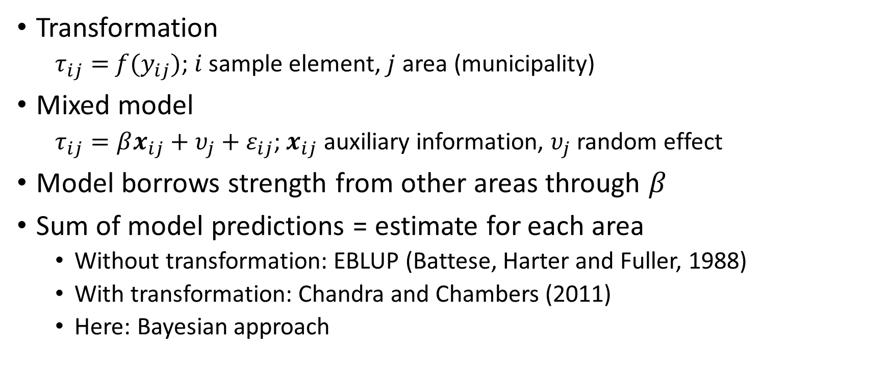
Small area estimation, method 1
Transformation
  $τ_{ij}=$ ${f(y}_{ij})$; $i$sample element, $j$ area (municipality)
Mixed model
  $τ_{ij}=βx_{ij}+υ_{j}+ε_{ij}$; $x_{ij}$ auxiliary information, $υ_{j}$ random effect
Model borrows strength from other areas through $β$
Sum of model predictions = estimate for each area
  Without transformation: EBLUP (Battese, Harter and Fuller, 1988)
  With transformation: Chandra and Chambers (2011)
  Here: Bayesian approach

Slide 6
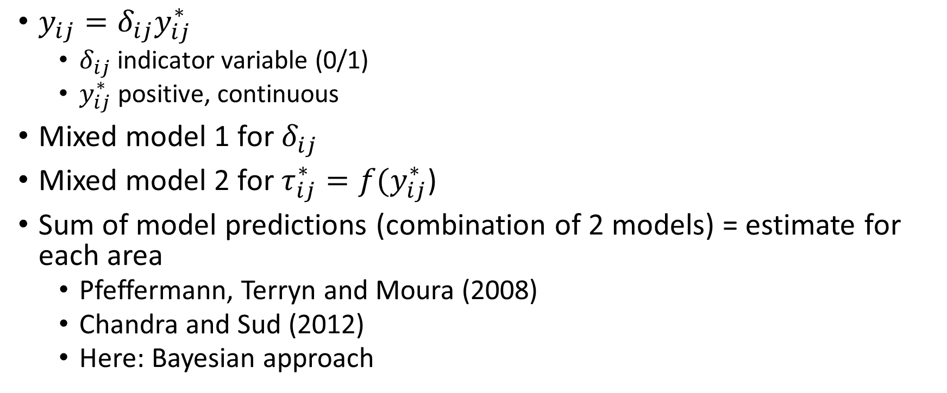
Small area estimation, method 2 (two models)
$y_{ij}=δ_{ij}y_{ij}^{∗}$
  $δ_{ij}$ indicator variable (0/1)
  $y_{ij}^{∗}$ positive, continuous
Mixed model 1 for $δ_{ij}$
Mixed model 2 for$τ_{ij}^{∗}=f(y_{ij}^{∗}$)
Sum of model predictions (combination of 2 models) = estimate for each area
  Pfeffermann, Terryn and Moura (2008)
  Chandra and Sud (2012)
  Here: Bayesian approach

Slide 7
Cross validation as model selection method
Idea: estimate model (or both models) with (large) part of the sample
Predict for the remainder of the sample
Repeat until there are predictions for all sample elements
Compare predictions with true sample values
Here: mean squared prediction error for all models larger than “prediction” 0.
Therefore: consider predictions at area level

Slide 8
Other model selection methods
Plausibility: compare model estimates with direct estimates
  Large differences are suspicious
Standard errors of the model estimates
  Biased in case of model misspecification
Check of model assumptions

Slide 9
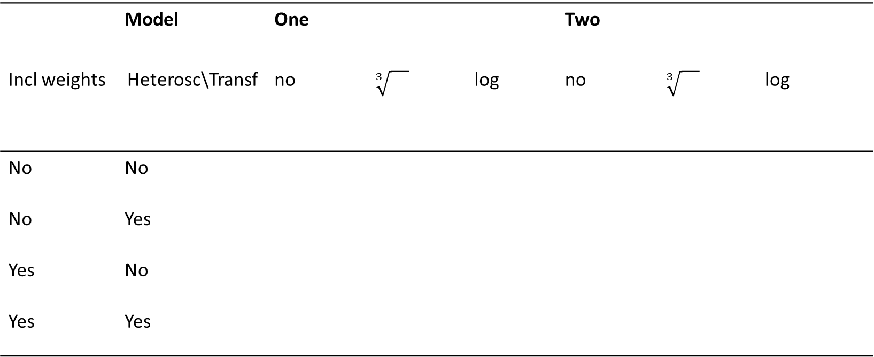
Investigated models (1)
 | Model | One |  |  | Two
Incl weights | Heterosc\Transf | no | $$\sqrt[3]{}$$ | log | no | $$\sqrt[3]{}$$ | log
No | No
No | Yes
Yes | No
Yes | Yes

Slide 10
Investigated models (2)
Auxiliary information
Different kinds of random effects
Different versions of modelling heteroscedasticity
Different models for indicator variable
Result: no strong influence (weak auxiliary information)

Slide 11
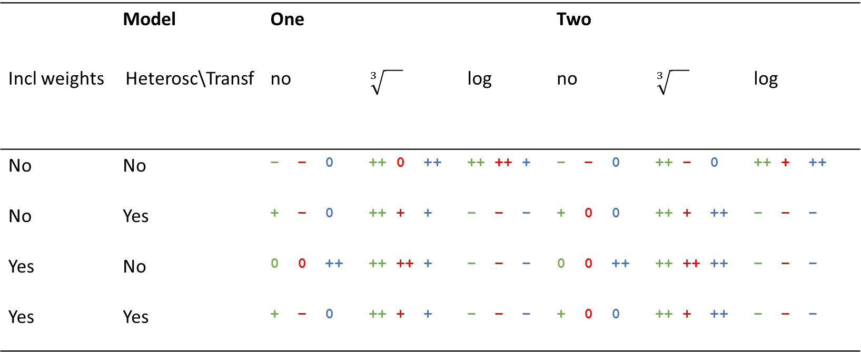
Results
 | Model | One |  |  | Two
Incl weights | Heterosc\Transf | no | $$\sqrt[3]{}$$ | log | no | $$\sqrt[3]{}$$ | log
No | No | − − 0 | ++ 0 ++ | ++ ++ + | − − 0 | ++ − 0 | ++ + ++
No | Yes | + − 0 | ++ + + | − − − | + 0 0 | ++ + ++ | − − −
Yes | No | 0 0 ++ | ++ ++ + | − − − | 0 0 ++ | ++ ++ ++ | − − −
Yes | Yes | + − 0 | ++ + + | − − − | + 0 0 | ++ + ++ | − − −
++ very accurate … − not accurate
green SE, red CV, blue compare with true value

Slide 12
Results
 | Model | One |  |  | Two
Incl weights | Heterosc\Transf | no | $$\sqrt[3]{}$$ | log | no | $$\sqrt[3]{}$$ | log
No | No | − − 0 | ++ 0 ++ | ++ ++ + | − − 0 | ++ − 0 | ++ + ++
No | Yes | + − 0 | ++ + + | − − − | + 0 0 | ++ + ++ | − − −
Yes | No | 0 0 ++ | ++ ++ + | − − − | 0 0 ++ | ++ ++ ++ | − − −
Yes | Yes | + − 0 | ++ + + | − − − | + 0 0 | ++ + ++ | − − −
++ very accurate … − not accurate
green SE, red CV, blue compare with true value

Slide 13
Results
 | Model | One |  |  | Two
Incl weights | Heterosc\Transf | no | $$\sqrt[3]{}$$ | log | no | $$\sqrt[3]{}$$ | log
No | No | − − 0 | ++ 0 ++ | ++ ++ + | − − 0 | ++ − 0 | ++ + ++
No | Yes | + − 0 | ++ + + | − − − | + 0 0 | ++ + ++ | − − −
Yes | No | 0 0 ++ | ++ ++ + | − − − | 0 0 ++ | ++ ++ ++ | − − −
Yes | Yes | + − 0 | ++ + + | − − − | + 0 0 | ++ + ++ | − − −
++ very accurate … − not accurate
green SE, red CV, blue compare with true value

Slide 14
Results
 | Model | One |  |  | Two
Incl weights | Heterosc\Transf | no | $$\sqrt[3]{}$$ | log | no | $$\sqrt[3]{}$$ | log
No | No | − − 0 | ++ 0 ++ | ++ ++ + | − − 0 | ++ − 0 | ++ + ++
No | Yes | + − 0 | ++ + + | − − − | + 0 0 | ++ + ++ | − − −
Yes | No | 0 0 ++ | ++ ++ + | − − − | 0 0 ++ | ++ ++ ++ | − − −
Yes | Yes | + − 0 | ++ + + | − − − | + 0 0 | ++ + ++ | − − −
++ very accurate … − not accurate
green SE, red CV, blue compare with true value

Slide 15
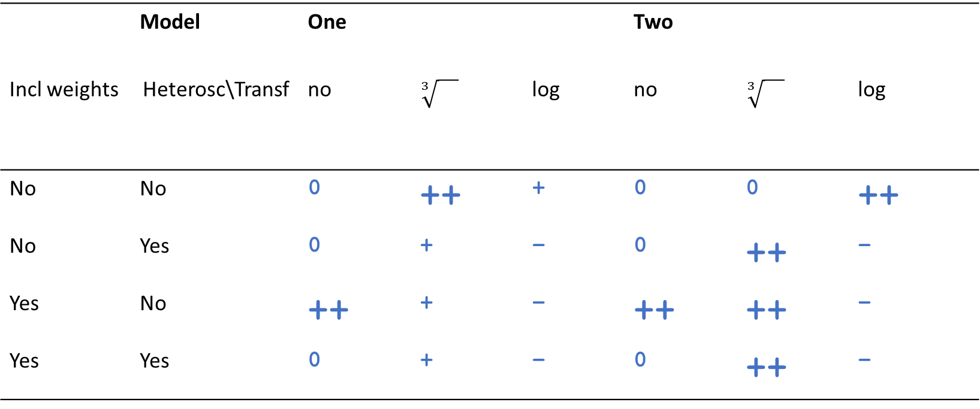
Results
 | Model | One |  |  | Two
Incl weights | Heterosc\Transf | no | $$\sqrt[3]{}$$ | log | no | $$\sqrt[3]{}$$ | log
No | No | 0 | ++ | + | 0 | 0 | ++
No | Yes | 0 | + | − | 0 | ++ | −
Yes | No | ++ | + | − | ++ | ++ | −
Yes | Yes | 0 | + | − | 0 | ++ | −
++ very accurate … − not accurate
blue compare with true value

Slide 16
Conclusions
SAE can improve accuracy of estimates for municipalities
Different specifications work well
  Take properties of data into account
    Two models
    Third root transformation
    Inclusion weights
  Some other specifications also accurate
Model selection methods correctly find non-accurate specifications
But do not distinguish between moderate and good specifications

