Slide 1





Satellite-Net: Automatic Extraction of Land Cover Indicators from Satellite Imagery by Deep Learning
Italian National Institute of Statistics
Eleonora Bernasconi, Francesco Pugliese, Diego Zardetto, Monica Scannapieco
New Techniques and Technologies for Statistics (NTTS) Conference, 12th March 2019, Brussels

Slide 2
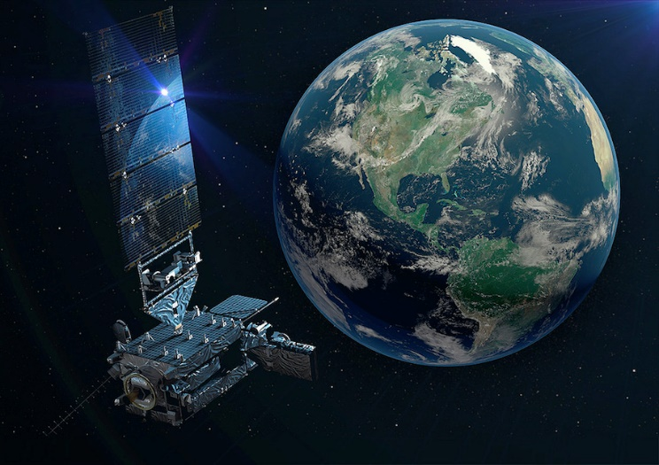
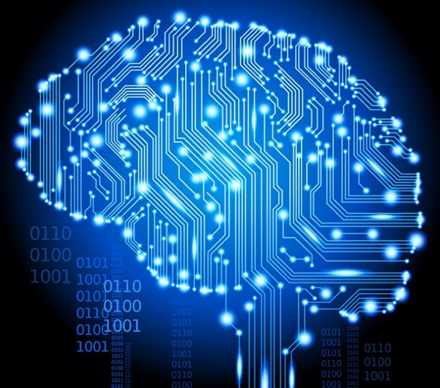
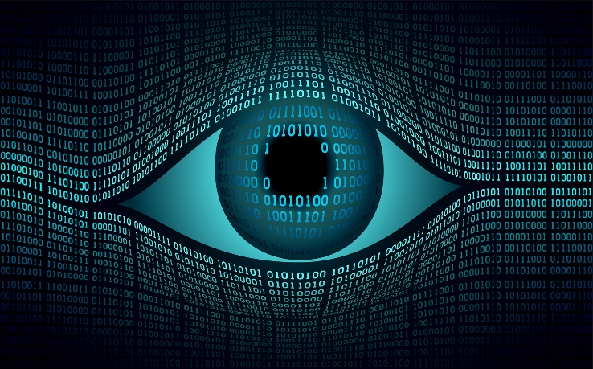
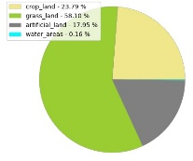
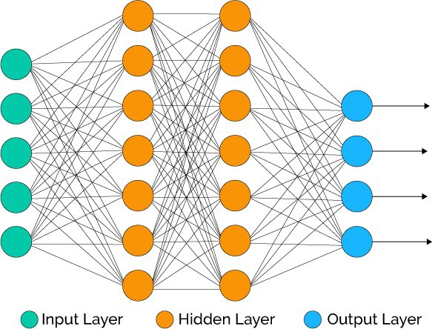

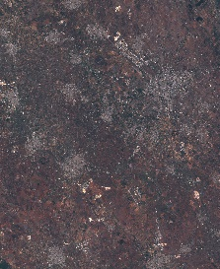
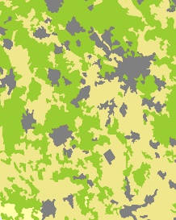
Motivation
DL and Computer Vision
EUROSAT dataset
Satellite-Net model
Example
Future Works

Slide 3
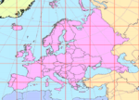

MOTIVATION OF THE WORK
Eurostat has been carrying out the LUCAS survey every 3 years since 2006 (last round in 2018) to estimate Land Cover (LC) and Land Use in the European Union:
  A 2-phase area sample survey of the whole EU territory
    1st phase: Master Sample of ~1.1 million points in a square grid of (2 km x 2 km) cells
    2nd phase: ~330,000 random points from the Master Sample
  Direct data collection, mainly on the ground (~70% of 2nd phase points), the rest by clerical photo-interpretation
  Provides LC estimates for all Member States up to NUTS-2 territorial level
Computer Vision methods (e.g. Deep Learning) + Satellite Imagery data (e.g. Sentinel-2) can be used for LC estimation:
  Classify-and-Count approach
    Train an image classification algorithm to predict the LC class of a satellite image tile
    Divide the satellite images covering a target area into tiles and use the trained algorithm to predict LC classes
    Obtain LC statistics for the target area by simply computing the relative frequencies of predicted LC classes
Pros: (i) dramatically reduce data collection costs/burden, (ii) provide more timely statistics, (iii) provide LC statistics beyond the NUTS-2 level, (iv) produce moderate resolution maps of the whole territory
Challenge: Can a fully automated approach provide LC estimates of satisfactory accuracy?

Slide 4

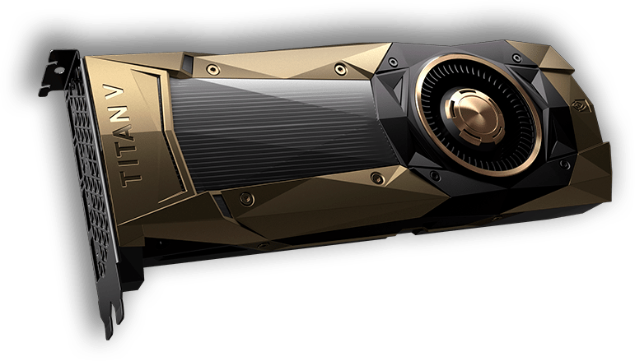


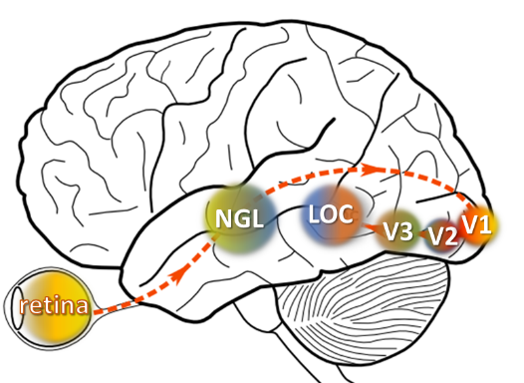

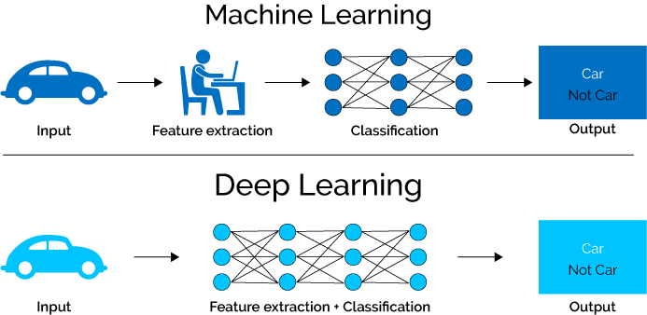
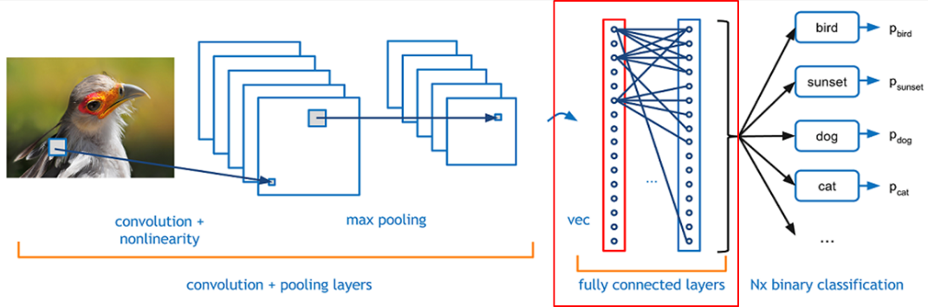
DEEP LEARNING AND COMPUTER VISION
With the DL and artificial intelligence, computers are learning to write the software they need on their own.
CONVOLUTIONAL NEURAL NETWORKS

Slide 5
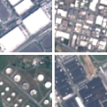
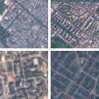
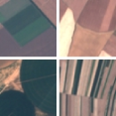
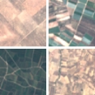
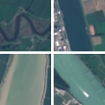
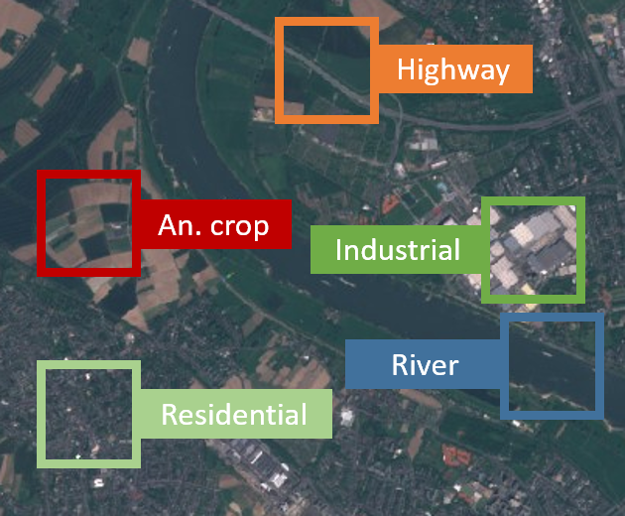
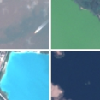
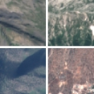
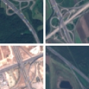
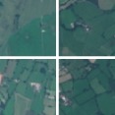
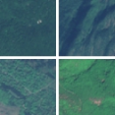


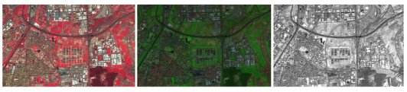

EUROSAT DATASET
INDUSTRIAL
RESIDENTIAL
ANNUALCROP
PERMANENT CROP
RIVER
SEA LAKE
HERBACEOUS VEGETATION
HIGHWAY
PASTURE
FOREST
The images have a size of 64x64 pixels.
Each class contains 2,000 to 3,000 images.
The dataset contains 27,000 images

Slide 6
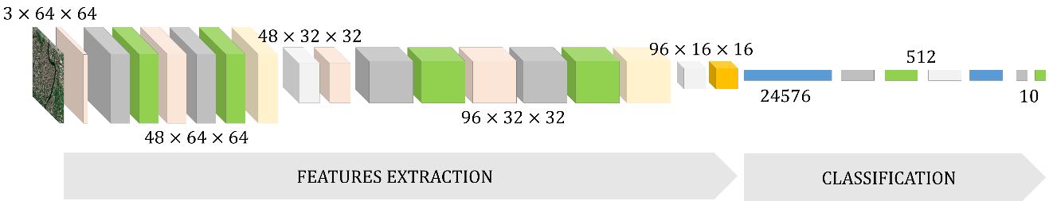
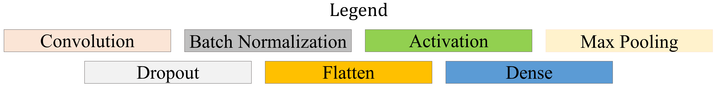
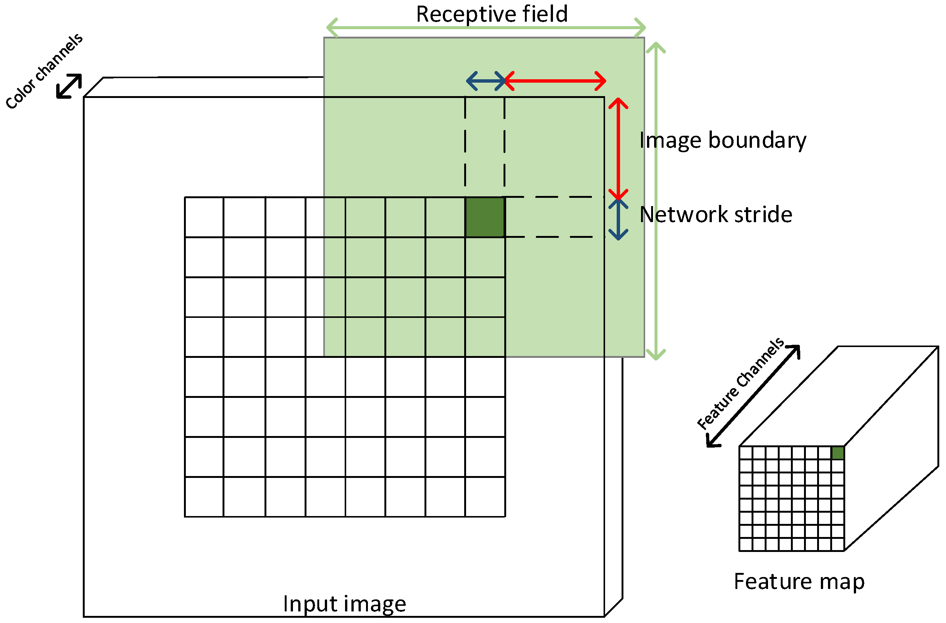
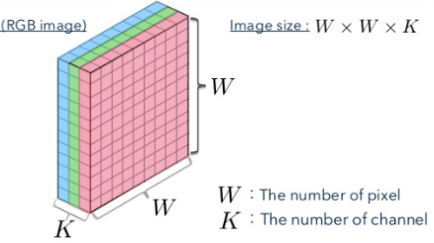
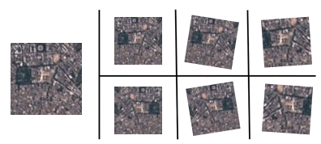
SATELLITE-NET MODEL
DATA AUGMENTATION

Slide 7
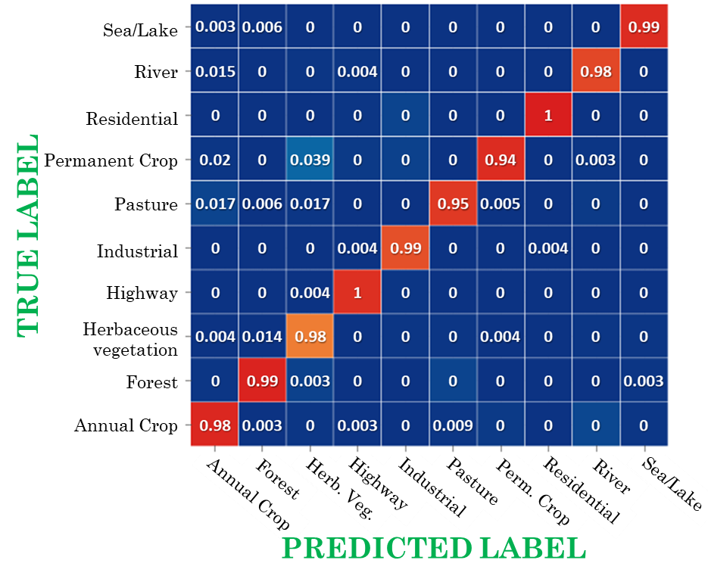
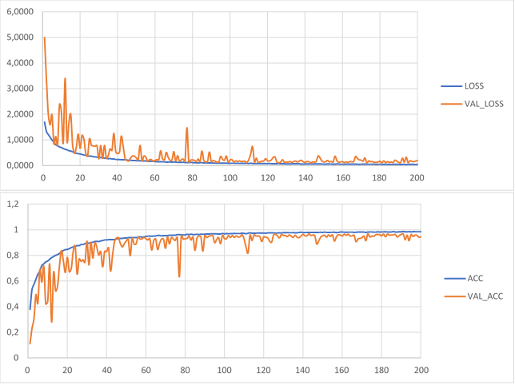
PERFORMANCE
Save best model

Slide 8
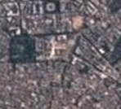

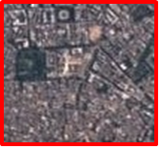
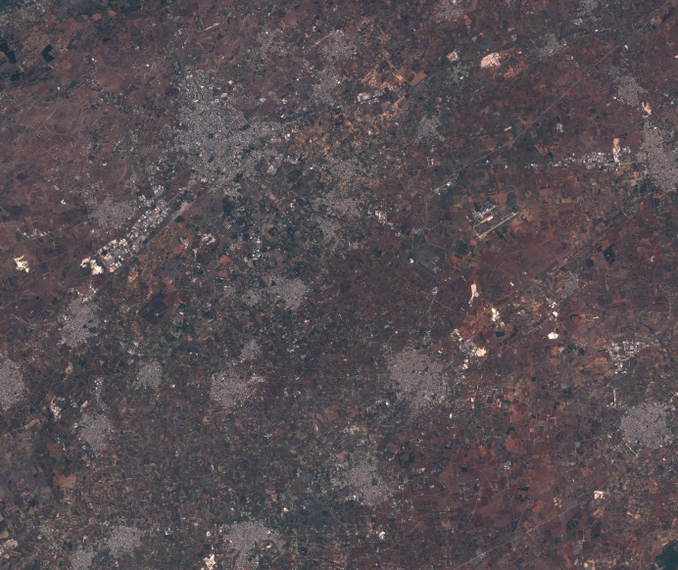
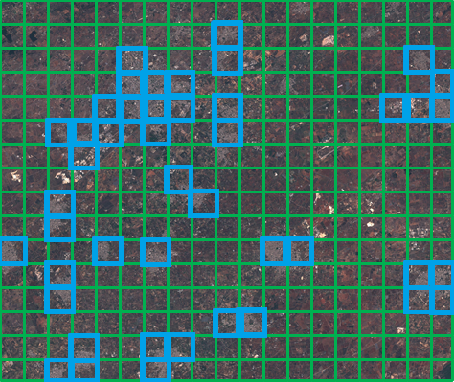
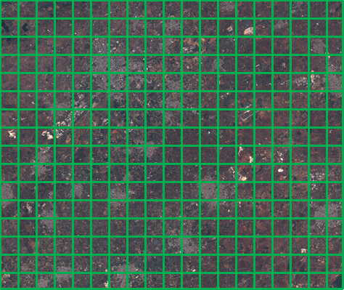
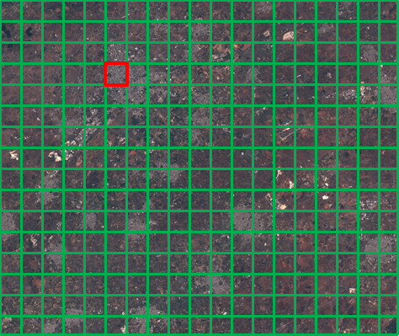
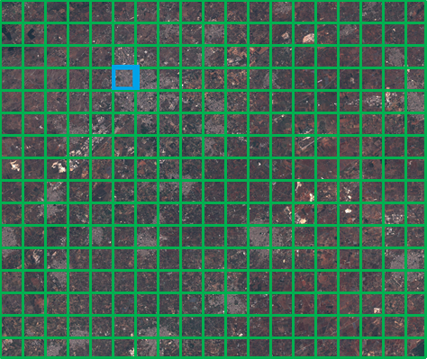
TRAINED DEEP CNN
RESIDENTIAL
CLASS | LAND COVER
… | …
Residential | 14.8 %
… | …
Satellite image (Puglia crop)

Slide 9
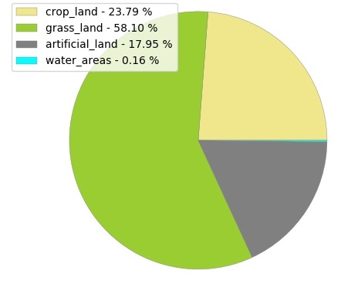
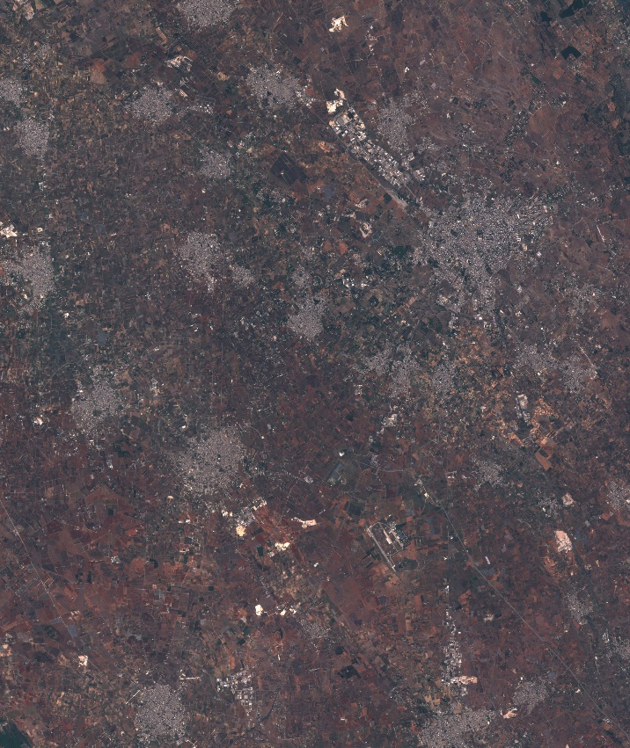
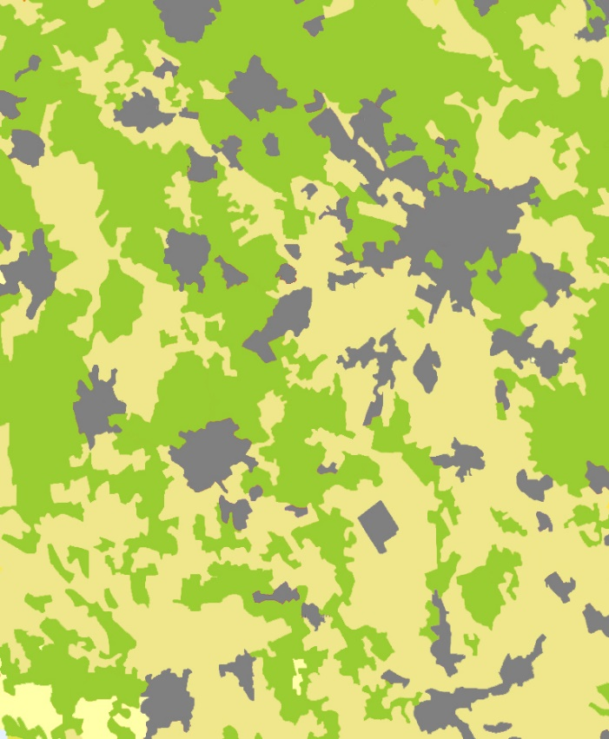
EXAMPLE
Automatic scanning of a portion of Apulia territory

Slide 10
FUTURE WORK
Our Satellite-Net CNN proved to perform very well in the Land Cover classification task when tested on the EUROSAT dataset
However, its accuracy seems to decrease when tested on tiles taken from generic Sentinel-2 images. We are currently investigating this issue (JPG compression seems to play a role)
Moreover, the EUROSAT dataset comes with LC classes that differ from (and cannot be unequivocally mapped to) LUCAS classes
In addition, EUROSAT classes “Highway” and “River” do not fit well with our classify-and-count approach, leading to upward biased LC estimates
Next Step: Build our own training dataset for Land Cover classification according to LUCAS
  Get available in situ microdata of LUCAS 2018 for Italy
  Use the geolocation of LUCAS microdata to build a Sentinel-2 tile centered around each LUCAS sample point
  Annotate all the obtained Sentinel-2 tiles with the LUCAS class attached to the corresponding sample point

Slide 11
REFERENCES
Rajalingappaa, S. (2018). Deep learning for computer vision : expert techniques to train advanced neural networks using TensorFlow and Keras, Birmingham UK, Packt Publishing, 2018.
Helber, P., Bischke, B., Dengel, A., & Borth, D. : Eurosat: A novel dataset and deep learning benchmark for land use and land cover classification. arXiv preprint arXiv:1709.00029, 2017.
M. Castelluccio, G. Poggi, C. Sansone, and L. Verdoliva. : Land use classification in remote sensing images by convolutional neural networks, arXiv preprint arXiv:1508.00092, 2015.
Karimi H., Karimi B. : Geospatial Data Science Techniques and Applications, Taylor & Francis Group, 2018.
Khan S., Rahmani H., Shah S. A. A., Bennamoun M. : A Guide to Convolutional Neural Networks for Computer Vision, Morgan & Claypool Publishers, 2018.
Green K., Congalton R., and Tukman M. : Imagery and GIS : best practices for extracting information from imagery, Redlands California, Esri Press, 2017.
Aditi M., Gopi M. : Introduction to Visual Computing Core Concepts in Computer Vision, Graphics, and Image Processing, Taylor & Francis Group, 2018.
Y. LeCun, B. Boser, J. S. Denker, D. Henderson, R. E. Howard, W. Hubbard and L. D. Jackel: Backpropagation Applied to Handwritten Zip Code Recognition, Neural Computation, 1989.
Y. LeCun, P. Haffner, L. Bottou and Y. Bengio: Object Recognition with Gradient-Based Learning, in Forsyth, Springer, 1999.

Slide 12
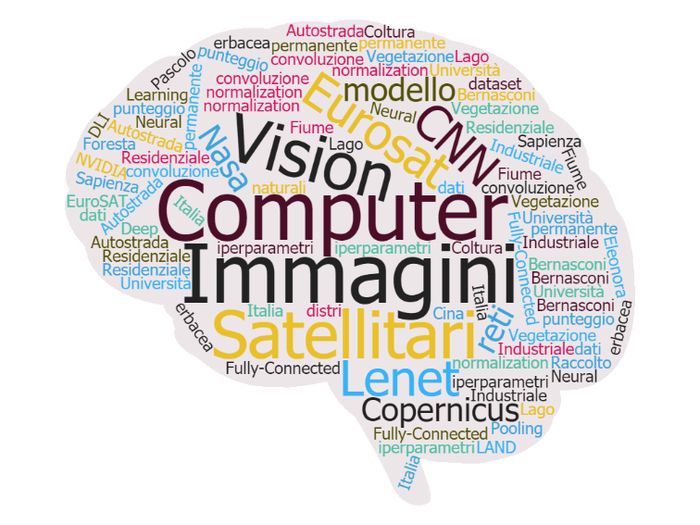
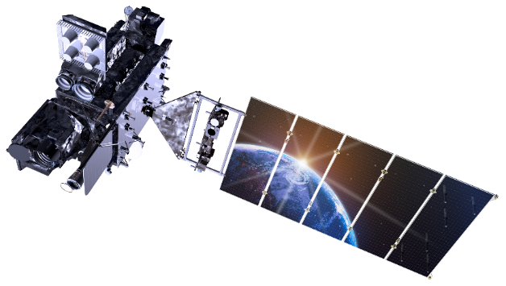
Thank you
for your attention
Eleonora Bernasconi

