Slide 1


ClairCity: official statistics as an enabler in a citizen-led European air quality project
Statistics Netherlands
Olav ten Bosch
NTTS, Brussels, 2019
This project has received funding from the European Union’s Horizon 2020 research and innovation programme under grant agreement No. 689289.

Slide 2
Contents
The problem
ClairCity, an EU citizen-led air quality project
The approach: quantification, citizen engagement, scenario analysis, policy packages
The role of official statistics
Wrap up

Slide 3




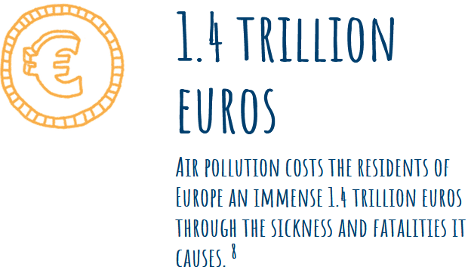
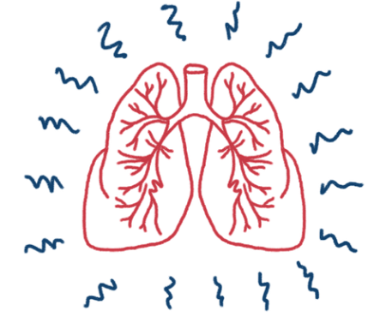

Slide 4





Slide 5
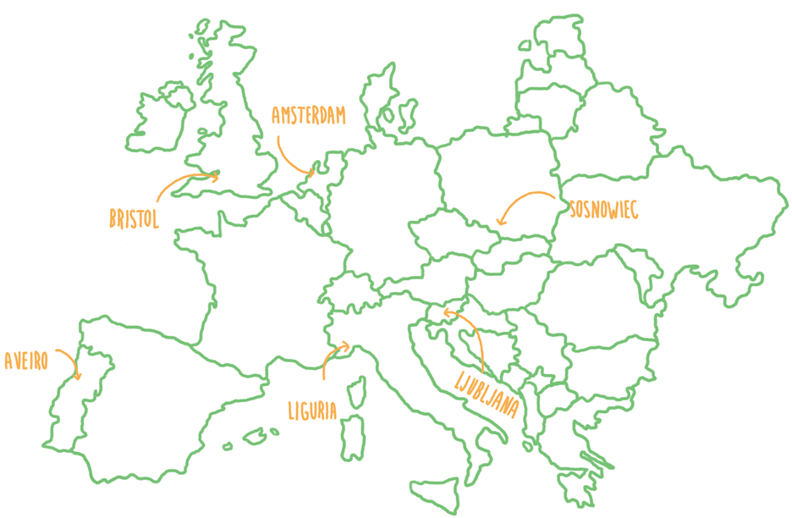
ClairCity: Citizen-Led Air pollution Reduction in Cities
EU H2020 project; 2016-2020; 6.7 Million Euro
9 scientific partners, 6 cities and one National Statistical Institute (NSI)
Goal: to help cities decide on the best local clean air strategies based on detailed emission models and scenario analyses

Slide 6

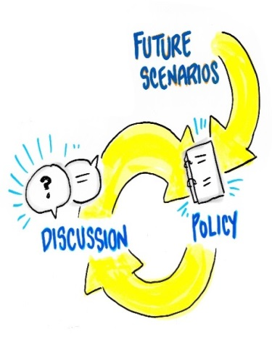



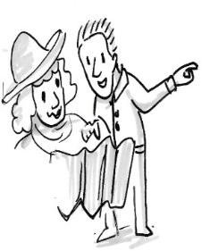








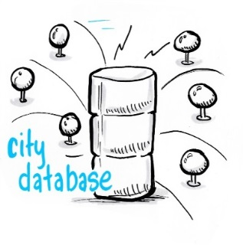
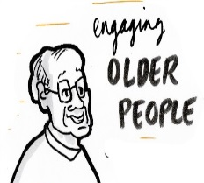

ClairCity approach
Phase 3: Scenario analysis, results and dissemination
Phase 1: Baseline evidence
Phase 2: Citizen and stakeholder engagement

Slide 7
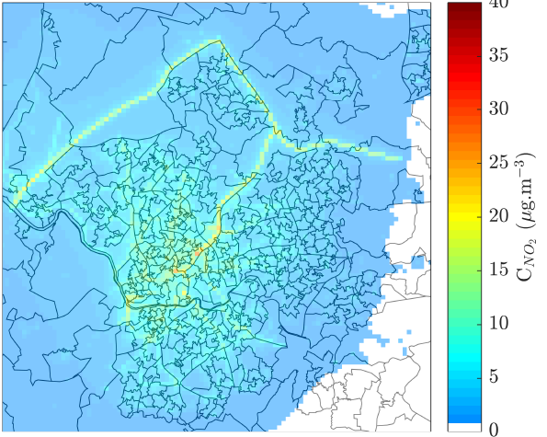
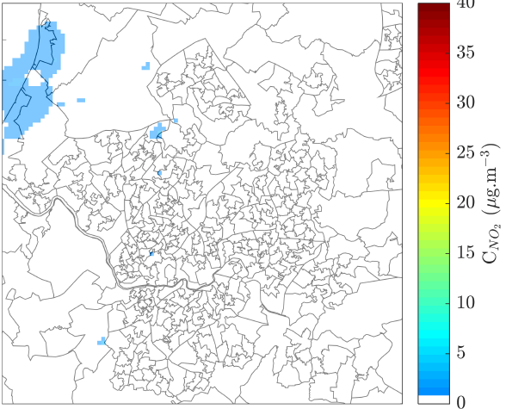
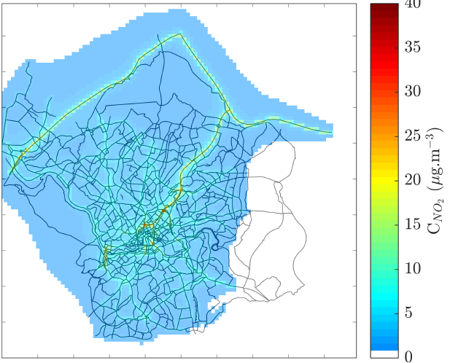
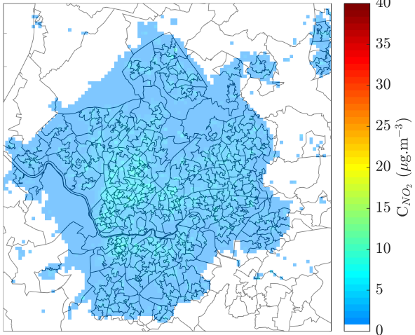
Baseline evidence (1)
Emission models per city based on data
from:
  UN and EU-organisations
  Universities (scientific models)
  National statistics offices
  City institutes
Industrial
Combined
Industrial
Residential and commercial
Transport
Road transport
Emission maps for Bristol

Slide 8
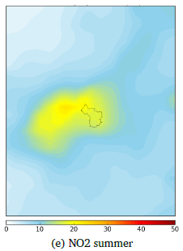
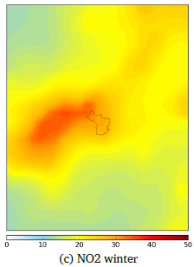
Baseline evidence (2)
Emission profiles for
weekdays / weekend;
annual /summer / winter;
hourly profiles
Effects on health in 2015, 2025, 2035 and 2050
      Premature deaths, years of life lost (YLL)
      Restricted Activity Days (RAD) & costs

Slide 9
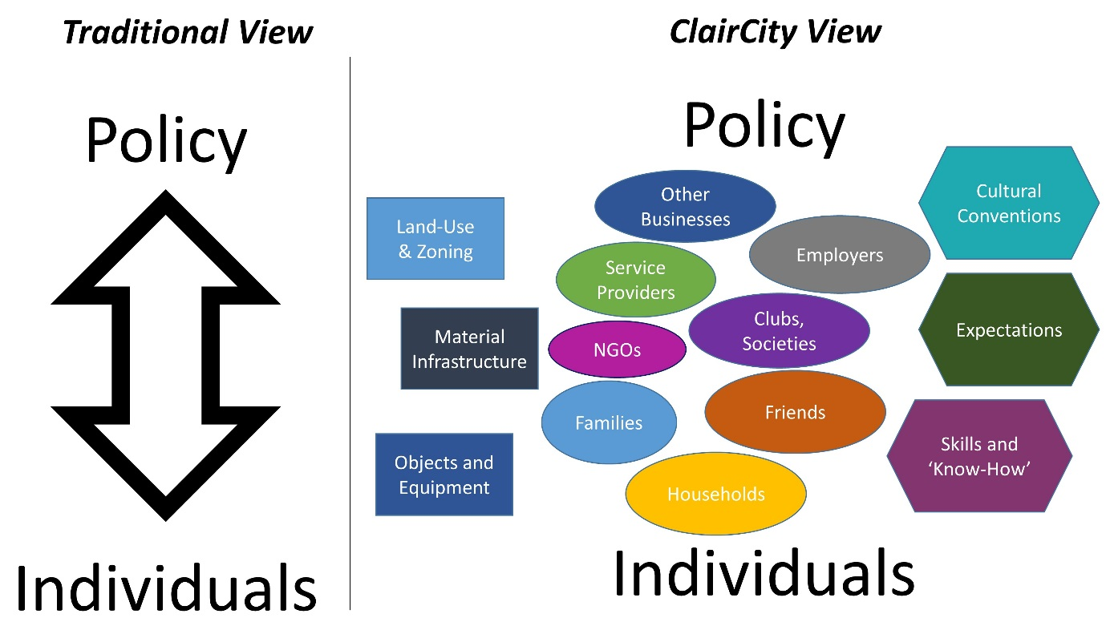

Citizen and stakeholder engagement
Part of the solution is changing peoples behaviour based on practice activity data and social science theory

Slide 10
City policy packages
Based on:
    Scenarios: business as usual (BAU) and 3 alternatives
Examples:
    Amsterdam: continue the policy to restrict heavy traffic and stimulate renewable energy
    Sosnowiec: Economic restructuring from coal and heavy industry. Raise awareness on winter smog
    Ljubljana: situated in a basin with negative influence on air pollution. Air pollution from transport is a major problem. Has an active policy towards climate improvement. Citizen’s engagement is already promoted.

Slide 11
The role of official statistics
Projects such as ClairCity have a heavy and diverse data demand
NSIs can help:
  Advice on data management, metadata standards, data linking, version management, open data standards, statistical disclosure control, API’s, visualization
  Make available instruments used internally for wider communities
NSIs can learn:
  Data use in practice: what official statistics data is actually needed? How is it used? How do researchers work with it?
  Can we re-use some of the ClairCity instruments in official statistics?

Slide 12
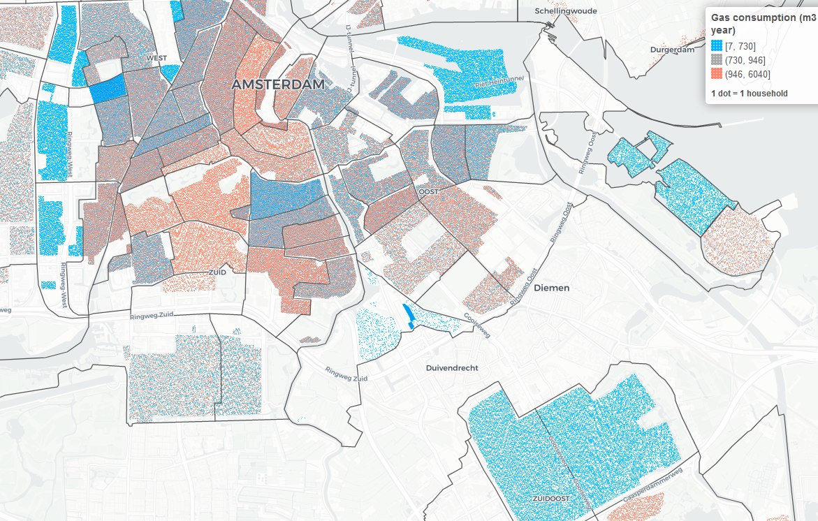
Baseline evidence: urban module
Dotmaps are statistically safe population maps
It shows both distribution and composition of a population
  One colored dot represents one person
  To protect privacy, dots are distributed randomly per neighbourhood
https://claircitydata.cbs.nl/dotmaps/amsterdam_v2

Slide 13
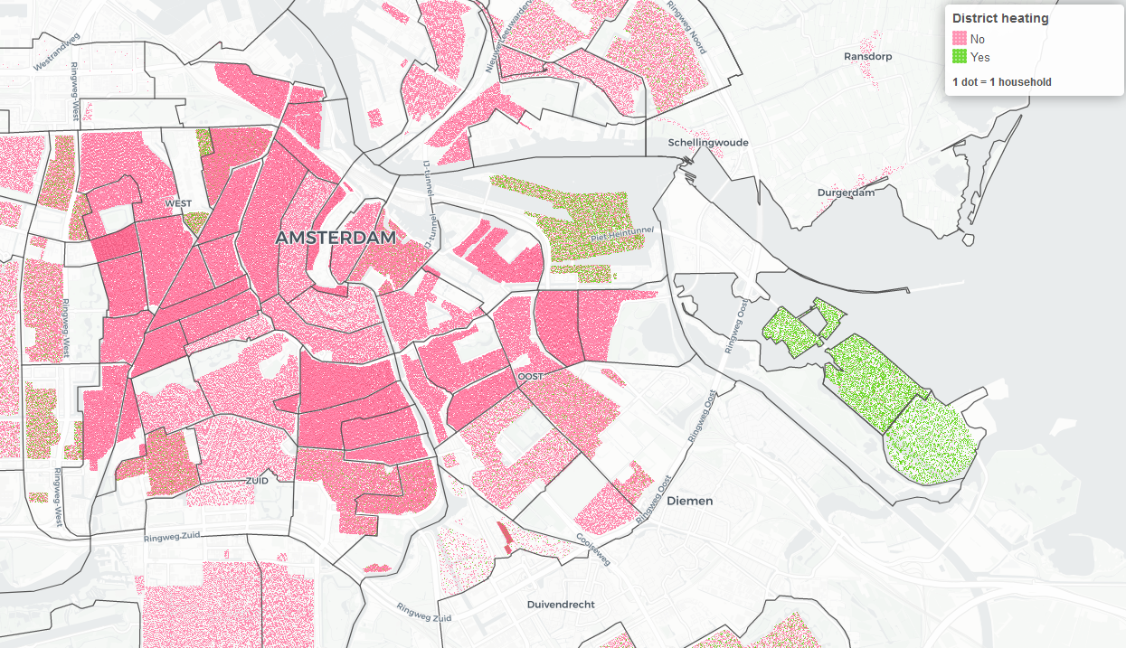
https://claircitydata.cbs.nl/dotmaps/amsterdam_v2

Slide 14
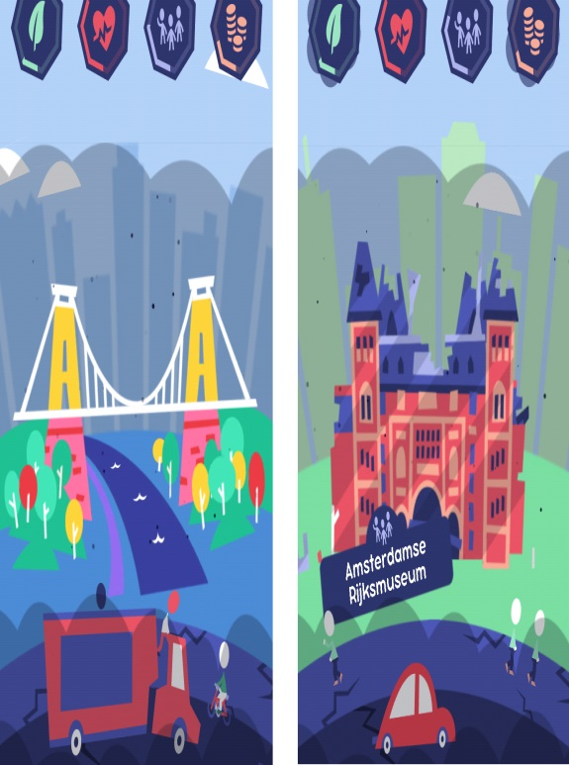




Gamification
www.claircity.eu/get-involved/our-game/
www.claircity.eu/amsterdam/get-involved/our-game/

Slide 15
Wrap up
Air quality needs to be improved further in the EU, especially in cities
In the ClairCity project 16 organizations with mixed expertise developed detailed models and scenarios for clean air in 6 European cities
Partnerships are crucial for this work
NSIs can help but also learn:
  Advice on data management, metadata guidelines and statistical concepts
  make available instruments such as a data portal and visualization knowledge and tools
  Learn on the actual use and demands of official statistics from research projects
  re-use some of the concepts used such as tools for citizen engagement and gamification

Slide 16
www.claircity.eu
@claircity
Questions?
Olav ten Bosch
o.tenbosch@cbs.nl
Thanks to colleagues from :
UWE (Bristol), DTU (Denmark), NILU (Norway), PBL (NL), REC (Hungary), Techne (Italy), TML (Leuven), Univ. of Aveiro (Portugal), Trinomics (NL), Municipalities Amsterdam, Bristol, Ljubljana , Sosnowiec and regions Aveiro and Liguria
This project has received funding from the European Union’s Horizon 2020 research and innovation programme under grant agreement No. 689289.

