Slide 1
Big data and consumer prices
DJ Hoogerdijk
C Lamboray

Slide 2
(Harmonised) Consumer Price Index (HICP/CPI) measures average price change for goods and services purchased by households.
It is a measure of inflation (monetary policy), a measure for compensation, deflator for national accounts …
In an increasingly digitalised world, “pen & paper” price collection can and needs to be replaced by web scraped data and transaction data generated by the increasingly digitalised retail trade.
Eurostat has supported the development and use of these sources.

Slide 3
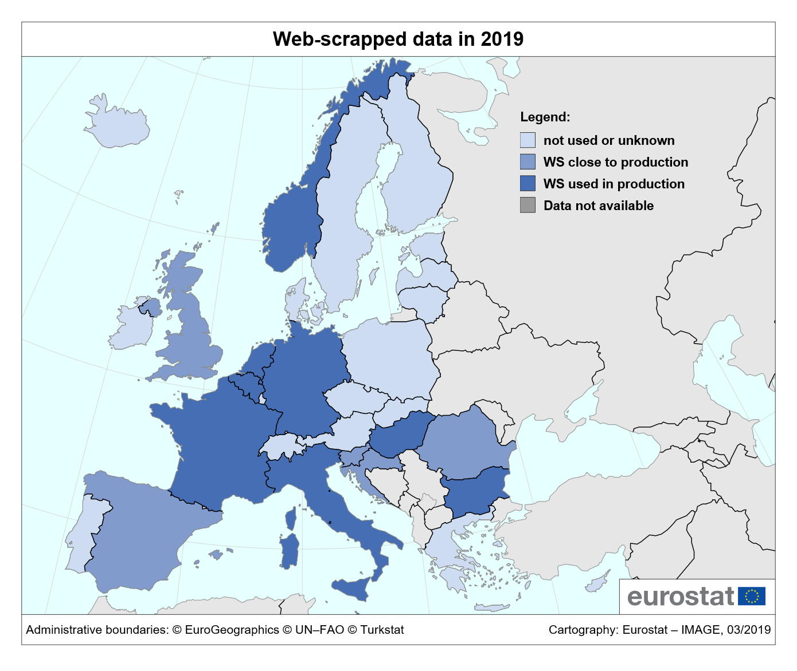
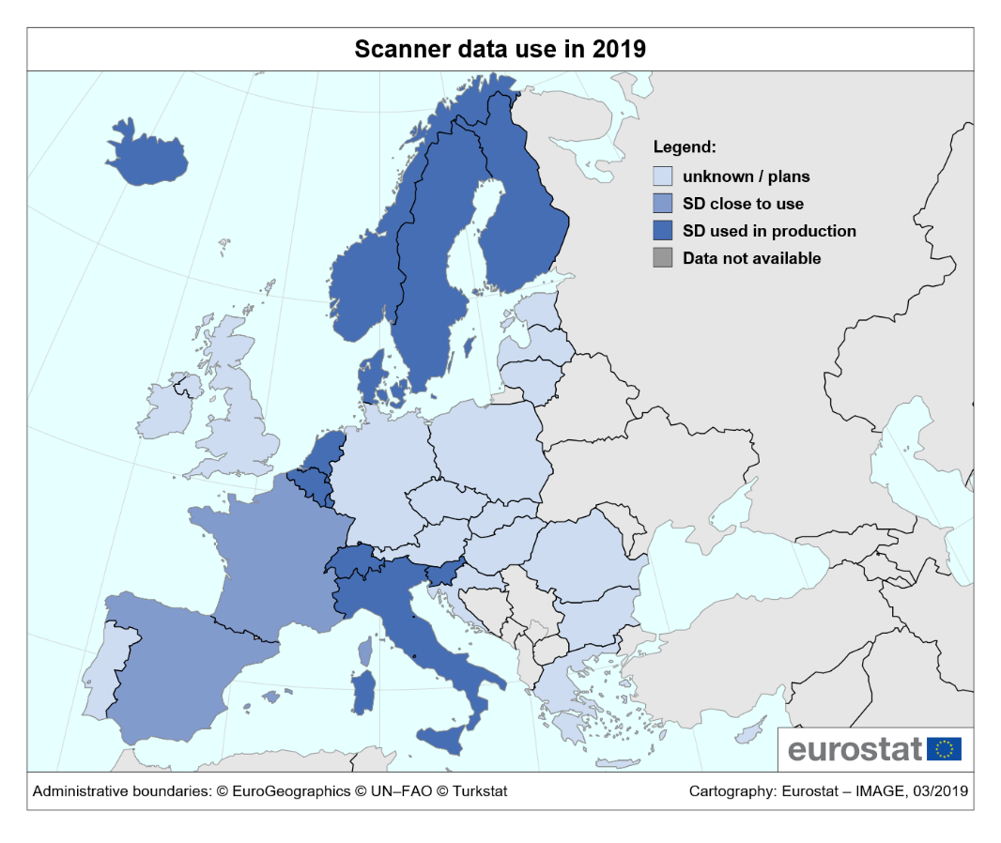
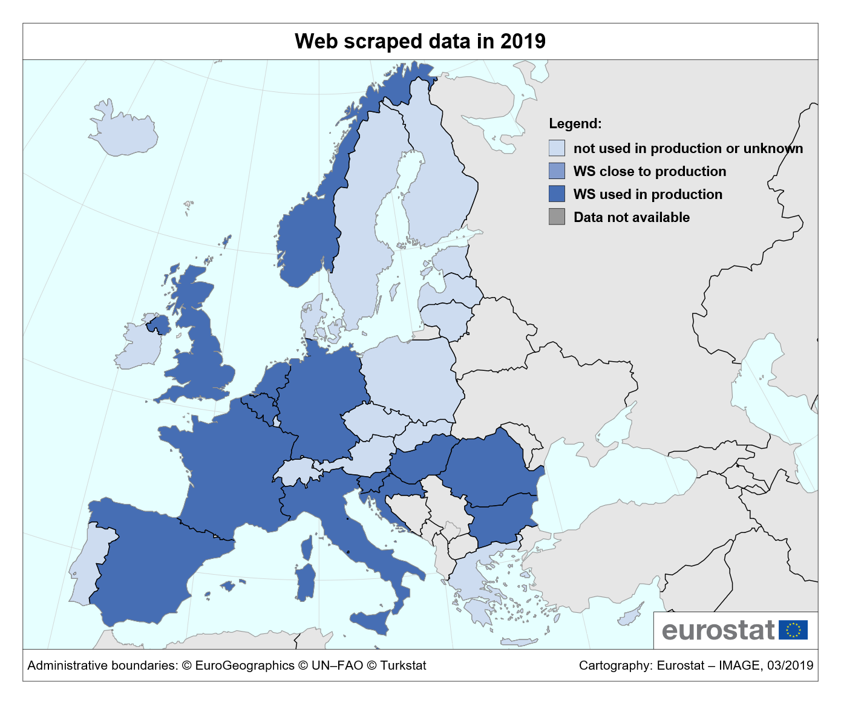

Slide 4
4 presentations:
2 on web scraped data
2 on scanner data
New data sources require new methods!

Slide 5
Integration of volatile online prices into the consumer price index
Christian Blaudow
Assistant Head of Section
Federal Statistical Office of Germany (Destatis)
christian.blaudow@destatis.de

Slide 6
Challenges for price statistics (1)
Situation of online price collection (at Destatis)
  roughly 10.000 products in the CPI/HICP
  collection of one price per month
Growing importance of e-commerce
  Dynamic universe in terms of product availability and prices
  Broader variety of products
  Price setting often nontransparent
  New phenomena on the online market (dynamic pricing)
Conclusion: inclusion of more products and collection of more prices needed

Slide 7
Challenges for price statistics (2)
Dynamic pricing
  Use of automatic algorithms to change prices at short notice
  Allows sellers to tailor their marketing or inventory to the needs of their customers
  Factors:
    Competitor pricing
    Time-based pricing
    Supply and demand
    Customer profile
    External factors in the market

Slide 8
Challenges for price statistics (3)

Slide 9
Solution – Web Scraping (1)
Web scraping is a process whereby websites are automatically retrieved and predefined data are extracted at preset times
Price collection may be repeated infinite times
Use of databases (e.g. MySQL), scraping tools (e.g. iMacros, Selenium), statistic programs (e.g. SAS, R)
@Destatis
  Applied for the imitation and replacement of manual price collections
  Monitoring and analysis of price developments (dynamic pricing)

Slide 10
Solution – Web Scraping (2)
General remarks
  Increase of efficiency and productivity: synergy effects by collecting many prices at the same web shop
  Shift of tasks: less resources needed for the collection of data, more resources needed for the maintenance of programs and analysis of retrieved data
Challenges
  Denied access to web page (“captcha”)
  Unclear legal situation
  Issue of pricing the same basket over time: new methods needed in order to estimate price developments

Slide 11
Using web scraped data in the production of consumer price indices
Tanya Flower, ONS
tanya.flower@ons.gov.uk

Slide 12
Old methodology & new data sources
The CPI/HICP is based on a matched sample approach
If an item is no longer available – find a comparable replacement or make a suitable quality adjustment
The size of web scraped data makes this manual adjustment difficult, and “hidden” price changes may be lost

Slide 13
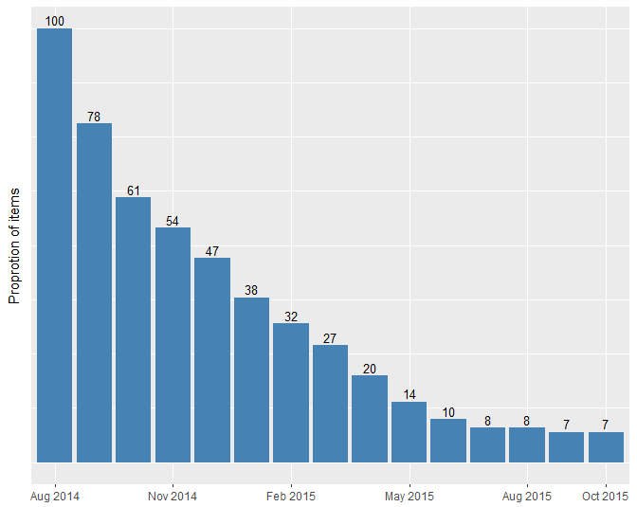
Item churn & chained indices
Men shirt’s

Slide 14
From individual items to homogenous products (HPs)..
A possible solution is to move to an unmatched model
Homogenous products can be found by identifying groups of attributes to cluster on, for example brand, material..
Unsupervised machine learning can be used to create clusters, which are then fixed over time to form HPs
The average price of these HPs can then be used as input into a price index (CLIP)

Slide 15
CLIP – step 1 : creating clusters
Clusters are found in base period using the Mean Shift algorithm
Mean Shift was used as it requires no a priori choices about cluster shapes and number of clusters
Attributes:
  Product name
  Price
  Style
  Retailer
  Discount information

Slide 16
CLIP – step 2: fix clusters over time
Use a decision tree to find the underlying rules that define the cluster → homogenous products
Price is removed as a characteristic
For subsequent months, items are then sorted into these HPs using this decision tree
The specific item mix of a HP will vary over time, but all items will be of comparable quality as defined by these rules

Slide 17
CLIP – step 3: generate a price index
The average price of HPs can be fed as input into all possible price index methods (rather than individual items)
For CLIP, we use a Laspeyres type index where the price change for each HP is aggregated together to form an overall category index using the number of items in each HP in the base period for the expenditure weights

Slide 18
Men shirt’s

Slide 19
All clothing

Slide 20
Drawbacks to CLIP
Sufficient product metadata is required to create the clusters
  Unit value bias
  May mean that no clusters are able to be found
HPs based on clustering are less easy to interpret than manual filtering of attributes

Slide 21
”Exploring the use of scanner data in the Norwegian CPI/HICP for items of high churn”
Ragnhild Nygaard
Statistics Norway ragnhild.nygaard@ssb.no

Slide 22
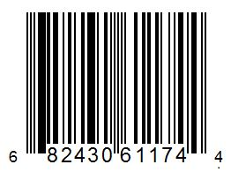
Scanner data
Price and quantity data unlike web scraped data that is purely price data
Transaction data generated in stores at the time of purchase when items are scanned
  Price, quantity, store, period, short description of the item
Product IDs or item codes
  GTINs - Global Trade Item Number - unique store independent identification code
  for items
Unit values created per item codes (GTINs) - turnover divided by quantity sold

Slide 23
Defining products with scanner data
Crucial question: GTIN = product?
  Item code (GTIN) level may be too detailed ⇒ match between new and old item code may be missed
A broader concept may be needed ⇒ homogenous products (HPs)
  A sum of different item codes of similar attributes
Quantity weighted average of the item codes within the HPs allows for new item codes entering and old ones disappearing

Slide 24
HPs for sport clothing and equipment
HP «x»
Store concept 1
Scanner data from a major sport retailer introduced in the Norwegian CPI/HICP in 2018
Introduced HPs based on available price determining variables
HPs aggregated up to for instance “Jackets for men”
Store concept 1|Raincoat, men| Helly Hansen (brand)
Item code 12345, Helly Hansen, Portland raincoat, 990 Black size M, price € 89
Item code 23456, Helly Hansen, Floyen raincoat, 183 Red, size S, price € 84
Item code 34567, Helly Hansen, Portland raincoat, 183 Red, size XL, price € 89
Item code 45678, Helly Hansen, Svalbard raincoat, Cayenne, size XL, price € 79.9
New item(s) entering the market:
Item code 34567, …
Old item(s) leaving the market:
Item code 45678, …

Slide 25
Comparing HPs and item codes
Using HPs matter!
  Socks, men Jackets, men

Slide 26
Index bias - “chain drift”
NSIs want to make use of the potential of scanner data in index compilation
  Provides information on both price and quantity
  Provides timely introduction of new items
Frequent update (chaining) of the index allows new items to be included frequently
Large period-to-period fluctuations in price and quantities in combination with frequent chaining may cause “chain drift”
  Example: Items are sold at heavily discounted prices ⇒ large increases in purchases, consumers stock up ⇒ high volatility in both prices and quantities

Slide 27
“Chain drift”
“Chain drift” problem occurs when prices are back to their “normal” level, but the quantities purchased may often be below their “normal” levels ⇒ downward drift in the index
Challenge: To include new items and to use price and quantity in index compilation at detailed level without causing “chain drift”

Slide 28
“Evaluating multilateral index methods
on supermarket scanner data”
Ken Van Loon
Statistics Belgium
ken.vanloon@economie.fgov.be

Slide 29
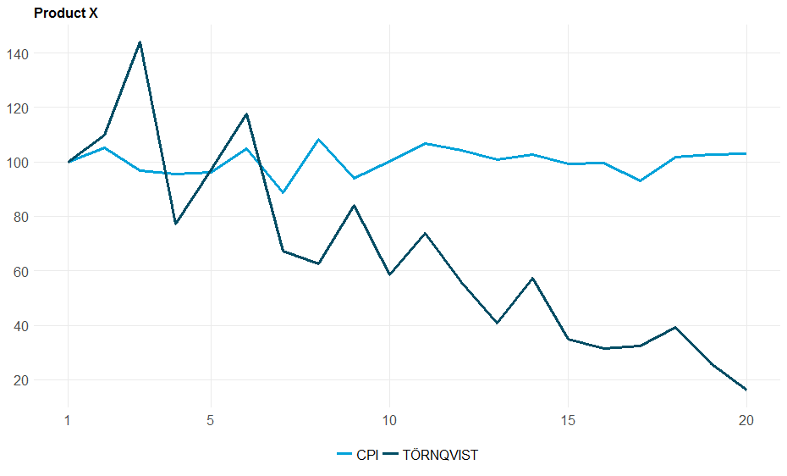
Chain drift
The effect of chain drift can be quite large
Chain drift
29

Slide 30
Current methods
To avoid chain drift, currently two kinds of methods are mostly used:
1. Direct bilateral:
→ Allows using explicit weights, but excludes new products
2. Chained bilateral:
→ Includes new products, but doesn’t allow the use of explicit weights
0
1
2
3
(time)
0
1
2
3
(time)
30

Slide 31
Multilateral methods I
A potential solution for chain drift is using multilateral methods → uses the whole time window
→ explicit weights can be used AND includes new products
Historically used for spatial price comparisons:
  Direct price level comparison between country A and C should give the same result as indirectly comparing A with C via country B
Applied to intertemporal context: Index_{1,3} = Index_{1,2} x Index_{2,3}
T=0
T=3
T=1
T=2
31

Slide 32
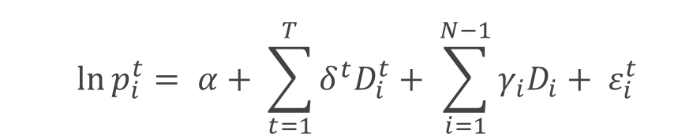
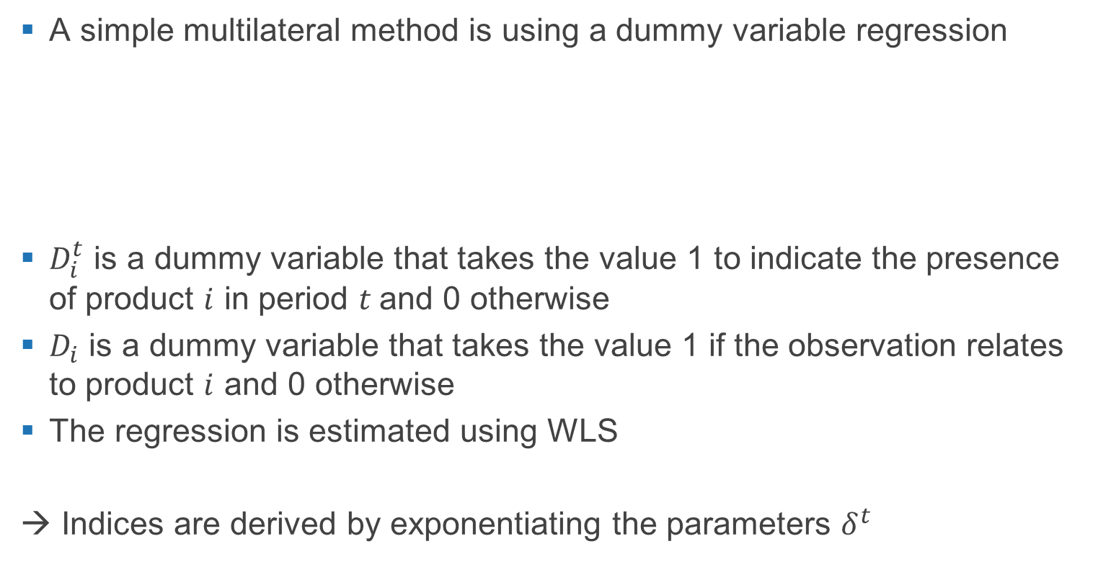
Multilateral methods II
A simple multilateral method is using a dummy variable regression
$D_{i}^{t}$ is a dummy variable that takes the value 1 to indicate the presence of product $i$ in period $t$ and 0 otherwise
$D_{i}$ is a dummy variable that takes the value 1 if the observation relates to product $i$ and 0 otherwise
The regression is estimated using WLS
→ Indices are derived by exponentiating the parameters $δ^{t}$
 | $$\ln{p_{i}^{t}}= α+ \sum_{t=1}^{T}{δ^{t}D_{i}^{t}}+ \sum_{i=1}^{N−1}{γ_{i}D_{i}}+ ε_{i}^{t}$$
32

Slide 33
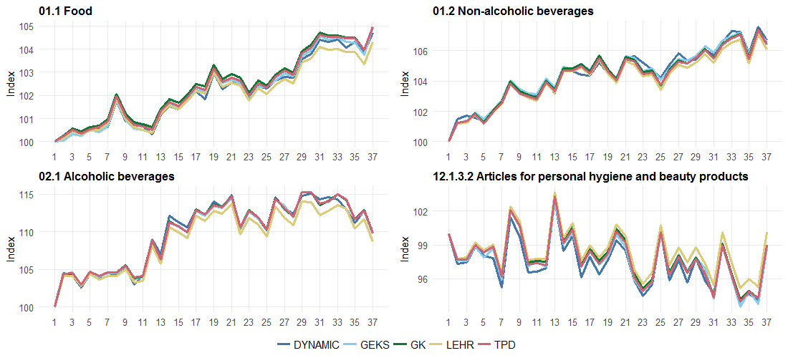
Multilateral methods III
This method and others were tested on a supermarket dataset:
  Used in production for the Belgian CPI/HICP
  Covers 37 months
  Contains around 480 product groups
Results are quite “robust”, different methods give similar results
33

Slide 34
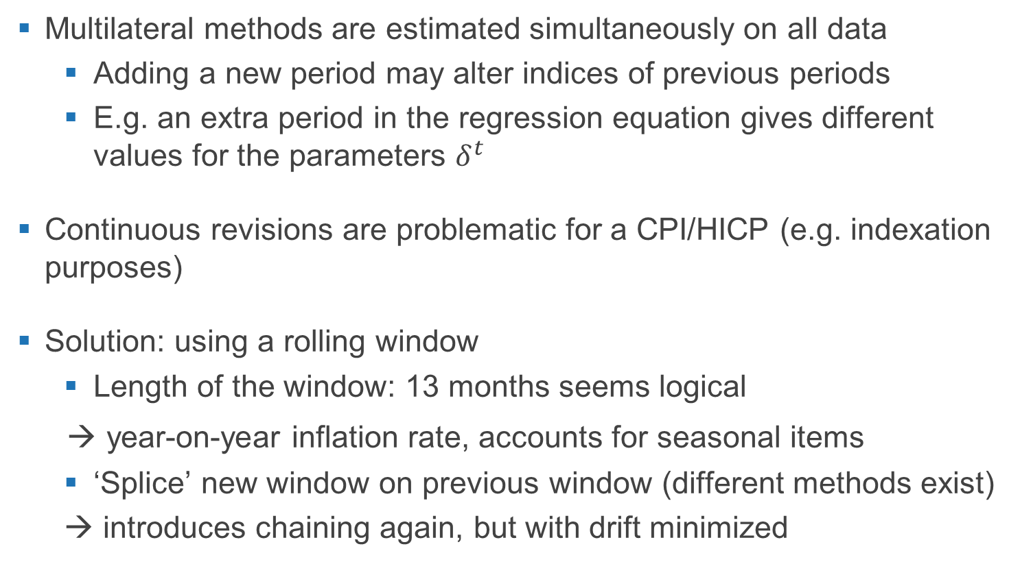
Multilateral methods IV
Multilateral methods are estimated simultaneously on all data
  Adding a new period may alter indices of previous periods
  E.g. an extra period in the regression equation gives different values for the parameters $δ^{t}$
Continuous revisions are problematic for a CPI/HICP (e.g. indexation purposes)
Solution: using a rolling window
  Length of the window: 13 months seems logical
→ year-on-year inflation rate, accounts for seasonal items
  ‘Splice’ new window on previous window (different methods exist)
  → introduces chaining again, but with drift minimized
34

Slide 35
Web scraping | Scanner data
Dynamic product assortments
 | Detailed and timely weights
Classification techniques have become a part of price statistics.
The classification procedures can have a significant impact on results!!

Slide 36
Web scraping | Scanner data
Dynamic product assortments
 | Detailed and timely weights
New statistical issues (chain drift) require new compilation approaches (multilateral methods).

Slide 37
- Inflation can be measured better and more efficiently.
- Designing price indices has become more complex (and more interesting).
- The interpretation of the data and the communication with users has become more challenging.

Slide 38





Thank you ….
Christian Blaudow
Tanya Flower
Ragnhild Nygaard
Ken Van Loon
Dirk-Jan Hoogerdijk &
Claude Lamboray

