Slide 1
Publishing georeferenced statistical data using linked open data technologies
Merging statistics and geospatial information grant series
Mirosław Migacz
GIS Consultant
Statistics Poland

Slide 2

The project
Title: „Development of guidelines for publishing statistical data as linked open data”
„Merging statistics and geospatial information” grant series
2016 – 2017
main goal: prepare a background for LOD implementation in official statistics

Slide 3

















Before
3218
4.4.32.64.18
powiat
łobeski
(LAU 1)
lobeski
4326418

Slide 4
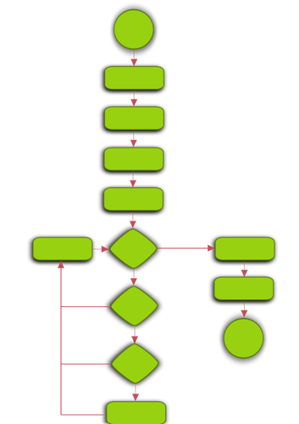

After
powiat łobeski
http://
nts.stat.gov.pl/4/4/32/64/18

Slide 5








Specific objectives
identify data sources
identify statistical units
harmonize, generalize and build URIs for statistical units
transform statistical data, geospatial data and metadata into RDF (pilot)
conclude the pilot transformation and fomulate recommendations for a full-on implementation

Slide 6



Primary data sources
Local Data Bank | biggest set of statistical information available for a wide range of years updated monthly
Demography Database | integrated data source for state and structure of population, vital statistics and migrations
Development monitoring system STRATEG | a system for facilitating and monitoring the development policy key measures to monitor execution of strategies at local, regional, transregional and EU level.

Slide 7

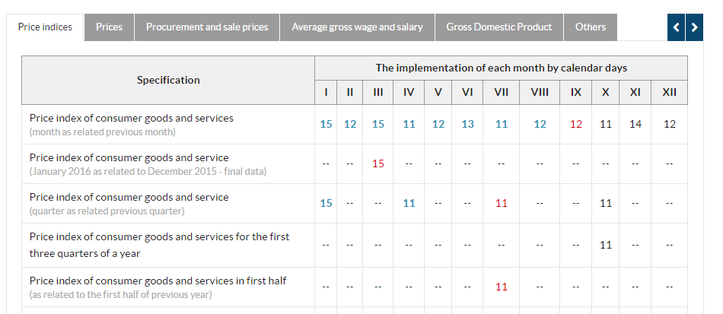
Identification of data sources
Other data sources:
  publications
  tables
  communiques
  announcements
  articles

Slide 8
Data sources - inventory
Metadata:
  thematic category,
  format (PDF, DOC, XLS, CSV),
  spatial reference (country, NUTS, LAU, functional areas, urban areas),
  temporal reference (years)
  presence of identifiers (TERYT, NTS, NUTS)
  update cycle
Preliminary analysis of data sources:
  openness
  redundance of information
  popularity (based on view / download stats)

Slide 9
Statistical units inventory
macroregion (NUTS 1)
voivodship
region (NUTS 2)
subregion (NUTS 3)
powiat (LAU 1)
gmina (LAU 2)
administrative boundaries:
  administrative units
  NUTS
Non-standard statistical units:
  functional areas /
  urban areas
  Groups of administrative / statistical units
  Derive mostly
  from strategic documents
NUTS
ADMINISTRATIVE

Slide 10
Statistical units harmonization – KTS
KTS – classification combining administrative and statistical units
introduced last year to comply with NUTS 2016
14-digit code
symbol | name
10000000000000 | Poland
10020000000000 | macroregion
10023200000000 | voivodship
10023210000000 | region
10023216400000 | subregion
10023216418000 | powiat
10023216418053 | gmina

Slide 11
Geometry harmonization/generalization
Input data:
  administrative boundaries since 2002 for LAU 2 (gmina), excluding 2007
Harmonization process:
  structure standardization
  standardization of identifiers (creating KTS identifiers)
  aggregation to higher level units (LAU 1 -> NUTS 1)
Generalization:
  several generalization scenarios tested for purposes of choosing
  an optimal one
  datasets with generalized and non-generalized
  geometries prepared for 2002-2016

Slide 12

Linked open data pilot
data
statistical data
geospatial data
data sources catalogue
demographic classifications
statistical unit geometries
metadata

Slide 13
LOD pilot – statistical data
data:
  demographic data for 2016 from three major databases (Local Data Bank, Demography Database, STRATEG system),
ontologies for classifications:
  age codelist defined using SKOS (skos) & Dublin Core (dct),
  sex codelist re-used from SDMX, added Polish translation,
definining metadata for statistical values (observations):
  based primarily on SDMX ontologies (attribute, code, measure, dimension),
  qb:Observation class from Data Cube.

Slide 14
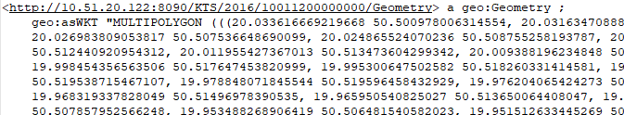
LOD pilot – geospatial data
input geometries:
  voivodship geometries for 2016,
ontologies:
  ontology for the KTS classification defined using RDF Schema (rdfs) & GeoSPARQL (geo) vocabularies,
geometry encoding:
  separate geo:Geometry entities with geometry encoded in WKT (Well Known Text) format (geo:wktLiteral).

Slide 15
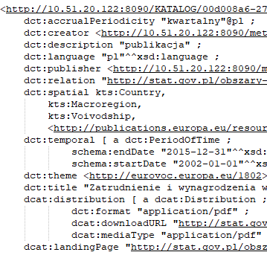

LOD pilot – data sources catalogue
DCAT-AP (dcat) application profile for data portals in Europe,
data sources as dcat:Dataset classes,
links to other vocabularies:
  EuroVoc (for thematic categories),
  EU Publication Office continent / country codelist (for spatial reference)
  Internet Media Type (MIME)

Slide 16
LOD pilot – linking
dataset catalogue
geospatial data
statistical data
spatial domain
for datasets
dataset definitions
for statistical data
geometries
for observations

Slide 17
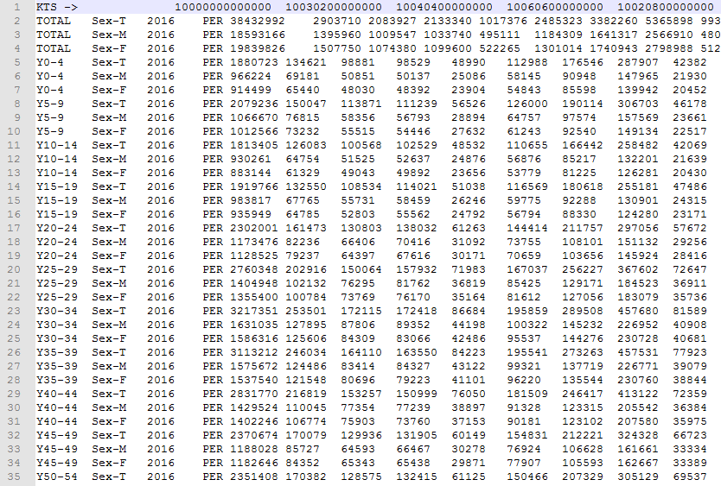
Data transformation into RDF
1. Source files in CSV

Slide 18
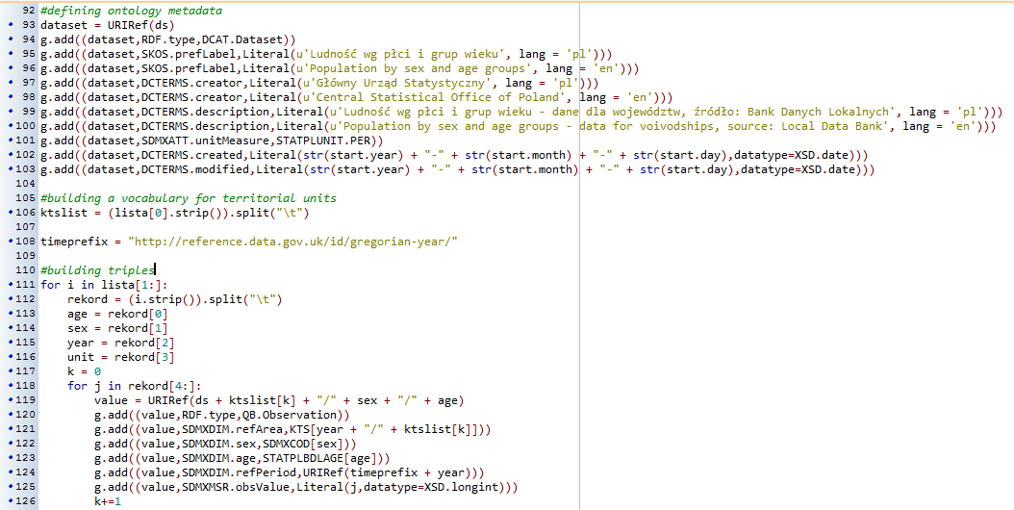
Data transformation into RDF
2. Python script using RDFlib module for transformation:

Slide 19
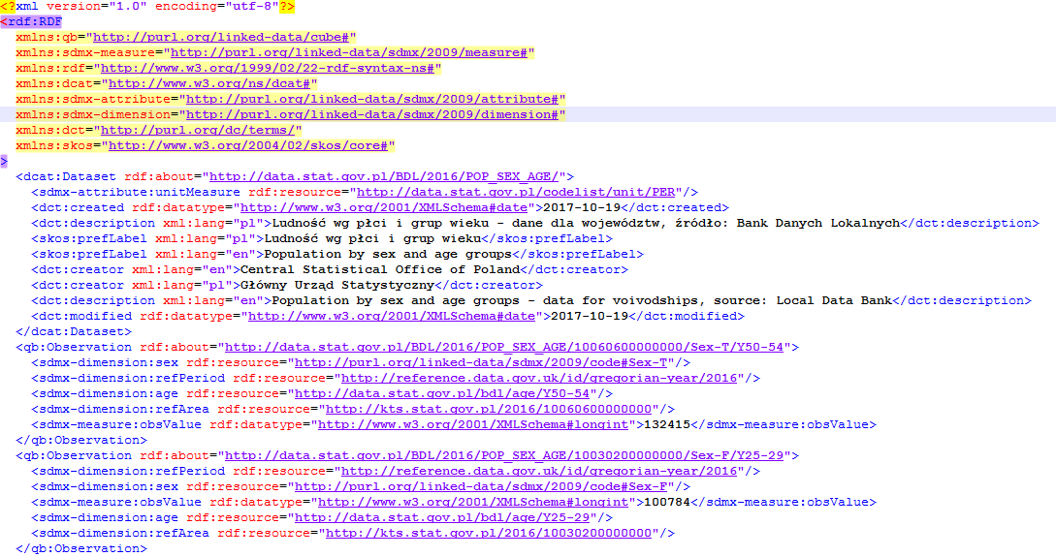
Data transformation into RDF
3a. Results in any desired format (RDF-XML):

Slide 20
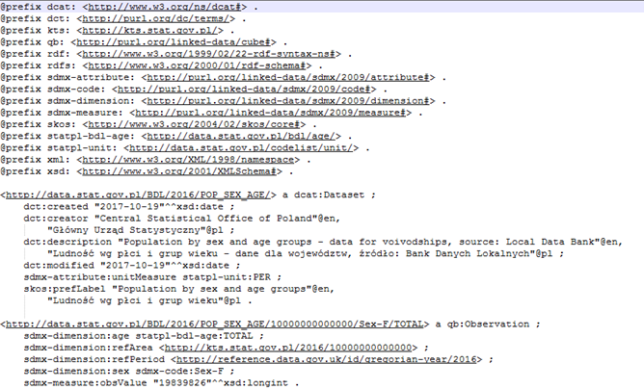
Data transformation into RDF
3b. Results in any desired format (Turtle):

Slide 21

LOD pilot – triple store
Apache Jena Fuseki used as a SPARQL server,
71717 triples loaded,
single Fuseki dataset (STAT_LOD) to allow cross-querying and cross-browsing data created initially in separate files
SPARQL endpoint for querying

Slide 22
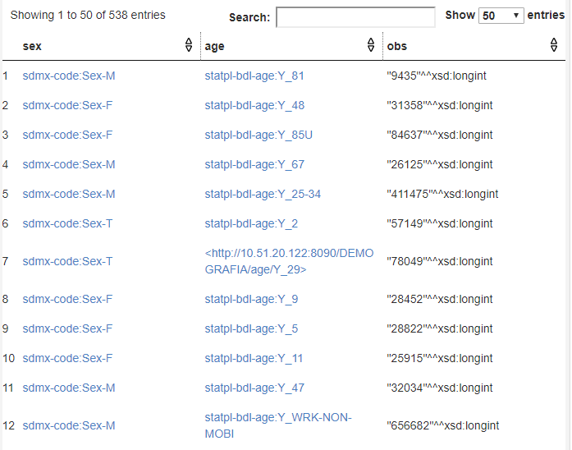
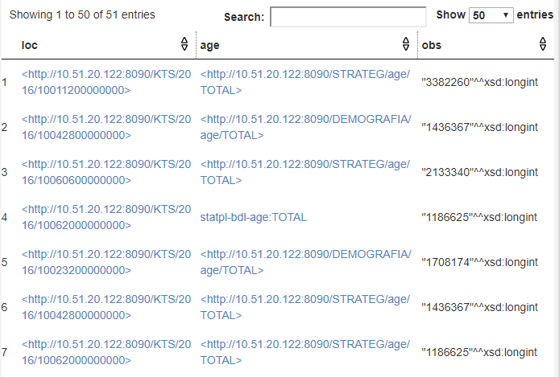
LOD pilot – SPARQL endpoint

Slide 23
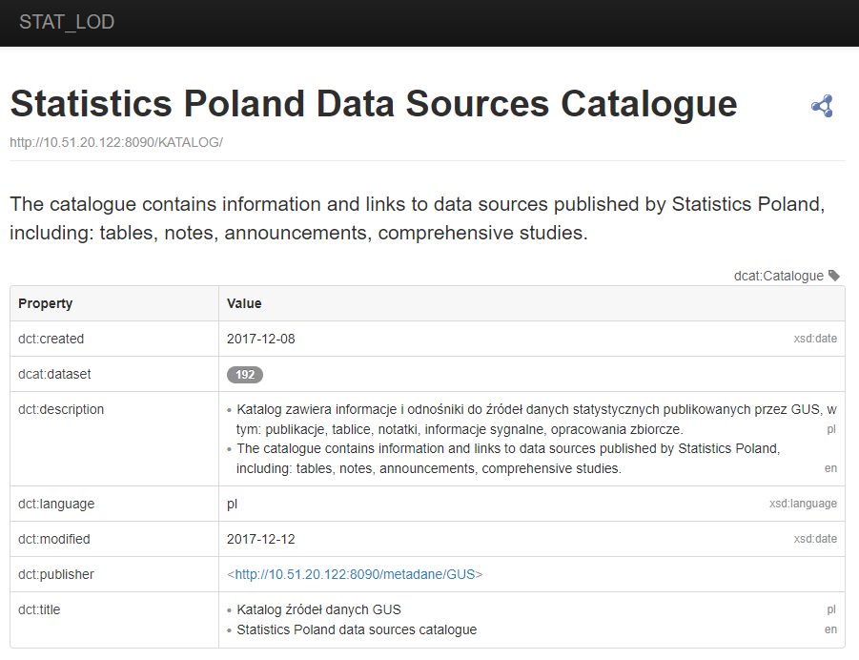
LOD pilot – Pubby frontend (catalogue)

Slide 24
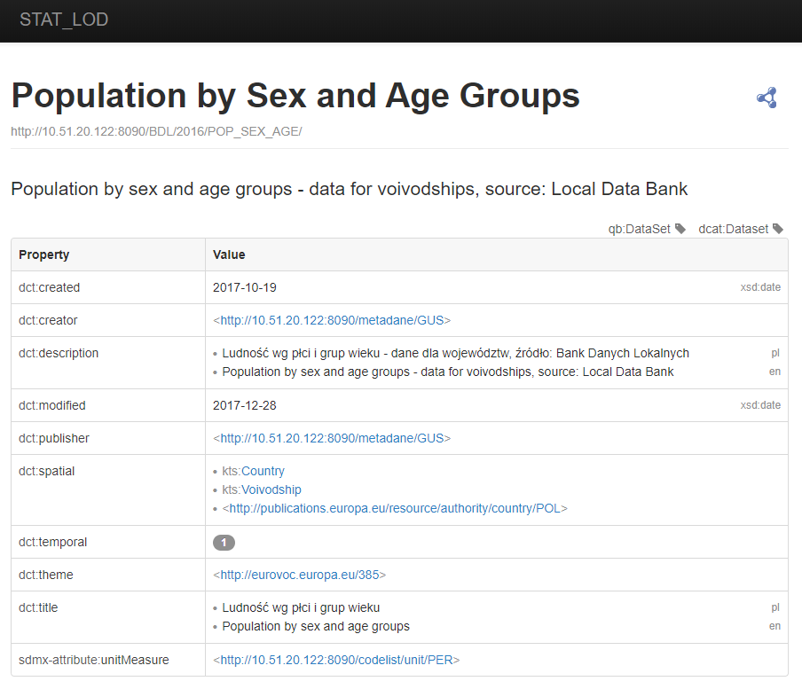
LOD pilot – Pubby frontend (dataset)

Slide 25
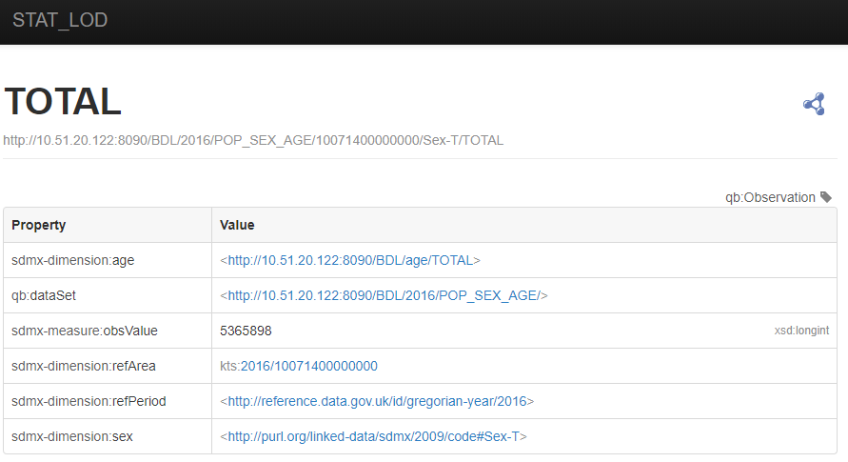
LOD pilot – Pubby frontend (value)

Slide 26
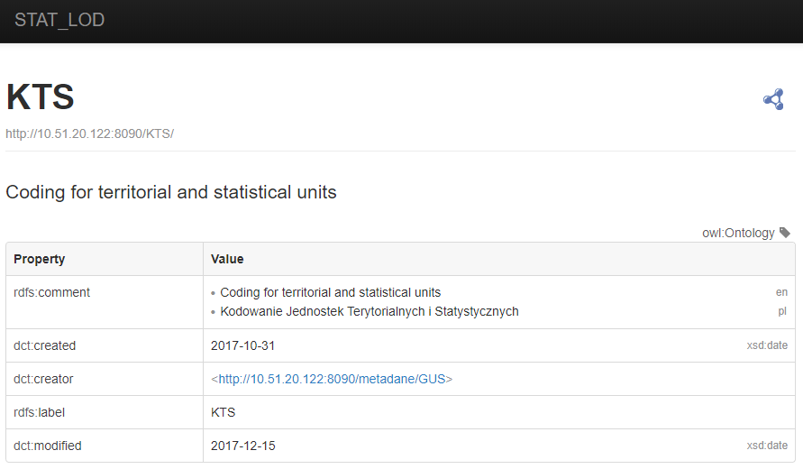
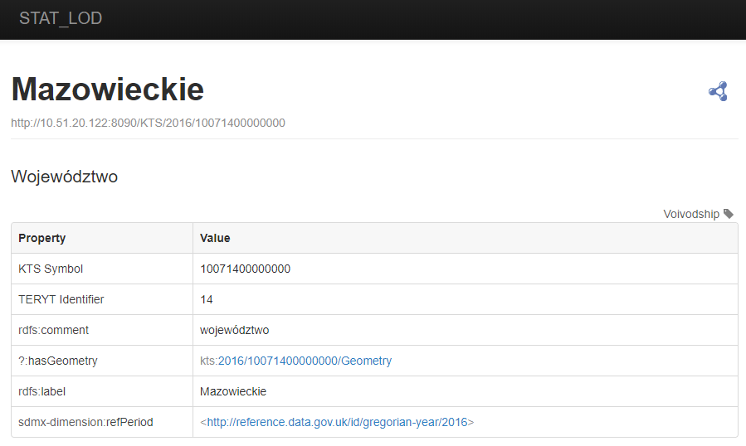
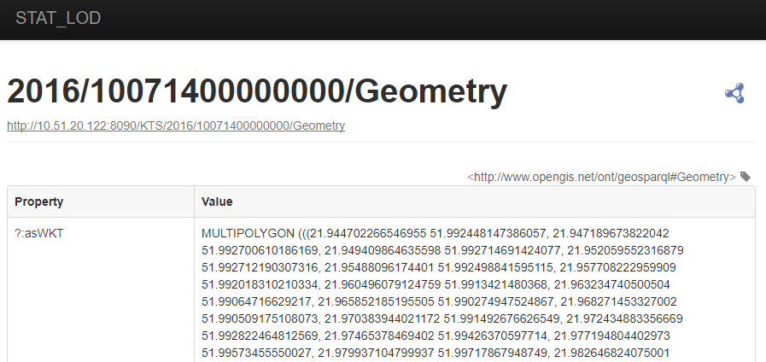
LOD pilot – Pubby frontend (geometry)

Slide 27
LOD pilot – conclusions
No reference implementation for statistical linked open data:
  lack of integrity between RDF metadata sets published by one authority,
  links to non-existing entities,
  lack of maintenance,
Lack of pan-European guidelines for statistical linked open data:
  common vocabularies,
  recommended or dedicated software components,
  DIGICOM ESSNet LOD project.

Slide 28
LOD pilot – conclusions
Some software / programming components not being developed anymore,
  implementations might become unstable,
  Python-based implementation seem sustainable at this point,
Semantic harmonization of statistical classifications:
  different meanings for supposedly the same classification elements, e.g. 0-5 can be “0 to 5” or “0 to less than five”,
  not only a pan-European issue, may exist
  at country level,

Slide 29
LOD pilot – conclusions
Methodology for publishing spatial data as linked open data:
  single entity per single geometry:
    inventory of boundary changes,
    geometry instances with non-meaningful identifiers (UUIDs),
  separate geometries for respective years:
    a complete set of geometries each year, regardless of changes,
    geometry instances with meaningful
    identifiers (KTS + year).

Slide 30
LOD pilot – conclusions
Most linked open data implementations are technically correct:
  it is nearly impossible to produce incorrect RDF metadata files,
  you can put anything in the RDF graph, but does it make sense semantically?
Linked open data implementations based on Python scripts are easy to amend in the future,
RDF vocabulary specifications are easier to interpret with a UML model provided (Thank you, Captain Obvious ☺)

Slide 31


Publishing georeferenced
statistical data using
linked open data technologies
Merging statistics and geospatial information grant series
Mirosław Migacz
GIS Consultant
Statistics Poland
www.linkedin.com/in/migacz
m.migacz@stat.gov.pl

