Slide 1
Administrative Data and statistical matching
A. Wegscheider-Pichler
Unit Analysis
Brussels
13th March 2019
Study: Environmental conditions and environmental behavior with respect to household income

Slide 2
2018 Project by Statistics Austria
Income is a crucial factor for environmental conditions and behaviour but the data base micro-census has no income variable (except unemployment income)
  2014 pilot study with data for 2011 generated total household income by statistical matching with data from EU-SILC
2018/19 follow up study with data for 2015 to validate the 2014 results BUT
now around 87 % of the income components were collected from administrative sources (register data)
The missing income parts were again filled by „Statistical Matching“ with data from EU-SILC

Slide 3
Register Data at Statistics Austria
Each register that has to provide data for Statistics Austria delivers them with a so-called "branch-specific personal identification number for official statistics” (bPIN OS)
Responsible for the bPIN system is the Austrian Ministry of Digitalization (not Statistics Austria itself)
The bPIN OS can only be decrypted by Statistics Austria and does not allow for drawing any conclusions about the persons themselves →
Statistics Austria receives completely anonymized data sets that can be linked with each other with the help of the bPIN OS

Slide 4
Administrative Data (87%)
Around 87% of household income data stem from register sources
Income components for wages, pensions, unemployment payment…. are generated that way
to ensure compliance with the confidentiality guidelines, the register data is assigned with an encrypted 172-digit personal key, (decrypted 28 digits) the so-called "branch-specific personal identification number for official statistics“ - bPIN OS
Procedure for linking administrative data follows that of EU-SILC:
Income tax, payroll tax, social security, housing subsidies, Gross income (unemployment, pension...), other income components

Slide 5
Matching Process (13%)
Still missing: income from self-employed, housing assistance…
Identifying relevant socio-demographic matching variables and harmonizing them in the data sets
Administrative income variables were used for generating income in the micro-census dataset AND used for Statistical Matching
Random Forest Modell - Machine-learning algorithm in which several (in this case 1,500) decision trees were created randomly
Each of these decision trees provided one estimate of income, these estimates were then averaged
The decision trees used random samples of data from EU-SILC

Slide 6
Matching Process (13%) - Problem
For very low and very high income there were relevant deviations from the data generated compared to the actual income!
But: one focus of the study is on households at-risk-of-poverty = households with low income
Problem: how get a better fit for these incomes?

Slide 7
Matching Process (13%) - Solution
In a second run, first only the households at-risk-of-poverty were estimated for the micro-census data (dichotomous variable)
This variable then was used as an additional regressor for the regression trees
This led to a better fit on the case level
Substantial improvements for the poor and the rich households (equivalised household income) were achieved
Part of the deviations can be explained by the different structure of the two samples

Slide 8
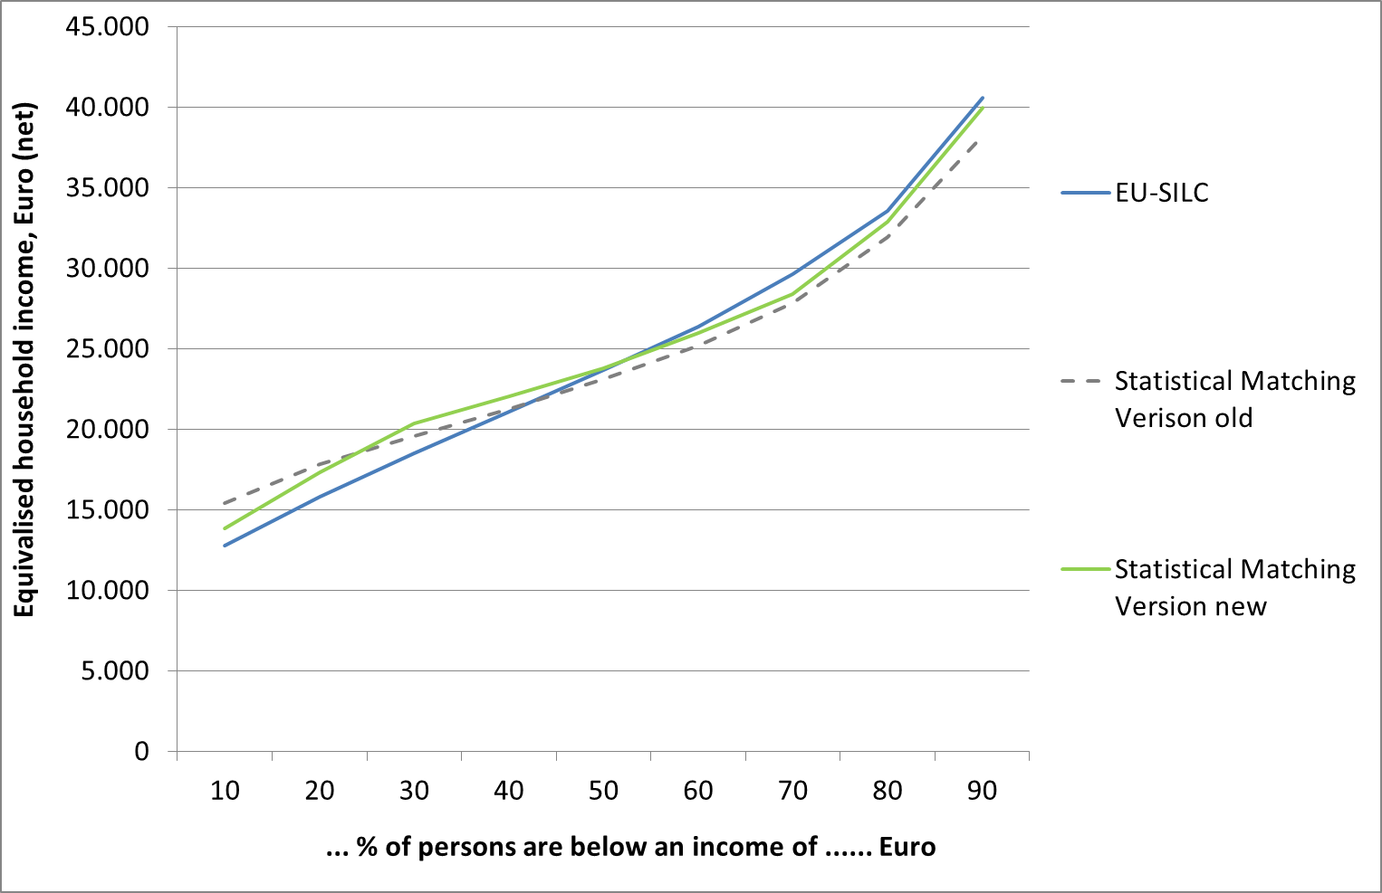
Income Variable – Data Check

Slide 9
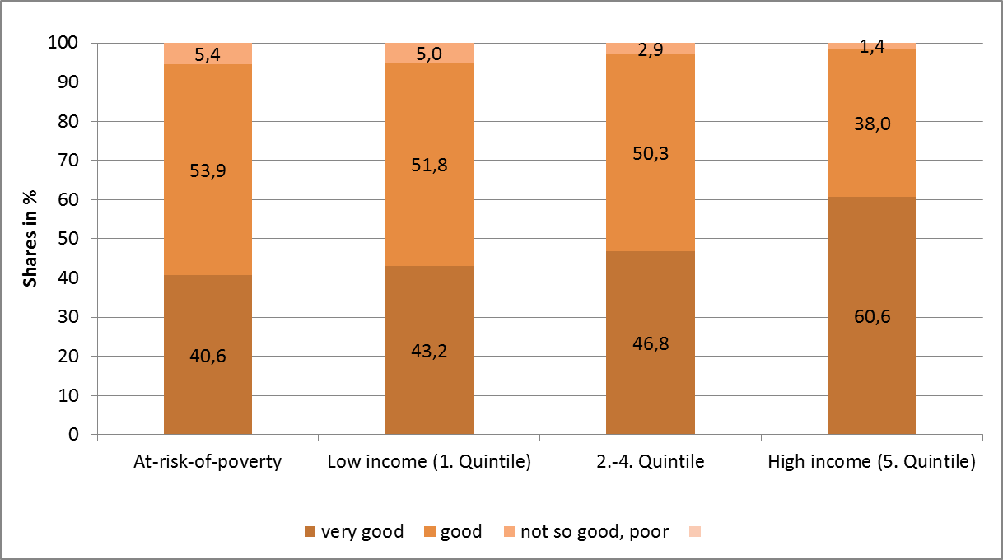
Results - verifying the matching (Example)
Quality of life by equivalised household income
S: Micro Census Environment 2015

Slide 10
Further descriptive outcomes
Households with low income report higher disturbance by noise than households with high income
Households with high income report more often to buy organic food
Public transport is less attractive for households with high income
Households with low income use private transport (by car) less often than households with medium or high income

Slide 11
Findings
Use of administrative data to generate income components improves data quality, BUT: not all relevant data is available
Statistical matching is fast, reduces the response burden and therefore the costs
Mixed use of both methods is the best way to generate new variables such as the household income:
- get as much variables as possible from register sources
- close the gap for the missing income components
What always matters: structure of the samples

