Slide 1

An improved multiobjective approach of
temporal disaggregation, a special case of
multivariate Denton
Gabor Lovics
gabor.lovics@ksh.hu
NTTS 12-14. 03. 2019

Slide 2


































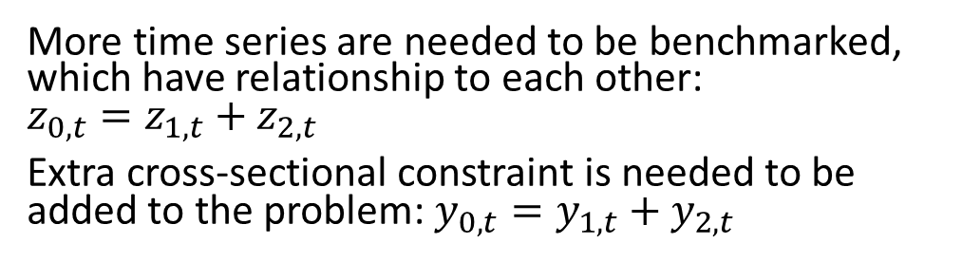


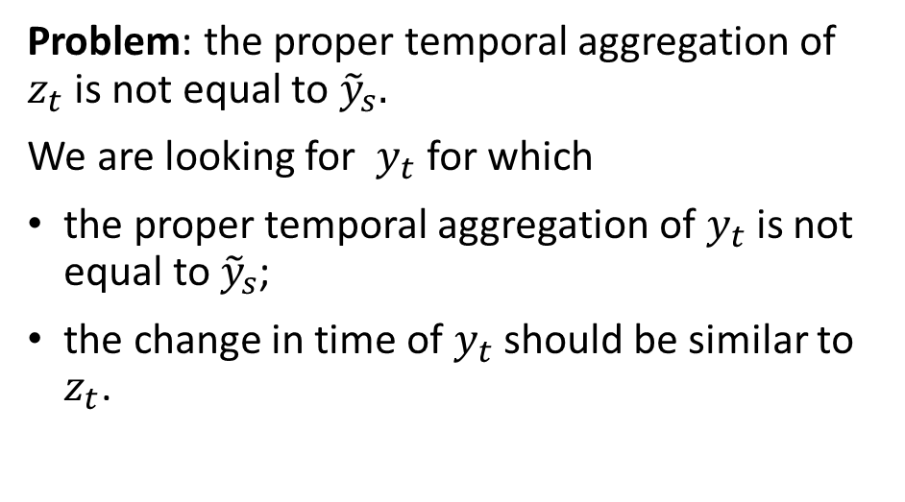




Benchmarking problems
Univariate case
Multivariate case
$${\tilde{y}}_{0,1}$$
$${\tilde{y}}_{0,2}$$
$$z_{1}$$
$$z_{2}$$
$$z_{3}$$
$$z_{4}$$
$$z_{5}$$
$$z_{6}$$
$$z_{7}$$
$$z_{8}$$
$$z_{0,1}$$
$$z_{0,2}$$
$$z_{0,3}$$
$$z_{0,4}$$
$$z_{0,5}$$
$$z_{0,6}$$
$$z_{0,7}$$
$$z_{0,8}$$
$${\tilde{y}}_{1,1}$$
$${\tilde{y}}_{1,2}$$
$${\tilde{y}}_{1}$$
$${\tilde{y}}_{2}$$
Problem: the proper temporal aggregation of $z_{t}$is not equal to ${\tilde{y}}_{s}.$
We are looking for $y_{t}$ for which
the proper temporal aggregation of $y_{t}$is not equal to ${\tilde{y}}_{s}$;
the change in time of $y_{t}$ should be similar to $z_{t}$.
$$z_{1,1}$$
$$z_{1,2}$$
$$z_{1,3}$$
$$z_{1,4}$$
$$z_{1,5}$$
$$z_{1,6}$$
$$z_{1,7}$$
$$z_{1,8}$$
$$z_{2,1}$$
$$z_{2,2}$$
$$z_{2,3}$$
$$z_{2,4}$$
$$z_{2,5}$$
$$z_{2,6}$$
$$z_{2,7}$$
$$z_{2,8}$$
$${\tilde{y}}_{2,1}$$
$${\tilde{y}}_{2,2}$$
More time series are needed to be benchmarked, which have relationship to each other:
$z_{0,t}=z_{1,t}+z_{2,t}$
Extra cross-sectional constraint is needed to be added to the problem: $y_{0,t}=y_{1,t}+y_{2,t}$

Slide 3
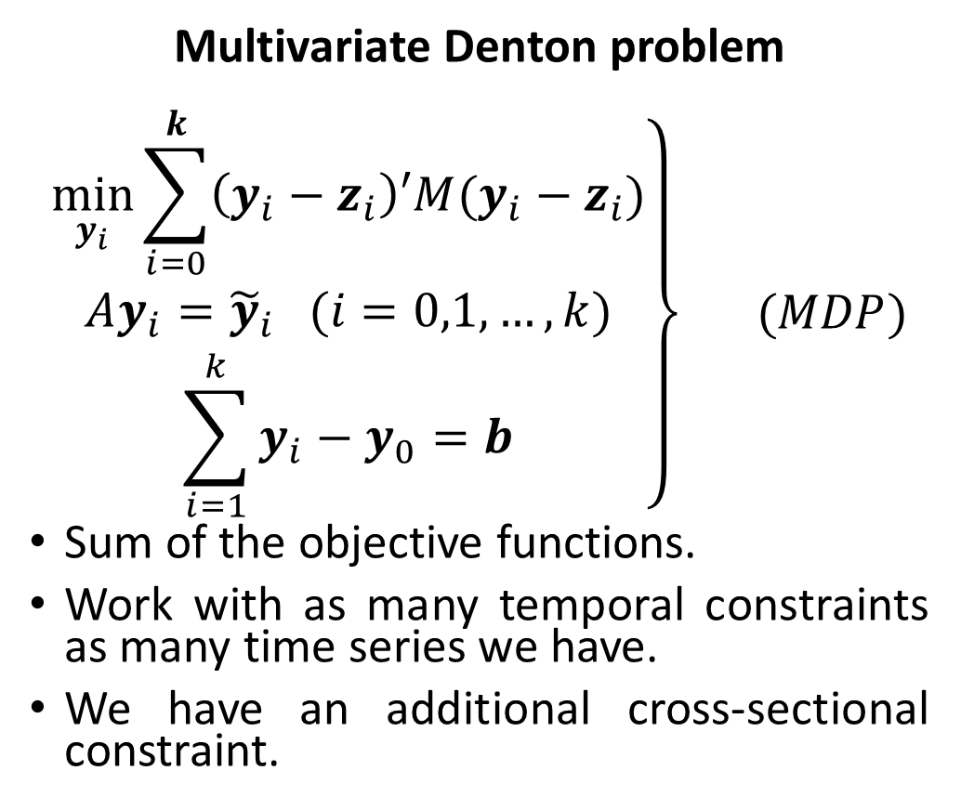
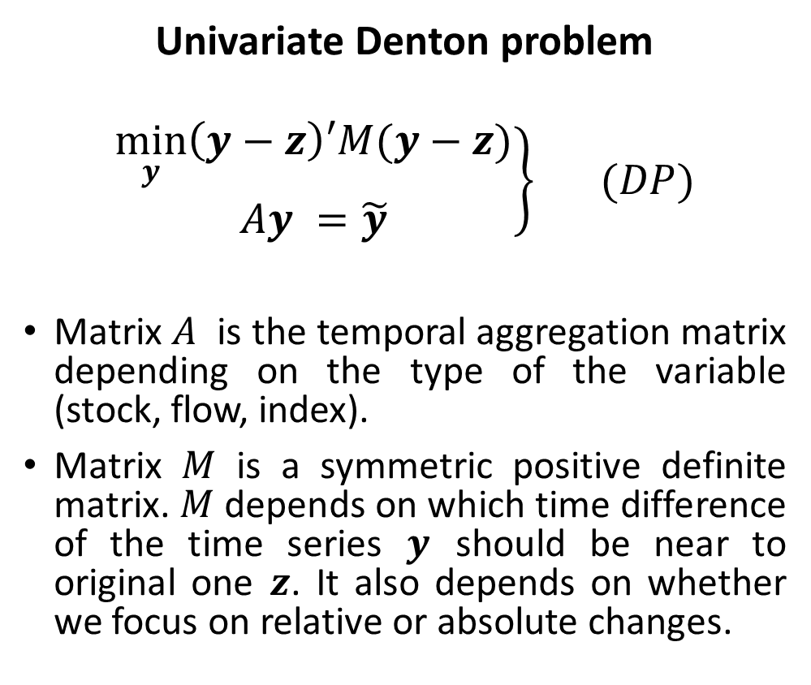
Uni- and multivariate Denton problem
Univariate Denton problem
$$\left.\begin{aligned}\min_{y}\left(y−z\right)′M(y−z) \\ Ay =\tilde{y}\end{aligned}\right\} (DP)$$
Matrix $A$ is the temporal aggregation matrix depending on the type of the variable (stock, flow, index).
Matrix $M$ is a symmetric positive definite matrix. $M$ depends on which time difference of the time series $y$ should be near to original one $z$. It also depends on whether we focus on relative or absolute changes.
Multivariate Denton problem
$$\left.\begin{aligned}\min_{y_{i}}{\sum_{i=0}^{k}{\left(y_{i}−z_{i}\right)′M(y_{i}−z_{i})}} \\ Ay_{i}={\tilde{y}}_{i} (i=0,1,…,k) \\ \sum_{i=1}^{k}{y_{i}}−y_{0}=b\end{aligned}\right\} (MDP)$$
Sum of the objective functions.
Work with as many temporal constraints as many time series we have.
We have an additional cross-sectional constraint.

Slide 4
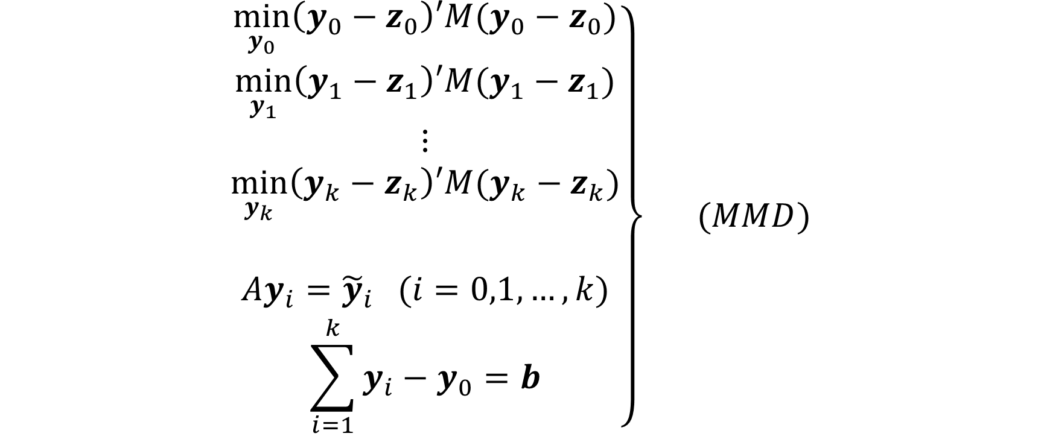
Multiobjective approach of the Multivariate Denton problem
$$\left.\begin{aligned}\min_{y_{0}}\left(y_{0}−z_{0}\right)′M(y_{0}−z_{0}) \\ \min_{y_{1}}\left(y_{1}−z_{1}\right)′M(y_{1}−z_{1}) \\ ⋮ \\ \min_{y_{k}}\left(y_{k}−z_{k}\right)′M(y_{k}−z_{k}) \\ \\ Ay_{i}={\tilde{y}}_{i} (i=0,1,…,k) \\ \sum_{i=1}^{k}{y_{i}}−y_{0}=b\end{aligned}\right\} (MMD)$$

Slide 5
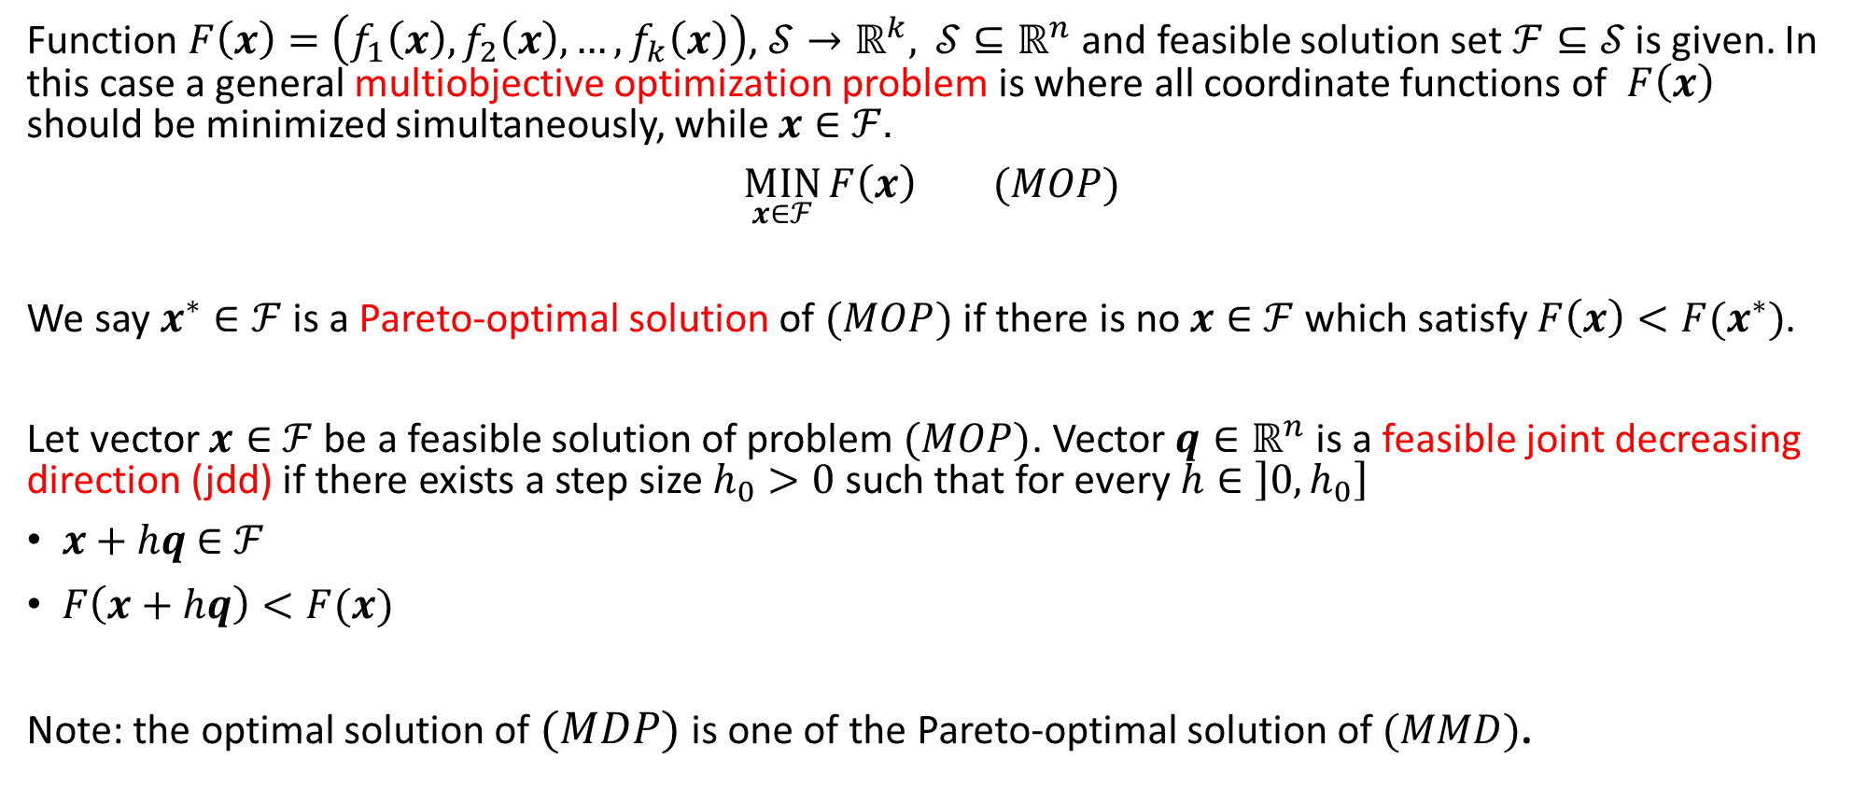
Concept of the Multiobjective optimization
Function $F\left(x\right)=\left(f_{1}\left(x\right),f_{2}\left(x\right),…,f_{k}\left(x\right)\right)$, $𝒮→ℝ^{k},$ $𝒮⊆ℝ^{n}$ and feasible solution set $ℱ⊆𝒮$ is given. In this case a general multiobjective optimization problem is where all coordinate functions of $F\left(x\right)$ should be minimized simultaneously, while $x∈$ $ℱ.$
$\underset{x∈ℱ}{MIN}{F\left(x\right) (MOP)}$
We say $x^{∗}∈ℱ$ is a Pareto-optimal solution of $(MOP)$ if there is no $x∈$ $ℱ$ which satisfy $F\left(x\right)<F(x^{∗})$.
Let vector $x∈$ $ℱ$ be a feasible solution of problem $(MOP)$. Vector $q∈ℝ^{n}$ is a feasible joint decreasing direction (jdd) if there exists a step size $h_{0}>0$such that for every $h∈\left]0,h_{0}\right]$
$x+hq$ $∈$ $ℱ$
$F\left(x+hq\right)<F(x)$
Note: the optimal solution of $(MDP)$ is one of the Pareto-optimal solution of $(MMD)$.

Slide 6
Calculate the joint decreasing direction
Method 1
Linear optimization problem
The number of the variables are equal to the number of the variables of the original problem
All the joint decreasing directions are optimal solutions of the problem
Flexible, but the result depends on the optimization process
Method 2
Quadratic optimization problem
The number of the variables are equal to the number of the time series of the original problem
It finds a special joint decreasing direction
Seems to be faster than method 1
Not so flexible, hard to give extra conditions to the process

Slide 7

The algorithm
Input: $z_{i}$,${\tilde{y}}_{i}$,$b$,$y_{i}^{G}$
Input: 𝒛_𝑖,𝒚 ̃_𝑖,𝒃,𝒚_𝑖^𝐺
Does jdd at $y_{i}$exist?
Does jdd at 𝒚_𝑖exist?
yes
Let $q$ be jdd at $y_{i}$
$$y_{i}=y_{i}+hq$$
Let 𝒒 be jdd at 𝒚_𝑖
𝒚_𝑖=𝒚_𝑖+ℎ𝒒
$$y_{i}^{G}\underset{→}{}y_{i}^{S}∈ℱ$$
$$y_{i}=y_{i}^{S}$$
𝒚_𝑖^𝐺 →┴ 𝒚_𝑖^𝑆∈ℱ
𝒚_𝑖=𝒚_𝑖^𝑆
$$y_{i}^{G}=(y_{i,1}^{∗},…,y_{i,t}^{∗},z_{t+1},z_{t+2},z_{t+3},z_{t+4})$$
$$y_{i}^{∗}=y_{i}$$
no

Slide 8
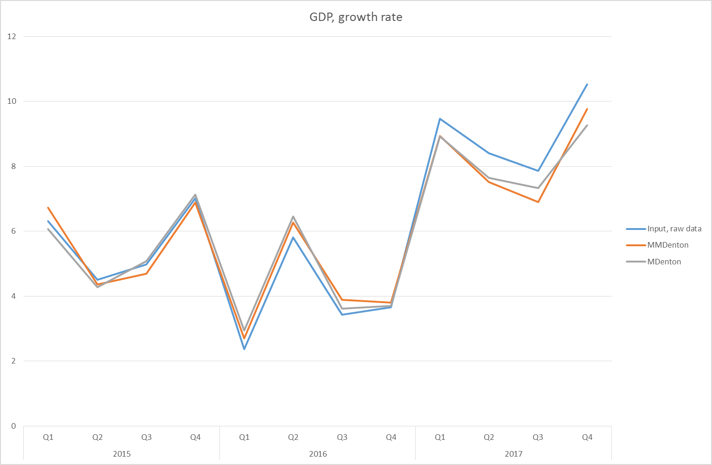
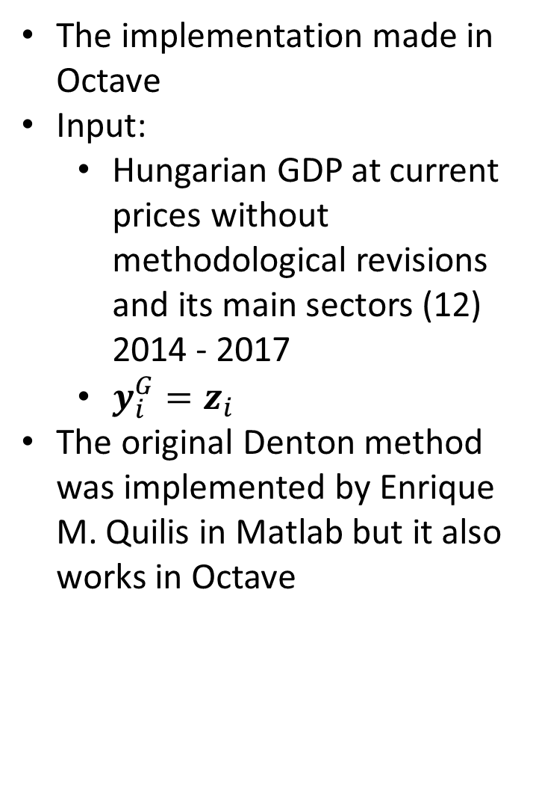
First test results
The implementation made in Octave
Input:
  Hungarian GDP at current prices without methodological revisions and its main sectors (12)
  2014 - 2017
  $y_{i}^{G}=z_{i}$
The original Denton method was implemented by Enrique M. Quilis in Matlab but it also works in Octave

Slide 9
First test results (2)
Input : 3 random AR(1) processes and their sum.
At Run 0 reconciliation was made by Original Multivariate Denton method in 5 years data.
Every other runs were made by original and Multiobjective Multivariate Denton method with one extra year.
The RMSE of the revisions have been calculated.

Slide 10
Future research and developments
More tests of the existing implementation
Extra conditions
  Non negativity conditions for the original variable
  Conditions for acceptable Pareto-optimal solutions
Any other idea?

Slide 11
Thank you for your attention!

