Slide 1
Quality of Multisource Statistics
NTTS 2019
STS07
Walter J. Radermacher

Slide 2
STS07: Multisource Statistics
Assessing multisource processes: the new Total Process Error Framework
  Roberta Varriale, Fabiana Rocci & Orietta Luzi
Measuring the Quality of Multisource Statistics
  Ton de Waal, Arnout van Delden & Sander Scholtus
Functional geographies through the R package LabourMarketAreas
  Daniela Ichim & Luisa Franconi
Predictive performance of a hybrid technique for the multiple imputation of survey data
  Humera Razzak & Christian Heumann

Slide 3
Real life questions concerning statistical quality
Are the results of the population census correct?
  In a lawsuit, the Federal Constitutional Court of Germany deals with the complaint of some local authorities and municipalities, which cast doubt on the results of the ‘Census 2011’
Have inequalities in our societies worsened?
  The statistical coverage of the material aspects of inequalities is linked to the distributions of income, consumption and wealth. There are however some gaps in the official statistics in this respect
Are Greek statistics on GDP and public finances correct?
  Greek public deficit figures for 2009 were problematic, with the forecasts of the deficit to GDP ratio having to be increased from an initial 3.7% to a final 12.5%. In April 2010, the first statistical estimate of the actual outcome increased the ratio to 13.6%. Ultimately a revised estimate of 15.4% was submitted to and published by Eurostat in November 2010.

Slide 4
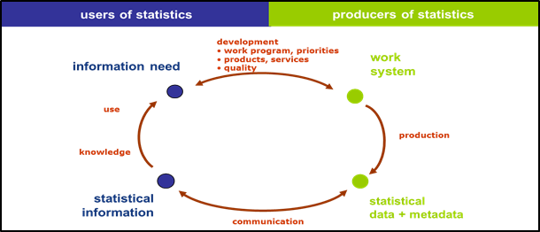
Knowledge generation and statistical production

Slide 5

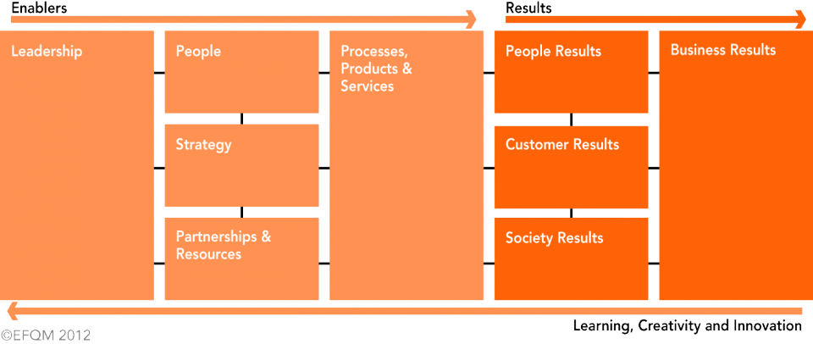
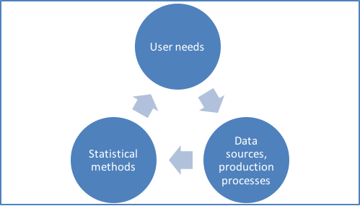
Quality management

Slide 6
Quality criteria for European statistics: Code of Practice
Institutional environment | Statistical processes | Statistical output
Professional independence Coordination and cooperation Mandate for data collection Adequacy of resources Commitment to quality Statistical confidentiality Impartiality and objectivity | Sound methodology Appropriate statistical procedures Non-excessive burden on respondents Cost-effectiveness | Relevance Accuracy and reliability Timeliness and punctuality Coherence and comparability Accessibility and clarity

Slide 7
Statistical programme, classic
Admin Data
Census
t
Census t+10
Survey Data
Quality
(and Cost)

Slide 8
Statistical programme, msmm
Quality, Cost

Slide 9
Source | Strenght | Weakness | Opportunity | Threat
Survey | Control, scientific design, neutrality, micro data | Partial, costly, time-consuming, response burden | Focussed surveys, quality assurance, small area estimation | Pressure from all sides, concerning costs, time and burden
Admin/ Register | Availablilty, low costs, broad coverage | Dominance by admin owner, comparability, | First pillar in msmm design | Too dominant undermining statistics’ role + quality
Geo / Big Data | Availability, timeliness | Dominance by others, private owners, costs, privacy | Growing importance for selected areas | Data ≠ Info not understood by politicians
Accounting | Macro, full coverage, consistency | Quality in details and breakdowns | Framing the programme, complex indicators | Too complex, communication of indicators

Slide 10

GSBPM Generic Statistical Business Process Model

Slide 11
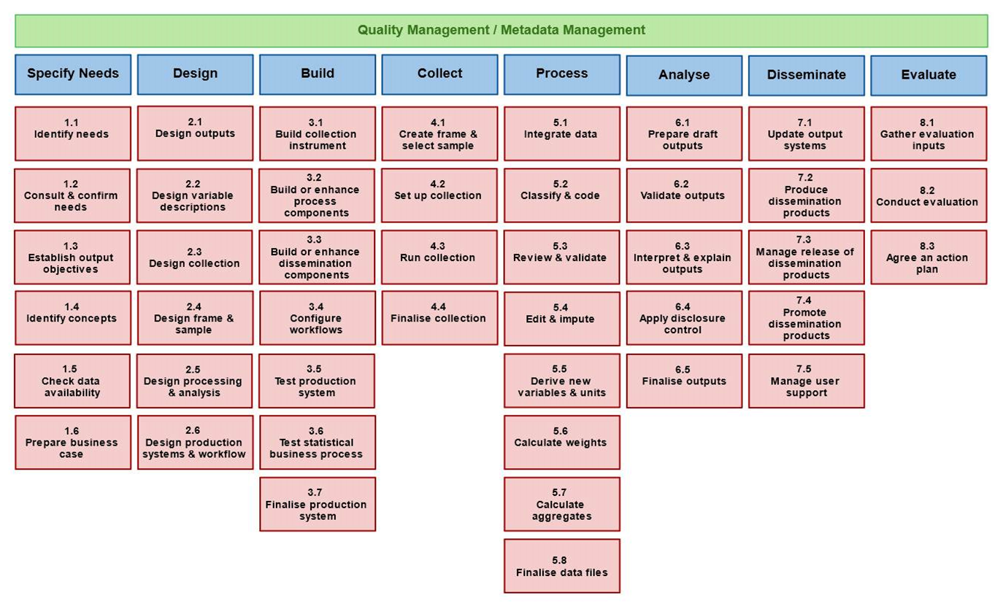
GSBPM

Slide 12
What could the future bring?
Quality definition, measurement and assurance in a msmm design
Review/revision of the Code of Practice
Survey methodologies applied to the new role of surveys
New methods of inference and generation of solid estimates for policy relevant indicators (e.g. small area estimation)
Cooperation crossing disciplines (amongst others geo and data sciences)
Survey methodologists as scientific advisor in the metamorphosis of programme design and production of msmm-statistics
Survey methods used for market research and communication of quality

Slide 13

Thank you
wjr@outlook.de

