Slide 1
Open data sources for retrieving information on multinational enterprise groups
  Conference on New Technologies for official Statistics
  Brussels, 12-14 March 2019

Slide 2
  Content
What is EuroGroups Register (EGR)
Short overview of DBpedia
Feasibility study objectives
Results for proof of concept
  Coverage
  Completeness
  Accuracy
  Timelines
Conclusions

Slide 3
What is EGR?
The EuroGroups Register (EGR) is a statistical business register of multinational enterprise groups in the EU Member States and in the EFTA countries
    coverage: multinational groups present in Europe, their constituent enterprises and legal units
    the EGR process is in operation since 2009
  For statistical use only
  Restricted use in national statistical offices and national central banks of EU and EFTA countries

Slide 4
Information needed for statistical representation
Legal units
  Unique identifiers
Relationships: ownership shares / voting rights
  LEU A controls LEU B with x% voting rights
Enterprises
  Economic characteristics (turnover, employment)
  Links to legal units
Groups
  Group characteristics (turnover, employment)
  Global decision centre

Slide 5
Statistical representation
As a complete structure of legal units and their controlling relationships and the economic enterprises
Enterprise 1
Head
LEU A
Enterprise Group
LEU B
LEU F
LEU G
Enterprise 4
LEU C
LEU D
LEU H
LEU I
Enterprise 2
LEU E
LEU J
LEU K
Enterprise 3
Enterprise 5

Slide 6
EGR 2.0 process overview
CDP
EGR
NSI
Identification service
Identification of legal units
Commercial data provider – CDP (LEU,REL)
Processing NSI and commercial data
NSI data (LEU, REL, ENT)
Consult and update preliminary frame and GEG data
Initial and preliminary frames
Final frame
6

Slide 7
Problem statement
The European part of the legal units, enterprises and enterprise groups are well-covered by EGR, but there is missing data for units outside of the EU and EFTA as well as for attributes on the group level.
Web crawling and different open data projects are seen as further opportunities to increase the quality of the EGR, its completeness and accuracy.

Slide 8

  DBpedia
  « global and unified access to knowledge »
  Started in 2008 as community effort for semi-automatic knowledge extraction from Wikipedia
  One of the most successful open knowledge graphs (OKG)
  working on https://databus.dbpedia.org
    Shared effort on KG Governance, Integration, Collaboration, Curation ...
    Pushes societal value and data economy
    Maven with Git-for-data and persistent identifiers

Slide 9
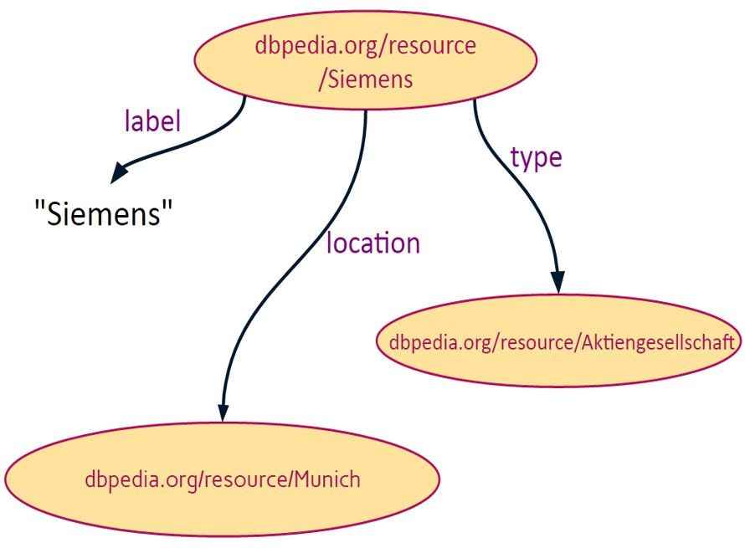
  DBpedia Extraction Framework
  Open source software which extracts structured semantic data (RDF) from Wikipedia (infoboxes) in order to make it publicly available as OKG
    Execute sophisticated queries against Wikipedia data
    Link different datasets to Wiki/DBpedia resources
Example RDF Data for Siemens AG

Slide 10
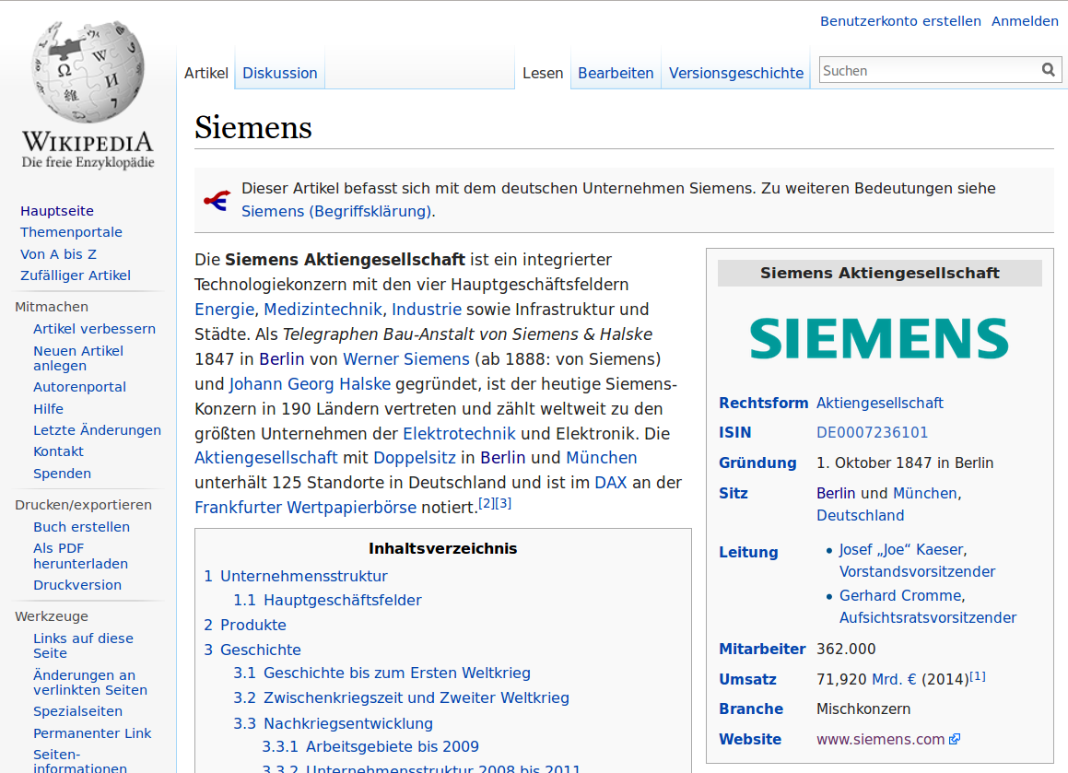
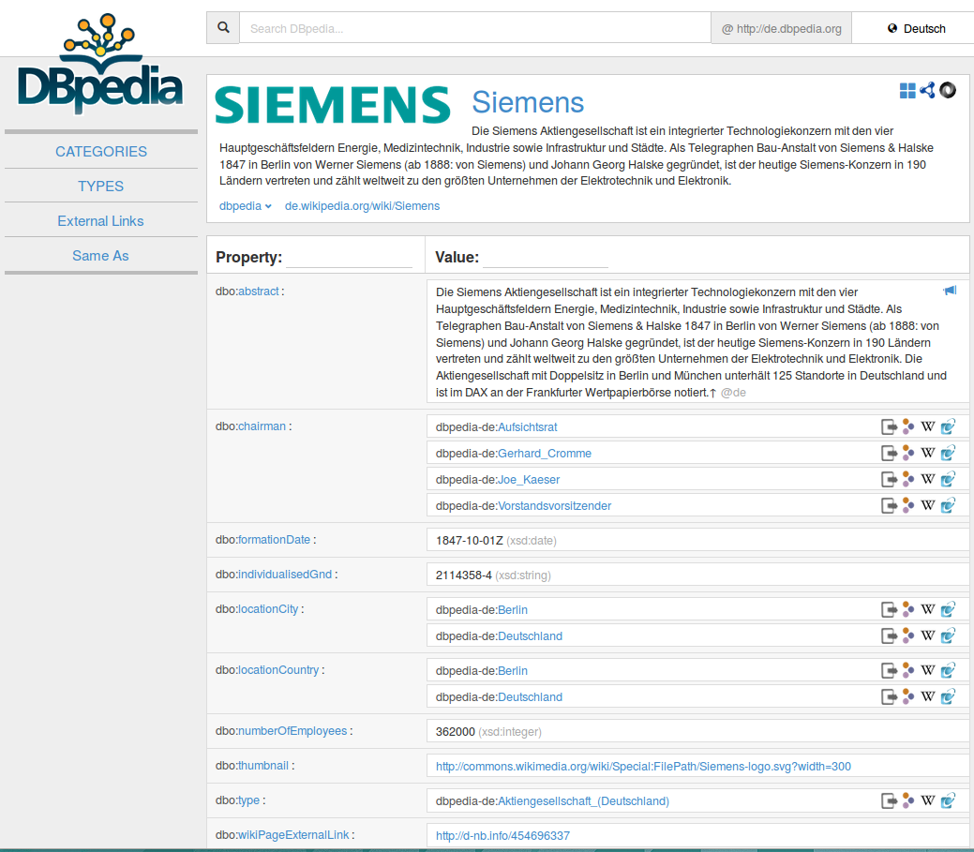
  Wikipedia Knowledge Extraction
  project that extracts structured data from Wikipedia (infoboxes) in order to make it publicly available
    Execute sophisticated queries against Wikipedia data
    Link different datasets to Wikipedia data

Slide 11
  Feasibility study objectives
  The project goal was to create an interface that handles a list of groups names and returns a list of results with information on aggregate numbers for those groups.
  The contractor, Leipzig University, was provided with a population of 73 group names in order to design an interface that fetches search results from DBpedia.

Slide 12
  Proof of Concept Results
  This Proof of Concept focused on validating the following indicators:
  Coverage – number of successful matched enterprise group names
  Completeness – number of received values for the different attributes
  Accuracy – quality of the returned values when compared to annual report data
  Timelines – availability of data for certain reference period based on EGR cycle

Slide 13
  Coverage 2016
  The searches carried out during the testing phase proved that 70 of 73 groups could be found in DBpedia.
  The group names used were taken from a data set received from Dun and Bradstreet covering a selection of 3000 groups addressing groups size and geographical location diversity.

Slide 14
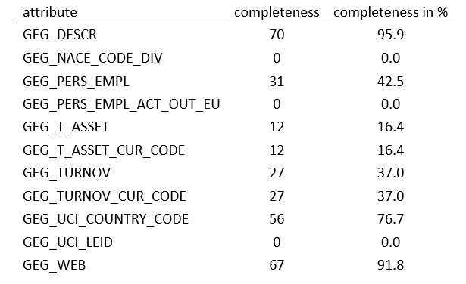
  Completeness 2016

Slide 15
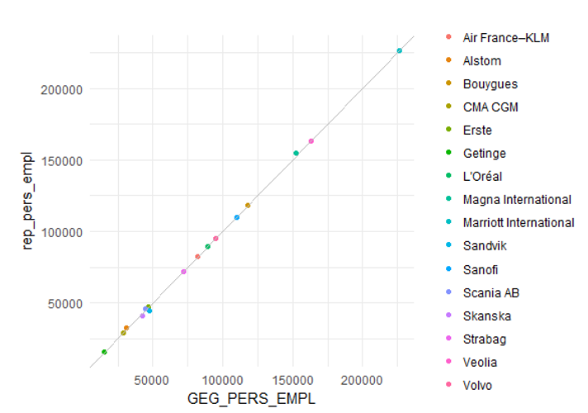
  Accuracy 2016: Employees

Slide 16
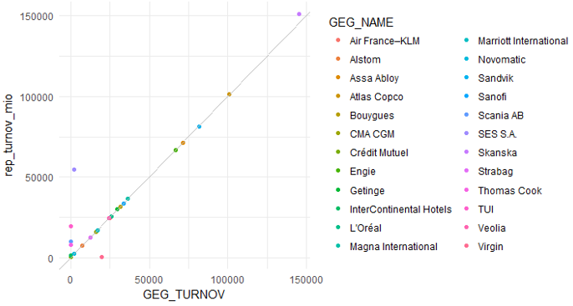
  Accuracy 2016: Turnover

Slide 17
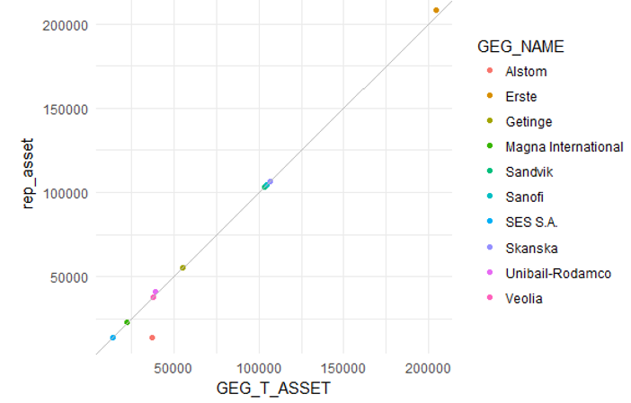
  Accuracy 2016: Assets

Slide 18
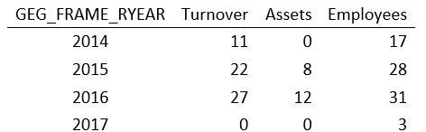
  Timelines: Coverage 2014 - 2017
The interface includes a historical mode that allows to retrieve data on enterprise groups even if Wikipedia data has already been updated with new data.
Due to the delay with which the EGR provides data on enterprise groups this feature is essential

Slide 19
  Conclusions
The results from the feasibility study did not managed to achieve complete automation. Further steps in a prototype phase will test the possibility of making cross reference links between EGR and DBpedia in the context of automation.
The highest percentage of data coverage achieved was for persons employed attribute - still below 50% (42.5%), for turnover it is 37.0% and for assets 16.4%.
The retrieved data on the three parameters showed high accuracy when compared to the figures published by the groups on their websites.

Slide 20
  Thank you!

Slide 21
  DBpedia Information and contact
  https://wiki.dbpedia.org/
  hellmann@informatik.uni-leipzig.de

