Slide 1
Estimation of measurement errors in social survey
Tho Nguyen
Supervisor: Prof. Geert Molenberghs
Co-supervisor: Laurent Van Belle

Slide 2
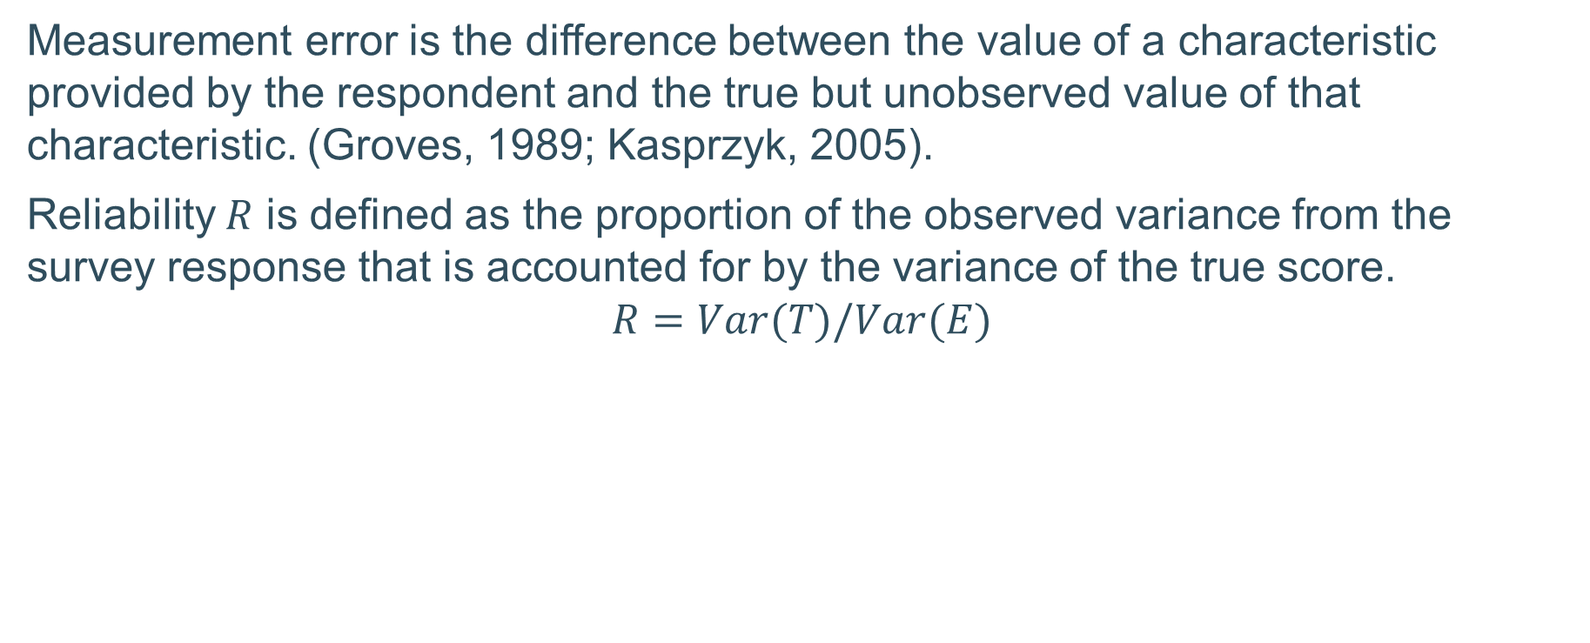
Definition
Measurement error is the difference between the value of a characteristic provided by the respondent and the true but unobserved value of that characteristic. (Groves, 1989; Kasprzyk, 2005).
Reliability $R$ is defined as the proportion of the observed variance from the survey response that is accounted for by the variance of the true score.
$$R=Var(T)/Var(E)$$
Notes:
Social survey data are often collected through human interaction, which is prone to error. The data is collected with the assumption that the characteristics and concepts being measured may be precisely defined, and can be obtained through a set of well-defined procedures, and have true scores independent of the survey.
If a survey variable is unreliable, the statistical inferences obtained using that variable is in turn also untrustworthy. Thus, before the data of a survey variable can be used, the estimation of the reliability of that variable is necessary.

Slide 3
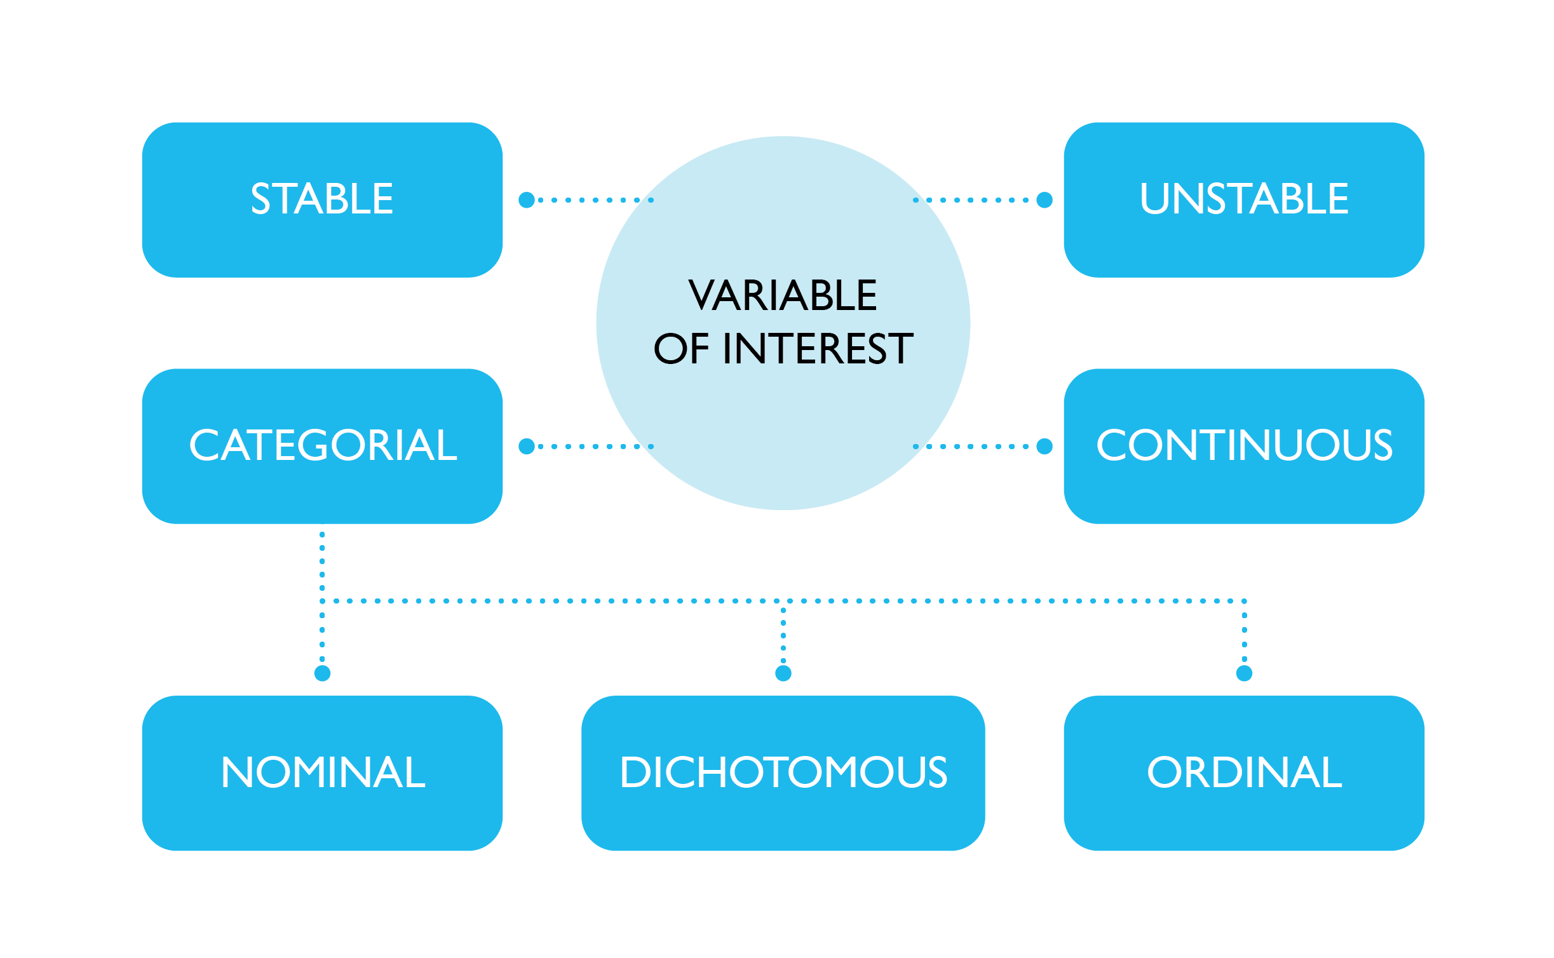
Variable classifications
Notes:
Social survey data are often collected through human interaction, which is prone to error. The data is collected with the assumption that the characteristics and concepts being measured may be precisely defined, and can be obtained through a set of well-defined procedures, and have true scores independent of the survey.
If a survey variable is unreliable, the statistical inferences obtained using that variable is in turn also untrustworthy. Thus, before the data of a survey variable can be used, the estimation of the reliability of that variable is necessary.

Slide 4
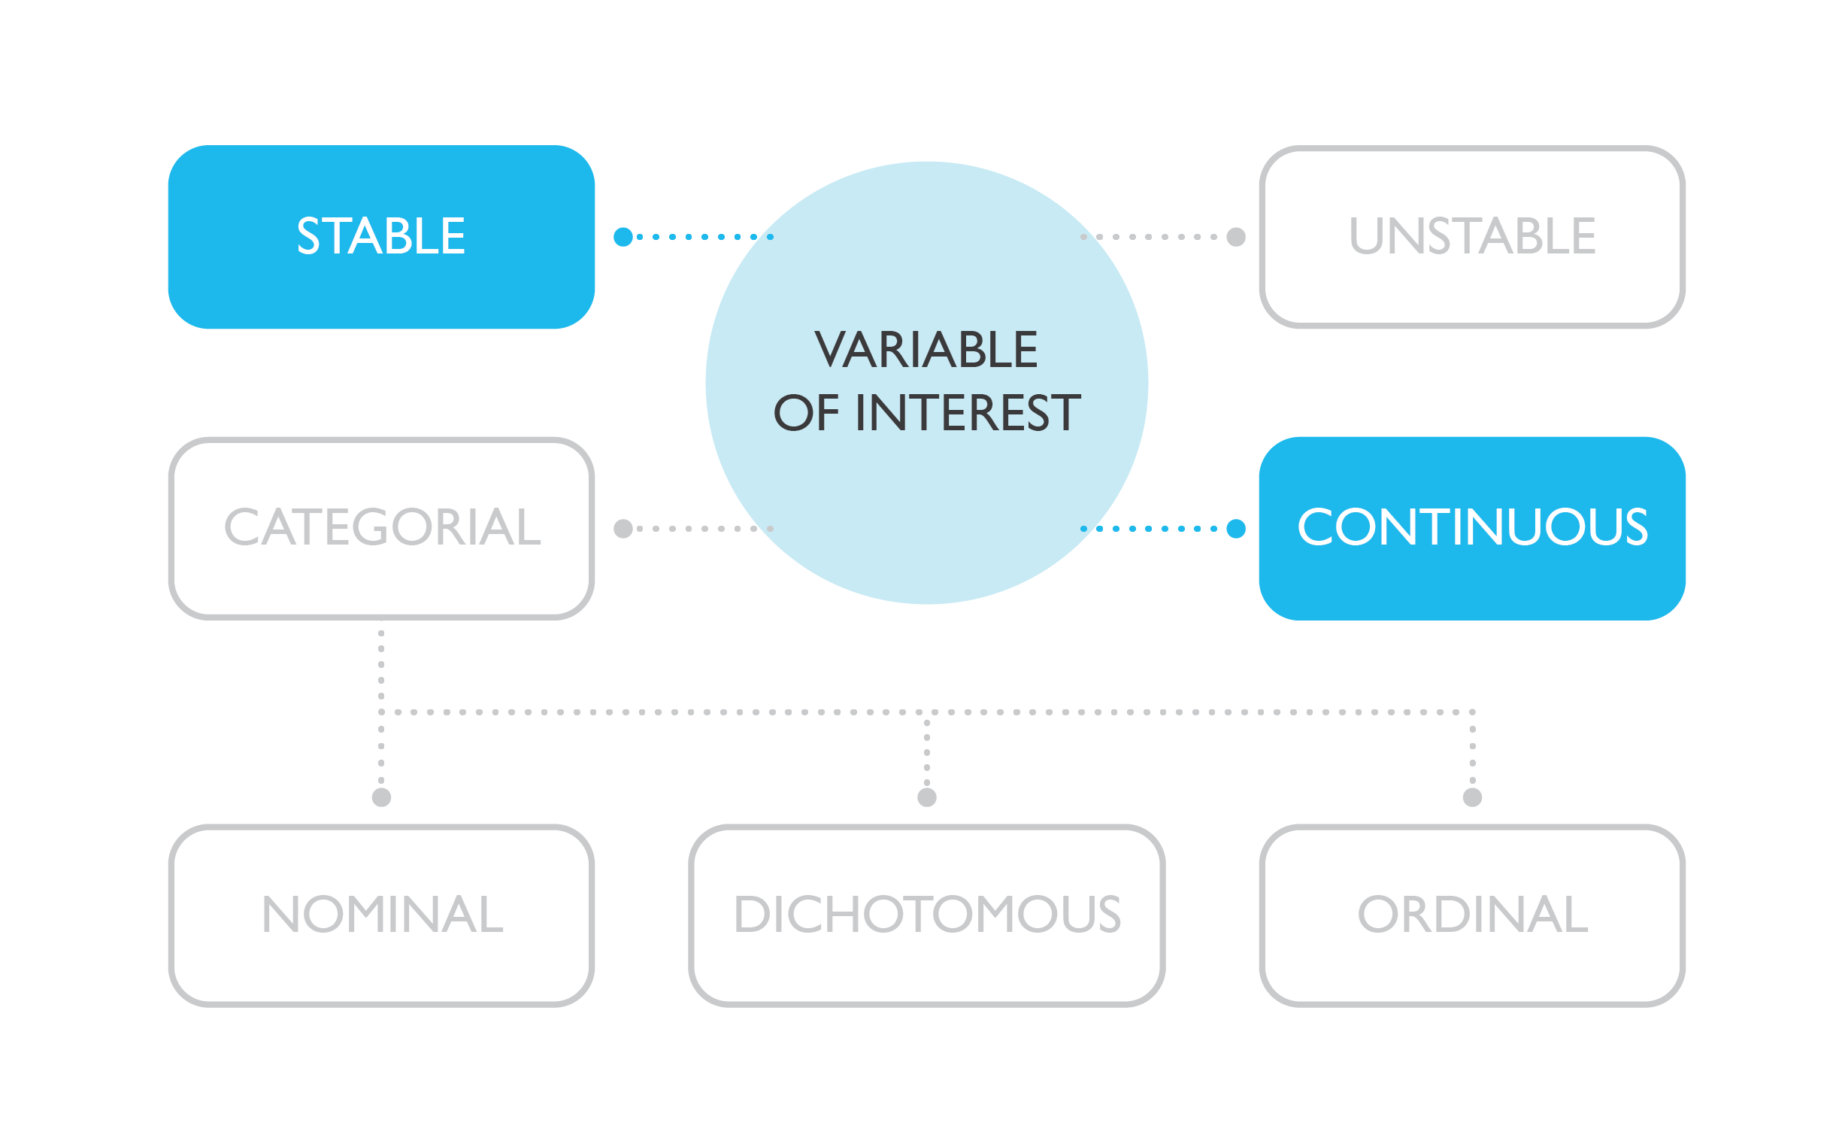

Slide 5
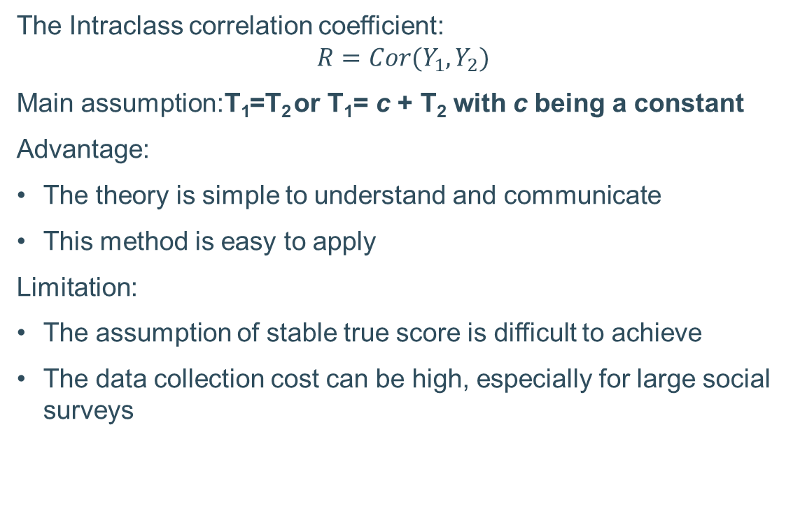
Stable continuous variables
The Intraclass correlation coefficient:
$$R=Cor(Y_{1},Y_{2})$$
Main assumption:T₁=T₂ or T₁= c + T₂ with c being a constant
Advantage:
The theory is simple to understand and communicate
This method is easy to apply
Limitation:
The assumption of stable true score is difficult to achieve
The data collection cost can be high, especially for large social surveys

Slide 6
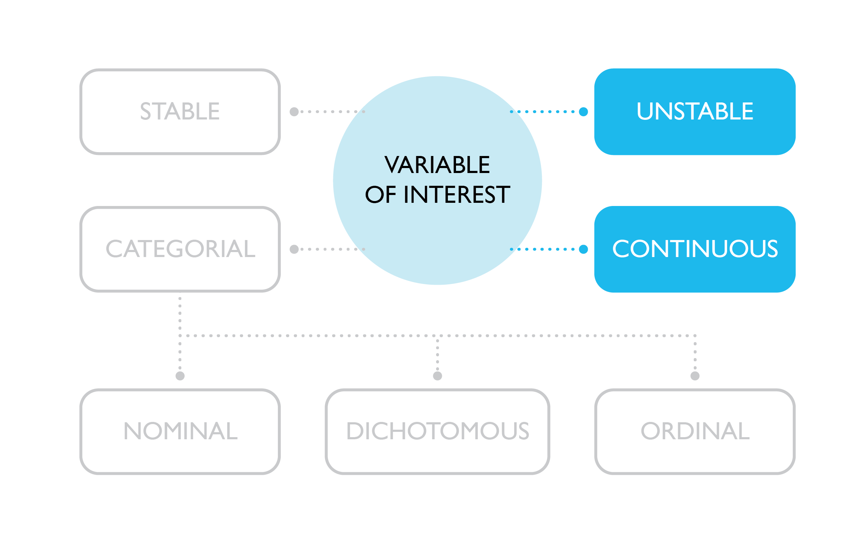

Slide 7
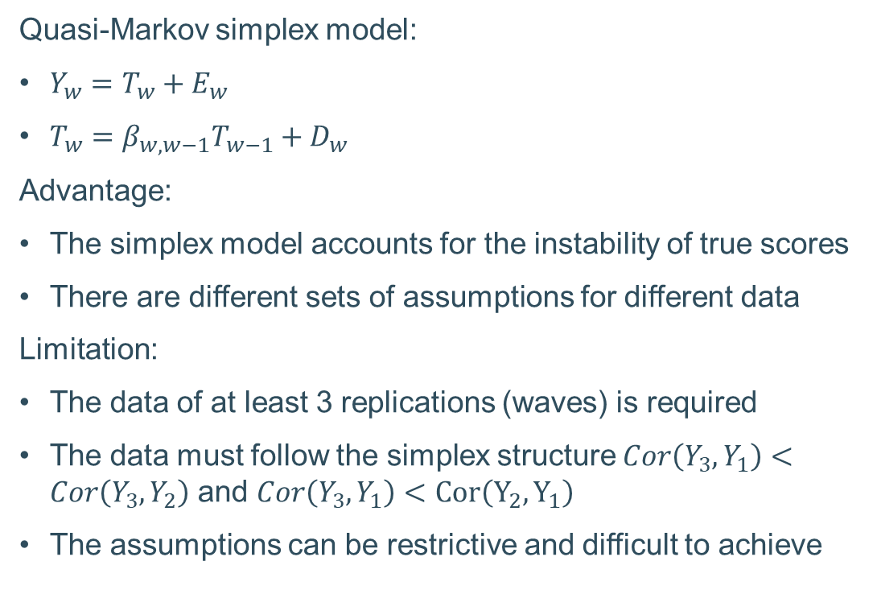
Unstable continuous variables
Quasi-Markov simplex model:
$Y_{w}=T_{w}+E_{w}$
$T_{w}=β_{w,w−1}T_{w−1}+D_{w}$
Advantage:
The simplex model accounts for the instability of true scores
There are different sets of assumptions for different data
Limitation:
The data of at least 3 replications (waves) is required
The data must follow the simplex structure $Cor\left(Y_{3},Y_{1}\right)<Cor\left(Y_{3},Y_{2}\right)$ and $Cor\left(Y_{3},Y_{1}\right)<Cor\left(Y_{2},Y_{1}\right)$
The assumptions can be restrictive and difficult to achieve

Slide 8
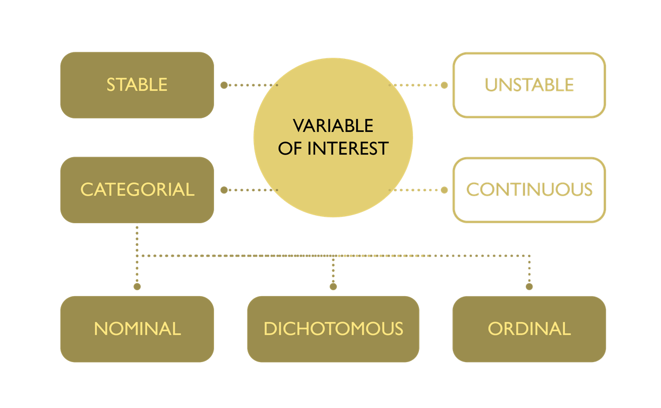

Slide 9
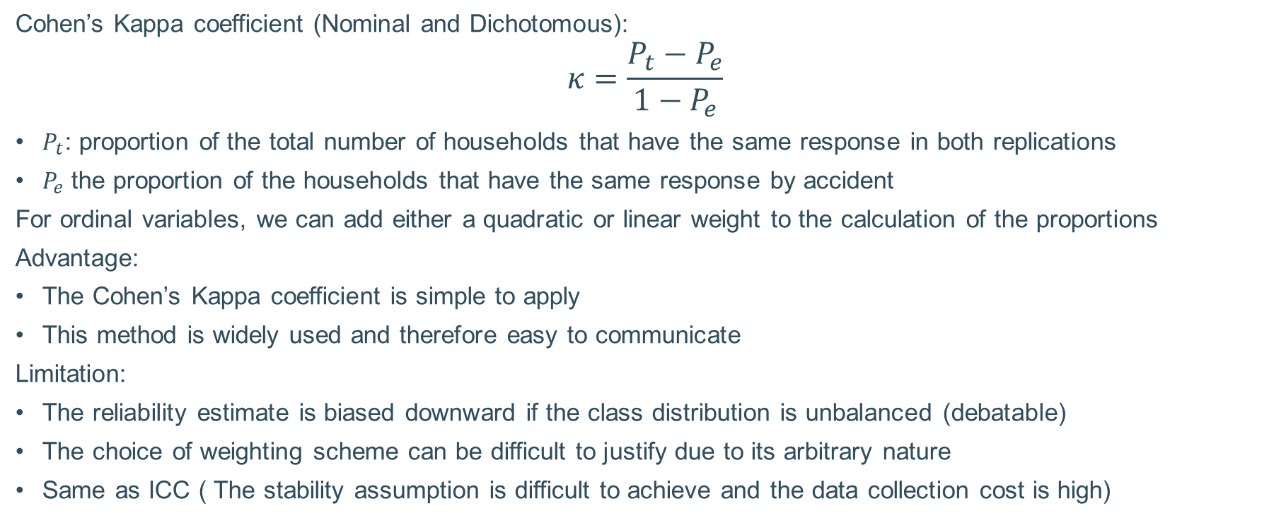
Stable categorical variables
Cohen’s Kappa coefficient (Nominal and Dichotomous):
$$κ=\frac{P_{t}−P_{e}}{1−P_{e}}$$
$P_{t}$: proportion of the total number of households that have the same response in both replications
$P_{e}$ the proportion of the households that have the same response by accident
For ordinal variables, we can add either a quadratic or linear weight to the calculation of the proportions
Advantage:
The Cohen’s Kappa coefficient is simple to apply
This method is widely used and therefore easy to communicate
Limitation:
The reliability estimate is biased downward if the class distribution is unbalanced (debatable)
The choice of weighting scheme can be difficult to justify due to its arbitrary nature
Same as ICC ( The stability assumption is difficult to achieve and the data collection cost is high)
Notes:
As shown by Kramer in “Ramifications of a population model for κ as a coefficient of reliability”, the kappa coefficient is a reliability coefficient.
The kappa coefficient also require the stability assumption for the true scores of respondents.

Slide 10
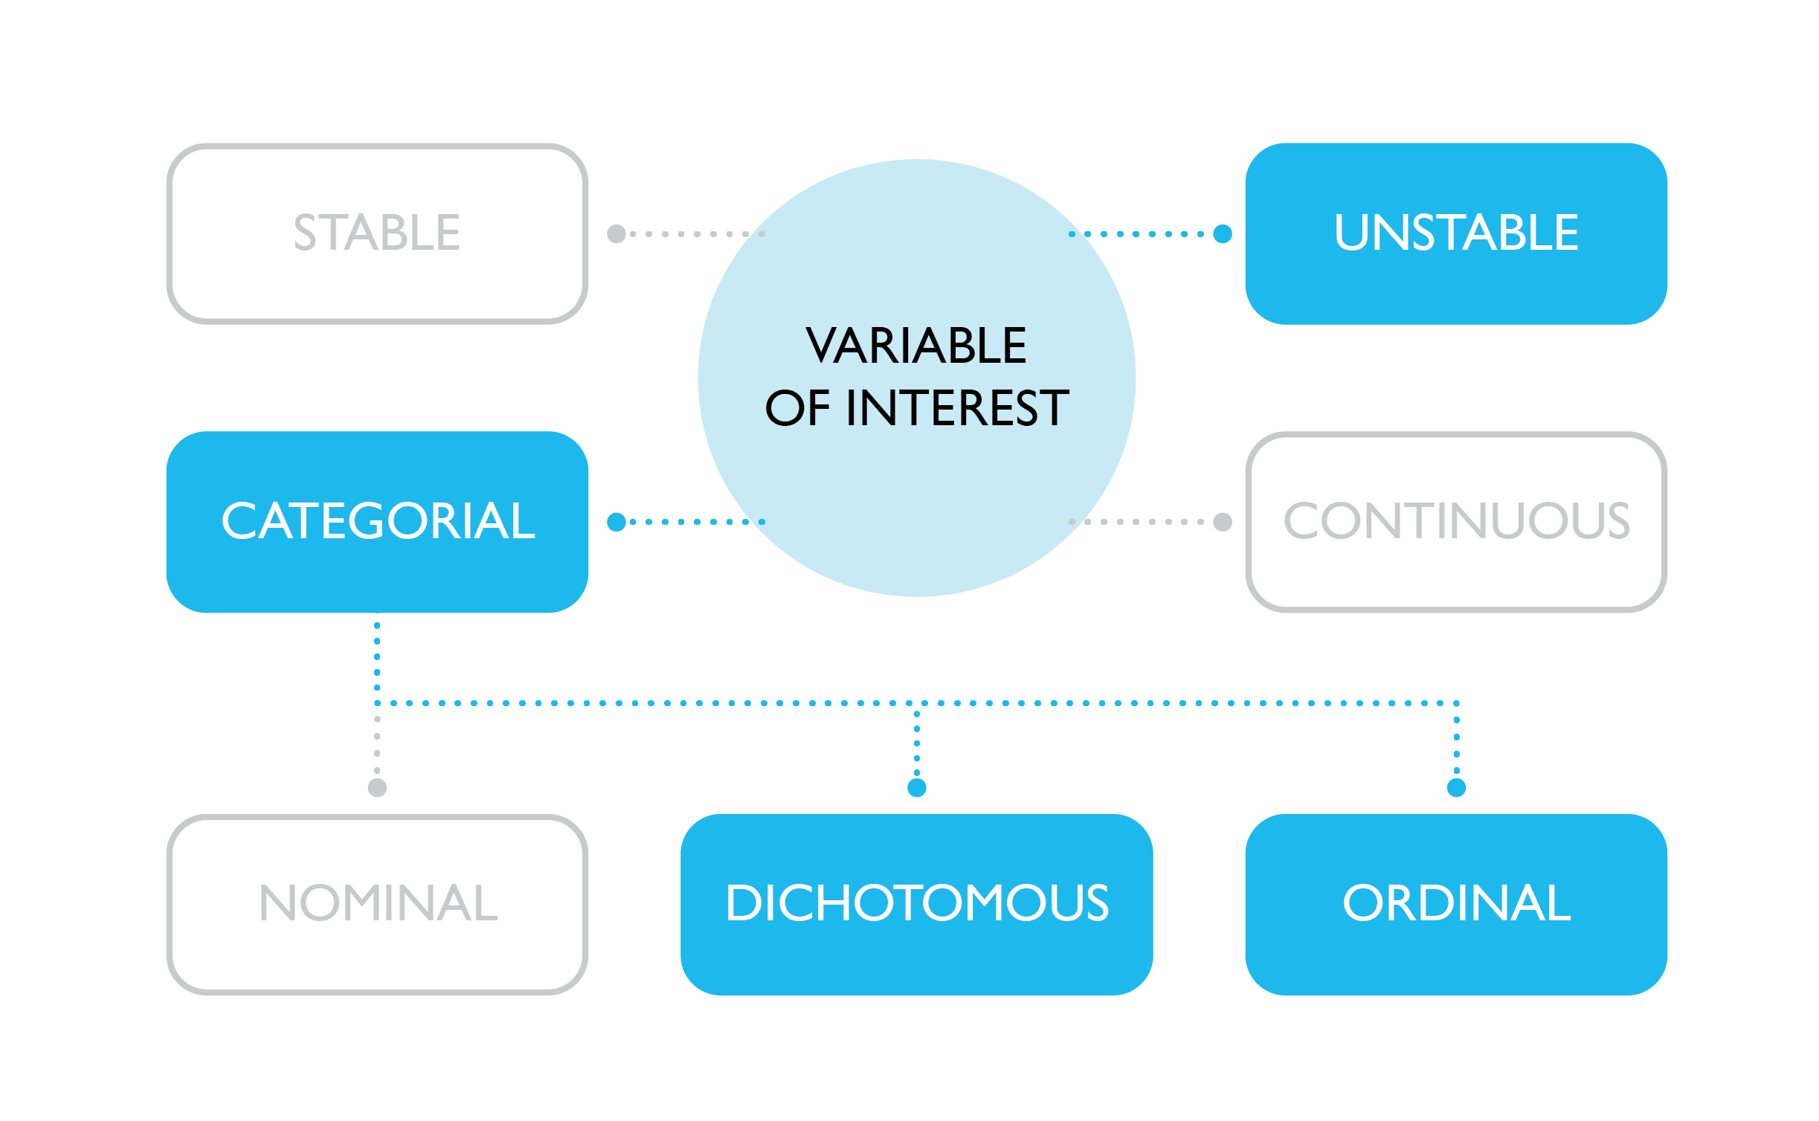

Slide 11
Unstable ordinal and dichotomous variables
Quasi-Markov simplex model
Continuous
Ordinal
Quasi-Markov simplex model for categorical variables:
Dichotomous variables: Tetrachoric correlation
  Nominal variables: Possible after transforming a nominal variable into multiple dichotomous variables
Ordinal variables: Polychoric correlation
Advantage:
Same advantages ad the continuous case
Disadvantage:
This method assumes an underlying continuous variable of interest being measured by these categorical variables, which may not be true
Same limitations as the continuous case
Comparison of continuous and ordinal measures of continuous latent variables (Alwin, Margins of error, 2007).
Notes:
e.g. Education level is used to measure the continuous latent variable “years of education”.

Slide 12
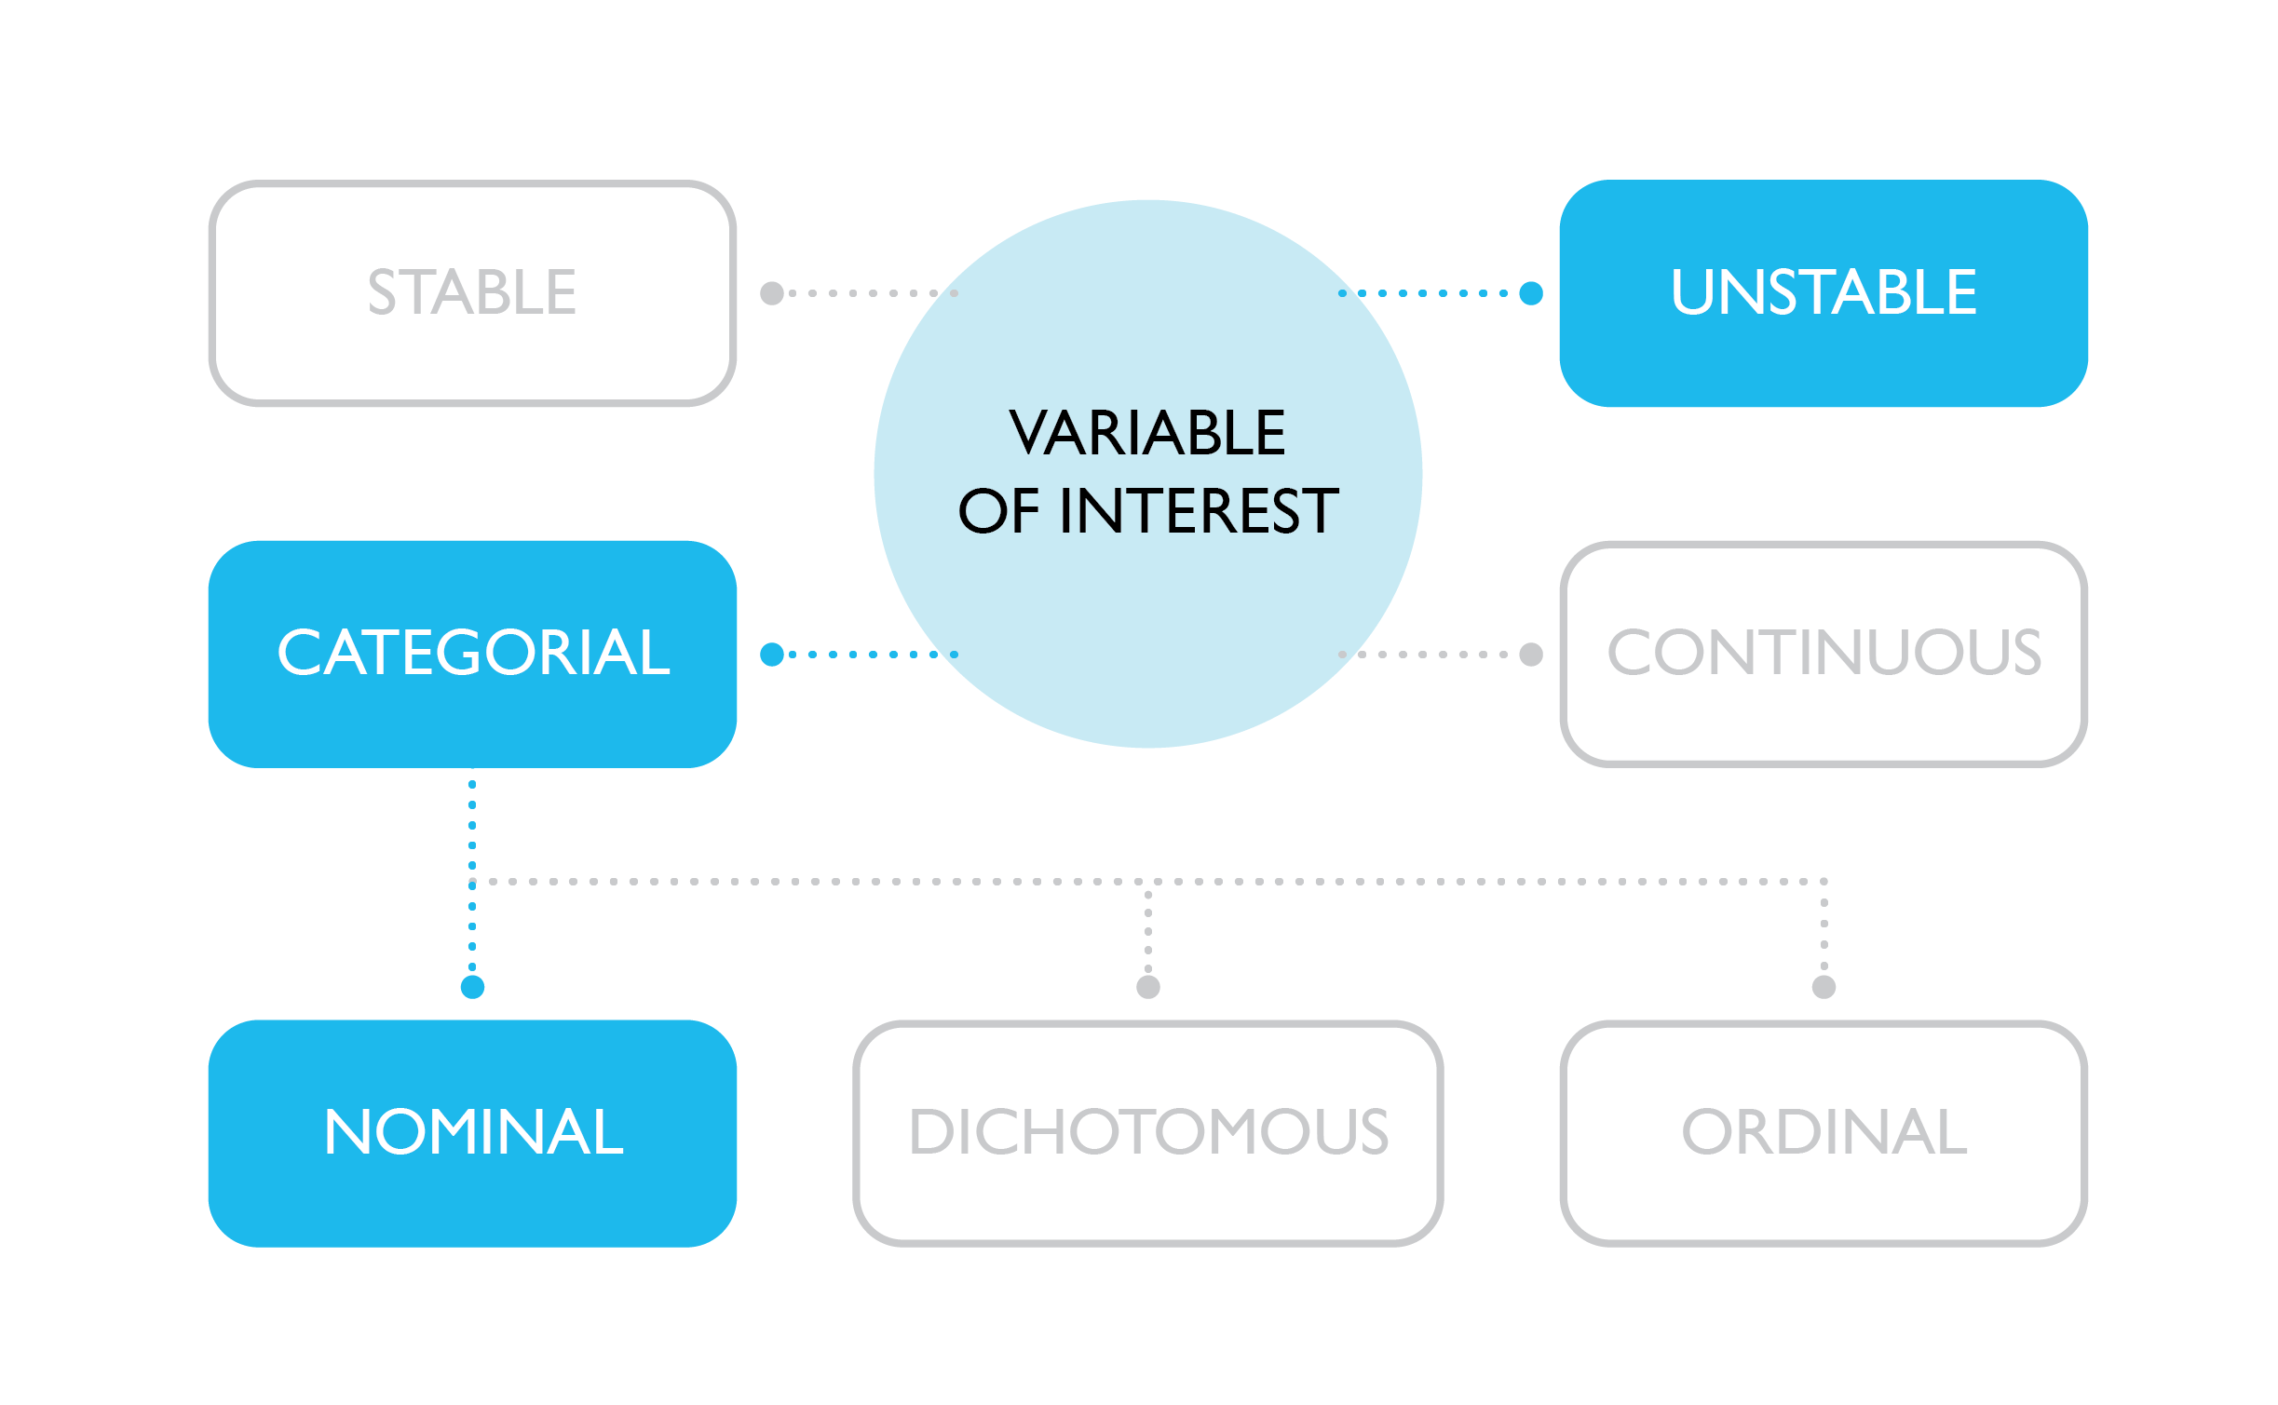

Slide 13
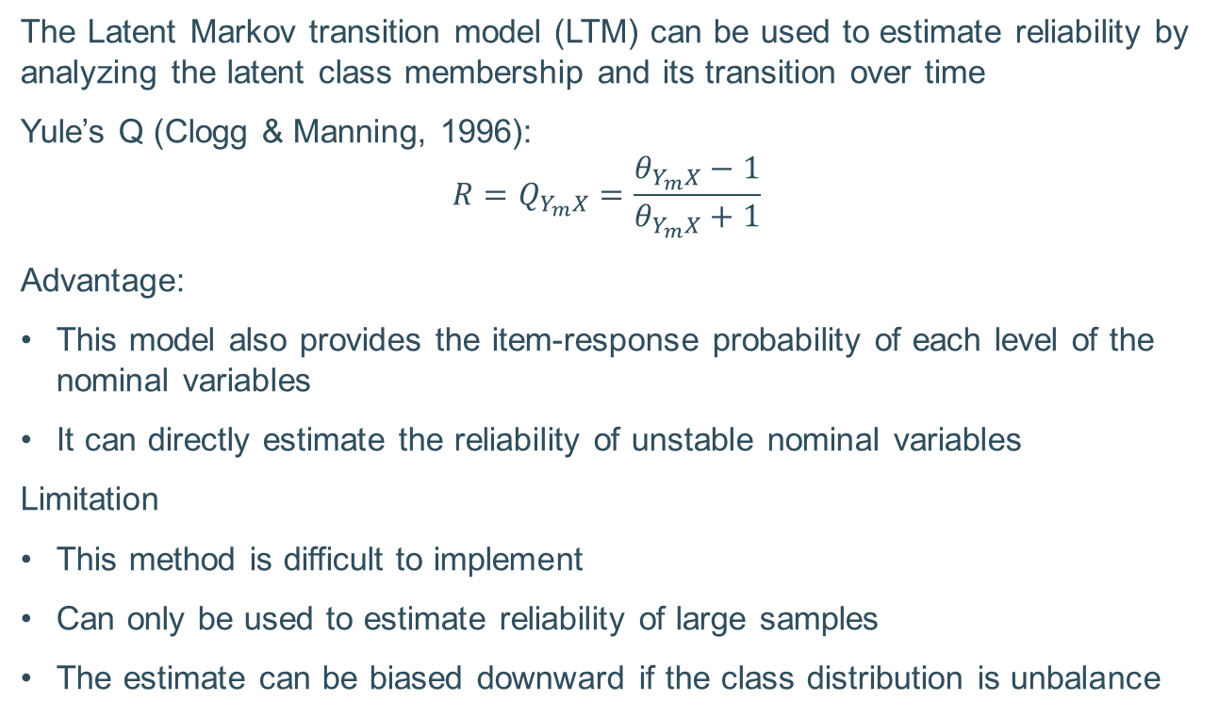
Unstable nominal variables
Latent transition model
The Latent Markov transition model (LTM) can be used to estimate reliability by analyzing the latent class membership and its transition over time
Yule’s Q (Clogg & Manning, 1996):
$${R=Q}_{Y_{m}X}=\frac{θ_{Y_{m}X}−1}{θ_{Y_{m}X}+1}$$
Advantage:
This model also provides the item-response probability of each level of the nominal variables
It can directly estimate the reliability of unstable nominal variables
Limitation
This method is difficult to implement
Can only be used to estimate reliability of large samples
The estimate can be biased downward if the class distribution is unbalance
Notes:
For model identification with only 3 waves in the survey data, the assumptions of homogeneity of the transition probabilities and equality of reliabilities over time are required (Alwin, 2007; Wiggins, 1973). The first assumption is equivalent to$Π_{X_{2}X_{1}}=Π_{X_{3}X_{2}}$, and the second assumption requires$Π_{Y_{1}X_{1}}=Π_{Y_{2}X_{2}}=Π_{Y_{3}X_{3}}$.

Slide 14
Summary
Type of variable |  | Stable variable | Unstable variable
Continuous |  | Intraclass correlation coefficient (1,1) | Quasi-Markov simplex model with Pearson correlation/covariance matrix
Categorical | Nominal | Cohen's Kappa coefficient OR Latent class model | Quasi-Markov simplex model with Tetrachoric correlation on dummy variables OR Latent transition model
 | Dichotomous | Cohen's Kappa coefficient OR Latent class model | Quasi-Markov simplex model with Tetrachoric correlation
 | Ordinal | Weighted Kappa coefficient OR Weighted Latent class model | Quasi-Markov simplex model with Polychoric correlation

Slide 15
Appendix
Mixed model approach to reliability estimation
Under a (generalized) linear mixed model, the reliability of a variable can be estimated as the ratio of the variance explained by the model to the total observed variance.
Advantage:
The mixed model use “extra information” from the covariates to allows for better separation of measurement error from true variation
Can be used in cases where all of the aforementioned reliability estimation methods fail
The assumptions are more flexible
Disadvantage:
It is difficult to construct a theoretically sound model for a variable of interest
Each model is only suitable for a single group of variables, or even a single variable, and need to be changed for different groups/variables.
The mixed model may provide a better reliability estimation, but is difficult to apply, replicate or communicate

Slide 16
Appendix
Reliability of subpopulations
To analyze the effects of other factors on the reliability of a variable:
Identify factors that might affect the reliability of a variable of interest (e.g. gender, language of the interview…).
Separate the sample into subsamples according to the chosen factors
Estimate the reliability of the variable of interest for each subsample, along with its confidence interval
The confidence intervals can be used to test the hypothesis of equal reliabilities
The Bonferroni correction can be used to correct for multiple testing

