Slide 1
Measuring the Quality of Multisource Statistics
Ton de Waal
13 March, 2019

Slide 2
Overview
Komuso: ESSnet on quality of multisource statistics
Measuring output quality
Work Package 3 of Komuso
Approach taken in Work Package 3
Results of Work Package 3
Illustration of Quality Measure and Calculation Method (QMCM)

Slide 3
Komuso: ESSnet on quality of multisource statistics
Komuso is part of ESS.VIP Admin Project
  Main objectives of ESS.VIP Admin Project: (i) improve use of administrative data sources and (ii) support quality assurance of output produced using administrative sources
  Aim of Komuso: produce quality guidelines for NSIs
January 2016 – April 2017: 1st SGA of Komuso (“Preparatory work for developing quality measurements for multisource statistics”)
May 2017 – October 2018: 2nd SGA (“Quality guidelines for multisource statistics”)
October 2018 – October 2019: 3rd SGA (“Completion of quality guidelines for multisource statistics and related communication actions”)

Slide 4
Work Package 3 of Komuso
Work Package 3 focuses on measuring quality of statistical output based on multiple data sources

Slide 5
Multisource statistics
More data available
Errors become much more visible: we can (make an attempt to) correct more errors than for single-source statistics

Slide 6

Measuring output quality for multisource statistics
More data available
Errors become much more visible: we can (make an attempt to) correct more errors than for single-source statistics

Slide 7
Measuring output quality for multisource statistics
Many different situations can occur
More processing steps (e.g. record linkage step) are needed
  We want to take all processing steps into account when measuring output quality
We want to take error correction process into account

Slide 8
Measuring output quality for multisource statistics
Many different situations can occur
More processing steps (e.g. record linkage step) are needed
  We want to take all processing steps into account when measuring output quality
We want to take error correction process into account
Measuring output quality for multisource statistics is very complicated

Slide 9

Measuring output quality for multisource statistics
Many different situations can occur
More processing steps (e.g. record linkage step) are needed
  We want to take all processing steps into account when measuring output quality
We want to take error correction process into account
Measuring output quality for multisource statistics is very complicated

Slide 10
Approach taken in WP 3
We have subdivided the work into three steps:
We carry out a literature review or suitability test
  In literature review we study and describe existing quality measures/indicators and recipes to compute them
  In suitability test we also test quality measures/indicators and recipes to compute them
We produce “Quality Measures and Calculation Methods” (QMCMs)
  QMCM is short description of quality measure/indicator and accompanying calculation recipe as well as description of situations in which quality measure/indicator and recipe can be applied
We provide hands-on examples to QMCMs

Slide 11
Results of WP 3
Thus far 23 QMCMs and 21 hands-on examples have been produced
  18 QMCMs and 16 examples for quality dimension “Accuracy”
  1 QMCM and example for “Timeliness”
  3 QMCMs and 3 examples for “Coherence”
  1 QMCM and example for “Relevance”
QMCMs for “Accuracy”:
  3 QMCMs on general quality frameworks
  6 QMCMs on sampling errors
  4 QMCMs on measurement error in target variables,
  3 QMCMs on linkage and coverage errors
  2 QMCMs on measurement error in classifying variables

Slide 12

Example of QMCM: situation
Suppose that one has linked dataset with observed variables $y_{1},…,y_{p}$ from different data sources
Underlying “true” target variables are not observed directly and are denoted by latent variables $η_{1},…,η_{m}$

Slide 13
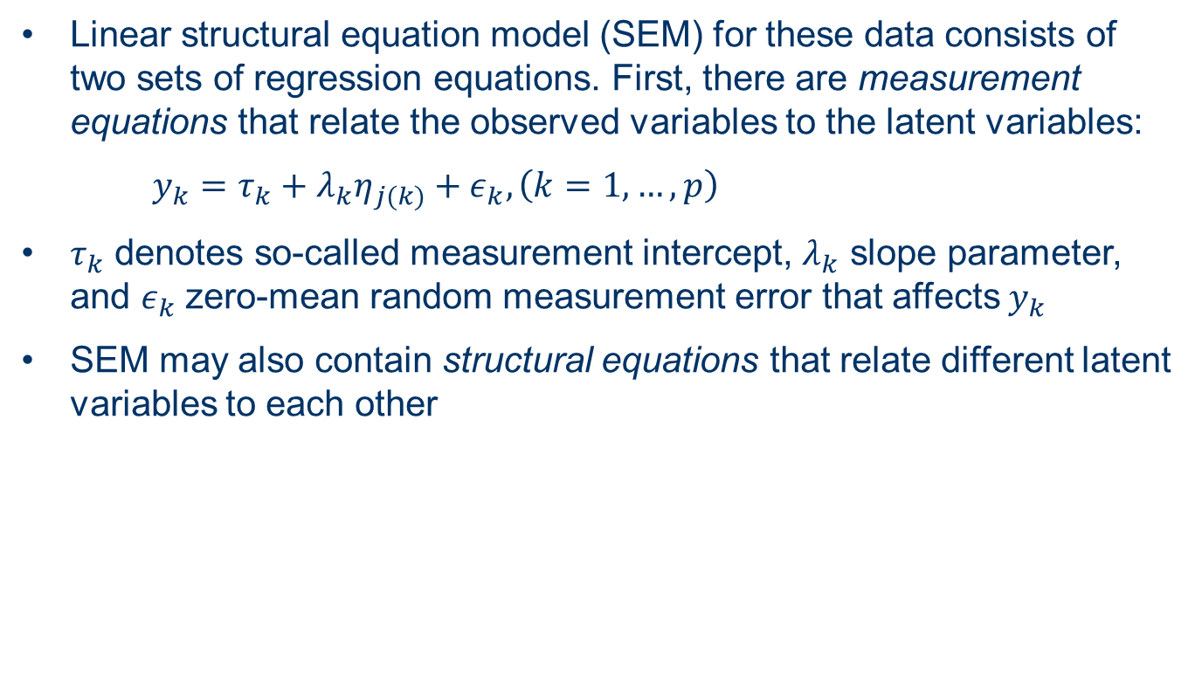
Example of QMCM: SEM models
Linear structural equation model (SEM) for these data consists of two sets of regression equations. First, there are measurement equations that relate the observed variables to the latent variables:
$y_{k}=τ_{k}+λ_{k}η_{j(k)}+ε_{k}, \left(k=1,…,p\right)$
$τ_{k}$ denotes so-called measurement intercept, $λ_{k}$ slope parameter, and $ε_{k}$ zero-mean random measurement error that affects $y_{k}$
SEM may also contain structural equations that relate different latent variables to each other

Slide 14
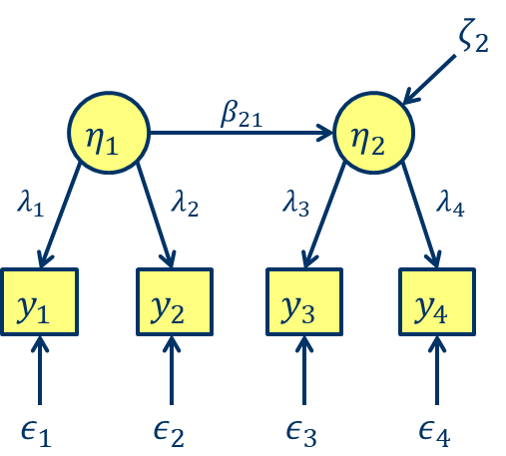
Example of QMCM: SEM models

Slide 15

Example of QMCM: SEM models
Once SEM has been estimated, validity and measurement bias of observed variables can be assessed from model parameters
Validity coefficient $VC$ of $y_{k}$ is defined as absolute value of correlation between $y_{k}$ and $η_{j(k)}$
$τ_{k}$ and $λ_{k}$ provide information about measurement bias in $y_{k}$ with respect to $η_{j(k)}$

Slide 16
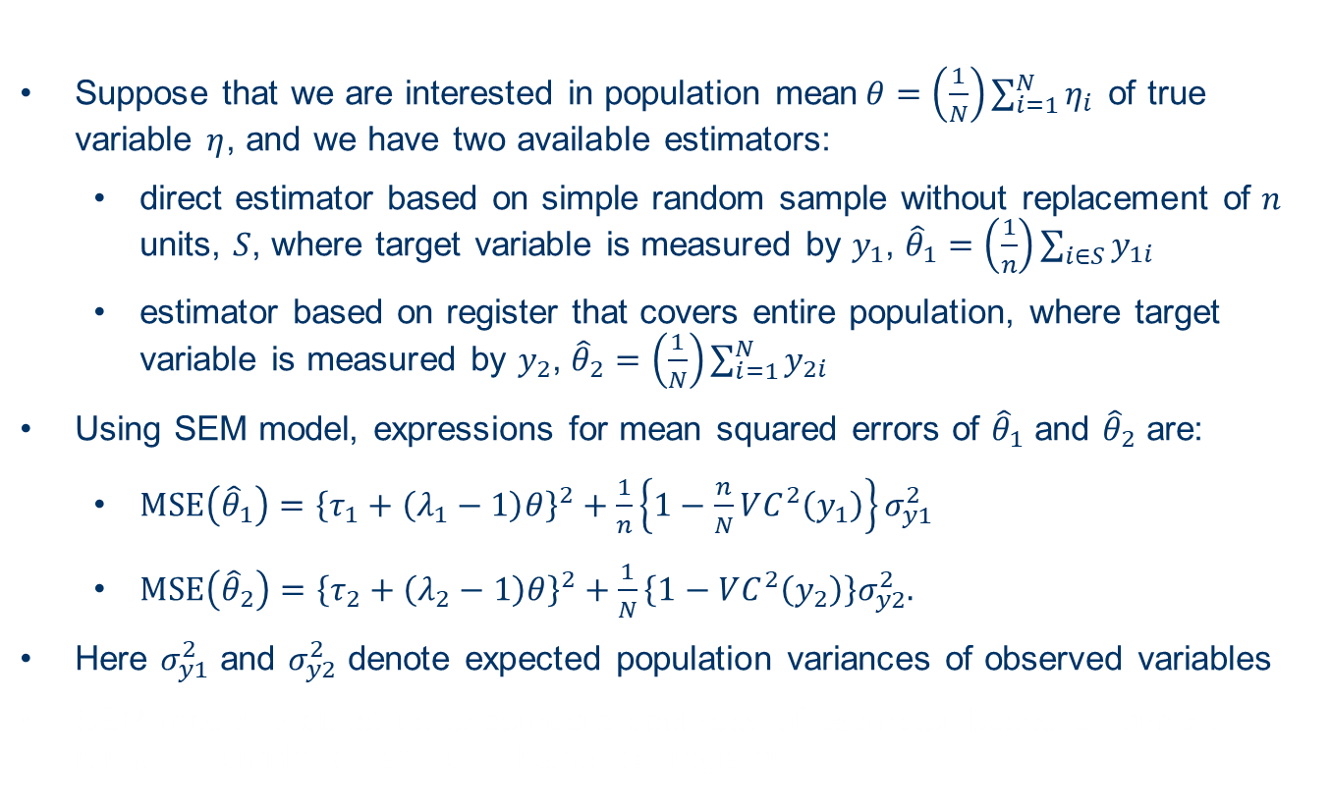
Example of QMCM: measuring output quality
Suppose that we are interested in population mean$θ=\left(\frac{1}{N}\right)\sum_{i=1}^{N}{η_{i}}$ of true variable $η$, and we have two available estimators:
  direct estimator based on simple random sample without replacement of $n$ units, $S$, where target variable is measured by $y_{1}$, ${\hat{θ}}_{1}=\left(\frac{1}{n}\right)\sum_{i∈S}{y_{1i}}$
  estimator based on register that covers entire population, where target variable is measured by $y_{2}$, ${\hat{θ}}_{2}=\left(\frac{1}{N}\right)\sum_{i=1}^{N}{y_{2i}}$
Using SEM model, expressions for mean squared errors of ${\hat{θ}}_{1}$ and ${\hat{θ}}_{2}$ are:
  $MSE\left({\hat{θ}}_{1}\right)={\left\{τ_{1}+\left(λ_{1}−1\right)θ\right\}}^{2}+\frac{1}{n}\left\{1−\frac{n}{N}VC^{2}\left(y_{1}\right)\right\}σ_{y1}^{2}$
  $MSE\left({\hat{θ}}_{2}\right)={\left\{τ_{2}+\left(λ_{2}−1\right)θ\right\}}^{2}+\frac{1}{N}\left\{1−VC^{2}\left(y_{2}\right)\right\}σ_{y2}^{2}.$
Here $σ_{y1}^{2}$ and $σ_{y2}^{2}$ denote expected population variances of observed variables
SEM model enables us to compare accuracy of estimator based on simple random sample to estimator based on register

Slide 17
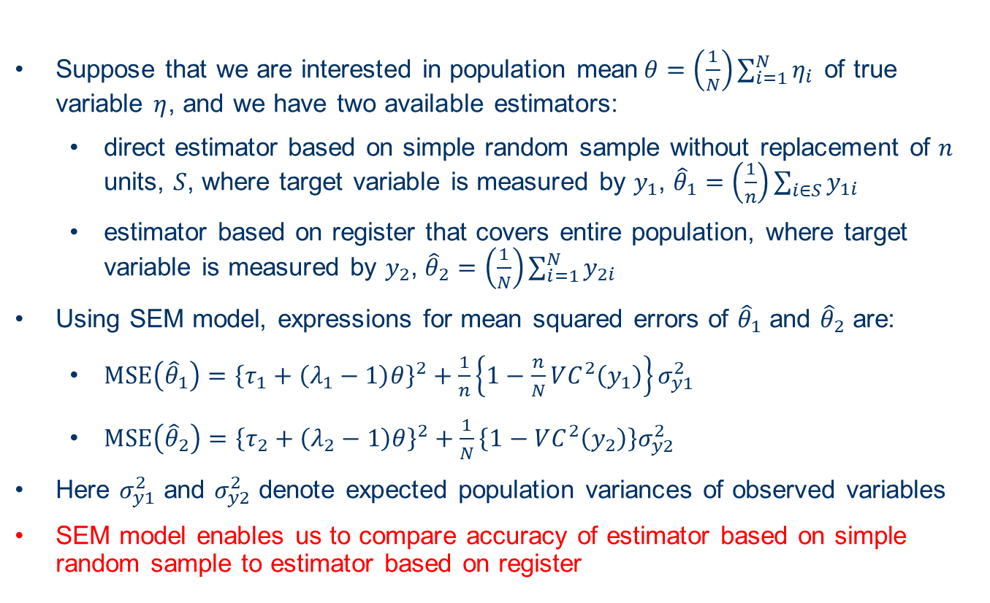
Example of QMCM: measuring output quality
Suppose that we are interested in population mean$θ=\left(\frac{1}{N}\right)\sum_{i=1}^{N}{η_{i}}$ of true variable $η$, and we have two available estimators:
  direct estimator based on simple random sample without replacement of $n$ units, $S$, where target variable is measured by $y_{1}$, ${\hat{θ}}_{1}=\left(\frac{1}{n}\right)\sum_{i∈S}{y_{1i}}$
  estimator based on register that covers entire population, where target variable is measured by $y_{2}$, ${\hat{θ}}_{2}=\left(\frac{1}{N}\right)\sum_{i=1}^{N}{y_{2i}}$
Using SEM model, expressions for mean squared errors of ${\hat{θ}}_{1}$ and ${\hat{θ}}_{2}$ are:
  $MSE\left({\hat{θ}}_{1}\right)={\left\{τ_{1}+\left(λ_{1}−1\right)θ\right\}}^{2}+\frac{1}{n}\left\{1−\frac{n}{N}VC^{2}\left(y_{1}\right)\right\}σ_{y1}^{2}$
  $MSE\left({\hat{θ}}_{2}\right)={\left\{τ_{2}+\left(λ_{2}−1\right)θ\right\}}^{2}+\frac{1}{N}\left\{1−VC^{2}\left(y_{2}\right)\right\}σ_{y2}^{2}$
Here $σ_{y1}^{2}$ and $σ_{y2}^{2}$ denote expected population variances of observed variables
SEM model enables us to compare accuracy of estimator based on simple random sample to estimator based on register

Slide 18
Conclusions
We have produced large number of QMCMs and related hands-on examples for broad range of situations and error types
In the 3rd and final SGA of the ESSnet we aim to take feedback on produced QMCMs and hands-on examples into account and, where necessary or useful, produce new QMCMs and examples or update already developed ones

Slide 19

Thank you

