Slide 1
How to enlarge our audience: attract and explain
Reaching potential users and keep casual ones
NTTS 13 March 2019
Louise Corselli-Nordblad
Eurostat

Slide 2
Today’s presentation
1/ New behaviours of users
2/ Examples of what Eurostat has done in this field:
  a/ New look of Statistics Explained articles
  b/ Statistics 4 beginners
  c/ Interactive (digital) publications
  d/ Show some examples live

Slide 3


Attract and explain

Slide 4

In a fast moving world, there are new user expectations…
Easily accessible
Interactive
European statistics should be:
Easy to understand
Reusable

Slide 5
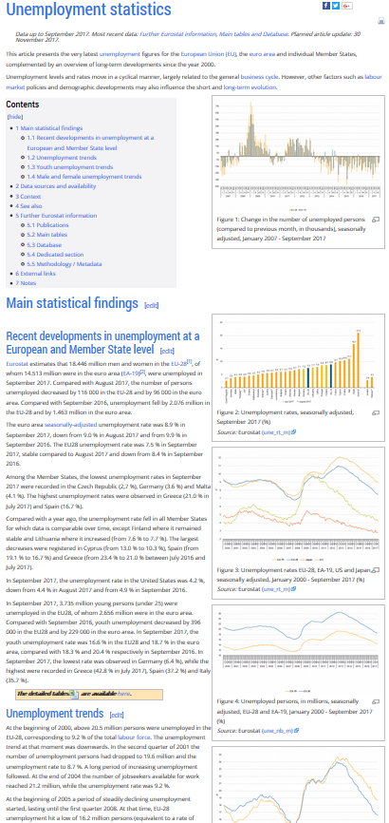
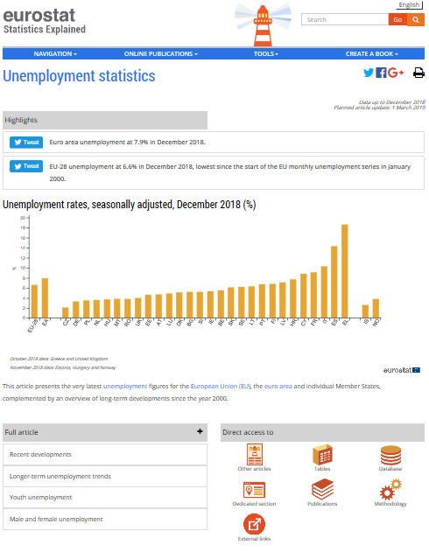
What has Eurostat done in this field? (a)
Changed the layout of Statistics Explained articles
Old
New

Slide 6
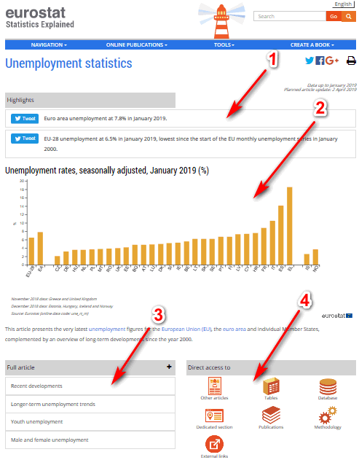
New layout in detail
Main tweeable messages
Interactive or static visualisation
Clickable chapters – chose what is interesting
Icons refering to further information

Slide 7

What has Eurostat done in this field?
(b)
Statistics 4 beginners
- Part of Statistics Explained
- Aim: to make the world of statistics a bit easier
- Target groups: students at upper secondary and everyone with a basic/no knowledge of statistics

Slide 8
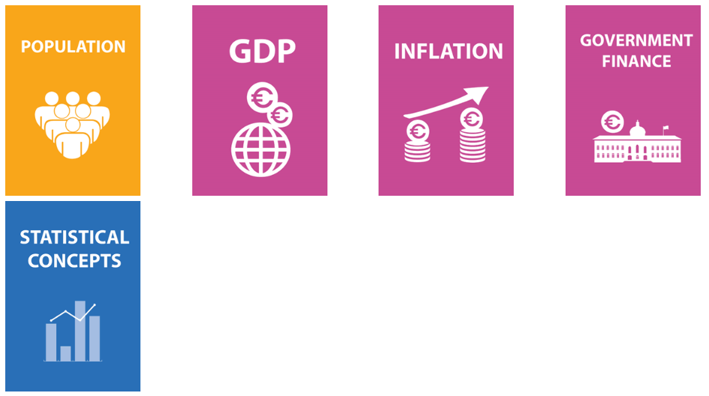
Current topics
+ Labour market and Trade in goods in the pipeline

Slide 9
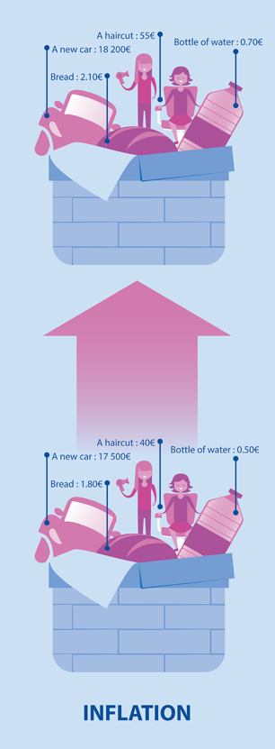
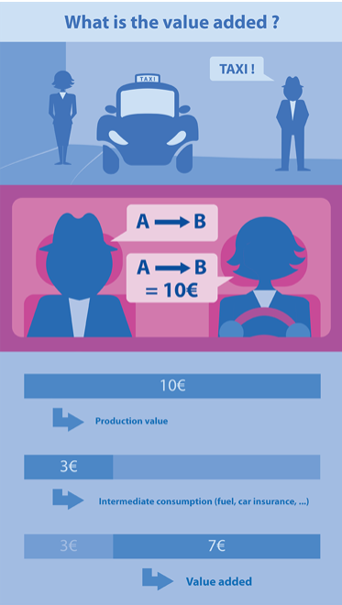
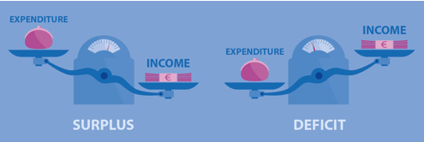
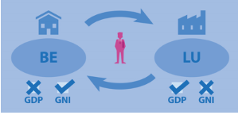
Examples of illustrations
What is public deficit and debt?
What is the difference between GDP and GNI?
What is value added?
What is inflation?

Slide 10


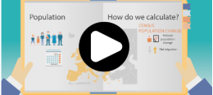
Animations
What is included in GDP? How to get one inflation rate
How to calculate the population change

Slide 11
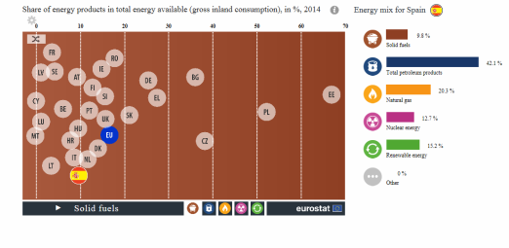

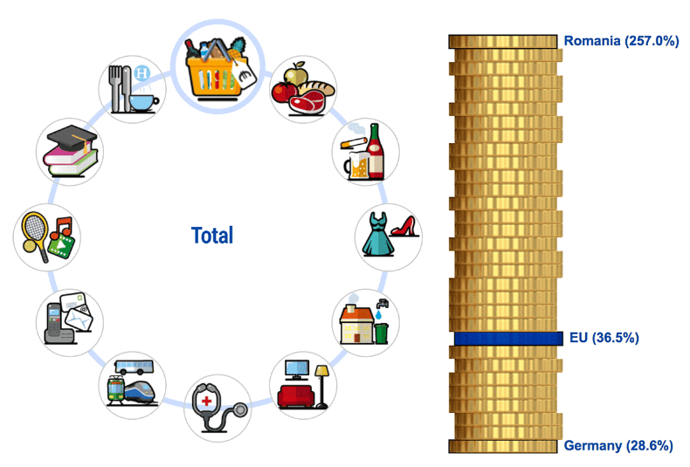
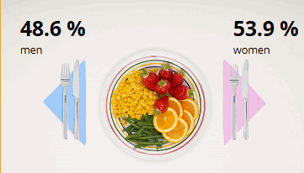
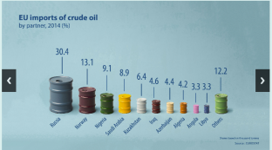
What has Eurostat done in this field? (c)
Interactive (digital) publications
They present statistics which better correspond to new behaviours of users:
Short texts targeting a non-specialist audience
Interactive infographics
Animations, illustrations, etc.

Slide 12


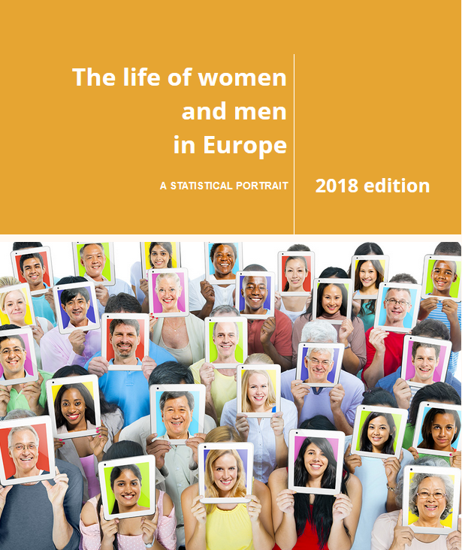

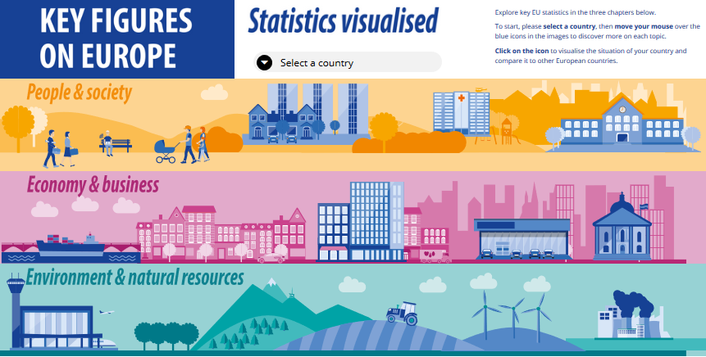
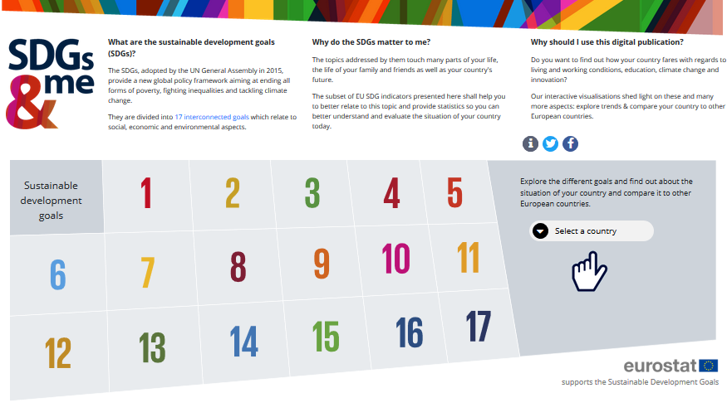
Interactive (digital) publications published so far

Slide 13
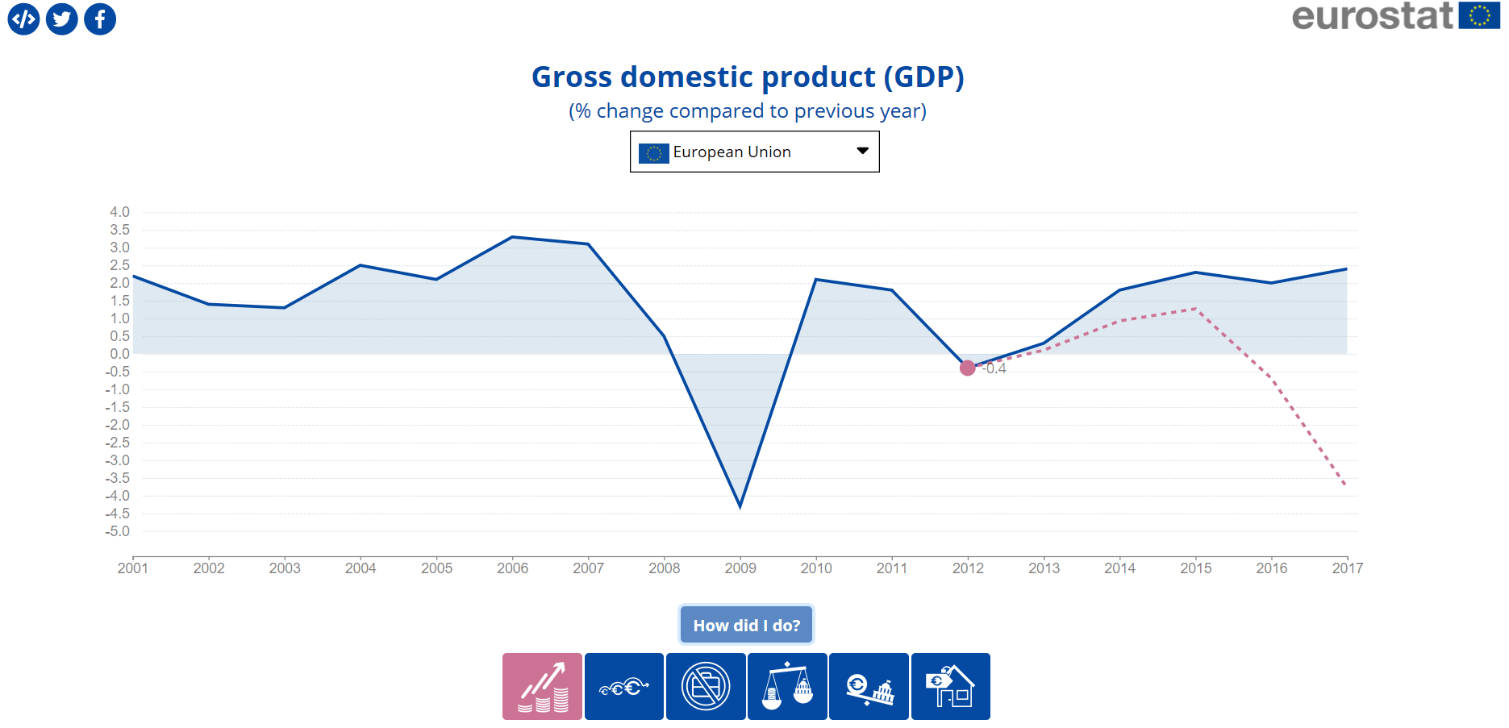
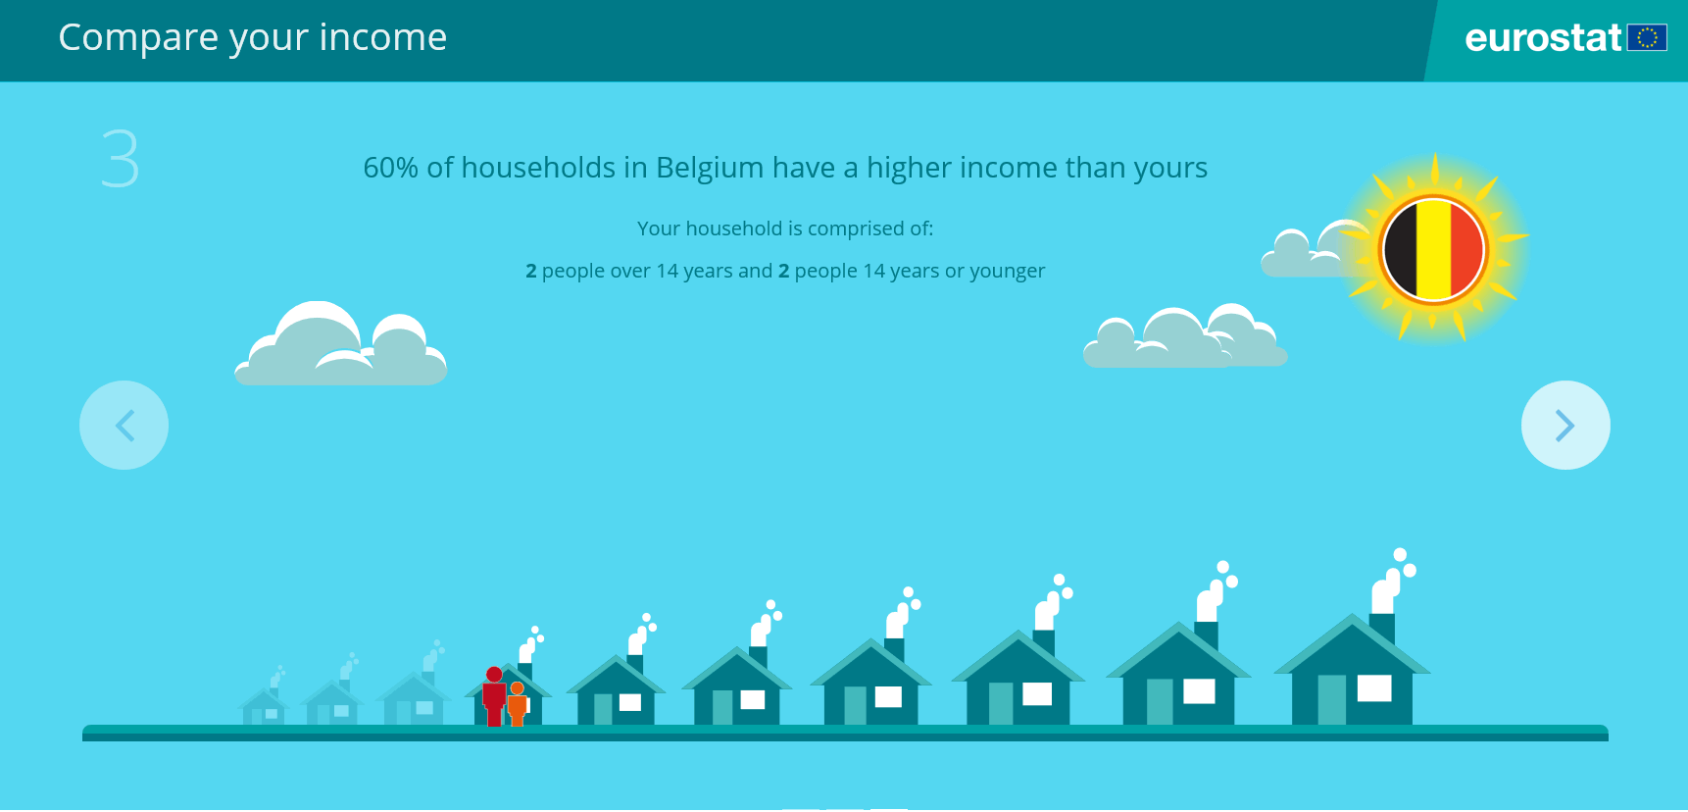
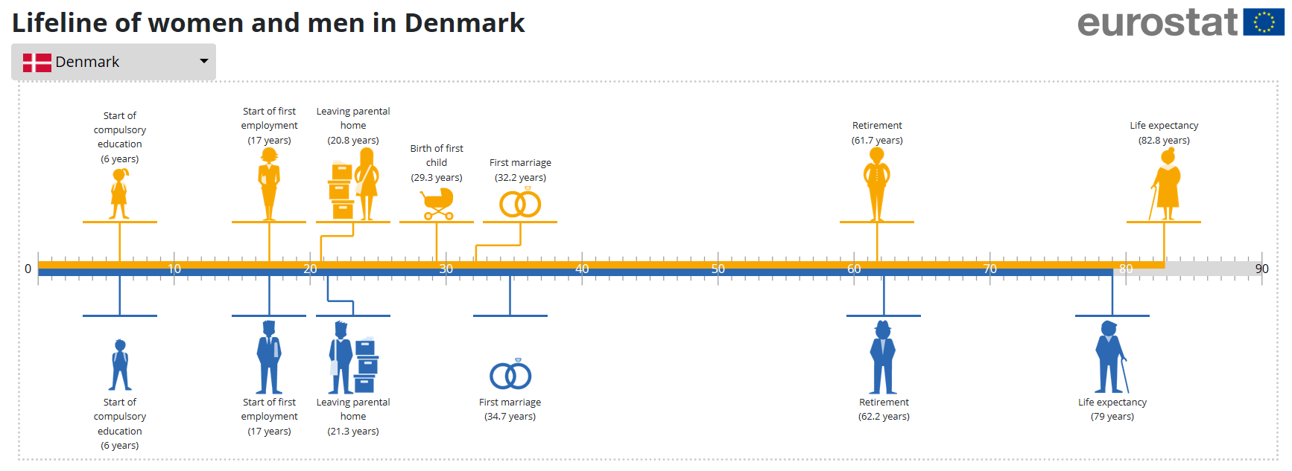
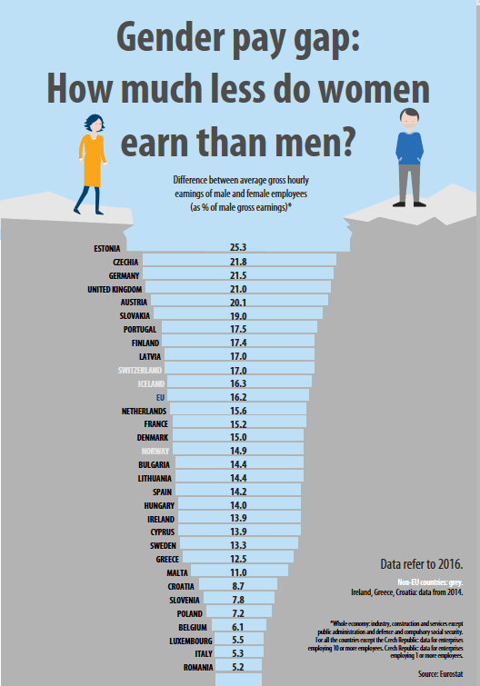
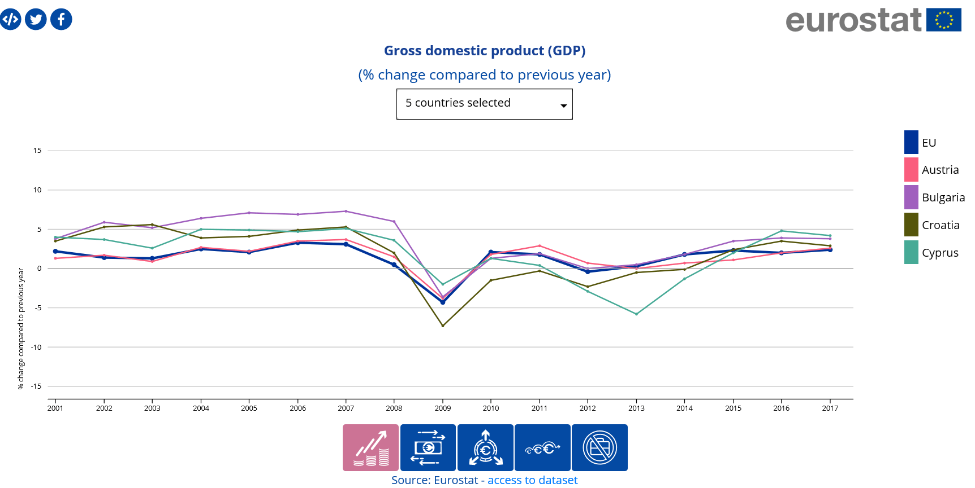
Examples of visualisations

Slide 14
Lessons learned for interactive publications
To have a well-functioning multi-disciplinary team containing developers, web designers, statisticians and communication experts – and to coordinate it
The importance of translating: proof is the The life of women and men in Europe released in 24 languages
Important to update and maintain the publications

Slide 15
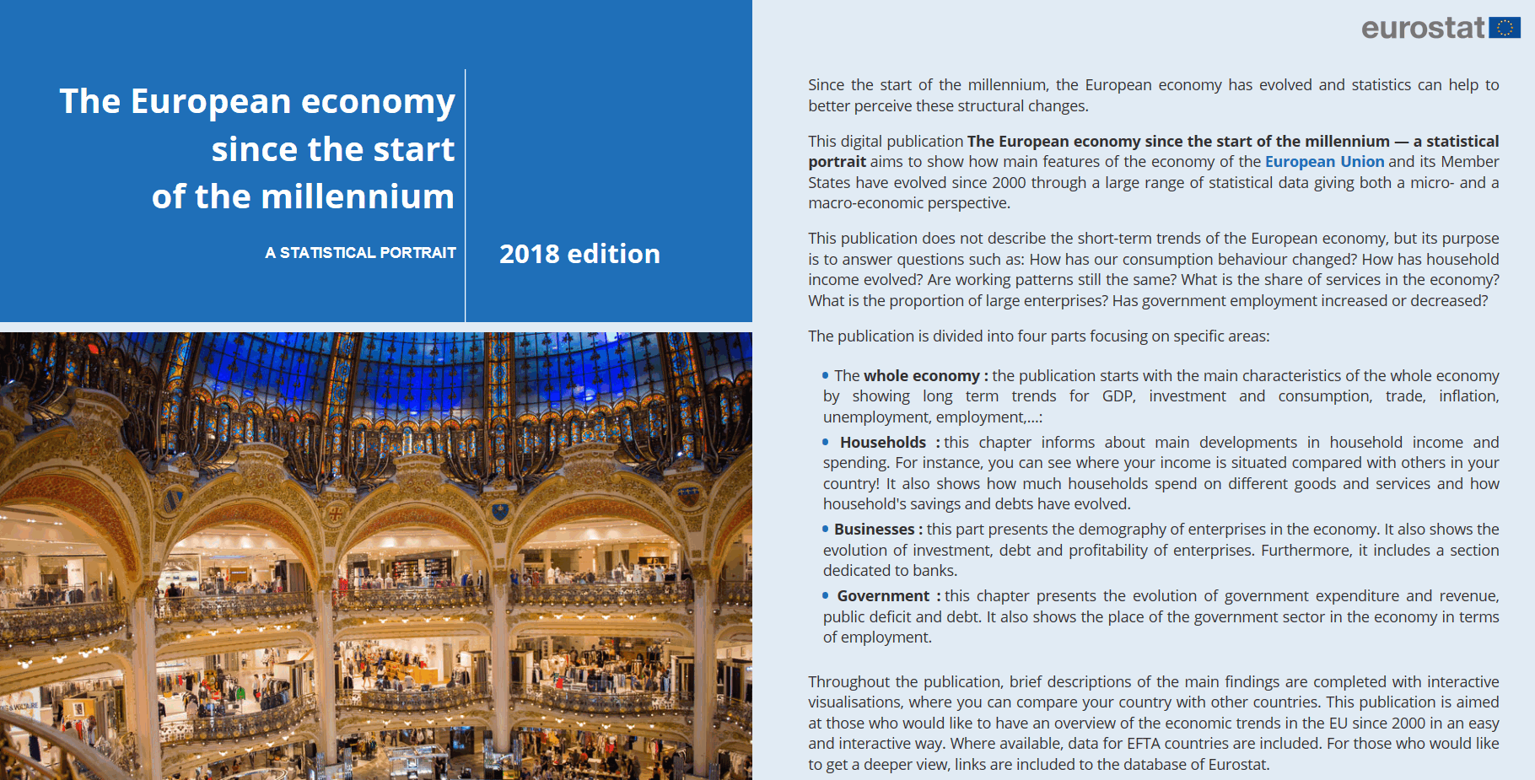
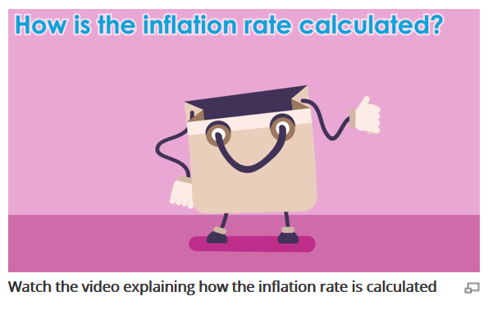
Let’s go live:
Digital publication The European economy since the start of the millenium
Animation on inflation from Statistics 4 beginners:

Slide 16
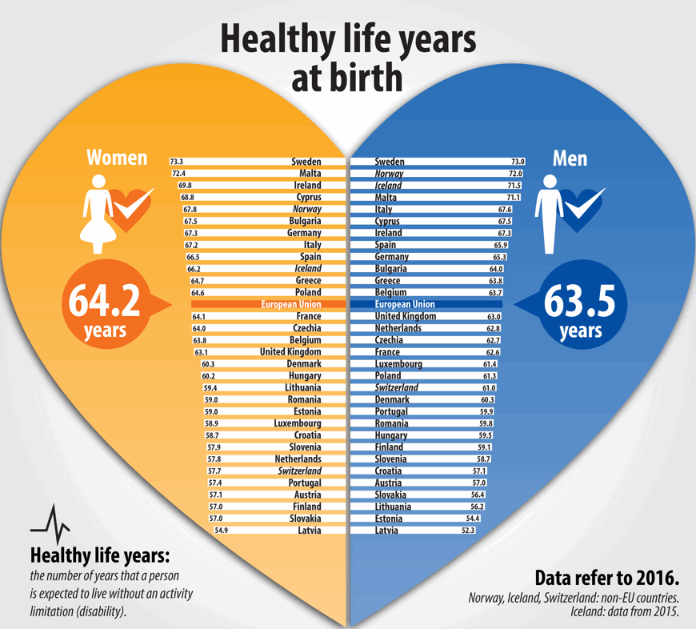
Any questions?
?

