Slide 1
microdata.no Instant Access to Microdata
NTTS / New Techniques and Technologies for Statistics
Brussels 14 March 2019

Slide 2
Thank you for inviting us
Dr. Johan Heldal Senior Adviser | Division for Methods Department for Digitalisation and shared business services | Statistics Norway johan.heldal@ssb.no
Svein Johansen Senior Adviser | Division for Access to Microdata Department of Social Statistics | Statistics Norway svein.johansen@ssb.no
Ørnulf Risnes Head of Digital Development Norwegian Centre for Research Data (NSD) ornulf.risnes@nsd.no

Slide 3
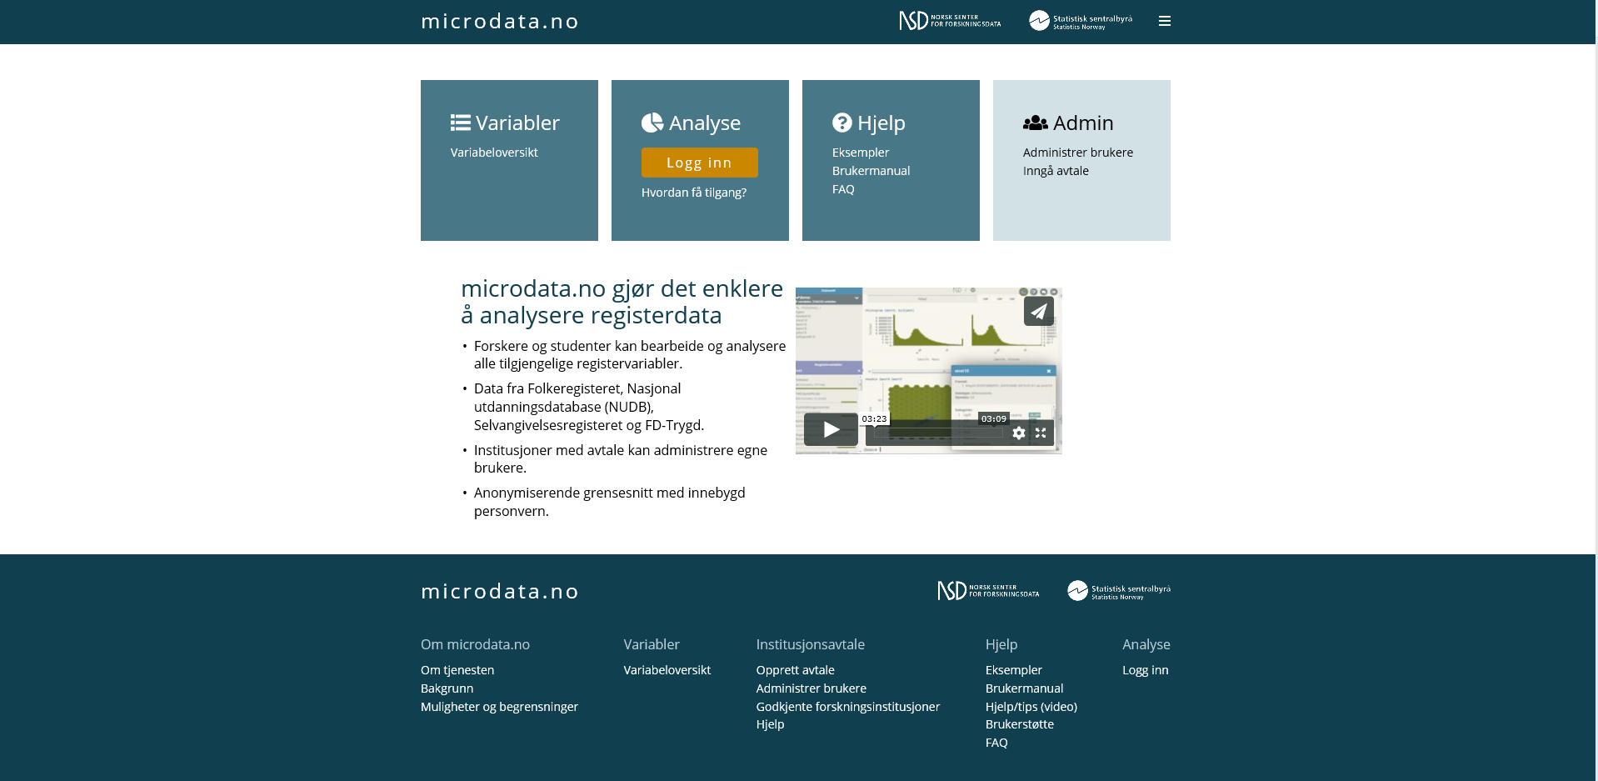
For researchers, PhD and master students in approved institutions - Fast access
- No application for data - Web interface with self service
- Microdata invisible
Notes:
Microdata.no opened March 2018 as a scientific service where researchers get access to a defined database with sharp register microdata without any form for application. They work online with instant access to whichever populations and variables they need, presently costless, in the future at a substantial lower cost than today.
Microdata.no was launched in March last year. By now some 30 institutions (among them the main universities and research institutes) with some 200 users are connected to the system.
Present content: 124 variables on population, education, labour market, income, and welfare benefits.
Developed 2012-2018 in co-operation with NSD – Norwegian Centre for Research data, and funded by The Research Council of Norway with some 4 mill Euro

Slide 4
microdata.no
Launched in March 2018.
30 institutions with some 200 users are connected to the system.
Present content: 124 register variables on population, education, labour market, income, and welfare benefits.
Event history data on 10,2 million individuals.
All national IDs ever issued in Norway.
Developed 2012–2018 jointly by Statistics Norway and NSD – Norwegian Centre for Research data.
Funded by The Research Council of Norway.
Written in Python and takes advantage of the statistics package Pandas.

Slide 5
Research is about results, not records
New and different approach: Metadata driven
Metadata are open for everybody.
Microdata records are invisible.
Data base stored in Statistics Norway
Safe login, three factor authentication
GSIM (General Statistical Information Model)
Results: confidentially safe on the fly
Notes:
Data base stored at Statistics Norway. Data hidden from the user. Only anonymous results downloadable
The clue: Anonymous = no need for applications and allowances.
The egg that WON’T stand: anonymous data. Expensive, reducing value for researchers
More realistic: make the output, the results anonymous.
But then the individual records must be invisible. Solution: Metadata driven. Sharp data stored at Statistics Norway. No information hidden.

Slide 6
Notes:
This is the front page. It is only in Norwegian so far. To log on you need a Norwegian national ID. English version of the page texts in near future. User interface and metadata in Norwegian. Part of 4-yeas’ plan to develop English version and enable international login. By clicking the square «Variabler» we come to the metadata page.

Slide 7
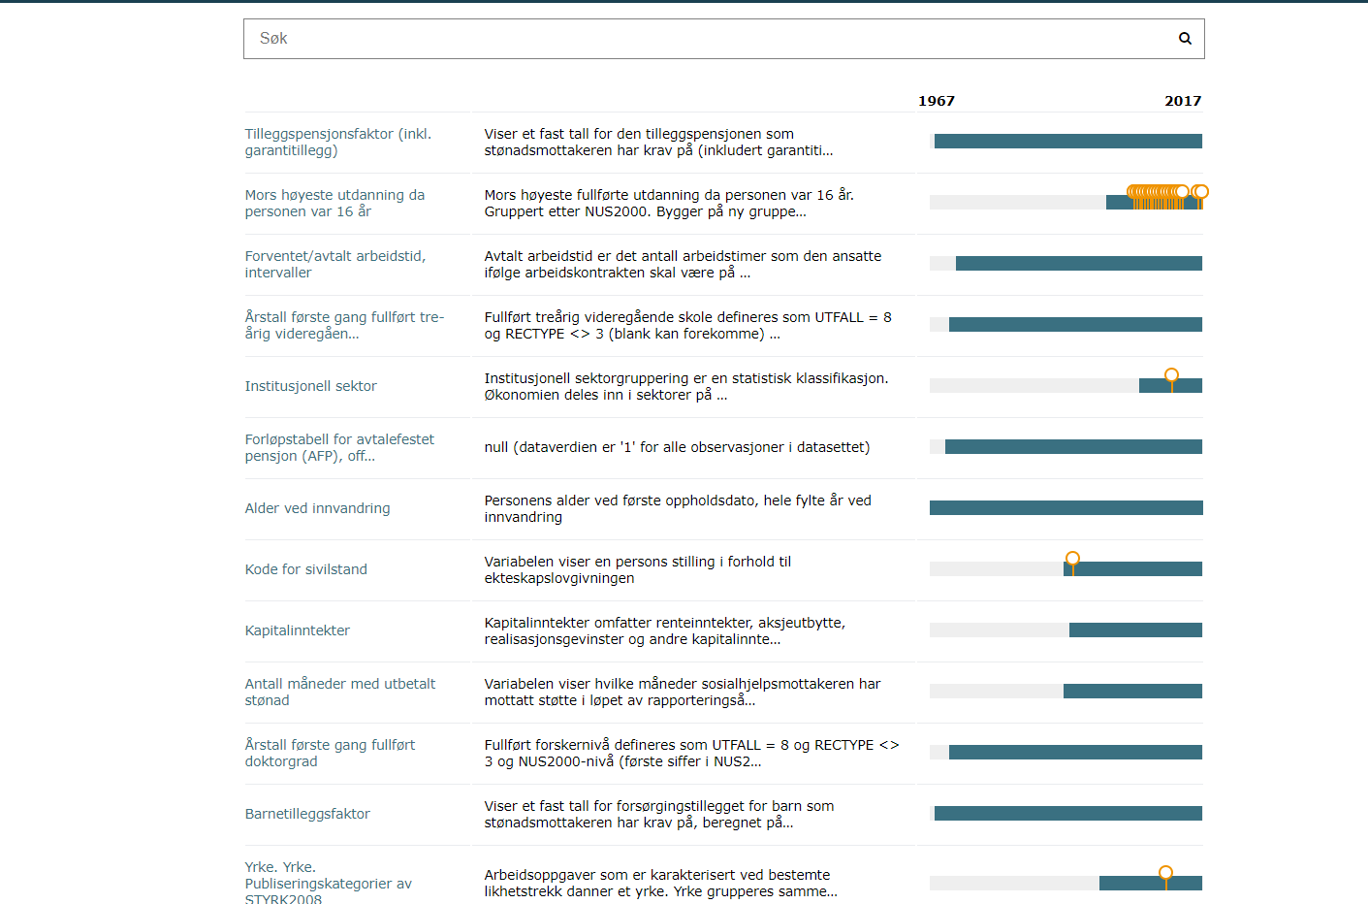
Notes:
Focus:
Rich metadata
Integration of data & metadata
General structures for data GSIM
Metadata are open for anybody
But so far only in Norwegian

Slide 8
Infrastructure layout – metadatadriven, remote access
Metadata
DataStore
User workspace
Notes:
Data are stored in microdata.no DataStore.
The Data are stored in Statistics Norway.
Users import interesting variables to User workspace and give them customized names if desireable

Slide 9
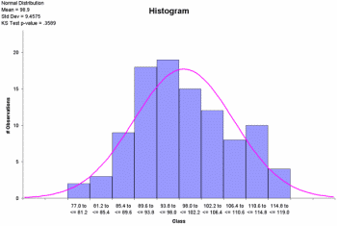
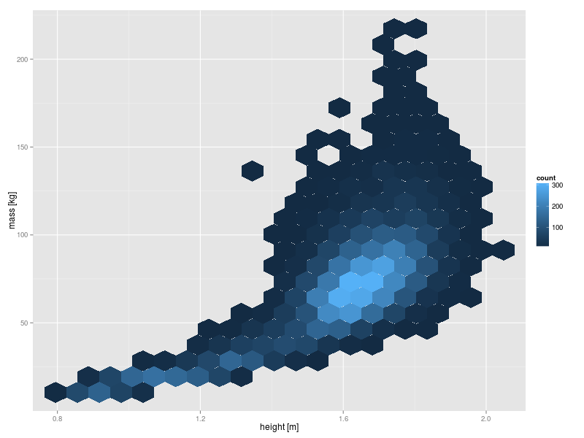
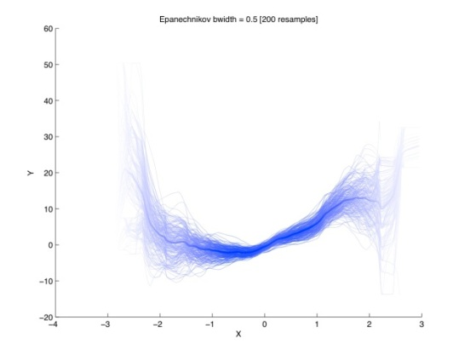
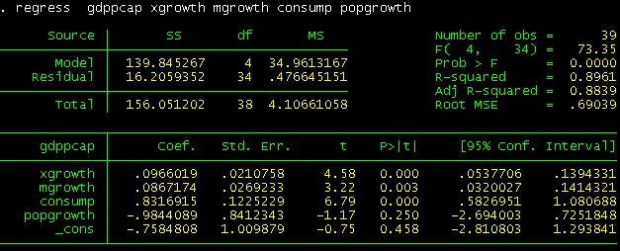
Confidentially safe output
Subsetting user workspace
S
Notes:
Based on the variables imported to the User Workspace, users can subset populations, recode variables, create new variables and do analyses.
The user defines the names of the variables in his or her workspace.

Slide 10
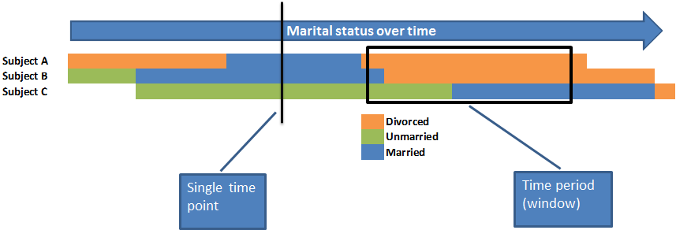
Temporality structure, an example.
Notes:
4 classes of Temporality: Event (start-stop), Single Time Point, Unchangeable, Accumulated

Slide 11
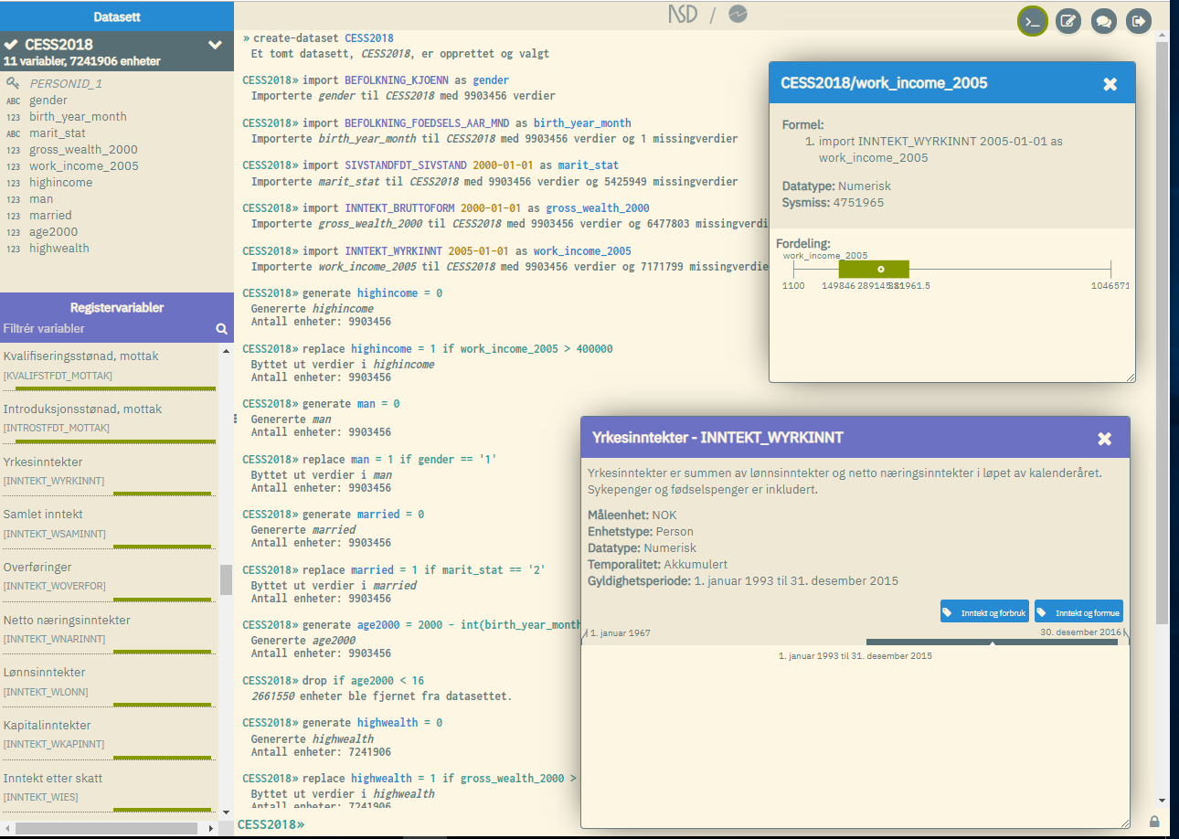
Command interface
Work space variable window
Click for metadata
Data store variable window
Click for metadata
Notes:
Command interface. This shows the meaning of metadata driven approach.
When importing variables from Data Store the user defines his or her own names in the work space.

Slide 12
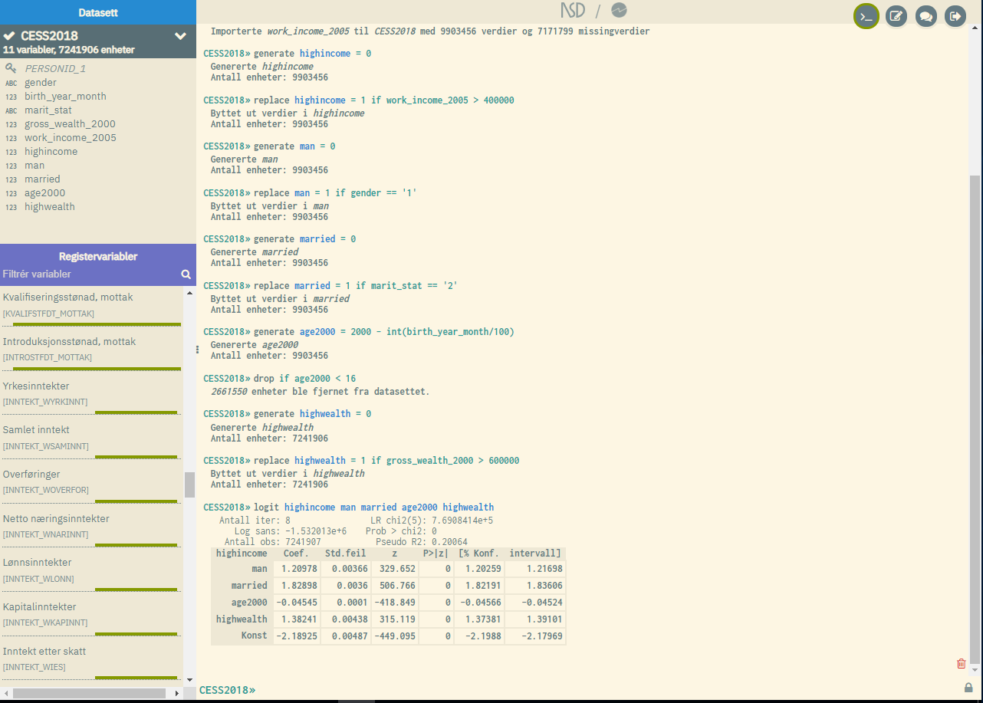
Command interface
Change to Script mode
Chat for assistance
Results of analysis
Notes:
Command mode

Slide 13
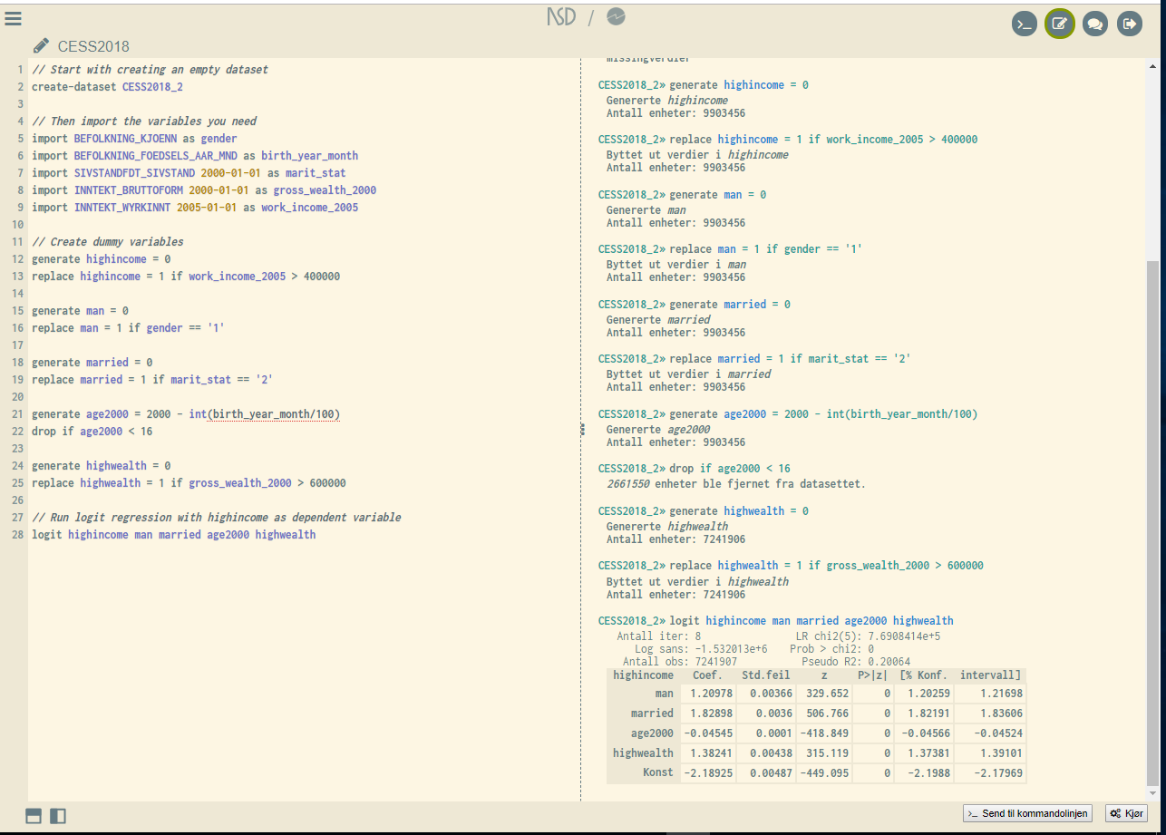
To
command
mode
Script mode interface.
You can run all commands an ensemble
Script in the left pane
Results in the right pane
Run
Notes:
Script mode interface

Slide 14
Metadata plays several roles
Informative: Open access at microdata.no
definitions, data types, temporality, code lists
Tech function. Data access only through metadata.
Supportive function. Interactive assistance in User Interface.

Slide 15
Statistical Disclosure Control (SDC)
Minimum size of populations to be analysed: At least 1 000
Constant unbiased restricted maximum entropy noise addition on counts (max ±5)
Inspired by the «Australian Bureau of Statistics method».
No perturbations to negative counts and no counts 1-4.
Magnitude totals adjusted proportionally to pertubed counts.
Automatic winsorization of all numerical variables when subsetting and importing.
hides extreme values
All activity on microdata.no is logged
Aims at preventing realistic disclosure scenarios

Slide 16
Access and reproducibility
Everybody with access to microdata.no have access to all data in the system.
This guarantees reproducibility by peers for all research done with its data.

Slide 17
Next on the Agenda
Include variables from new sources
E.g health registers
More statistical methods available
Give access to new groups, e.g. public administration.
International access to researchers.
Strengthened SDC methods.
Applications for new grants from the Norwegian Research Council are pending.
Notes:
We consider the metadata driven approach to be very useful, and have a strong wish to use it widely, both externally and internally in Statistics Norway.

Slide 18
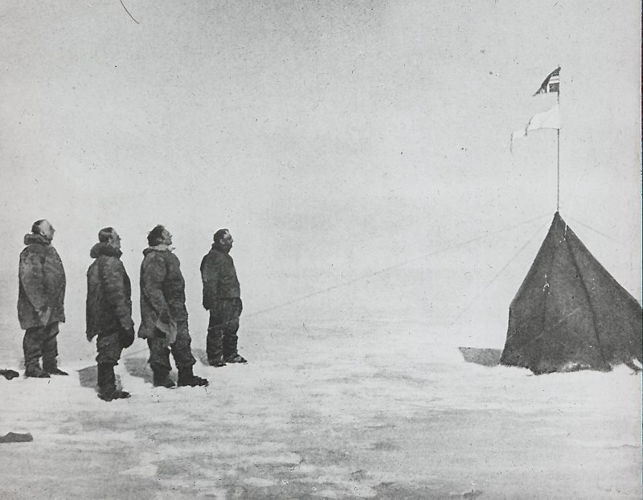
Appreciating the value of register data for research and the value of research, we want to create the best possible solution for register based research data
Thank You

