Slide 1
Engaging with users to modernise the dissemination of European statistics
OR
How to avoid creating statistical products no one understands!
Conference on New Techniques and Technologies for official Statistics (NTTS), 12 - 14/03/2019
Julia Urhausen & Maja Islam
Eurostat B4: Dissemination & user support
julia.urhausen@ec.europa.eu

Slide 2


Structure & content
Why? – Context
How? – Eurostat's user profiling exercise
What? - Usability tests
Which? - Implementation & lessons learned

Slide 3




1. Why? - Context
  Stay relevant as provider of official statistics of high quality
  Better communication with all our audiences
  Improve our existing products & services
  Develop new targeted products & services

Slide 4


2. How? - User profiling exercise
Setup:
Field studies: remote, in-context interviews & observation of user behavior with Eurostat products
40 participants from across Europe
Results:
Demographic / professional information on users' needs to be complemented with goals and behaviour
Users' continuum
Potential users can fit as advanced, intermediate or light users
Five personas of users of European statistics

Slide 5

What is a persona?
A persona is a specific, visual and textual representation of a group of users of a product, service or application
based on behaviours, goals and motivations of real users
that allow empathy with and focus on real users in order to guide design.

Slide 6



Technical Advanced User — Pietro
 | Key Goals Pietro wants to collect data of high quality for his clients. He is motivated to go the extra mile to provide them with exactly what they need fast. “The search time to find the right datasets is too long, but I cannot give up, it is my job to find the data I am looking for.” He is not looking for publications or visualisations, he is only interested in raw data. At his firm, they create publications and data visualisations themselves. Main Tasks Setting up automatic downloading of multiple datasets Browsing for new datasets that his clients might want Looking up datasets to send the link to clients Checking datasets suggested by clients | Characteristics Statistical literacy Computer proficiency Visits Eurostat daily, sometimes several times in one day. Tools used Bulk Download Web Services Database
Demographics 31 years old Works for a big consultancy firm that redistributes European and international statistics as a commodity to its clients.
We should make automation as easy as possible, allowing Pietro to download many datasets at once. We must not change the way data are disseminated or the way variables are measured without any notification.

Slide 7

Analytical Advanced User — Ingrid
 | Key Goals Ingrid typically goes straight to Eurostat’s database to get raw data, at least if she knows what she is looking for. Sometimes, however, she needs data on an unfamiliar topic. In that case she will search Google for publications from Eurostat to get an idea of the statistics available. “I sometimes distrust processed data, I prefer to draw my own conclusions” She needs to find datasets and download them to do her own calculations and create her own graphs. Main Tasks Looking for relevant datasets Adjusting the layout and format of the tables Saving bookmarks to return to the datasets later Downloading tables to Excel | Characteristics Statistical literacy Computer proficiency Visits Eurostat sometimes daily, when writing a research paper, but at least weekly. Tools used Database Statistics Explained Statistical Reports (but no PDFs because they are not user friendly)
Demographics 48 years old Works as a policy maker for the European Commission's Directorate General for Trade.
We should provide a good overview of everything that is available on Eurostat. We must not provide publications as PDFs, because they are not easy to work with (copy-paste).

Slide 8

Data Oriented Intermediate User — Isak
 | Key Goals As a journalist, Isak is constantly looking for many different angles to support the stories he is working on. This means he comes to the Eurostat website with a very specific goal in mind, not just to browse around. He does look at both data visualisations and tables with raw data, yet he only uses the latter for his articles. A graphical designer at his editorial office will create charts or infographics from those data when necessary. “The challenge lies in finding the data, more than in interpreting the data.” Main Tasks Searching for visualisations and raw data Downloading selections of specific tables Sometimes taking screenshots to show the graphic designer how the data could be presented | Characteristics Statistical literacy Computer proficiency Visits Eurostat a few times a week. Tools used Tables, Graphs, Maps Database (but less) Statistics Illustrated
Demographics 28 years old Works as a journalist for a national newspaper. He does not write about data, but looks for statistics on the topics he is writing about to support articles.
We should provide good crosslinks between different extraction and dissemination tools with data on the same topic. We must not let users waste time with looking for relevant data.

Slide 9


Visually Oriented Intermediate User — Mia
 | Key Goals Mia typically only visits Eurostat whenever she needs to put things in a European perspective for her studies. Although she has a specific goal in mind, she often deviates from that goal and starts exploring other topics too. Although she can interpret tables, she prefers to look at graphs and maps because they are easier to interpret and give an overview much more quickly. Mia does not mind getting conclusions from Eurostat’s publications and reports, but she draws her own when writing essays. “Raw numbers are interesting but graphs immediately give you an overview.” Main Tasks Searching for reports, publications and visualisations Copy/pasting text and making screenshots | Characteristics Statistical literacy Computer proficiency Visits Eurostat once a month, but sometimes more when writing an essay. Tools used Visualisation Tools Tables, Graphs, Maps Database (but less) Statistics Explained Statistical Reports
Demographics 21 years old Studies Political Sciences and International Relations. She is currently in the third year of her Bachelor program.
We should provide her with the tools to easily save and download the bits and pieces she needs for later reference. We must not let her get lost inside Eurostat, but still allow her to explore.

Slide 10


Personally Interested Light User — Kristoffer
 | Key Goals Although Kristoffer occasionally uses an article or data visualisation from Eurostat in his English class, he visits the website more out of personal interest. Usually he arrives on Eurostat by clicking on a Facebook post that intrigues him. He is very much interested in the European project and likes to look for similarities and differences between European member states. Looking at visualisations and occasionally reading reports is where it stops for Kristoffer. He never downloads data and seldomly digs deeper to draw his own conclusion. “The general view is enough for me, I am not enough of a specialist to dig deep into the data.” Main Tasks Checking out data visualisations (that he gets from Facebook) or reading reports | Characteristics Statistical literacy Computer proficiency Visits Eurostat about once a month. Tools used Facebook page Themes in the Spotlight Digital Publications Visualisation Tools Tables, Graphs, Maps
Demographics 42 years old Teaches English and History in high school. He is very interested in the European project and checks statistics out of personal interest.
We should make sure that users who arrive on Eurostat via Facebook can navigate their way around the rest of the site. We must not ignore the fact that he will also end up in the database or main tables every now and then.

Slide 11


3. What? - Usability tests
Example 1: Eurostat website
Statistics Explained – new page structure
Thematic sections on Eurostat website – new layout
Setup:
12 participants
In-lab or remote sessions in English (1h)
Think-aloud method
Understanding users’ goals and behaviour

Slide 12

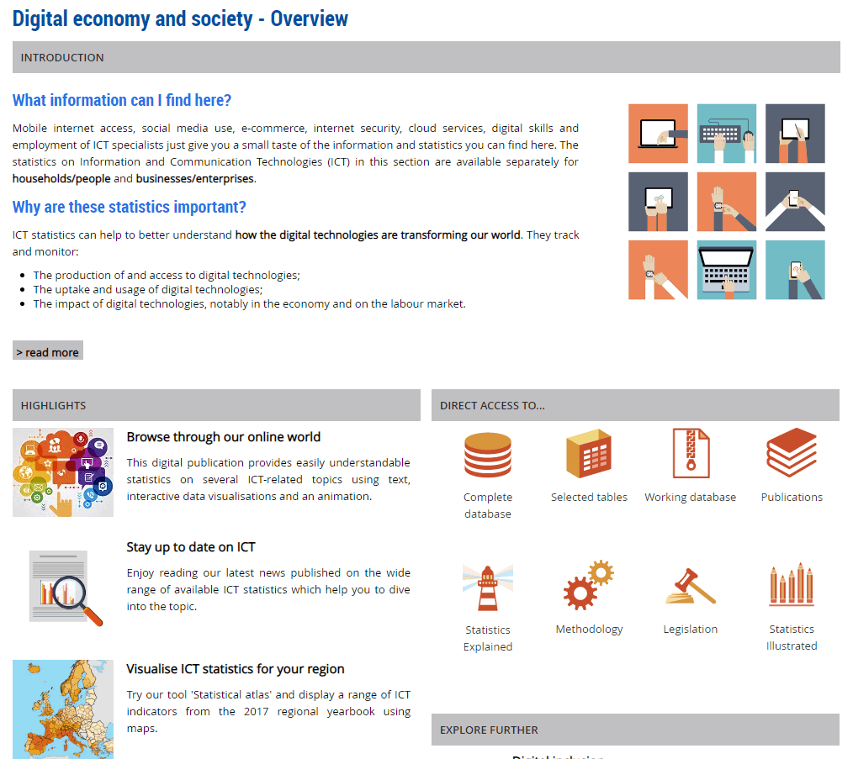
Users want:
to easily scan the page / identify the information that they are interested in / visual representation
easy: improve structure; add highlights, bullets, visuals, etc.; short "pointy" titles & texts

Slide 13

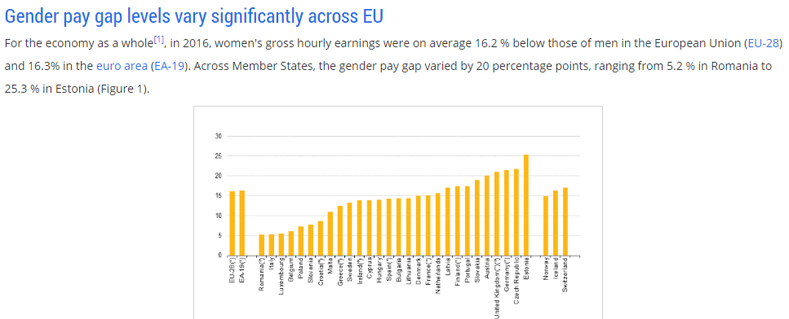
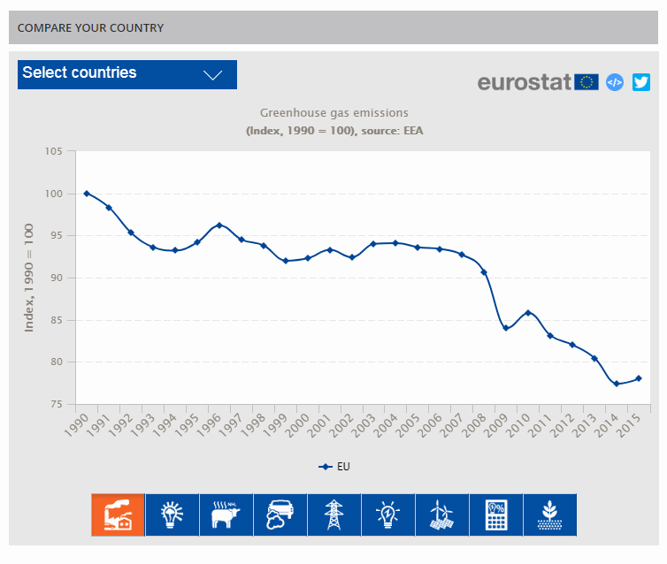
Users want:
graphs & charts:
- some want stand-alone graphs
- some want them complemented by text
Medium: technical development, creation & maintenance

Slide 14

3. What? - Usability tests
Example 2: SDGs
    New interactive digital publication
    Usability tests: beg. August / 9 users
    Released: 18 September
    https://ec.europa.eu/eurostat/cache/digpub/sdgs/
    Overall feedback:
    Users were enthusiastic, liked design & navigation
      “You get what you would expected to find.”
      “It’s a good tool to transfer information about the SDG’s to the general public."

Slide 15

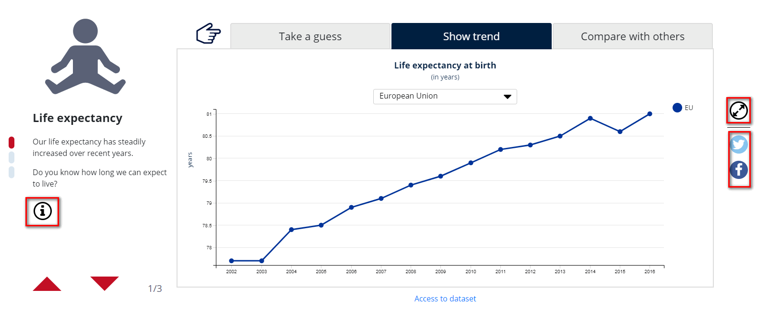
Users want:
to have buttons placed where they "belong"; not cluttered together
Easy, re-arranged location of icons

Slide 16

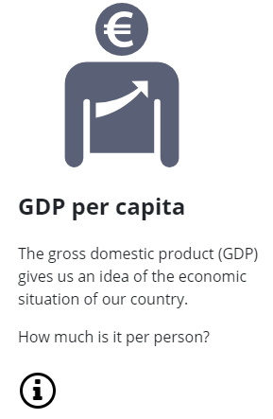

Users want:
easy understandable language / text / explanations
Easy, drafting text as cooperation between communication team & statisticians
User feedback:
  "The text is to the point and everything is clear."
  "There weren’t any words I didn’t understand."
  "It’s easy accessible for everybody, even for people like me who aren’t native English."

Slide 17

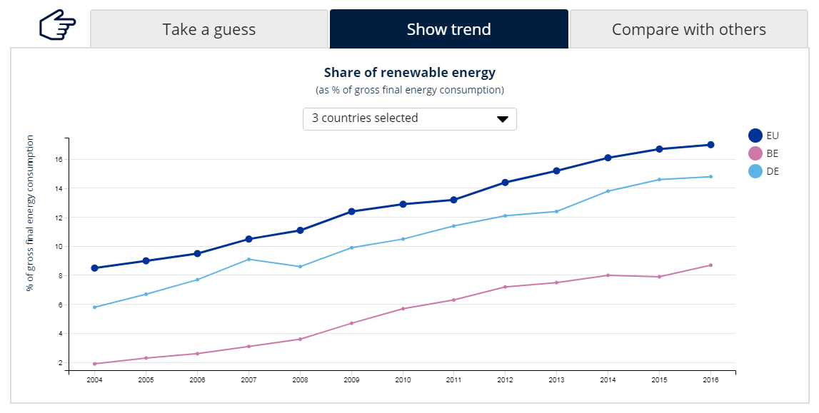
Users want:
to download / embed their customised charts
Difficult, lots of technical intervention necessary
Will be implemented for second release June ‘19

Slide 18

4. Which? - Implementation & lessons learned
Good understanding of users requires direct and continuous engagement
Users are on a continuum
Implementation of feedback: easy to challenging
Other websites shape user expectations
Direct & continuous engagement with users gives valuable insights about needs and expectations
Our challenge:
To design statistical products
that help users to easily achieve their goals
- without them noticing!

Slide 19

Thank you for your attention
Any questions?
julia.urhausen@ec.europa.eu
All icons used in this presentation © European Union

