Slide 1
Population Statistics without a Census or Register
Owen Abbott
Office for National Statistics
@owenabs

Slide 2
Introduction
ONS is transforming its population statistics system
Currently, the UK statistical system is underpinned by Censuses – next Census in 2021
The UK does not have a population register
There is an ambition to move away from Censuses
This talk outlines some of the methodological challenges and where we are on exploring these

Slide 3
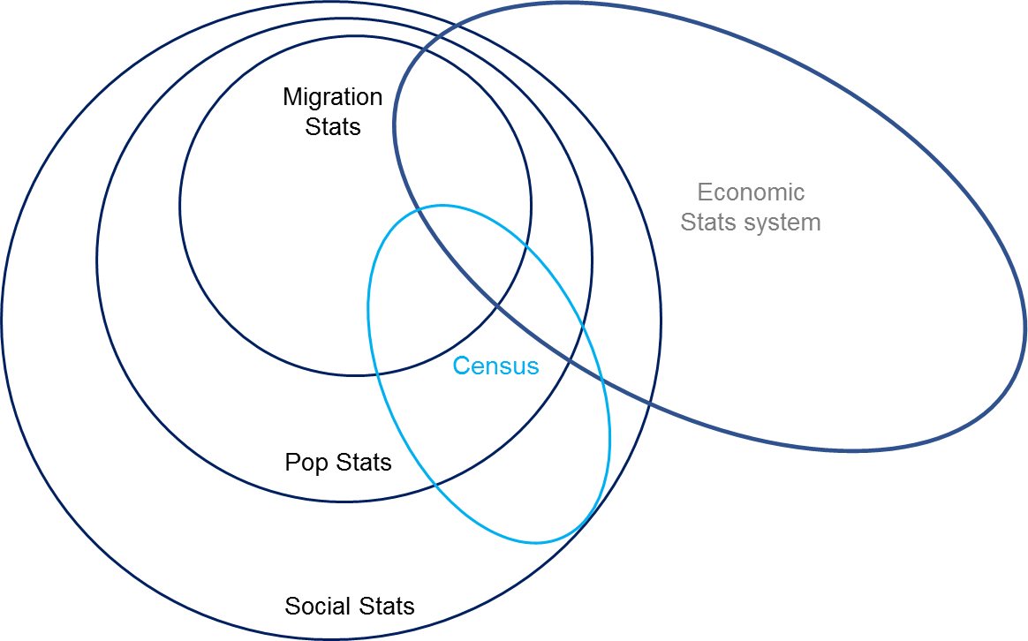
The population statistics system

Slide 4
Context – Population Statistics Transformation
National Statistician’s recommendation (March 2014)
Online 2021 Census,
Increased use of administrative data and surveys to both enhance the statistics from the 2021 Census and improve statistics between censuses.
The government’s response
an ambition that “censuses after 2021 will be conducted using other sources of data”.
ONS are progressing a programme of work to put administrative data at the core of our evidence on international migration (UK) and on population (England and Wales) by 2020

Slide 5
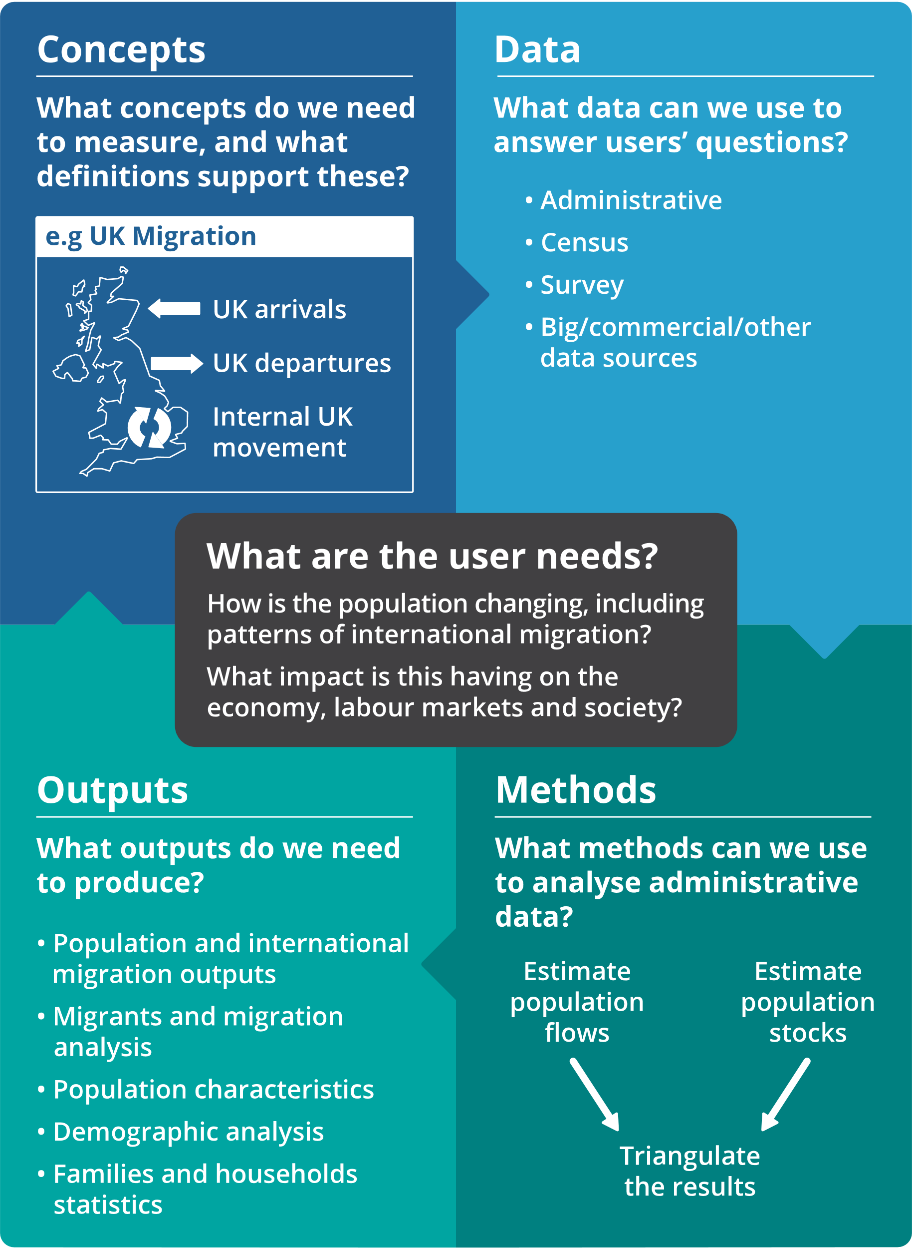

Slide 6
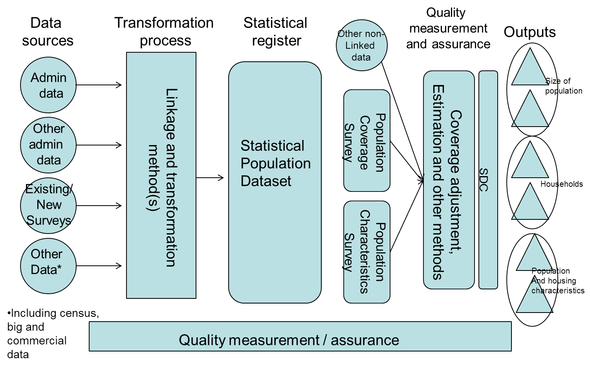
High level design
Aim: ‘Make the best possible population statistics every year’

Slide 7
Methodological challenges
Understand the admin data
Linkage without a common identifier
Population Coverage Survey design
Estimation of population size
Estimation of population flows (and consistency with 4)
Measuring uncertainty
Lots more which I don’t have time to talk about today!

Slide 8
Methodological challenges
Understand the admin data
Linkage without a common identifier
Population Coverage Survey design
Estimation of population size
Estimation of population flows (and consistency with 4)
Measuring uncertainty
Lots more which I don’t have time to talk about today!

Slide 9
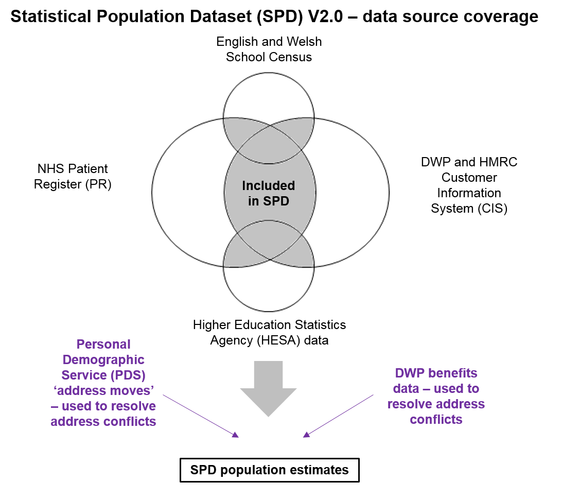
Understanding the admin data (1)

Slide 10
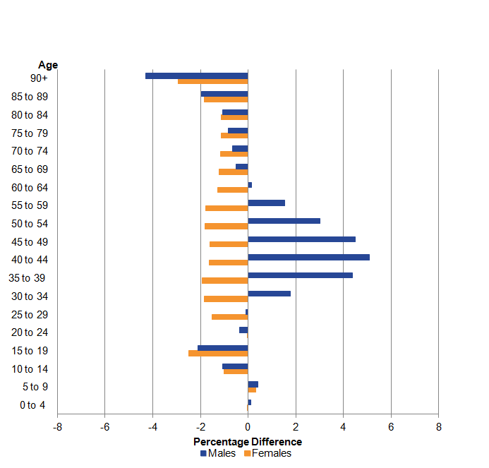
Understanding the admin data (2)

Slide 11
Survey design
Assuming we need some form of Population Coverage Survey to measure coverage
Assuming it can be a sample of addresses, stratified
350k households
Collect basic information from everyone at the address
Annual, spread throughout 4 quarters, integrated with our Labour Market Survey
Have done some tests, more happening now
Still likely to be voluntary so response 60-70%

Slide 12
Estimation (1)
Main issue in our admin data is over-coverage
If we try to remove (using activity data) we create some under-coverage
Exploring different estimation strategies using Capture-Recapture estimators, as well as Bayesian methods developed by SNZ, ideas from RoI and Italy

Slide 13
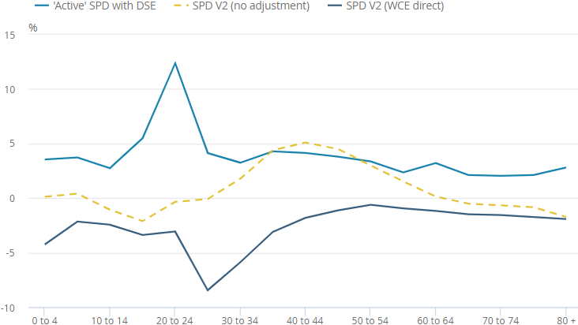
Estimation (2)
Some early work looking at simple DSE and Weighting Class estimators (Males, 2011)

Slide 14
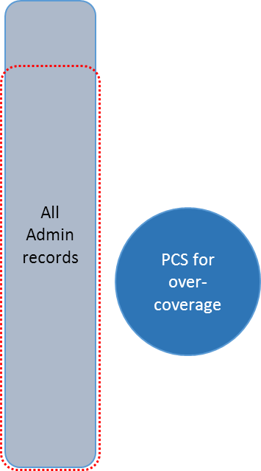
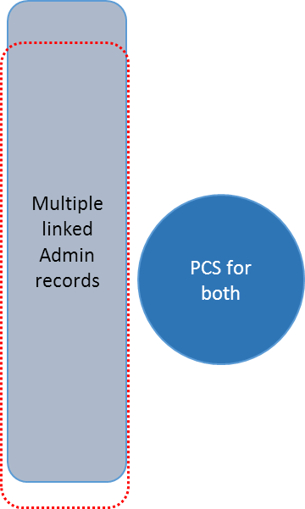
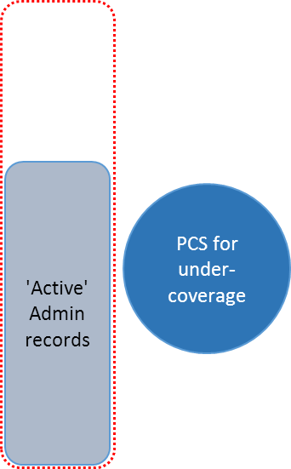
Estimation (3)
Is it better to estimate undercoverage, overcoverage or both??? What provides the best estimates?

Slide 15
Summary
ONS is exploring way to produce population statistics without a Census or a Register
We are continuing to engage with our users – and produce regular publications
There are lots of methodological challenges
There are also plenty of practical challenges
We are making good progress, but there is a long way to go still

Slide 16

More Information
Follow tweeting statisticians
@JayLindop_ONS (International Migration)
@becky_tinsley (Admin Data Census)
@RichPereira_ONS (Ageing and Demography)
Look at some of our publications
Transforming population and migration statistics: Research into developing an alternative approach to producing administrative data-based population stocks and flows
Admin Data Census Project pages
Research outputs: An update on developing household statistics for an Admin Data Census

