Slide 1

The EuroGroups Register
Agne Bikauskaite, August Götzfried
Eurostat
13 March 2019

Slide 2
Overview
Introduction
Scope of the EuroGroups Register (EGR)
The EGR production process
Coverage of the EGR
Data sharing and use
Experimental statistics based on EGR data
Further EGR improvement plans

Slide 3
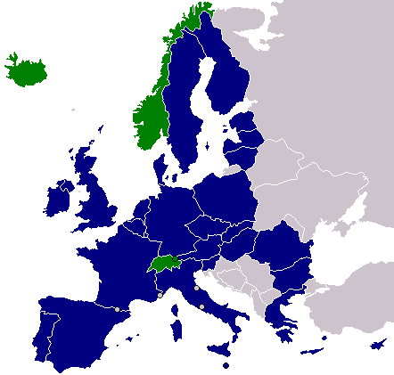
Introduction
The European Statistical System allocated high priority to the better measuring of globalisation
In the statistical processes and output
of business or macro-economic statistics
Some concrete actions were already
undertaken such as setting up of the
EuroGroups Register (EGR)
The EGR is part of the EU statistical infrastructure and has been built up to better capture globalisation effects as well as for improving the consistency of national data on enterprise groups

Slide 4

The EuroGroups Register
The EGR covers multinational enterprise groups operating in Europe
It provides the statistical authorities of the EU and EFTA countries with yearly population frames of multinational enterprise groups
The Register's main function is to provide the statistical authorities with a harmonised picture of multinational groups for their national statistics
The EGR has been growing in terms of quality over years and for reference year 2017 covers more than 127 000 multinational enterprise groups in the EU and EFTA
When at least one legal unit of a multination enterprise group is registered in the EU or EFTA country, the group is in the scope of the EGR

Slide 5
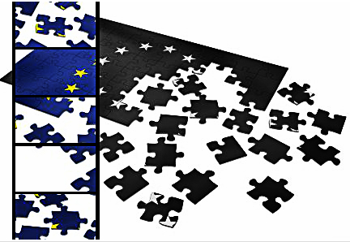
Scope of the EGR
The fragmented picture that statistical authorities of EU and EFTA countries have on multinational groups causes growing harmonisation problems for EU statistics on globalisation
The EGR is designed to provide a unique survey frame for these statistics and therefore to
serve as the basic tool for
improving them
National statistical institutes
(NSIs) and national central
banks can use EGR as
consolidated and
harmonised frame when
producing national statistics
related to globalization

Slide 6
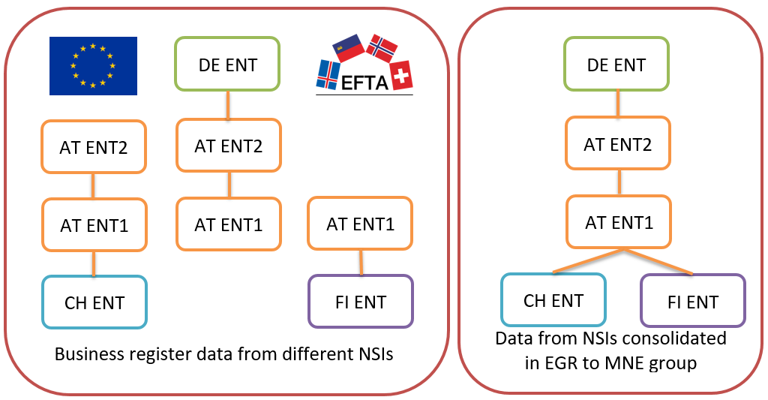
Compilation of the groups in EGR

Slide 7
The EGR production process (1)
The EGR produces annual data
Groups are as of 31st December of the reference year
The collection and validation of EGR data are complex and long processes
The EGR final data currently are available 15 months after the end of the reference year
Eurostat collects data on enterprise groups from the national statistical business registers of EU and EFTA countries and from one commercial data source
National registers deliver micro data on the constituent units of the groups and on their relationships
Complementary commercial data ensures coverage for units outside the EU and EFTA, and full consistency of the largest enterprise groups

Slide 8
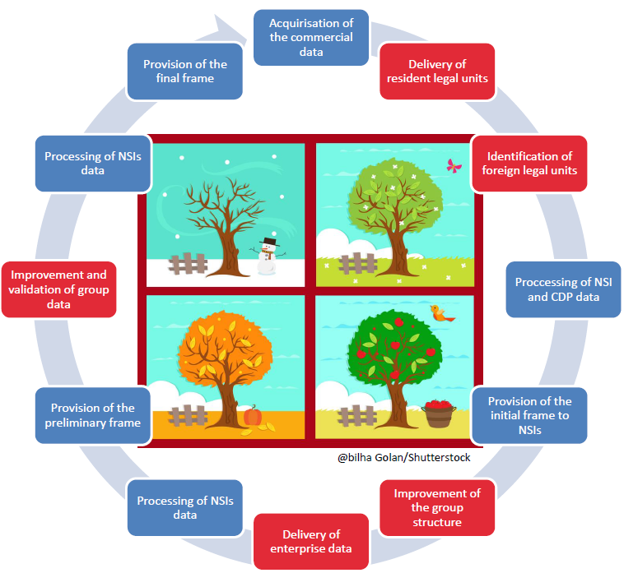
The EGR production process (2)
After validation of input data from the different sources Eurostat via the EGR calculates the consolidated output on the legal units, on their relationships and on their enterprises
Having final information on legal units and relationships for a reference year the EGR compiles the enterprise group structures

Slide 9
EGR coverage
2014 61 146 groups
2015 79 863 groups
2016 111 508 groups
2017 127 300 groups

Slide 10
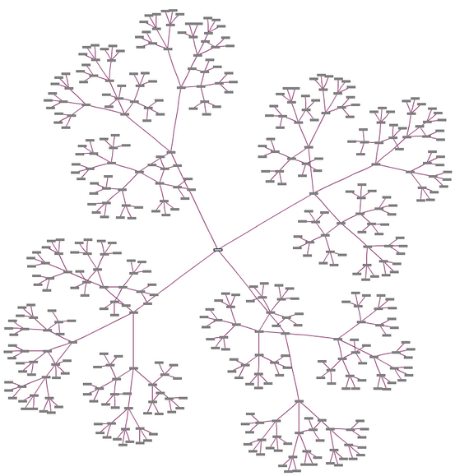
Data sharing and use of the EGR (1)
The EGR is a statistical register with restricted use
The EGR data with the harmonised frame of the multinational groups are only accessible for statisticians producing national statistics in the EU and EFTA NSIs and national central banks
The EGR provides harmonised information for the users on:
Enterprise groups, enterprises, legal units (identification, demographic and economic characteristics)
Relationships and control
Shareholdings of at least 10 per cent

Slide 11
EGR data users
NA
GNI
FDI
FATS
BOP
SBS

Slide 12



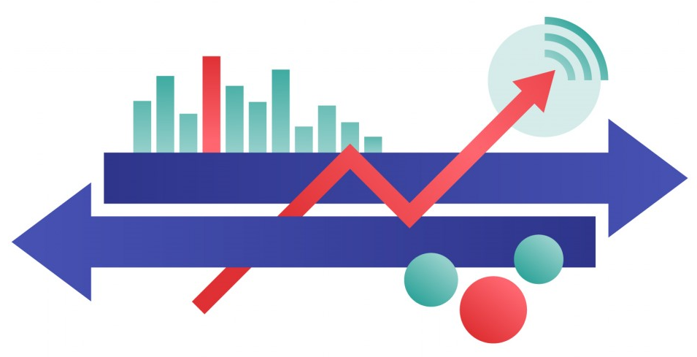

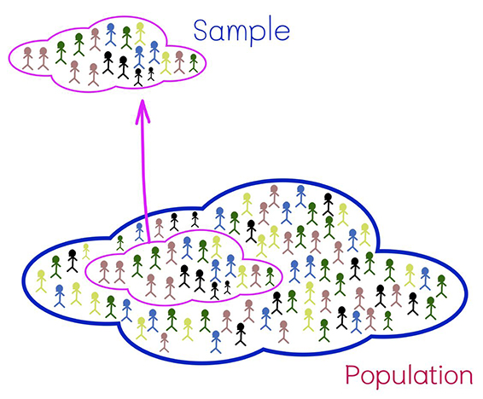


National
databases
EGR

Slide 13
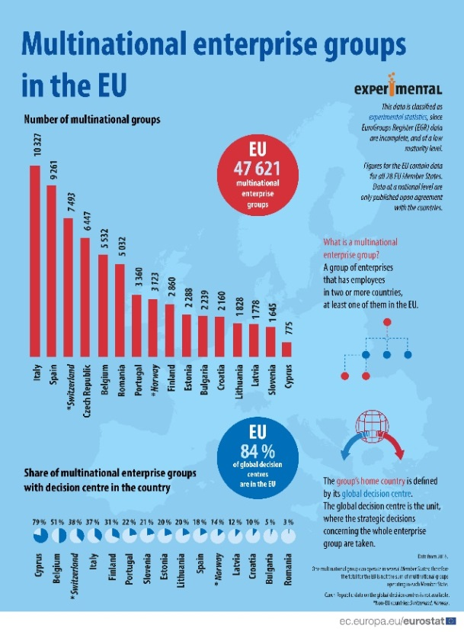

Experimental statistics based on EGR data (1)
In an effort to better respond to users' needs Eurostat publishes experimental statistics on the related Eurostat website based on the EGR data
The EGR experimental statistics article focuses on the population of the active multinational enterprise groups in the EU and EFTA countries
Active multinational enterprise groups in the EU mean groups that have employees in two or more countries, at least one of them in the EU

Slide 14
Experimental statistics based on EGR data (2)
According to the EGR, 47 621 active multinational groups were registered in the EU in 2016
40 081 were from EU Member States (their global decision centres were in EU Member States)
The rest from other countries, mostly from Switzerland (2 843), United States (2 200), Norway (441), followed by Japan (350) and Canada (200)
The EGR is a very rich data source, Eurostat and the NSIs are continuously working to improve its quality
Having sufficient quality level in the future, the EGR can be the source of very relevant and valuable European official statistics

Slide 15

Open algorithms of experimental statistics output
Openness
Quality
Transparency
Trust
Accountability
Clearness
https://github.com/eurostat/statistics-coded/tree/master/icts/multinational_enterprise_groups_SQL

Slide 16
Outlook for EGR production and use
Eurostat and the NSIs are continuously working to improve the quality of EGR
Further improvements are planned on the EGR processes, on its coverage, accuracy and timeliness
Additional data sources will be analysed and used in the future
The main goal of Eurostat is to enhance the use of the EGR in official statistics

Slide 17
Further information on EGR
Information on the EGR on Eurostat website:
https://ec.europa.eu/eurostat/web/structural-business-statistics/structural-business-statistics/eurogroups-register
Entry page to the EGR articles on Eurostat Statistics Explained website:
https://ec.europa.eu/eurostat/statistics-explained/index.php?title=EuroGroups_register
Experimental statistics from EGR on Eurostat website:
https://ec.europa.eu/eurostat/web/experimental-statistics/multinational-enterprise-groups

Slide 18
Thank you!
Questions
Contact:
estat-egr@ec.europa.eu

