Slide 1
Implementing ModernStats standards in Statistics Norway
NTTS 2019, Brussels 11-14 March - Trygve Falch (trygve.falch@ssb.no)
@trygu
github.com/statisticsnorway

Slide 2
GSBPM in Statistics Norway
We have translated into Norwegian and added more details
Used as a reference model for internal and national communication and collaboration
Used as a tool for the ongoing modernization effort in Statistics Norway

Slide 3
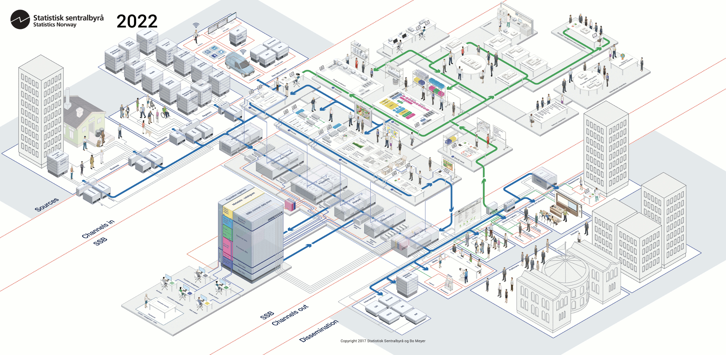

Slide 4
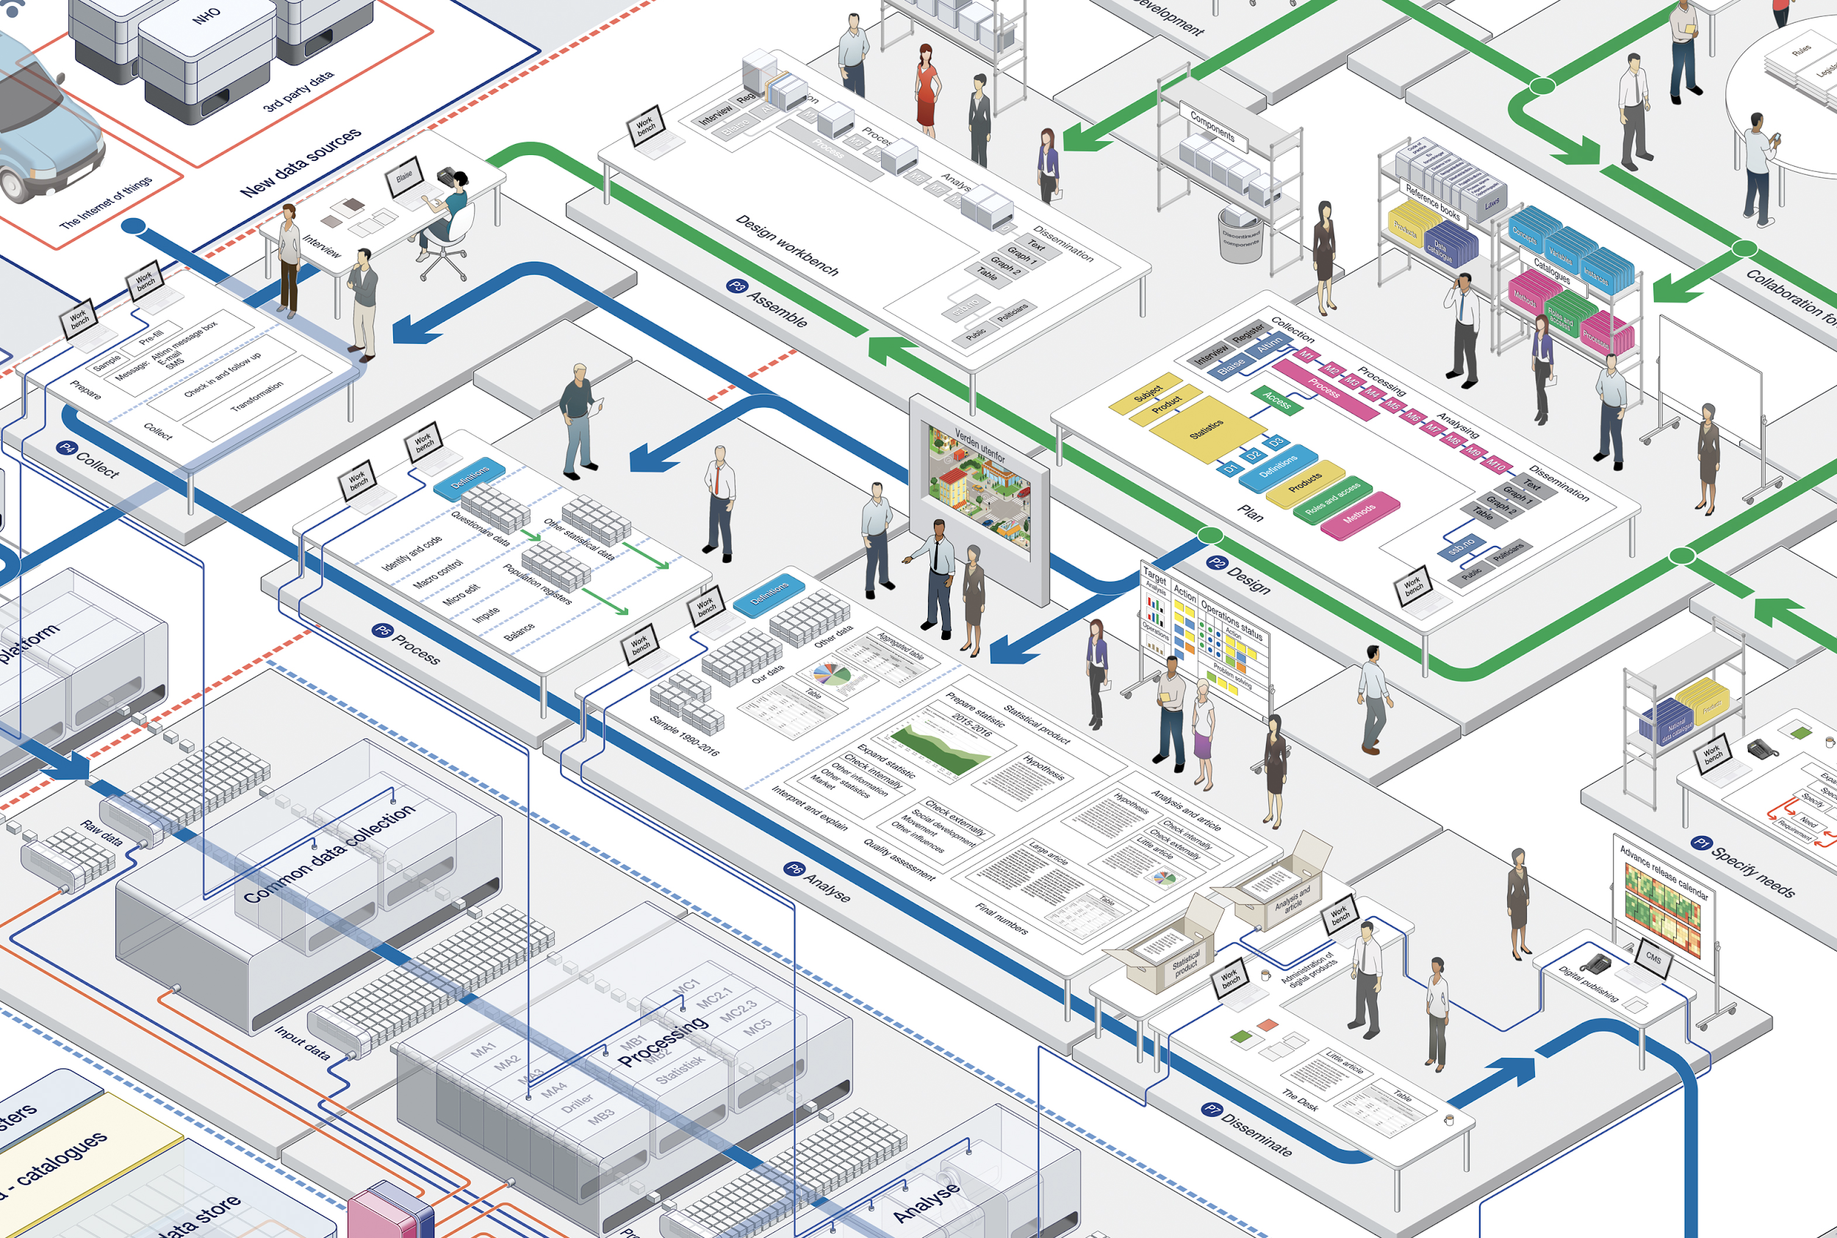

Slide 5
GSIM in Statistics Norway
Ease of internal communication
Ease of external (with other government organisations or data provider/consumers) communication
Facilitate re-using/sharing of methods, service or capability within the organisation
Facilitate re-using/sharing of methods, services or capability with other organisations e.g. data archives
Potentially reducing the number of silo systems that have to be maintained
We are systematically mapping our systems to use GSIM

Slide 6
Example of implementation - Linked Data store (LDS)
Data silos across the statistical production line
Lack of coherent data and metadata access (where is our data!?)
Versioning and data lineage
Reduce lock in and increase ability to adopt new technology fast
Cloud native approach
Service oriented

Slide 7
What is it?
General purpose, logical data API for any type of structured data
Provider API (Adapters) for any type of underlying storage technology
Time based versioning for all providers
Describe data layer schema using an extended RAML specification (Rest API modeling language) (GSIM modelled as JSON-schema)
Distributed
Open source

Slide 8
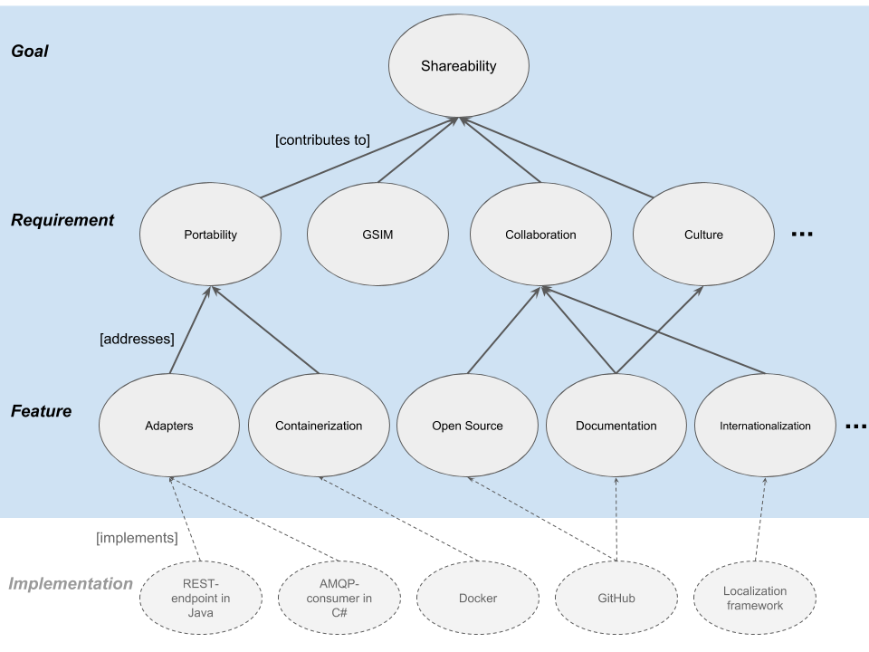
CSPA
Design principles
Features (Adapters, Containers)
Not prescriptive
Ports and adapters
Think about the abstractions
Databases and storage
Output
Used as guidance for designing services

Slide 9
Example of implementation - Java-VTL
Simple, and standardized data transformation and processing capability for statisticians
The system uses VTL to visualize data lineage
Used in a workbench, with simple coding IDE with syntax highlighting and syntax check
Notes:
We use it mostly for transformation, although we have implemented some of the validation functionality.
We have made a data connector to our classification system, so that we can use VTL to do simple code list validation f.ex.

Slide 10
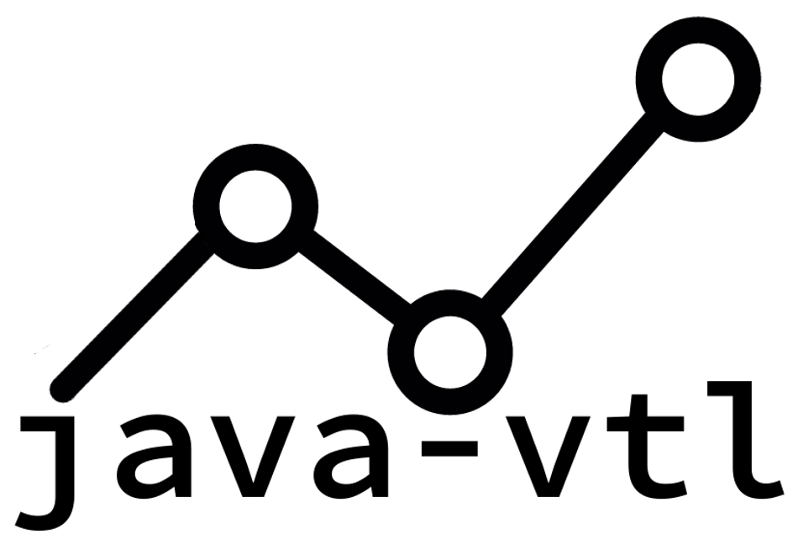
What is it?
Java implementation of the VTL specification
Provider interfaces which can connect to any data source (Adapters)
Supports transformations and simple validations
Supports filter propagation (filtering close to the data).
We have T-shirts! http://bit.ly/java-vtl

Slide 11
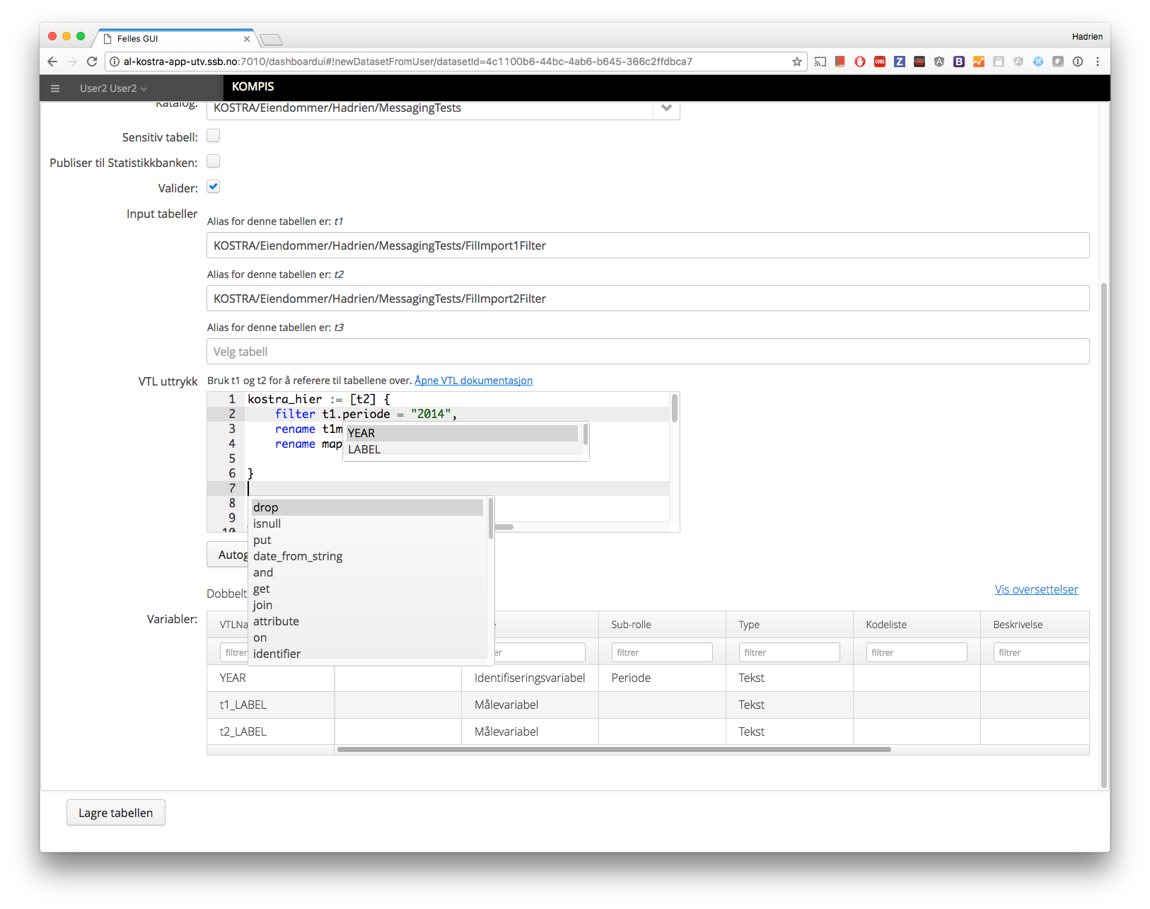

Slide 12
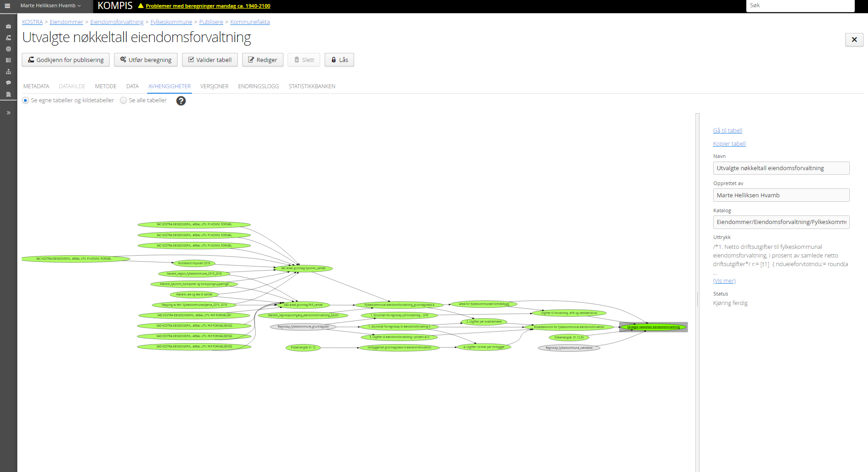

Slide 13
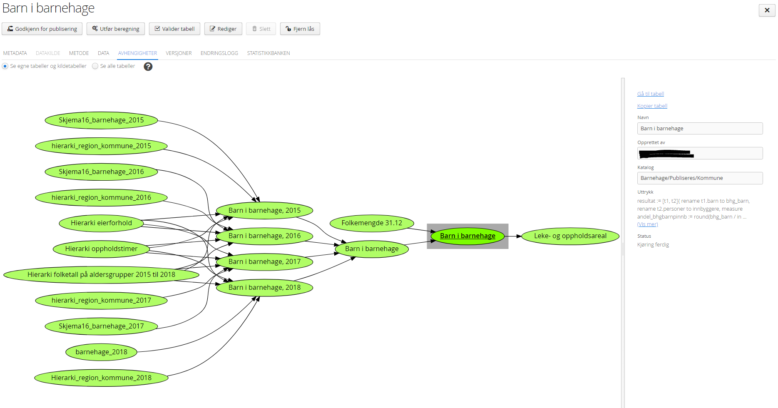

Slide 14
Thank you!
And now; Links
Java-VTL: http://java-vtl.org
LDS: http://bit.ly/lds-repository
GSIM Logical Information Mode machine readable: https://github.com/statisticsnorway/gsim-raml-schema
Statistics Norway Vision (full res): http://bit.ly/ssb-vision

