Slide 1
MARS: A method for defining products and linking barcodes of item relaunches
Antonio Chessa
Statistics Netherlands, Consumer Prices
NTTS conference 2019, Brussels, 14 March 2019

Slide 2
Outline
Product definition in the Consumer Price Index (CPI)
Modernisation of price collection
MARS: A new approach to product definition
Illustration of the method
Final remarks

Slide 3
Traditional price collection
Samples of products are set up
Products are defined in terms of attributes
A representative item is chosen for each product
Item prices are recorded each month (in shops, by phone)
A replacement is chosen if an item is no longer available

Slide 4

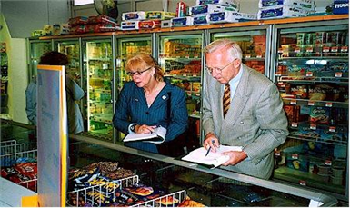

From pen-and-paper to electronic data sets

Slide 5


Transaction (scanner) data
Variables | Values
Year + week | 201502
GTIN (barcode) | 5410013119500
GTIN description | SPA REINE
Package size | 1
Package volume | 1 L
Item group code | 343
Item group description | Water uncarbonated
Sales value (expenditure) | 71,000
Sales quantity | 100,000

Slide 6
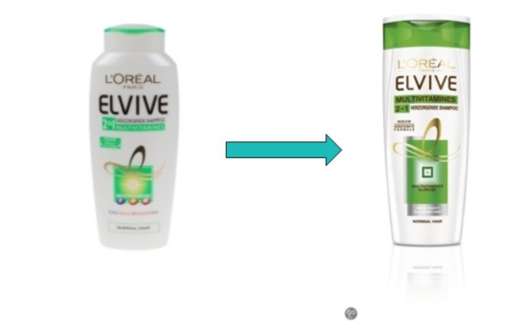

GTINs as products: The ‘relaunch’ problem
OLD
NEW
GTIN: 3600521740767
GTIN: 3600522004998
Elvive shampoo 2-in-1 multivitamine
Volume: 250 ML
Price week 38, 2011: € 3,18
Price week 39, 2011: € 2,00
Elvive shampoo 2-in-1 multivitamine
Volume: 250 ML
Not yet sold
First price, week 39, 2011: € 3,98
Clearance price
Price after reintroduction

Slide 7


Product definition: MARS balances two factors
Stable assortments ⇒ GTINs
Dynamic assortments: ?
Homogeneity
Continuity
Homogeneity
Continuity
Tight
Tight
?
Broad
Broad

Slide 8
Illustration for TVs: (1) GTIN level
/continuity
GTINs: most detailed product level
High churn rate, low product match

Slide 9
(2) TVs grouped by screen size only
/continuity
Homogeneity is affected:
TVs of different screen types, brands, etc.
end up in the same size clusters
Product match is maximised

Slide 10
(3) By screen size, screen type and 3D
/continuity
(2) → (3): Homogeneity clearly improves
(2) → (3): Product match stays high

Slide 11
MARS: Combining the two measures
MARS = Match Adjusted R Squared

Slide 12
Focus on last months of year

Slide 13
Summary of findings
Product definition:
  GTINs are fine for stable assortmens (e.g. food)
  By set of attributes for more dynamic assortments (pharmacy products, clothing, electronics)
  Relaunches and price increases are picked up by MARS
Range of application:
  Different types of product can be handled
  MARS can be combined with any index method
Product definition can be automated to high degree

Slide 14
Future challenges
Applications to web scraped data
Applications beyond CPI?
Available metadata:
  Sparse: Are variables sufficient? Is it possible to establish this?
  Rich: Combinations of variables too many to enumerate ⇒ Efficient methods needed (e.g. combine MARS with simulated annealing?)

Slide 15
More info
A full paper is available
Contact: ag.chessa@cbs.nl

Slide 16
Thank you!
Questions?

