Slide 2
Perturbative methods for ESS census tables
Current status of SGA N° 2018.0108 under the FPA N° 11112.2014.005-2014.533
Co-financed by the European Commission
Peter-Paul de Wolf
14 March 2019

Slide 3
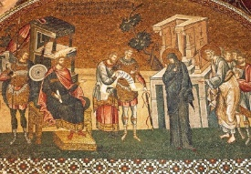
Introduction
Population census has long history
Eurostat: census hub (https://ec.europa.eu/CensusHub2/)
data from 32 European countries
Big step: Harmonized census output
But: No harmonized statistical disclosure control approaches (Member states used their own methods)

Slide 4
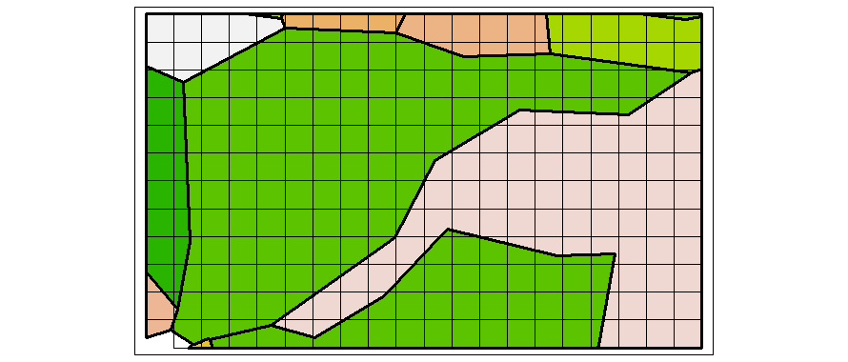
Introduction
Census 2021: also harmonized SDC ?
SGA “Harmonized protection of census data in the ESS”
Recommend methods for protecting census hyper-cubes
Grid squares (1 km²) AND administrative areas
new

Slide 5
Introduction
Two suggested methods:
(TRS)
and / or
(CKM)
Targeted Record Swapping
Adding noise using Cell Key Method

Slide 6
Targeted Record Swapping
Pre-tabular method (changes in microdata)
Preparation:
Specify variables that define risk (k-anonymity)
Specify variables that define regional hierarchy
Calculate risk for all households at each regional level
Specify variables that define “similar” households
Specify minimum swap rate

Slide 7
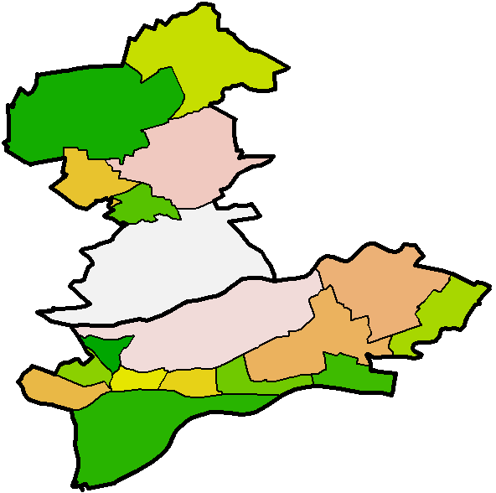
Targeted Record Swapping
Go from highest regional level to lowest:
Make donor-set of households
“Similar” households of the high risk households
Draw a donor household for a high risk household
Same regional level, different region
Swap all regional variables
If minimum swap rate is not reached, swap additional households at lowest regional level

Slide 8
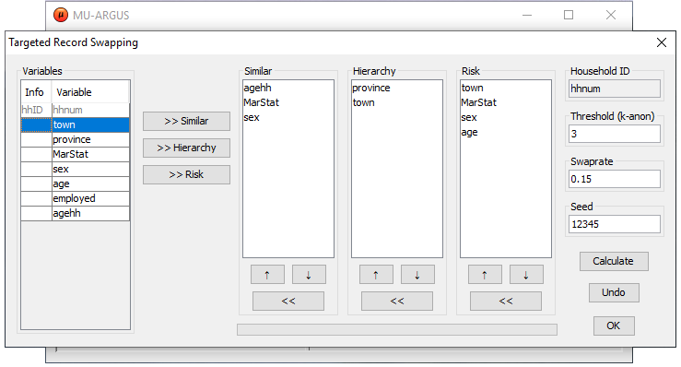
TRS Implementation
C++ code (library)
Callable from µ-Argus
Callable from R using e.g., package* recordSwapping
swapdata <- recordSwap(data,similar,hierarchy,risk,hid,th,swaprate,seed)
All available through subpages of TargetedRecordSwapping on
https://github.com/sdcTools/protoTestCensus
*TRS will become part of sdcMicro package

Slide 9
Noise addition using Cell Key Method
Post tabular method (noise added to table cells)
Determine p-table
Draw $𝒰(0,1)$ value for each record = record key
Sum record keys of records in each table cell
Assign fractional part of that sum as cell key to each table cell
Use cell value AND cell key AND p-table to get amount of noise to add to that cell

Slide 10
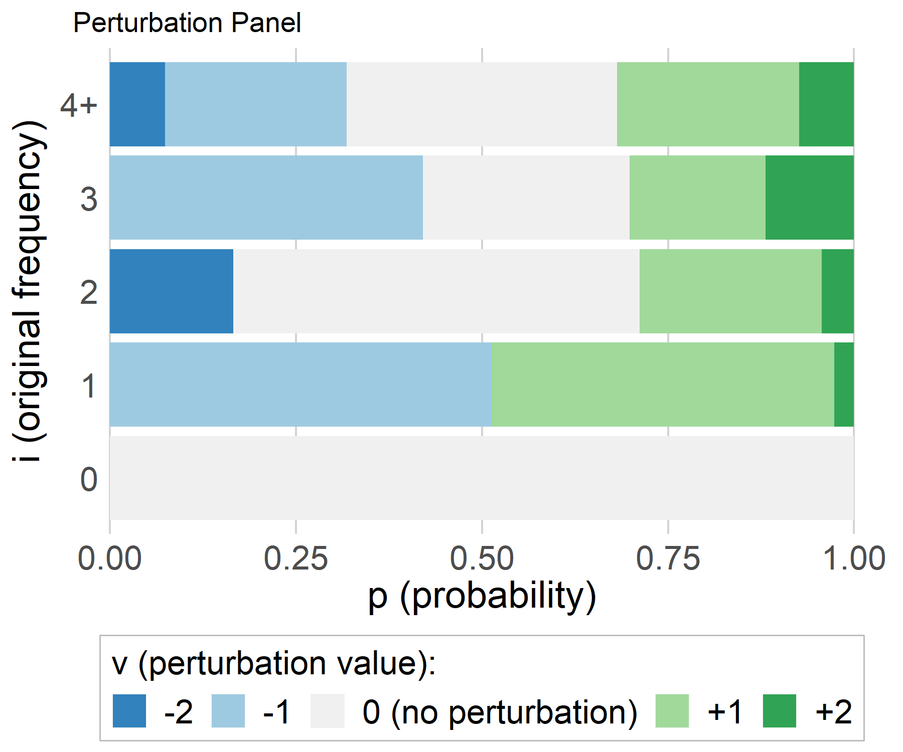
1. Determine p-table
p-table: Transition probabilities (R-package ptable)
p_{ij} = P(cell value i is changed into value j)
E.g., probabilities
Cumulative
_{i} ^{j} | 0 | 1 | 2 | 3 | 4 | 5 | 6
0 | 1 | 0 | 0 | 0 | 0 | 0 | 0
1 | 0.5133 | 0 | 0.4600 | 0.0267 | 0 | 0 | 0
2 | 0.1656 | 0 | 0.5463 | 0.2449 | 0.0432 | 0 | 0
3 | 0 | 0 | 0.4208 | 0.2776 | 0.1824 | 0.1192 | 0
4 | 0 | 0 | 0.0739 | 0.2442 | 0.3637 | 0.2442 | 0.0739
v = j – i :

Slide 11
2.–4. Draw record-keys and make cell-keys
ID | Sex | Age | Record Key
1 | M | A | 0.34582249
2 | F | B | 0.68438579
3 | F | B | 0.95880618
4 | F | C | 0.62902289
5 | M | B | 0.86598721
6 | F | C | 0.36307981
7 | M | A | 0.91420393
8 | M | A | 0.69629390
9 | M | B | 0.53460054
10 | F | B | 0.68511663
11 | F | B | 0.03426370
12 | M | B | 0.33696811
13 | F | B | 0.11181613
14 | F | A | 0.56526973
15 | M | A | 0.01047942
Sex | Age | i | Cell Key
T | T | 15 | 0.73611646
T | A | 5 | 0.53206947
T | B | 8 | 0.21194429
T | C | 2 | 0.99210270
M | T | 7 | 0.70435560
M | A | 4 | 0.96679974
M | B | 3 | 0.73755586
M | C | 0 | 0
F | T | 8 | 0.03176086
F | A | 1 | 0.56526973
F | B | 5 | 0.47438843
F | C | 2 | 0.99210270
Sex = M
Age = B
Sum=1.73755586

Slide 12
5. Determine amount of noise to add
Cumulative
Sex | Age | i | Cell Key
T | T | 15 | 0.73611646
T | A | 5 | 0.53206947
T | B | 8 | 0.21194429
T | C | 2 | 0.99210270
M | T | 7 | 0.70435560
M | A | 4 | 0.96679974
M | B | 3 | 0.73755586
M | C | 0 | 0
F | T | 8 | 0.03176086
F | A | 1 | 0.56526973
F | B | 5 | 0.47438843
F | C | 2 | 0.99210270
v = j – i :
(M, B): i = 3
(M, B): j = i + 1 = 4

Slide 13
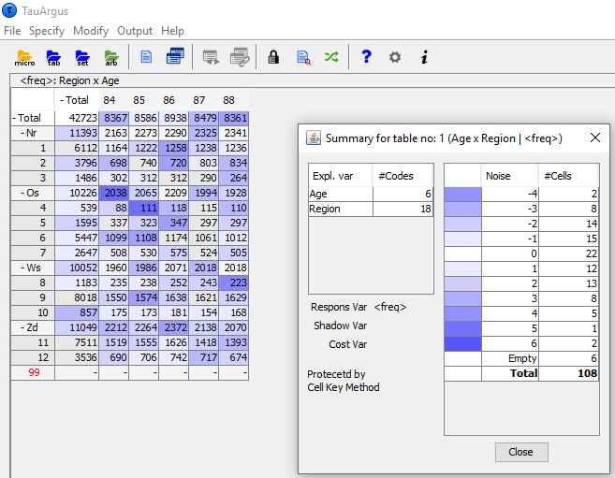
CKM implementation
Part of τ-Argus
R-package cellKey
inp <- ck_create_input(…)
new_table <- perturbTable(inp,dimList)
All available through subpages of CellKey on
https://github.com/sdcTools/protoTestCensus

Slide 14
Preliminary tests by project partners
CKM implementations
Test set of up to 10 million records
2011 census hypercubes 9.1-9.4 and 11.1-11.2
Acceptable runtime
Record keys and p-table need to be generated outside of τ-Argus
To force same record keys and p-table between runs
Easy to use

Slide 15
Preliminary tests by project partners
TRS implementations
Only tested with relatively small datasets
Very fast
Easy to use

Slide 16
Further tests
Open for census teams to test the implementations (announced in Eurostat email on 17 December 2018)
Already some feedback:
some questions on how to install
some questions on how to choose parameters

Slide 17
Next steps
Extend risk and utility measures
Guidelines for appropriate parameter values
Communication of method to public (users)
What parameters / quality measures can be given?
How does method protect census information?
Extend idea of CKM to more general situations

Slide 18
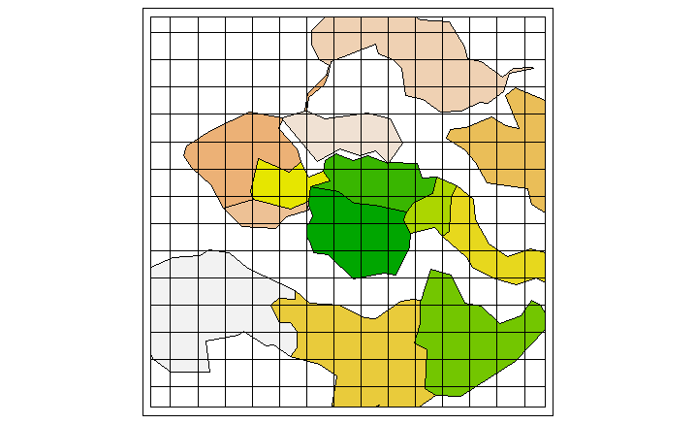
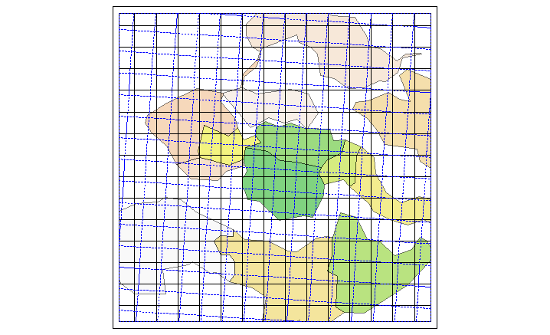
Next steps
Need (more) feedback from census teams on usage
Need feedback from users of protected tables
Assess risk related to
Grid cells versus administrative regions
European grid versus national grids
Any help/input is welcome!

