Slide 1


NTTS 2019
Brussels, March 2019
Functional geographies through the
package LabourMarketAreas
Daniela Ichim, Luisa Franconi
Istat, Italian National Statistical Institute
ichim@istat.it, franconi@istat.it

Slide 2
Outline
Labour Market Areas (LMAs)
  Italy
Multisource travel-to-work commuting data
  Extensions – MS, Cross-Border LMAs, European LMAs (LMAonLMA)
  Future Population Census
  Feasibility of enumeration areas and European 1km grid
  Conclusions
New Techniques and Technologies for official Statistics - NTTS 2019
Brussels, 12–14 March 2019

Slide 3
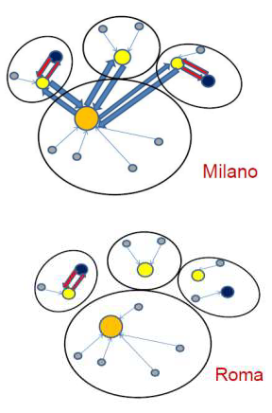
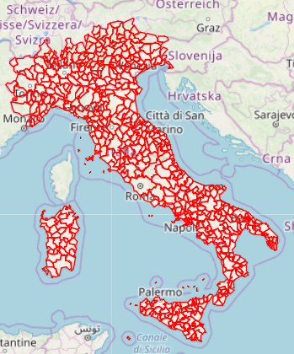
Labour Market Areas - LMAs
Labour Market Areas
  Definition sub-regional geographical areas where the majority of the labour force lives and works
  Usage comparable territories for policy making, reporting and analyses
      Employment; unemployment
      Complex and non complex industrial crisis areas
      [DL 83/2012, …, DM 4.08.2016]
New Techniques and Technologies for official Statistics - NTTS 2019
Brussels, 12–14 March 2019

Slide 4
LMAs
  2013-2017 work at European level https://ec.europa.eu/eurostat/cros/content/labour-market-areas_en
    shared sound methodology (greedy clustering algorithm)
  2016 Istat released the package LabourMarketAreas
    www.cran.r-project.org
    complete documentation of the implementation
    guidelines on the LMA delineation process
New Techniques and Technologies for official Statistics - NTTS 2019
Brussels, 12–14 March 2019

Slide 5
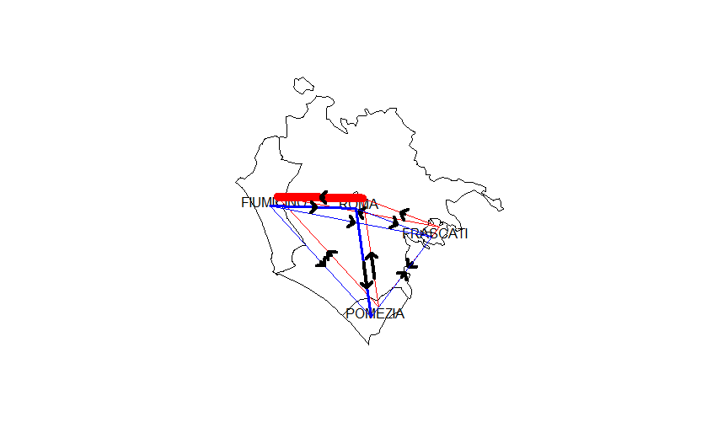
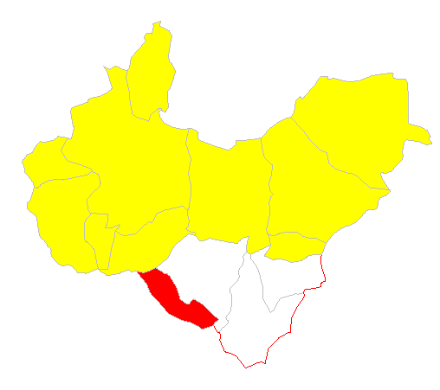
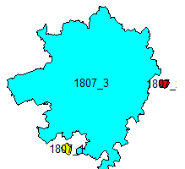
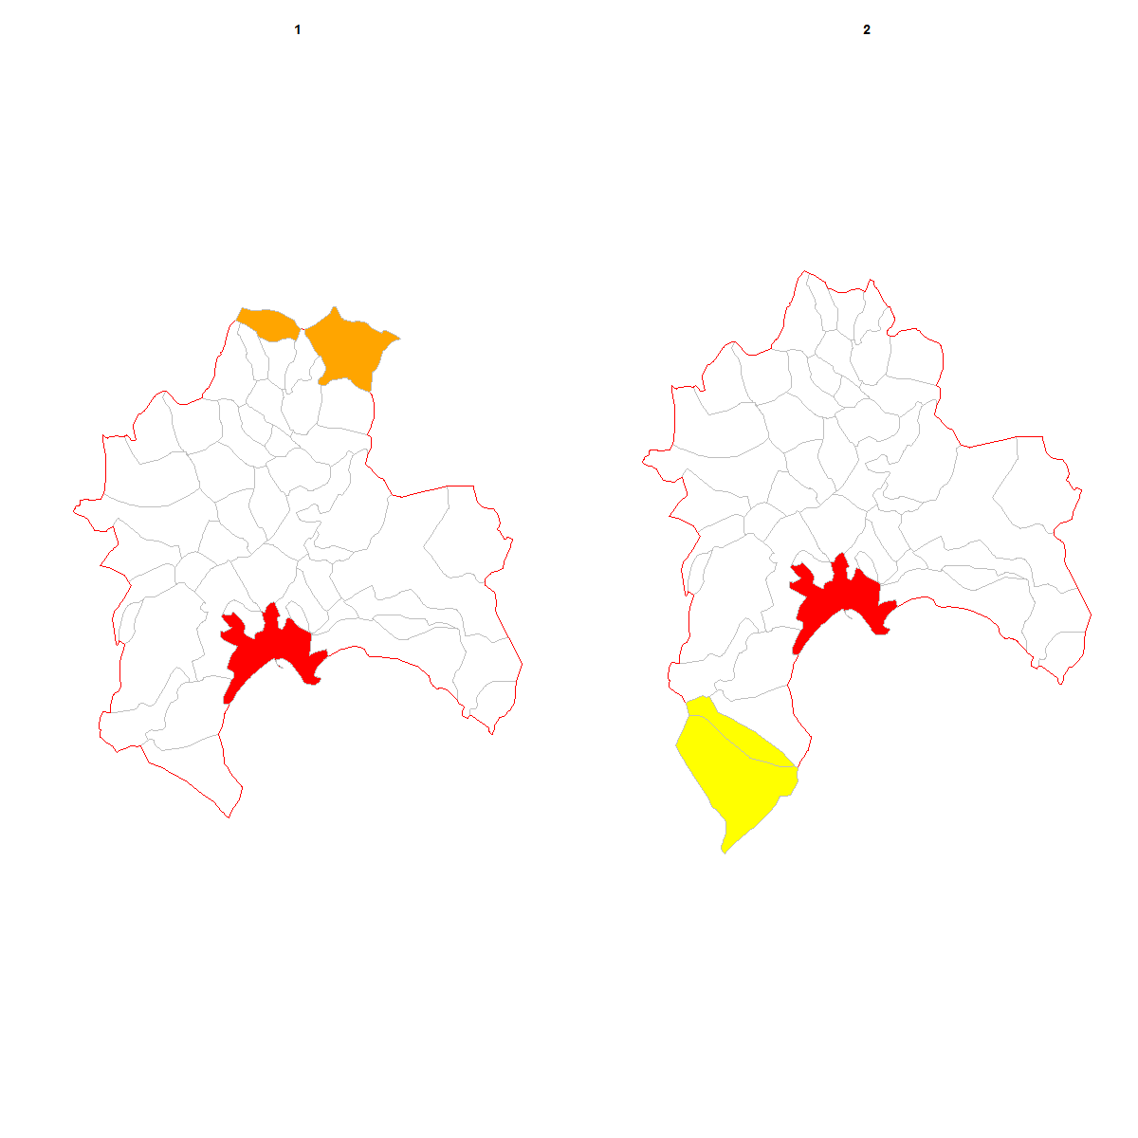
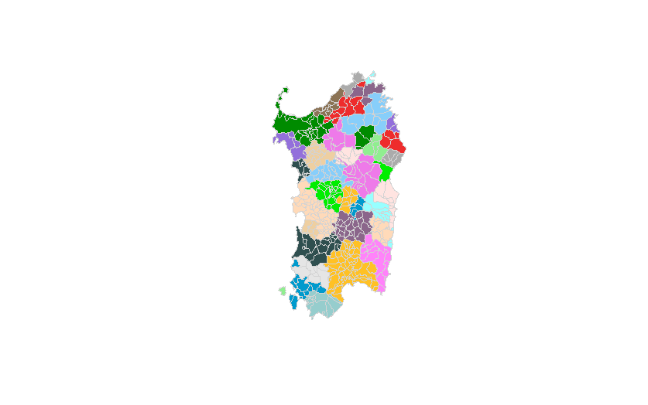
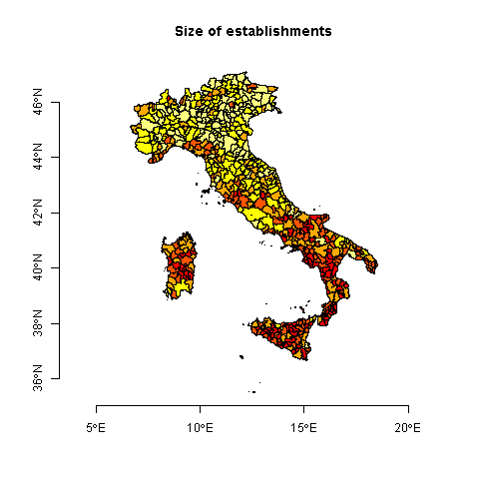
The R package LabourMarketAreas – modular structure
1. Preliminary treatment
2. Partition
3. Fine tuning
4. Analysis
5. Dissemination
6. Dissemination

Slide 6
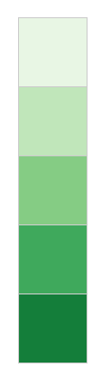
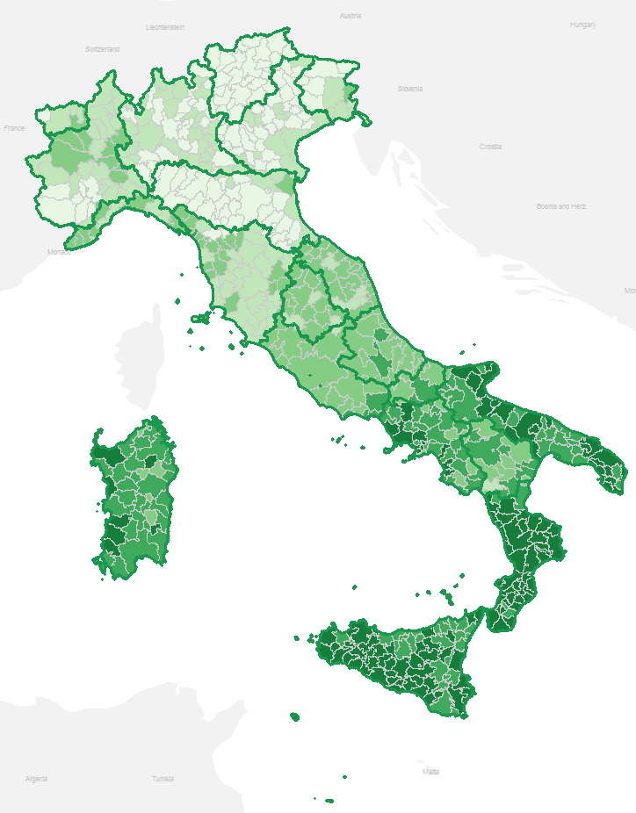
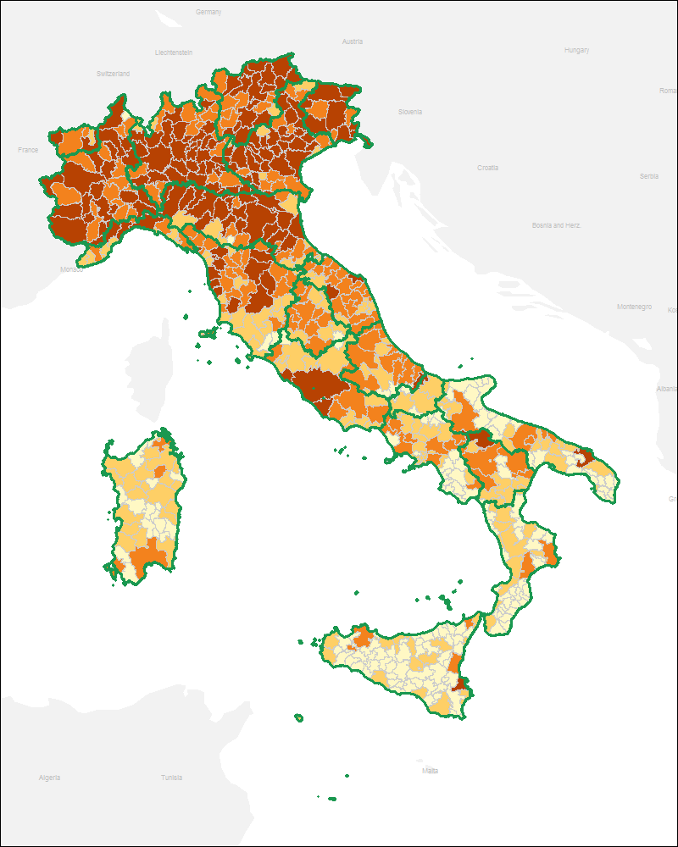
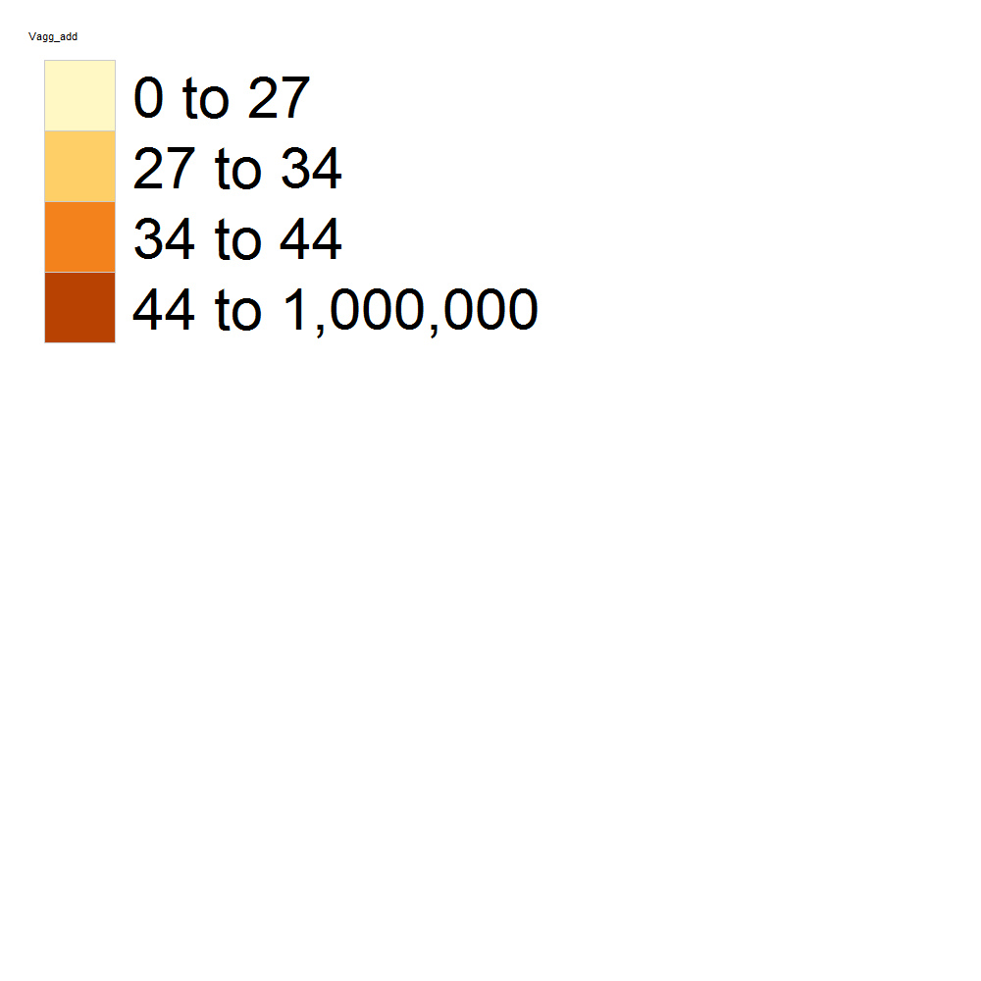
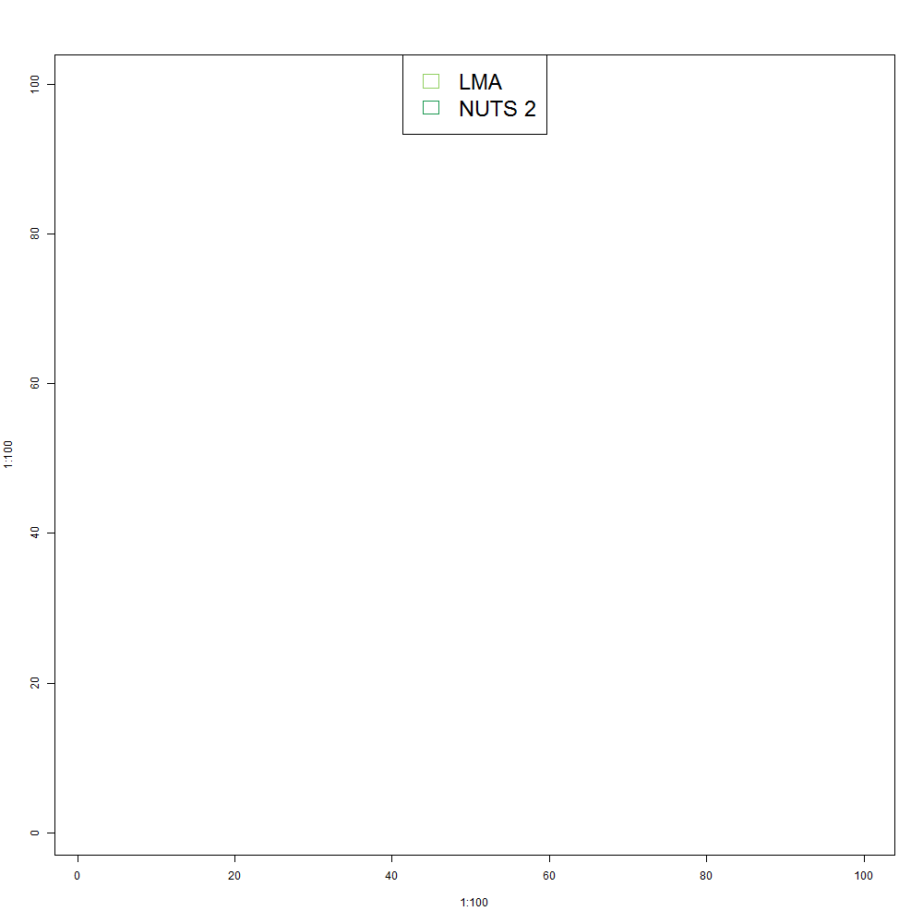
LMAs in Italy
2.4—7.2
< 27
7.2—9.2
9.2—13.8
27—34
13.8—19
34—44
> 19
> 44
NUTS 2
NUTS 2
  Istat, Unemployment rate, 2016
  Istat, Labour productivity, 2015 (1000 euro)
New Techniques and Technologies for official Statistics - NTTS 2019
Brussels, 12–14 March 2019

Slide 7
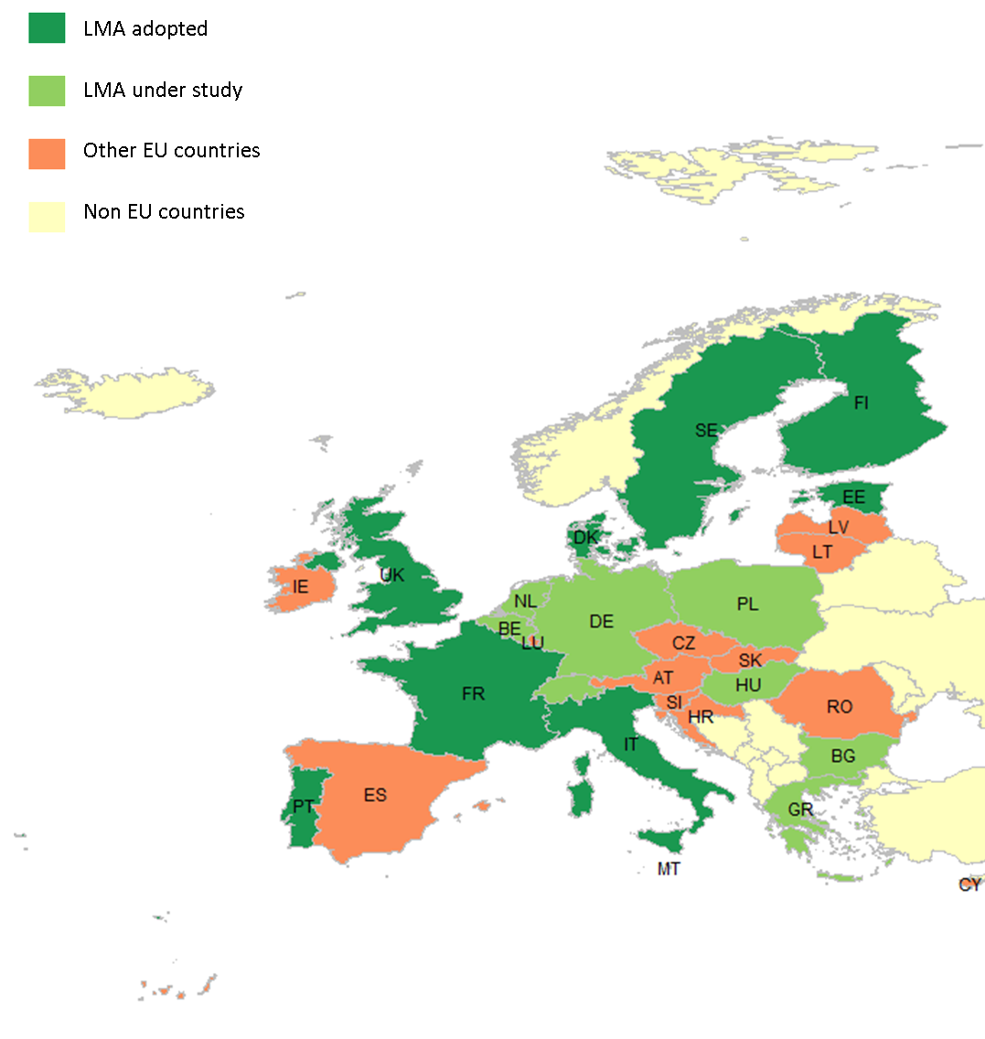
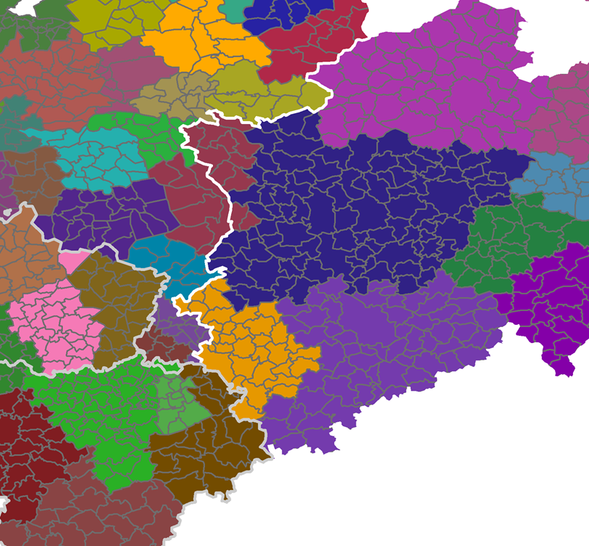
LMAs in Europe
package LabourMarketAreas
    NL, BE
New Techniques and Technologies for official Statistics - NTTS 2019
Brussels, 12–14 March 2019

Slide 8
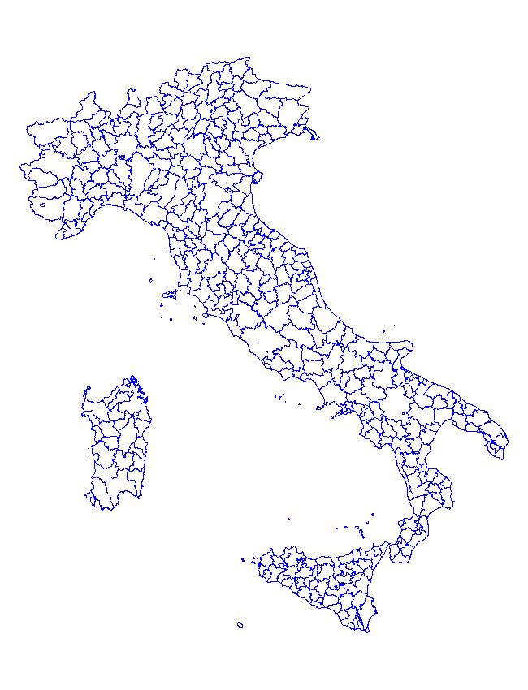
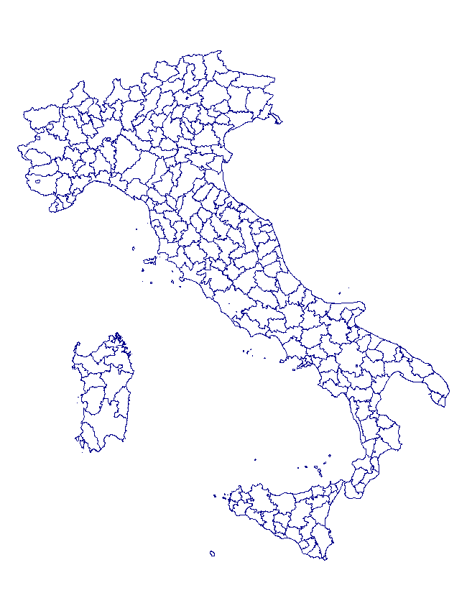
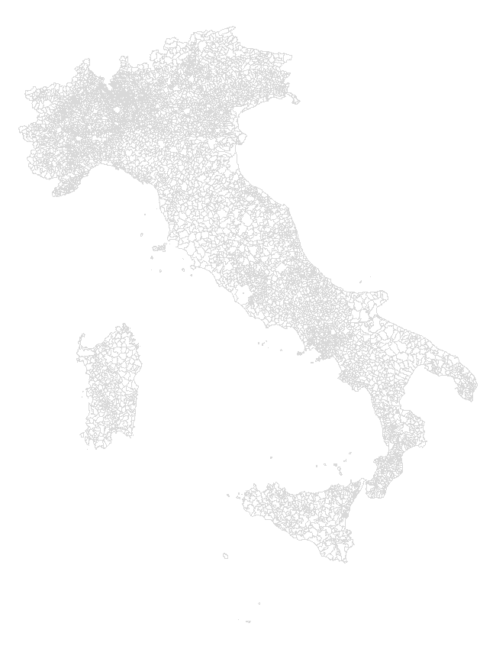
LMAs recent developments: EU comparability
EU Functional Areas
  using as building blocks the national LMAs
    built using the same parameters for the whole of Europe and
    the same tool, the package LabourMarketAreas
  LabourMarketAreas
  LabourMarketAreas
National parameters
Common EU parameters
LAUs LMAs EU Functional Areas
8
New Techniques and Technologies for official Statistics - NTTS 2019
Brussels, 12–14 March 2019

Slide 9
LMAs – next round
      Census 2011 - complete enumeration
      Census 2021 - administrative and survey data
      integration/estimation methods need to be developed
      survey data: precise definition of commuters but commuters refer to different periods in time, possibly different sub-populations, samples ….
      administrative data: possibly no side information on the type of workers, the commuting, if any, and its intensity;
      flexible outputs / increased detail: spatial/geographic
New Techniques and Technologies for official Statistics - NTTS 2019
Brussels, 12–14 March 2019

Slide 10
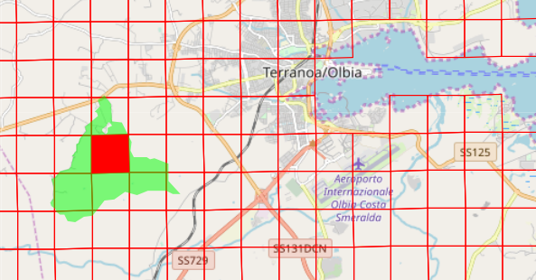
LMA at finer levels
Robustness of the package LabourMarketAreas
    Enumeration areas (EAs) / European grid 1km
    Commuter flows data from LAU to enumeration areas
      Spatial model; Istat web-site
    Commuter flows from EAs to European 1km grid
 |  |  |  | Population
 | N units | N flows | % flows = 1 | min | median | max
EU grid 1km | 310980 | 3925668 | 60% | 0 | 2 | 34151
LAU | 8092 | 538620 | 42% | 30 | 2522 | 2617175
New Techniques and Technologies for official Statistics - NTTS 2019
Brussels, 12–14 March 2019

Slide 11
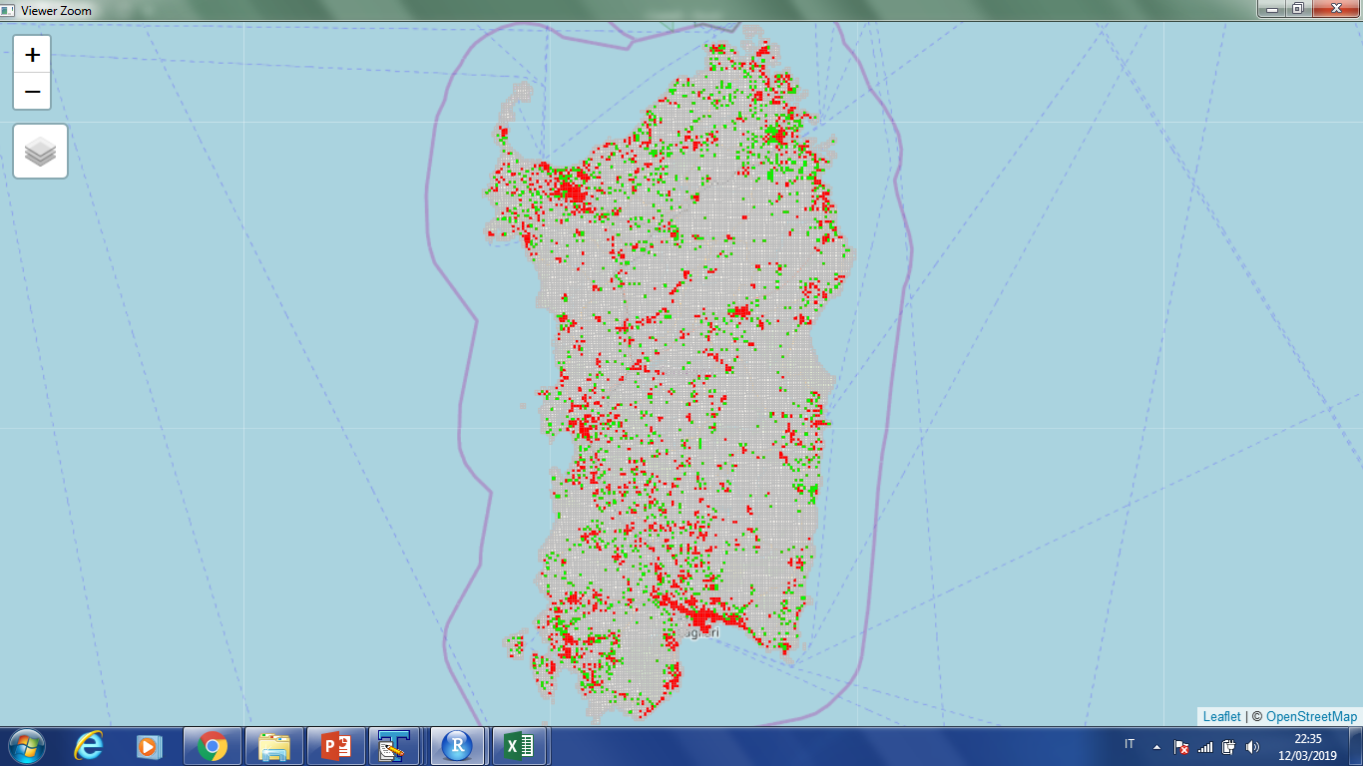
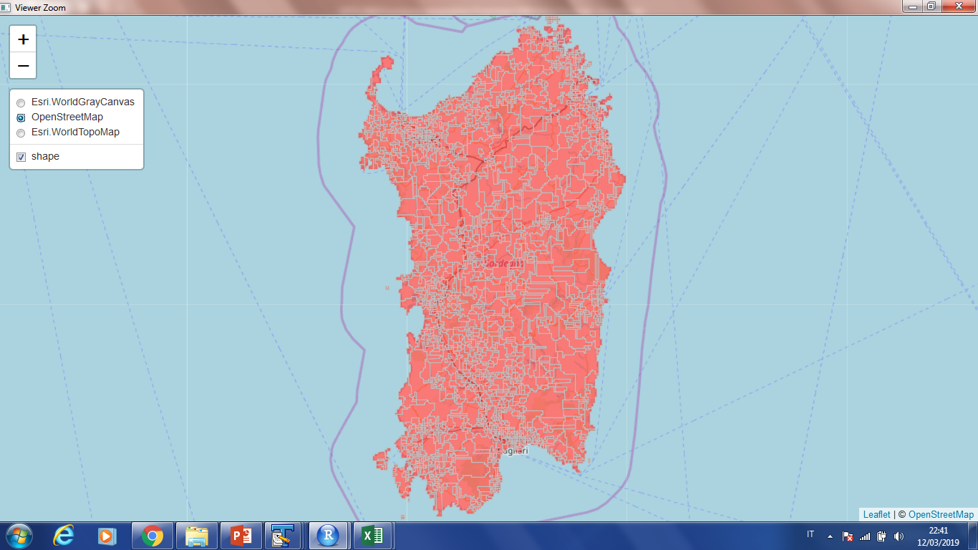
R LabourMarketAreas on grid
New Techniques and Technologies for official Statistics - NTTS 2019
Brussels, 12–14 March 2019

Slide 12
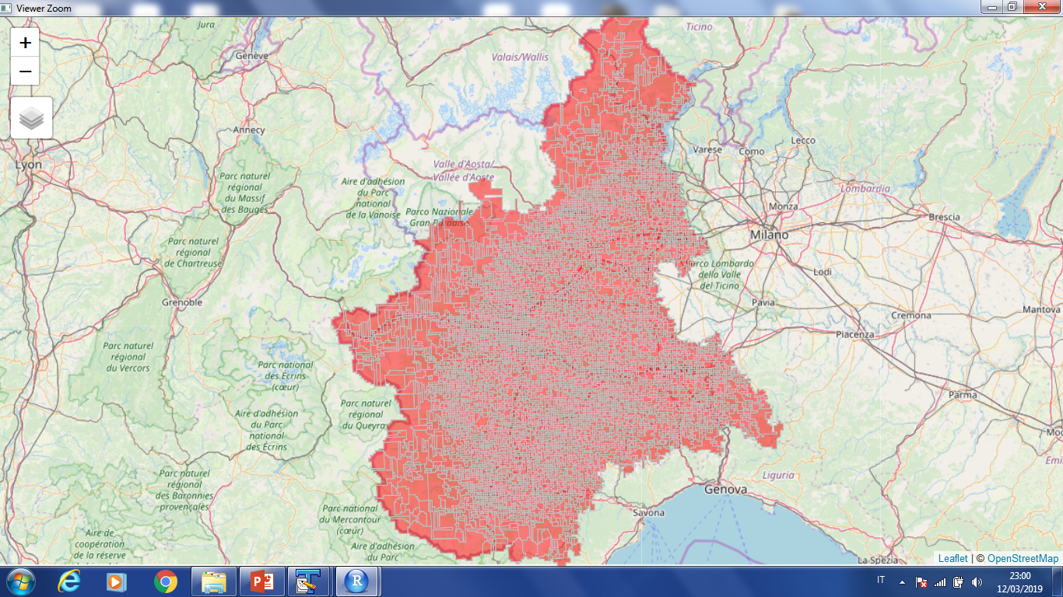
R LabourMarketAreas on grid
New Techniques and Technologies for official Statistics - NTTS 2019
Brussels, 12–14 March 2019

Slide 13
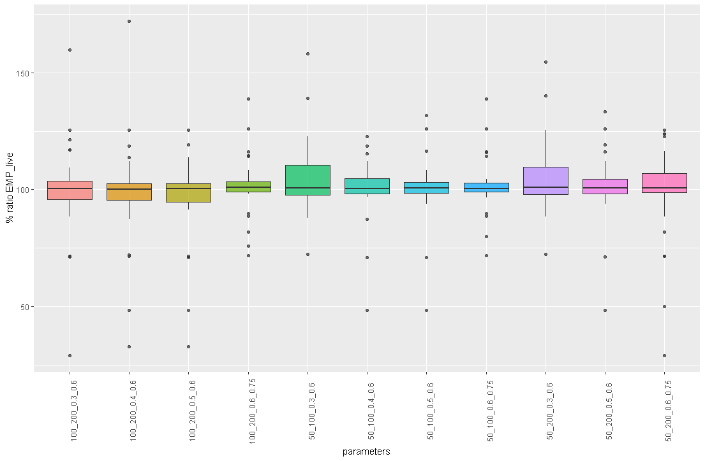
LMAonLMA on grid
  LabourMarketAreas to build the building blocks
  LabourMarketAreas using the national parameters
  Sardinia
  1st stage
New Techniques and Technologies for official Statistics - NTTS 2019
Brussels, 12–14 March 2019

Slide 14
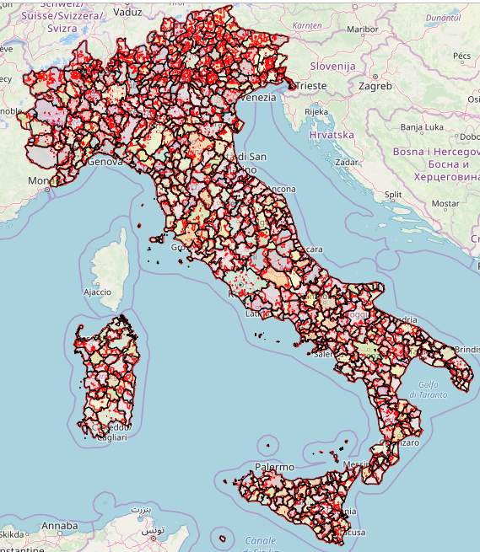
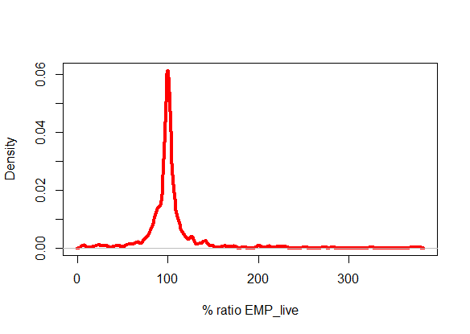
LMAonLMA on grid
LAU – 604 LMAs
European 1km grid – 569 LMAs
(1° stage parameters 50, 70, 0.3, 0.4)
80% between
84.1 and 120.7

Slide 15
CONCLUSIONS
LMA on grid:
  Free from any administrative borders
  Theoretical and computational issues to be considered
  Structural problems (automatic fine tuning) to be solved
  Grids and LAU similar LMAs
Robustness of the package LabourMarketAreas; EU challenge
LMAonLMA approach may be extended to other Member States/EU
New Techniques and Technologies for official Statistics - NTTS 2019
Brussels, 12–14 March 2019

Slide 16
Thank you!

