Slide 1
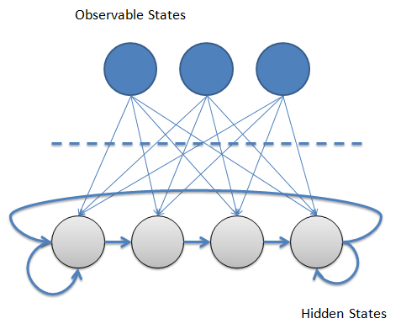


Integration of inconsistent data sources using Hidden Markov Models (HMMs)
Paulina Pankowska, Bart Bakker, Daniel Oberski & Dimitris Pavlopoulos

Slide 2

Background- measurement error and HMMs
Measurement error: threat to official statistics
NSI’s deal with the problem by:
  Using only the “superior” data source (timely statistics)
  Applying macro-integration (definite statistics)
An alternative solution:
  Applying latent variable modelling
    Latent class modelling (LCM)
    Hidden Markov Models (HMMs)
HMMs Consist of:
A structural part (latent/ true)
A measurement part (observed)

Slide 3
HMMs produCING official statistics?
    HMMs potentially attractive tool to correct for measurement error
But….
    They are complex, time consuming and expensive
    In most cases they require record linkage
    Might be (too) sensitive to changes in data collection processes
    Our research focus:
    Can HMMs be used to correct for measurement error in official statistics?
        Feasibility of parameter re-use
        Sensitivity to linkage error
        Effects of data collection processes (independent vs dependent interviewing)
3
Faculty / department / title presentation

Slide 4
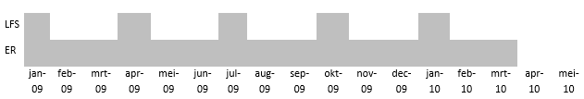
Data
  Linked dataset:
    Labour Force Survey (LFS)
    Employment Register (ER)
  8,886 individuals aged 25 to 55
  15 time points (months) per individual

Slide 5
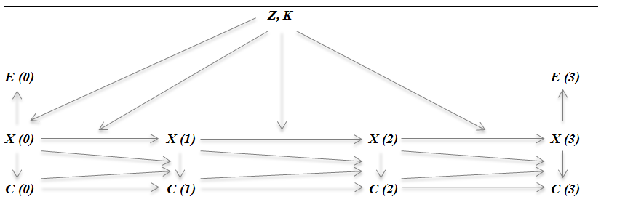
The hidden markov Model
        An extended two-indicator HMM
        Two indicators per time point
        Autocorrelation of error in register
        (Un)observed heterogeneity in latent initial probabilities and transitions
        Heterogenous latent transitions

Slide 6
feasibility of parameter re-use
  Analysing 2009 data ‘from scratch’
  compared to
  Re-using error parameters based on 2007 model estimates from Pavlopoulos and Vermunt (2015)
 | 3 monthly transition rates from temporary to permanent employment
LFS | 0.058
ER | 0.073
Original analysis of 2009 | 0.017
Re-using parameters from 2007 | 0.016
6

Slide 7
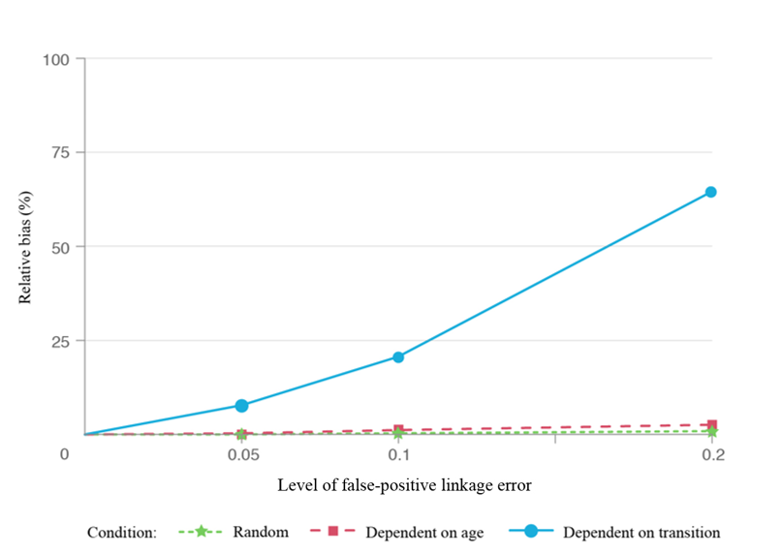
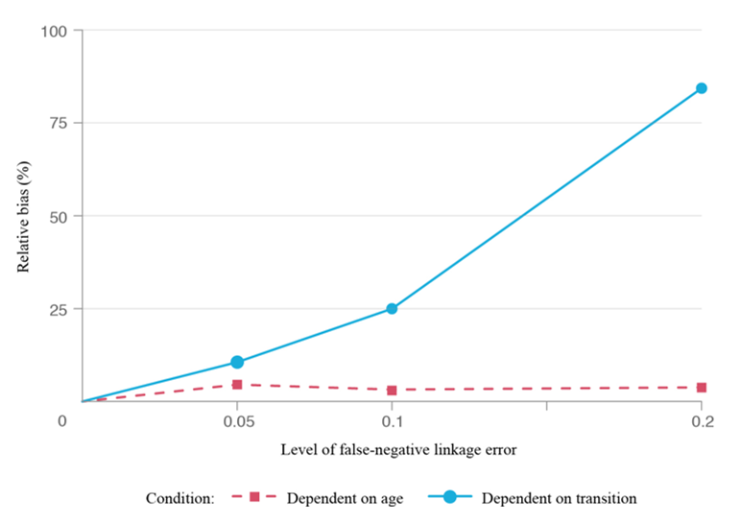

Relative bias from linkage error
Simulations with various degrees of false-negative (FN) and false-positive (FP) linkage errors:
    5, 10 and 20% of the individuals are excluded or mislinked
    Probabilities are (i) random (ii) depend on covariates correlated with outcome variable
    Individuals selected are mislinked (i) at random (ii) based on common characteristics – only for FP
    HMM estimations for each scenario are compared to original (‘linkage error free’) results
False-negative
False-positive
7

Slide 8


The effect of dependent interviewing
Temporary contracts
  DI:
      In place until end of 2009
      PDI- “remind, still”
      Only if no job change occurred
  INDI:
      In place since 2010
      Also in 2009 if job change occurred
  “Last time you had a temporary contract. Is this still the case?”
  “Do you currently have a permanent contract?”
8

Slide 9
The effect of dependent interviewing
Misclassification rates for those who had or would have had DI
Contract distribution and transition rates
(overall and by wave)
DI reduces random measurement error
DI increases systematic error
(overall and by wave)
(overall and by wave)
Scenario | Overall | Wave
 |  | 1 | 2 | 3 | 4 | 5
No job change & 2009- DI | 0,301 | - | 0,301 | 0,290 | 0,307 | 0,306
No job change & 2010- INDI | 0,297 | - | 0,291 | 0,295 | 0,300 | 0,305
Transition rate | 2009 |  | 2010
 | Observed | Latent | Observed | Latent
Temp to perm | 0,07 | 0,05 | 0,11 | 0,05
Autocorrelation not incl. | Autocorrelation incl. | Contract type
0,59 | 0,60 | Permanent
0,14 | 0,14 | Temporary
0,27 | 0,26 | Other
0,044 | 0,051 | Temp to perm transition rate
Observed at t-1 | Latent at t-1 | Latent at t | Observed at t
 |  |  | Perm | Temp | Other
Temporary | Permanent | Permanent | 0,10 | 0,90 | 0,00
Temporary | Other | Other | 0,00 | 0,87 | 0,13
9

Slide 10
Conclusions- what we know and what we want to know
Can we use HMMs to correct for ME when:
  There are more than 3 contract categories
  There are more covariates affecting the structural and/or measurement part of the HMM
How robust are HMMs to changes in data collection processes?
How can we combine HMMs and MI?
  Allows correcting for error in microdata
HMMs can potentially be used in the production of official statistics?
  Inexpensive- possible to re-use (error) parameters
  Linkage error largely not a problem
  Different data collection methods do not necessarily affect ME
10
Faculty / department / title presentation

Slide 11
Thank you!
Paulina Pankowska
p.k.p.pankowska@vu.nl
Bart Bakker
bfm.bakker@cbs.nl
Daniel Oberski
d.l.oberski@uu.nl
Dimitris Pavlopoulos
d.pavlopoulos@vu.nl
11
Faculty / department / title presentation

