Slide 1
Data(trans)forming
Roberto Barcellan
European Commission
DIGIT.D.1 – Data Services
NTTS2019
Brussels – 14 March 2019

Slide 2
Terraforming
transform (a planet) so as to
resemble the earth
especially so that it can support human life

Slide 3
Data(trans)forming
building tools, abilities, and, most crucially, a culture to exploit data …
1 1 0 1 0 1 0 1 0 0 1 0 1 0 1 0 1 0 0 1 0 0 0 0 1 0 1 0 0 1 0 1 1 1 1 0 0 1 1 1 0 0 0 0 1 0 0 1
1 0 1 0 0 1 0 1 1 1 1 0 0 1 1 1 0 0 0 0 1 0 0 1 1 1 0 1 0 1 0 1 0 0 1 0 1 0 1 0 1 0 0 1 0 0 0 0
0 1 0 1 0 1 0 0 1 0 0 0 0 1 0 1 0 0 1 0 1 1 1 1 0 0 1 1 1 0 0 0 0 1 0 0 1 1 1 0 1 0 1 0 1 0 0 1
0 0 1 0 0 1 1 1 0 1 0 0 0 1 0 0 1 1 1 0 1 0 0 0 1 0 0 1 1 1 0 1 0 0 0 1 0 0 1 1 1 0 1 0 0 1 1 1
for policy making
and functionning
to become a data-driven organisation
digital transformation

Slide 4
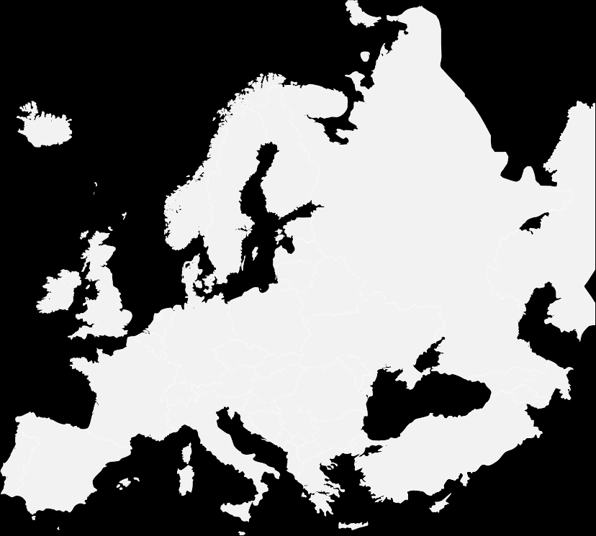
Towards Data-Driven Organisation
The higher purpose…
Better understanding of citizens’ needs
Human-centered
policies
Transparent and efficient processes and decisions
Better communication to the citizen

Slide 5
Digital Commission
Digitally transformed + User-focused + Data-driven
Digital Solutions
for Policy processes
for Administrative processes
Reusable Solutions Platform
Security
Governance
Data Ecosystem
Digital Infrastructure

Slide 6
Vincent
IT Architect
I want to use data for my work but…
Myriam
Policy Officer
Daniel
Data Scientist
What data can I find in my own DG?
Where can I find data?
Franco
IT Manager
How do I manage the data I have?
Myriam
Policy Officer
What are the tools / solutions I can reuse?
Who can help me extract insights from my data?

Slide 7
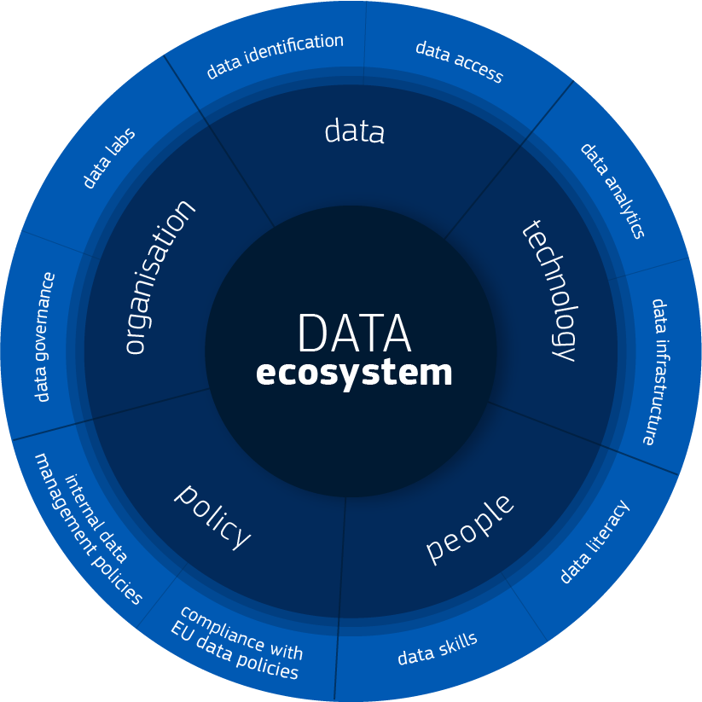
The Data Ecosystem
Who can help me extract insights from my data?
Where can I find data?
What are the tools / solutions I can reuse?
How do I manage the data I have?
What data can I find in my own DG?
The Data Ecosystem is a system of interconnected human and technological resources, working together to extract value from data and to use it for decision-making.

Slide 8
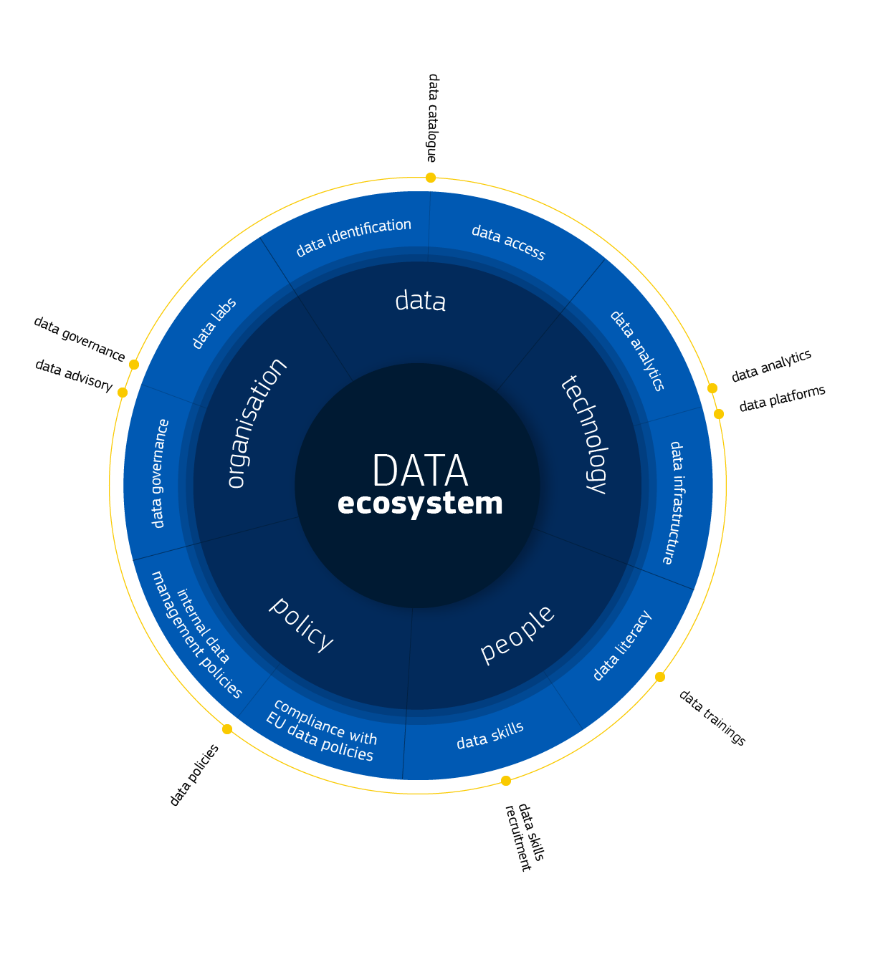
The Data Ecosystem
8 Actions
21 Enablers
5 Dimensions
10 Strategic Objectives

Slide 9
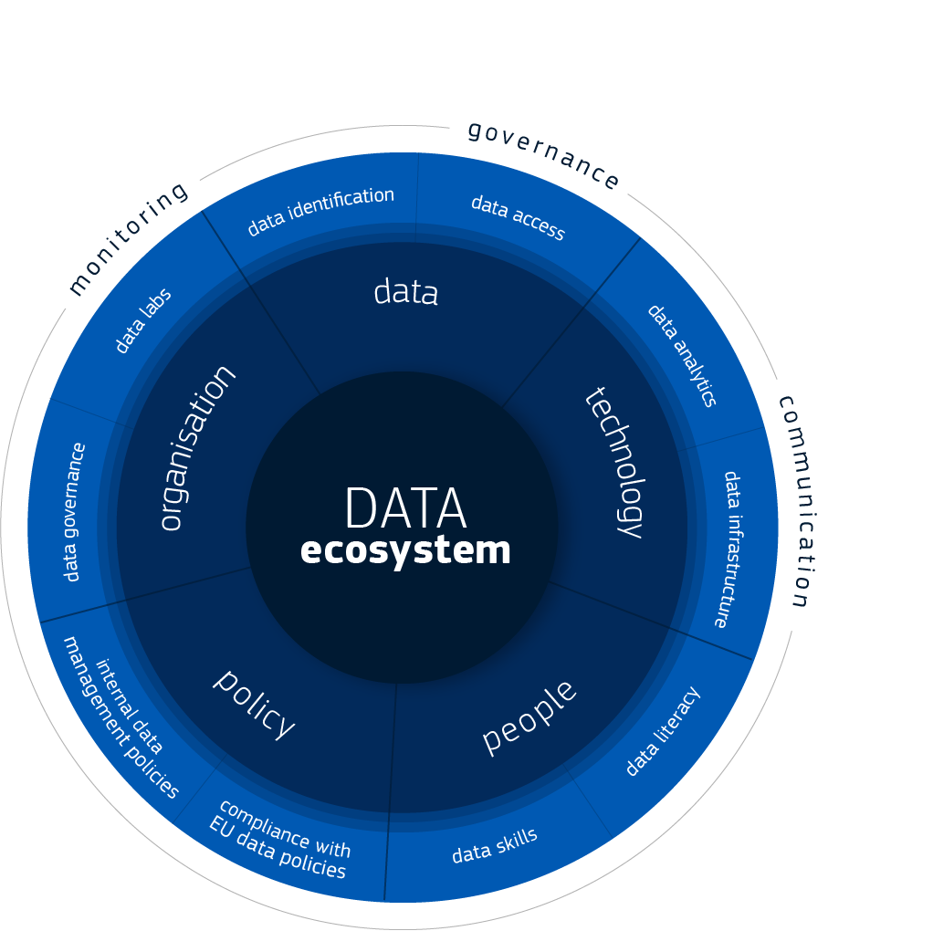
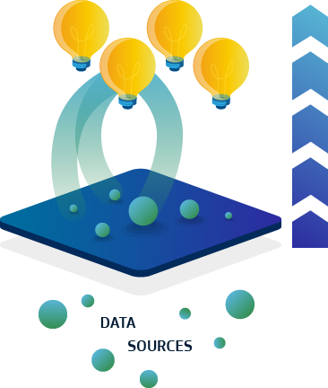
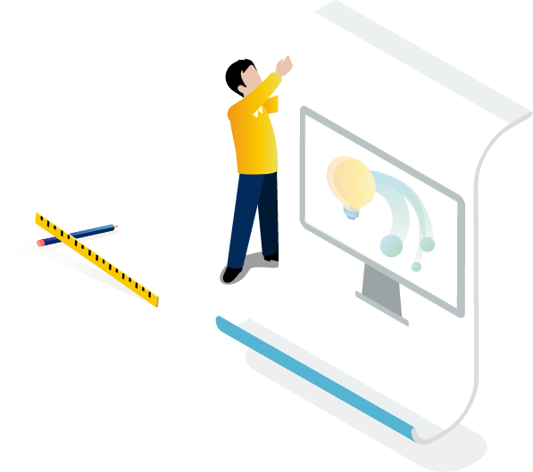
How
Data(trans)formation in motion
Coordination
Implementation
Prototyping
Coordination of the DataStrategy@EC Action Plan implementation
Implementation of the actions from the DataStrategy@EC Action Plan
Running prototypes, implementing parts or the whole Action Plan in the context of different business cases

Slide 10
Who are the users?
Myriam
Policy Officer
Daniel
Data Scientist
Franco
IT Manager
Marta
Business Manager
Vincent
IT Architect
Peter
Local Data Officer

Slide 11
Our Approach
Prototyping
Prototypes, pilots or proofs of concept are quick ways to test ideas for all or parts of the solution
Design
Thinking

Slide 12
The Process
Design
Thinking
User Needs
Design
Prototyping
1st Release
Applying user research techniques to collect user needs, which will help us better design the products or services
Ideation and design of the product or service based on the user needs
Prototype and test of the service or product with a group of users
Release of a first set of services or first version of a product

Slide 13
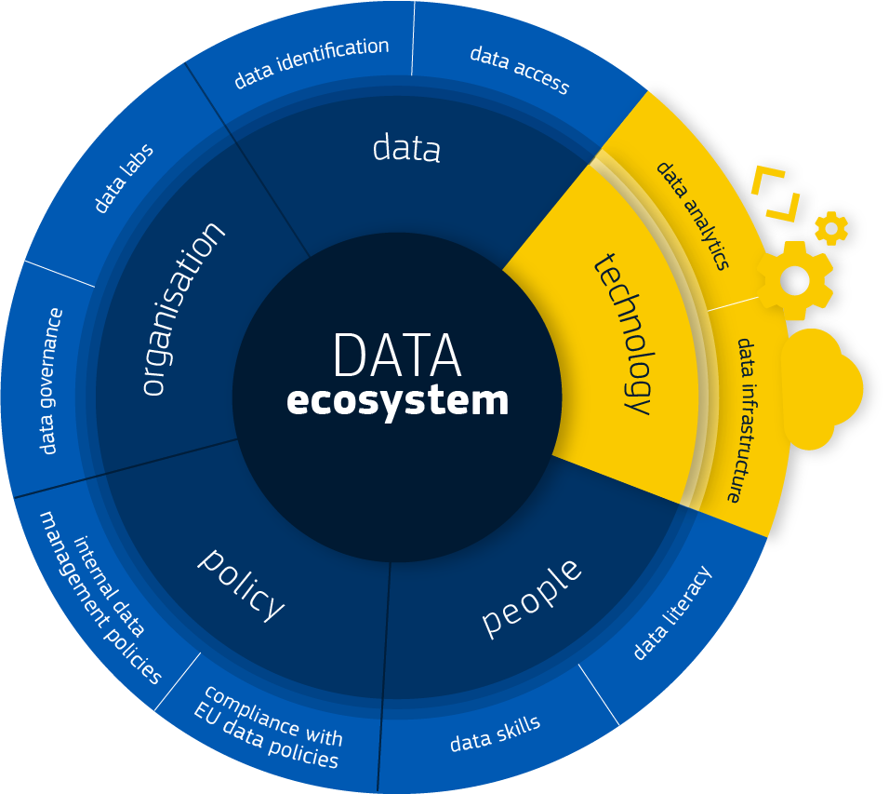
Zoom in
Technology

Slide 14
Implementation
EC Data Platform
Services
Services for end users and system implementors such as data analytics, data as a service, advisory.
Data Management
Data Analytics & AI
Data
as a Service
Advisory & Support
Rules and procedures to manage the entire data lifecycle, from its generation to its disposal, taking into account security and confidentiality.
Data Infrastructure
The foundation to centralise data used for decision-making in a single physical or virtual place.
Data will be ingested in the platform, stored, classified and made available to the consumers - humans or machines - through APIs or web interfaces.

Slide 15
In depth
Data Platform Architecture
Data Portal
Data Applications
3rd Party Systems
Services
Data Analytics & AI
DaaS
Advisory & Support for Implementation
Data Virtualisation
Data Lake
Metadata Repository
Data Management
Security and Access Control
Infrastructure
Data
Infrastructure
APIs
Data
Sources
Internal Data Base
Base Register
Documents / Unstructured Data
External Data (web, social media, IoT)

Slide 16
Services
Provision of pre-defined tools and algorithms ready-to-use for the most common types of analytics services, for non-technical users
Self-Service Analytics
Myriam
Policy Officer
Implementation of data analytics cases, from traditional business intelligence and reporting to advanced analytics and artificial intelligence
Analysis of Data
What is available that can help me analyse my data?
Marta
Business Manager
Data Analytics
& AI
I need to understand how to launch my project.
Daniel
Data Scientist
Provision of advanced tools for analytics, to be used by data experts in different DGs
Tools for Data Experts
Which tools can I use to run analytics myself?

Slide 17
Services
Vincent
IT Architect
Myriam
Policy Officer
Daniel
Data Scientist
Data
as a Service
What data can I use?
Where to find it?
Provision of data sets from different data sources for exploration or re-use, categorised according to different criteria. Data sets will be findable and accessible through a portal or through APIs.

Slide 18
Services
Franco
IT Manager
What are the tools / solutions I can reuse?
Data Analytics Advisory
Expert advice on tools, technologies and methodologies for data analytics
Advisory & Support
Vincent
IT Architect
How can I make my data available in the platform?
Data Integration Support
Support for integration of local or external databases with the data platform, through the data lake or data virtualisation
Peter
Local Data Officer
Data Management Support
I need to know how to manage my data
Support for implementation of corporate data management policies and guidelines, including data roles and responsibilities and metadata management

Slide 19
Prototyping
Some Examples
EU RESULTS
Piloting the Data Lake
What do we pilot?
This project allowed us to test the cloud data lake infrastructure and services.
EU Results collects information related to EU funded projects, that comes from the different information systems of spending DGs
This information doesn’t need to be structured according to a specific data model but can be ingested as it is exported from the DGs’ information systems (or, alternatively, from the open data exposed on the web). Analytics are run on the data and displayed on the EU Results portal.
Participants
DG BUDG
DG COMM

Slide 20
Big Data Test Infrastructure for the Member States
BDTI
Piloting Big Data
The Big Data Test Infrastructure (BDTI) will provide a complete set of data and analytics services, from infrastructure to tools and advisory, allowing European organisations to experiment with Big Data technologies and move towards a data-driven policy making
as part of the CEF "Data Value Chain"
A sandbox environment for the implementation of (big) data analytics pilot projects
Additional services facilitating the usage of the sandbox, such as testing and onboarding services
A set of software solutions and sample datasets to be easily downloaded or used
Built-in APIs for the ingestion of data, for public administrations who prefer to import their own data
A Community Portal to share knowledge
It will provide

Slide 21
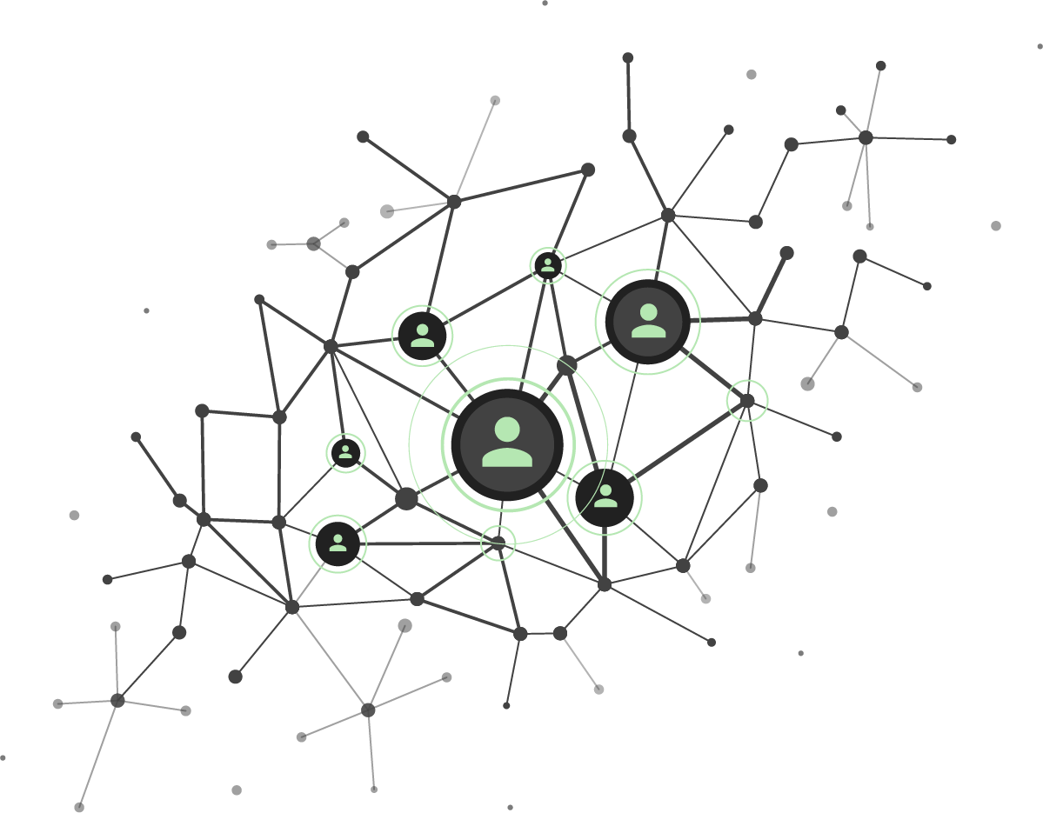
Co.innovation
Bringing together needs, expertise and financial resources from different DGs, Agencies, EUIs and MSs and make it happen.
let’s do it!
what if?
why not?
Great innovation never occurs in one field of expertise, not even in one organisation entity but it’s the product of collaboration across domains, across teams, outside our comfort zone.

Slide 22
What fits in CO.innovation?
Is it COcreated?
Can an idea be co-created by identifying common business challenges and potentially out of the box solutions? Can we learn from failures and successes?
Is it COllaborative?
Can we collaborate on this idea? Can we contribute together with experts, knowledge, infrastructure, tools or budget to make it happen?
Is it COrporate?
Can the idea help more than one DG? Can it be scaled up? Can we find a common benefit? Can we develop a common culture of innovation?

Slide 23
Co.innovation
enlarging cooperations
EUIs and
agencies
Member
States
Commission
Cross-departments
Member States
Public Administrations
European Institutions
European Agencies

Slide 24
Thank you
Roberto Barcellan
European Commission
DIGIT.D.1 – Data Services
roberto.barcellan@ec.europa.eu

