Slide 1


New Techniques and Technologies for Statistics
New Experimental Statistics at Istat:
the ‘Social Mood on Economy’ Index
Diego Zardetto
Istat
work with: Cristina Fabbri, Pasquale Testa and Luca Valentino
NTTS 2019, Bruxelles, 12 – 14 March 2019

Slide 2
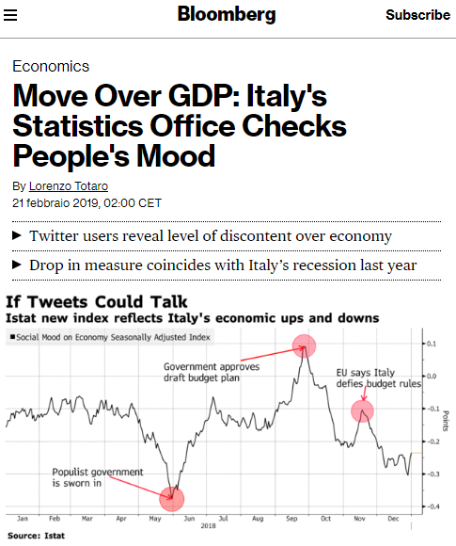
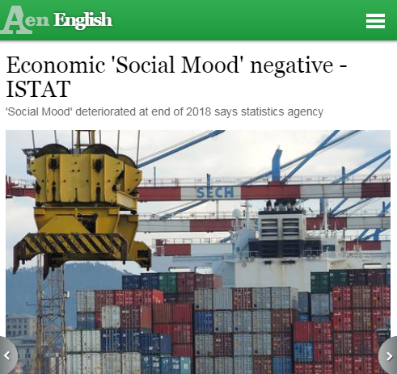
Introduction
Istat released in October 2018 (and updated since then) a new experimental statistic, based on Twitter data: the Social Mood on Economy Index
The index provides daily measures of the Italian sentiment on the state of the economy
  These measures are derived from samples of public tweets in Italian, which are captured in real time
  Data collection started in February 2016 and has been active since then almost without interruptions
The dissemination of the new index attracted significant interest from the media (both traditional and online)
Receptions were predominantly positive (the overwhelming majority praising Istat’s openness to innovation)
But few skeptical comments too!
Notes:
Domain-specific sentiment indices have to be contrasted to ‘generic’/‘general purpose’ indices of the ‘Mood of the Nation’ kind, which inevitably mix up all the topics into a poorly defined measure
Similar initiatives have been put in place by other NSIs in recent times, notably:
CBS (NL) attempts to “mimic” the time evolution of the Dutch Consumer Confidence Index by means of a sentiment index based on social media
CBS (NL) project to derive daily measures of social tension from Twitter
INEGI (MX) provides a generic ‘mood of twitterers’ online

Slide 3





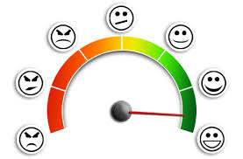
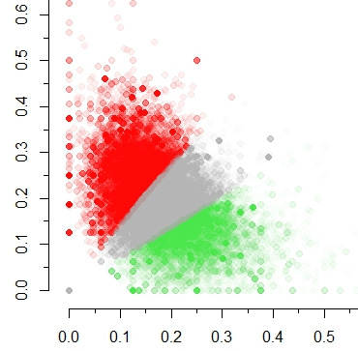
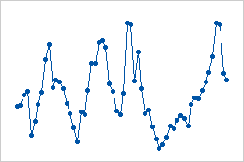
Processing Pipeline at a Glance
Twitter
Public
Stream
‘Social Mood
on Economy’
Filter
Filtering
Italian
Sentiment
Lexicon
Surveillance System
Outlier Detection
and Imputation
Sentiment Scoring
Clustering
Daily Index
Computation

Slide 4
The Quest for Relevance: Filters
The pointless babble issue affects all social media sources
We developed procedures to collect and process only tweets containing at least one word belonging to a specific ‘filter’, namely a definite set of relevant Italian keywords
  Ideally, filters should be able to capture relevant messages and eliminate off-topic ones since the beginning
  Domain-specific filters have been designed by subject-matter experts (possibly supported by data-driven techniques)
The ‘Social Mood on Economy’ filter collects on average ~50’000 tweets/day
It encompasses 60 keywords (actual words or phrases). Most of them have been borrowed from questionnaire items of the Italian Consumer Confidence Survey
  However, the phenomenon tracked by the Social Mood on Economy index and consumer confidence only partially overlap
    Still, the new index can detect events that influence consumer confidence but are missed by the official survey, e.g. the Central Italy earthquake of 24th Aug. 2016
Notes:
Filter’s major aims are the following:
increase relevance
decrease storage and computational complexity
increase accuracy of downstream analyses (by enhancing signal-to-noise ratio)
Current (end December 2018) stocks of tweets:
‘Social Mood on Economy’ filter: ~52 million

Slide 5
Data Collection and Processing
Data Collection Technique
  We exploit Twitter’s Streaming API to get low latency access to Twitter’s firehose and collect samples of public tweets
Target Population
  Public tweets whose text matches at least one keyword belonging to the filter
Sampling Design
  The sampling algorithm is a black box, as it is entirely controlled by Twitter’s Streaming API. At least 1% of all the eligible tweets flowing on Twitter at a given time are sampled
Process Granularity
  To compute daily index values, we process all the tweets collected in a single day as a single block
Input Data
  We only analyze the textual content of the tweets. (No information about users is ever accessed: the index only uses unlinked anonymized data)
Notes:
Public Tweets are immediately visible to anyone, whether or not they have a Twitter account (note that this is the default setting of the Twitter platform)
On the contrary, Protected Tweets may only be visible the followers of the author of the Tweet.

Slide 6
Text Processing and Sentiment Analysis
Text Cleaning and Normalization
  We perform standard NLP pre-processing steps:
  (i) convert to lowercase, (ii) tokenize running text into words, (iii) apply basic orthographic repairs, (iv) remove URLs, (v) remove non-alphabetic characters (e.g. ‘#’ or ‘@’),
  (vi) remove stop words, (vi) if needed, stem words to get rid of inflected forms
Sentiment Analysis Approach
  To classify tweets as Positive, Negative or Neutral we chose to adopt an unsupervised, lexicon-based approach
    We discarded supervised, Machine Learning approaches because we were unable to find large, high quality training sets of human-labeled tweets in Italian
Our Sentiment Analysis application involves two sequential steps
  Calculate sentiment scores for each tweet
  Use these sentiment scores to cluster tweets into three mutually exclusive classes: Positive (P), Negative (N) and Neutral (U)
To attach sentiment scores to a tweet we leverage an Italian Sentiment Lexicon, namely a vocabulary whose lemmas are associated to pre-computed positive and negative sentiment scores

Slide 7
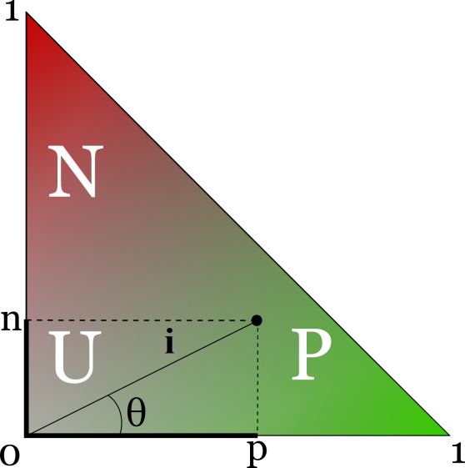
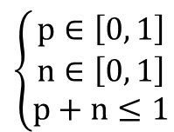
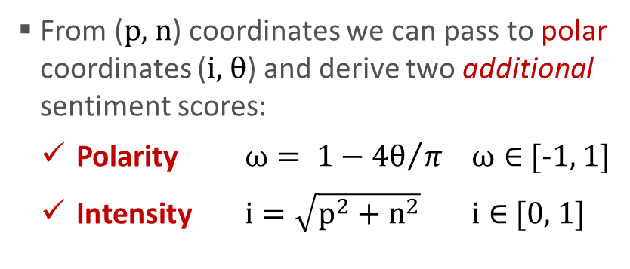
The Sentiment Space
$$\left\{\begin{matrix}p∈\left[0, 1\right] \\ n∈\left[0, 1\right] \\ p+n≤1\end{matrix}\right.$$
In the Lexicon, positive (p) and negative (n) sentiment
scores of lemmas are constrained as follows:
Therefore the Lexicon maps lemmas to points
belonging to the sentiment triangle:
From (p, n) coordinates we can pass to polar coordinates (i, θ) and derive two additional sentiment scores:
  Polarity $ω= 1−{4θ}/π$ $ω∈$ [-1, 1]
  Intensity $i=\sqrt{p^{2}+n^{2}}$ $i∈$ [0, 1]
lemma | pos | neg | polarity | intensity
caldo | 0.25 | 0.125 | 0.41 | 0.28
freddo | 0.047 | 0.297 | -0.8 | 0.3
This way the lemmas are
mapped to a 4D sentiment space
To enable clustering, tweets too must be mapped to this 4D space

Slide 8

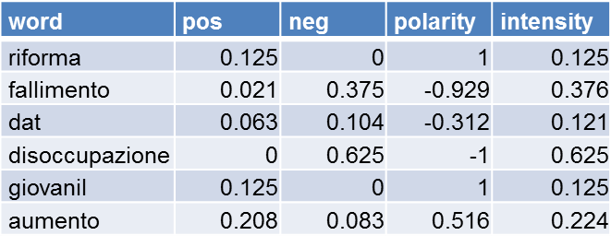

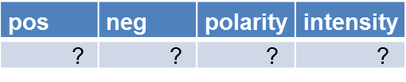
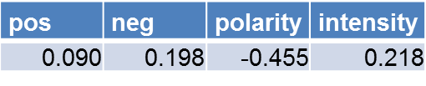
From Word-level to Tweet-level Sentiment Scores
1
disoccupazione
negative score
fallimento
dat
aumento
giovanil
0
riforma
1
positive score

Slide 9
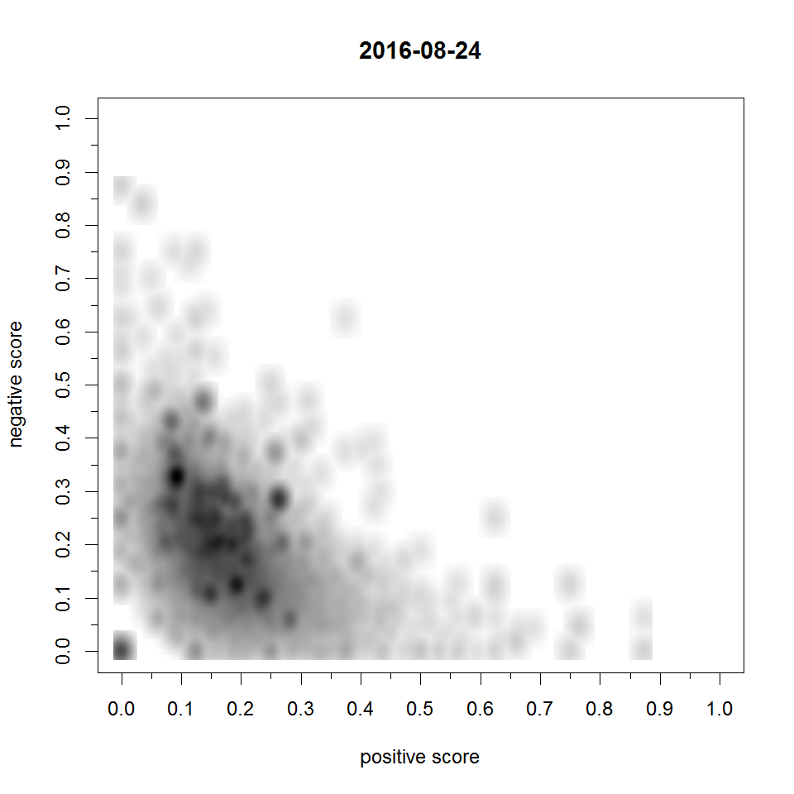
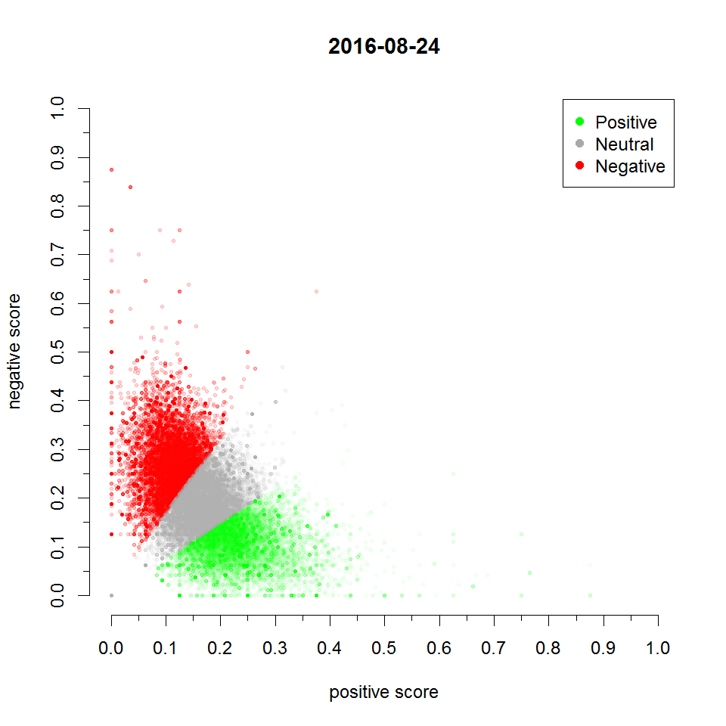

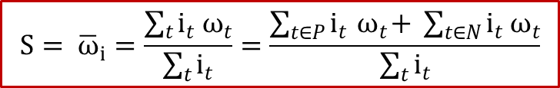
Clustering and Calculation of the Index
Once sentiment scores (p, n, ω, i) are available for all the tweets of a daily block…
…we use K-means to cluster them into Positive, Negative and Neutral tweets
  to lower the risk of finding a local optimum, we run it 100 times with random starts and pick the best solution
Lastly we compute the daily index value (S), which depends on the distribution of tweets within the Positive, Neutral and Negative classes
$$S= {\overline{ω}}_{i}=\frac{\sum_{t}{i_{t}{ ω}_{t}}}{\sum_{t}{i_{t}}}=\frac{\sum_{t∈P}{i_{t}{ ω}_{t}+ }\sum_{t∈N}{i_{t}{ ω}_{t}}}{\sum_{t}{i_{t}}}$$
where ${ ω}_{t}≝0 ∀t∈Neutral$
This index can be seen as the average of polarity (ω) weighted by intensity (i), provided we treat Neutral tweets as if their polarity were zero. Compared to traditional alternatives:
  It is more resilient to tweets’ misclassification
  It reduces day-to-day volatility
Notes:
Popular sentiment indices typically involve counts or proportions of positive and negative Tweets:
S= card(P) ⁄ ( card(P)+card(N) )
S=( card(P) - card(N) ) ⁄ ( card(P) + card(N) + card(U) )
S= card(P) ⁄ card(N)

Slide 10
Monitoring and Validation
No filter is perfect! Thus we devoted special care to make the index robust against possible contaminations by off-topic tweets that might pass the filter
We developed a surveillance system, which periodically searches for anomalous values in the daily time series by means of two independent and complementary outlier detection routines
  Daily values detected as potential outliers cause the system to generate a set of automated diagnostic reports
  These are then sent to human reviewers in charge of deciding whether the detected values are actually proper data points, or instead truly anomalous
Truly anomalous data typically arise when an off-topic tweet that happened to pass the filter becomes “viral” on Twitter
  Being re-twitted and quoted thousands of times in a day, viral tweets may have an unduly impact on the daily index and introduce bias
All the daily index values classified as truly anomalous are eventually imputed via nearest-neighbor interpolation

Slide 11
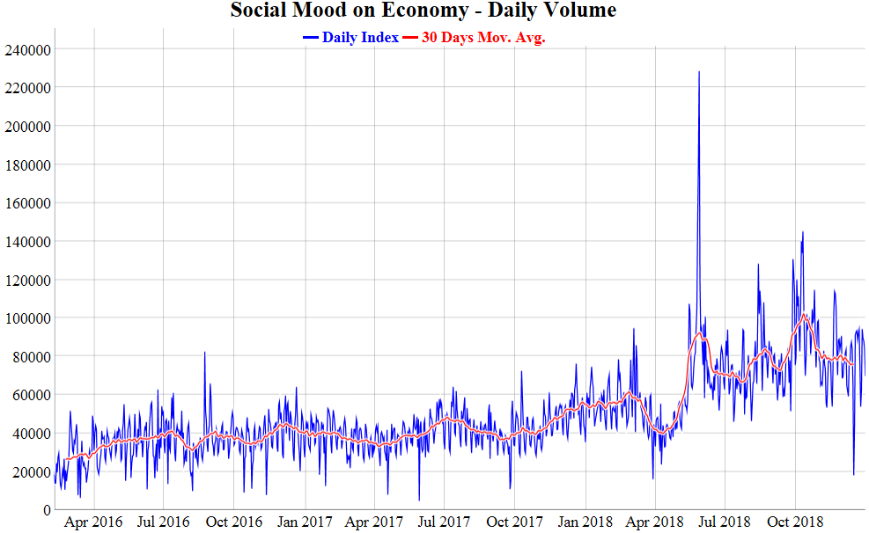
Volume Burst since 2018 Post-Election Crisis
29 May 2018
Spread Peaks Above 300 bps
230,000 tweets
16 May 2018
“Italy will ask the ECB a debt write-off of 250 billion €”
110,000 tweets
5 March 2018
Political Election Results
95,000 tweets
Notes:
Volume of collected tweets doubled after the start of the new M5S-Lega government:
43,000 before - 79,000 after
Timeline
4 March 2018
Italian general elections
5 March 2018
Elections results become clear (M5S and Lega won)
16 May 2018
A leaked draft of M5S-Lega Government Contract reports that “Italy will ask the ECB a debt write-off of 250 billion €” bought during ECB’s QE
27 May 2018
President Sergio Mattarella rejects Paolo Savona as Minister of Finance
Giuseppe Conte resigns its designation to Mattarella
President Mattarella’s speaks to the nation
28 May 2018
President Mattarella designates Carlo Cottarelli to form a government
29 May 2018
Carlo Cottarelli runs into difficulties and cannot manage to form a government
European Commissioner Gunther Oettinger says: <<the markets will teach Italians how to vote right>>
Btp-Bund Spread peaks and goes above 300 bps
30 May 2018
The M5S-Lega government sees the light

Slide 12
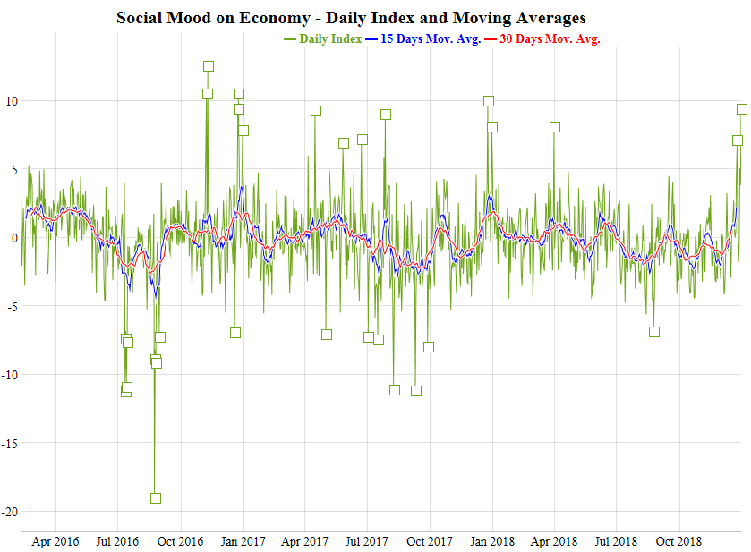
A Highly Volatile Time Series
Notes:
Some qualitative features of the daily time series:
High volatility
MEANINGFUL PEAKS AND VALLEYS
DEFINITELY NON WHITE NOISE
Short memory: values three or more lags away seem almost independent (HINT: average life-span of the News is 2-3 days)
Annual seasonality (but only 34 complete months so far…)

Slide 13

Conclusion
The daily time series of the Social Mood on Economy index has been released as Experimental Statistics, namely “for users’ consultation and evaluation”
  In the meantime, Istat’s Econometrics Service is studying whether the new index could improve short-term analysis and forecasting
For organizational reasons, updates of the index are currently being published on a quarterly basis
However a daily publication policy is technically feasible, with updates released online at [d + 1] and monthly revisions (for anomaly detection and seasonal adjustment)
Thanks!

