Slide 1
Applying Machine Learning for Automatic Product Categorization
12-14 March 2019
2019
U.S. Census Bureau, Washington, D.C.

Slide 2
Applying Machine Learning for Automatic Product Categorization
Andrea Roberson, U.S. Census Bureau
NTTS 2019
Thursday, March 14
14:15 – 14:30 p.m.
Room: MANS
Disclaimer: Any views expressed are those of the authors and not necessarily those of the U.S. Census Bureau.

Slide 3
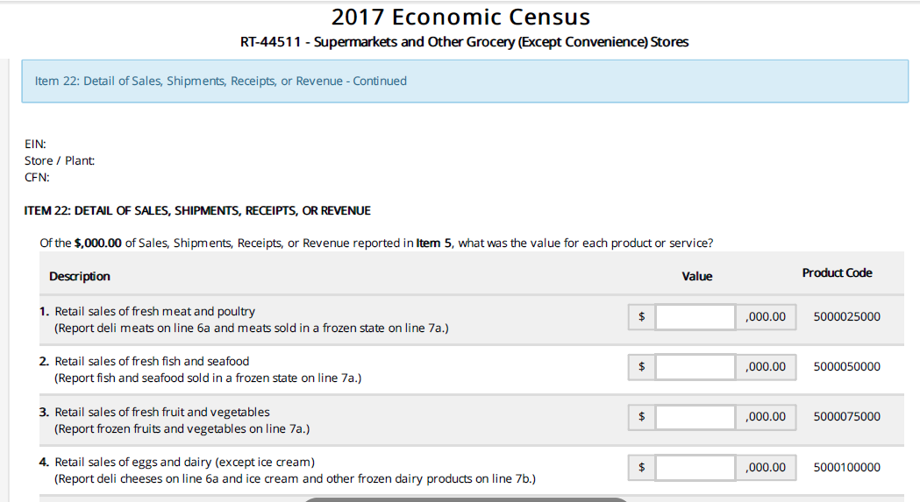
The project was motivated by item 22 of the Economic Census
North American Product Classification System (NAPCS)
Assigns codes to thousands of service products
Item 22: DETAIL OF SALES, SHIPMENTS, RECEIPTS OR REVENUE

Slide 4
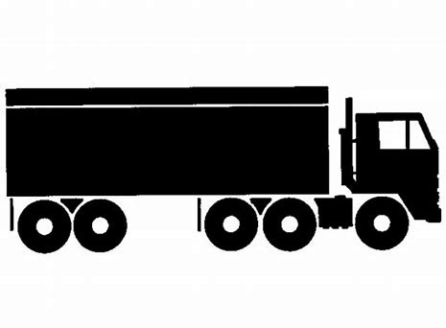
3.7 Million Businesses are Impacted
...equal to 6 tractor trailers
of notification letters
http://www.tecnopneumatic.gr/Uploads/PhotosFiles/analosima_voulkanismou_WEB/tech_icons/Tractor_Trailer2.jpg

Slide 5
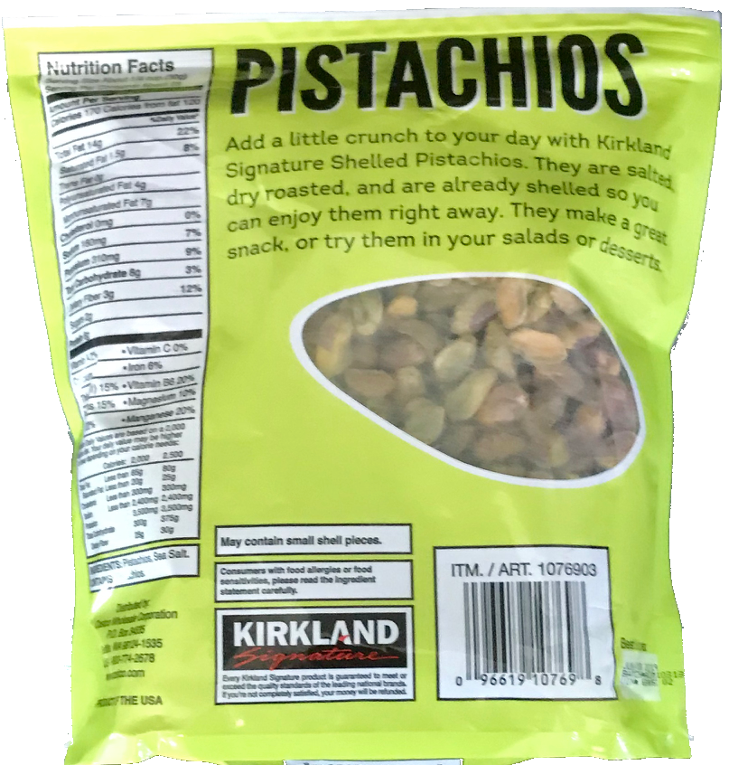
The 1,200+ NAPCS codes are
complex & can be ambiguous
Retail sales of candy, prepackaged cookies, and snack foods
Retail sales of food dry goods and other foods purchased for future consumption (Include flour, sugar, fats and oils, coffee, honey, jams and jellies, pasta, and crackers.)
Retail sales of fresh fruit and vegetables
Which NAPCS code?
Photo credit: Jeff Meisel

Slide 6
This is a
text classification
problem
Using the UPC product descriptions
can we predict the NAPCS codes?
→
UPC Description
NAPCS Code
DIAMOND OF CALIFORNIA SHELLED PISTACHIOS
snack foods

Slide 7
ML Algorithms
Learning model parameters via exposure to many example data points
Input data points (e.g. Survey write-in text, UPC Product descriptions)
Labels (e.g. Equipment vs. Structures)
Model architecture (e.g. Logistic Regression)
Loss function (measures performance of model, e.g. negative log-likelihood function)
Loss is used as a feedback signal to an optimizer (e.g. stochastic gradient descent algorithm) to iteratively adjust the model parameters
Training consists of feeding batches of data to training process to learn the optimal model parameters.

Slide 8
Using input data and labels to learn weights
A Machine Learning model is parameterized by its weights
Word (Feature) | Coefficient | Value
 | $${\hat{w}}_{0}$$ | -2.0
good | $${\hat{w}}_{1}$$ | 1.0
great | $${\hat{w}}_{2}$$ | 1.5
awesome | $${\hat{w}}_{3}$$ | 2.7
bad | $${\hat{w}}_{4}$$ | -1.0
terrible | $${\hat{w}}_{5}$$ | -2.1
awful | $${\hat{w}}_{6}$$ | -3.3
restaurant, the, we, … | ${\hat{w}}_{7}$, ${\hat{w}}_{8}$, ${\hat{w}}_{9}$ | 0.0
… |  | …

Slide 9
Learning
A loss function measures the quality of the model’s output
The loss function takes the predictions of the model and the true classification (what you wanted the model to predict) and computes a distance score, capturing how well the model has done on a batch of examples.
The fundamental trick in machine learning is to use this score as a feedback signal to adjust the value of the weights a little, in a direction that will lower the loss score for the current batch of examples. This adjustment is the job of the optimizer.
Feature Extraction
Feature Extraction

Slide 10
Loss is a feedback signal used to adjust weights
Updates are done via the stochastic gradient descent algorithm, using the chain rule to iteratively compute gradients for each coefficient.
Traditional optimization algorithms update weights by averaging the gradients of all data points. To economize computational cost we use stochastic gradient descent and only calculate gradients for a small random sample of the data.
The training loop, which, repeated a sufficient number of times (typically tens of iterations over thousands of examples), yields weight values that minimize the loss function.
Feature
Extraction
Feature
Extraction

Slide 11
Methodology Prepare the Data
Dimensionality Reduction
Goal: Represent instances with fewer variables
Text collections have a large number of features
10,000 – 1,000,000 unique words … and more
Feature Selection
Makes using a particular classifier feasible
Some classifiers can’t deal with 100,000 of features
Reduces training time
Training time for some methods is quadratic or worse in the number of features
Can improve generalization (performance)
Eliminates noise features
Avoids overfitting
Feature Extraction
Transform measurements from one space into another space in order to
Compress data or characterize data
Examples:
Data compression
Information redundancy removal
Data characterization
Similarity analysis

Slide 12
Chi-Square Feature Selection
χ² test is used to test the independence of two events, which for text is occurrence of a term and occurrence of a class (Manning, 2012).
Is “jaguar” a good predictor for the “auto” class?
We want to compare:
the observed distribution above; and
null hypothesis: that jaguar and auto are independent
 | Term = jaguar | Term ≠ jaguar
Class = auto | 2 | 500
Class ≠ auto | 3 | 9500

Slide 13
χ² statistic
Under the null hypothesis: (jaguar and auto independent)
How many co-occurrences of jaguar and auto do we expect?
$$χ^{2}\left(D,t,c\right)=\sum_{e_{t}∈\left\{0,1\right\}}{\sum_{e_{c}∈\left\{0,1\right\}}{\frac{{\left(N_{e_{t}e_{c}−}E_{e_{t}e_{c}}\right)}^{2}}{E_{e_{t}e_{c}}}}}$$
N is the observed frequency in D and E the expected frequency
$e_{t}$ takes the value 1 if the document contains term t and 0 otherwise
$e_{c}$ takes the value 1 if the document is in class c and 0 otherwise

Slide 14
χ² statistic
$$χ^{2}\left(D,t,c\right)=\sum_{e_{t}∈\left\{0,1\right\}}{\sum_{e_{c}∈\left\{0,1\right\}}{\frac{{\left(N_{e_{t}e_{c}−}E_{e_{t}e_{c}}\right)}^{2}}{E_{e_{t}e_{c}}}}}$$
$χ^{2}\left(D,t,c\right)=\frac{{\left(2−.25\right)}^{2}}{.25}$+ $\frac{{\left(3.−4.75\right)}^{2}}{4.75}$+ $\frac{{\left(500−502\right)}^{2}}{502}$+ $\frac{{\left(9500−9498\right)}^{2}}{9498}=12.9 \left(p<.001\right)$
The null hypothesis is rejected with confidence .999,
since 12.9 > 10.83 (the value for .999 confidence).
 | e_{jaguar}=1 | e_{jaguar}=0
e_{auto}=1 | $$N_{11}=2 E_{11}=\left(0.25\right)$$ | $$N_{10}=500 E_{10}=\left(502\right)$$
e_{auto}=0 | $$N_{01}=3 E_{01}=\left(4.75\right)$$ | $N_{00}=9500 E_{00}=\left(9498\right)$
expected
observed

Slide 15
Methodology
Feature selection via Mutual Information
We might not want to use all words, but just reliable, good discriminators
In the training set, choose k words which best discriminate (give most information about) the categories. One way is in terms of Mutual Information.
The Mutual Information (MI) between a word, class is:
For each word w and each category c
The observed joint distribution of $e_{w}$ and $e_{c}$
$$I(w,c)=\sum_{e_{w}∈\{0,1\}}{\sum_{e_{c}∈\{0,1\}}{p(e_{w},e_{c})\log{\frac{p(e_{w},e_{c})}{p(e_{w})p(e_{c})}}}}$$
The expected joint distribution of $e_{w}$ and $e_{c}$
if $e_{w}$ and $e_{c}$ were independent
MI measures the divergence of the actual joint distribution from the expected distribution under the independence assumption. The larger the divergence is, the higher the MI would be.

Slide 16
Methodology
Feature extraction via Latent Semantic Analysis (LSA)
LSA takes documents that are semantically similar (talk about the same topics), but are not similar in the vector space (because they use different words) and re-represents them in a reduced vector space in which they have higher similarity.
Similar terms map to similar location in low dimensional space
Noise reduction by dimension reduction

Slide 17
Methodology
LSA
Build a Term-Document Matrix (TDM) with rows representing words and columns representing context (a document or word string)
Apply Singular Value Decomposition (SVD)
unique mathematical decomposition of a matrix into the product of three matrices:
For an M × N matrix A of rank r
The columns of U are orthogonal eigenvectors of AA^{T}.
The columns of V are orthogonal eigenvectors of A^{T}A.
Eigenvalues λ₁ … λ_{r} of AA^{T} are the eigenvalues of A^{T}A.
The 'discarded' dimensions are those that are least informative = have low variance = are redundant (e.g. a word like 'the' occurred in every context or a word like 'anti-disestablishmentarianism' occurred in hardly any contexts).
Singular values

Slide 18
Data
Distribution of Drug Store Data
Classification Code
Frequency

Slide 19
Drug Store Model Selection
Fit models by applying various ML algorithms to the training set
Multinomial Naïve Bayes
Support Vector Machine
Logistic Regression
2. Apply fitted models to the test set

Slide 20
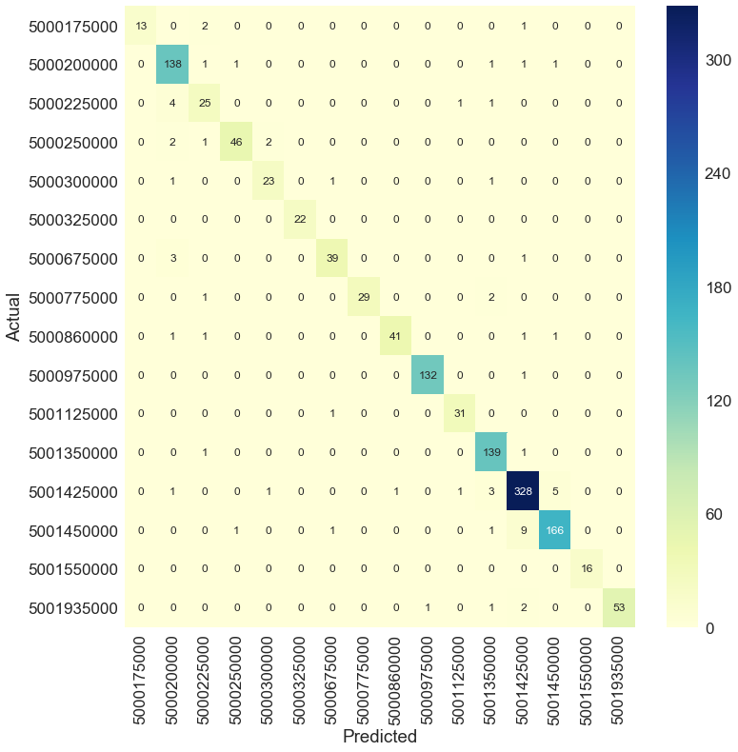
SVM Confusion Matrix (9100 features)

Slide 21
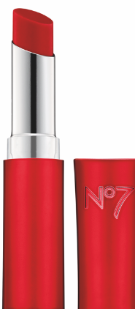
5001450000 | Retail sales of cosmetics and fragrances (Include face cream, makeup, cologne, and perfume.)
5001425000 | Retail sales of personal hygiene supplies (Include hand and foot care products, eye/contact lens care products, oral hygiene products, deodorants, hair care products, nail polish, toilet paper, facial tissues, sanitary napkins, and disposable diapers.)
Looking at Misclassified Examples
(5001425000)
(5001450000)
Personal hygiene predicted as cosmetics : 9 misclassifications
Cosmetics predicted as personal hygiene : 5 misclassifications
UPC Description |  | Actual | Predicted
NEUT MEN SKN CLRNG ACNE WSH 5.1OZ |  | 5001425000 | 5001450000
CALDESENE PROTECTING POWDER 5OZ |  | 5001425000 | 5001450000
COLORSILK BTTRCRM NAT BRWN 60/51N |  | 5001425000 | 5001450000
NO7 LIP BALM CORAL BLOSSOM .09OZ |  | 5001450000 | 5001425000
DR FRED SUMMIT SKN/WHITNR 202 2OZ |  | 5001450000 | 5001425000
COLORSILK H/C LIGHT BLONDE #81 |  | 5001450000 | 5001425000

Slide 22
The classifiers achieve > 90% accuracy on the drugstore dataset (Unigrams 9100 features)
Model | Accuracy | Average Precision | Average Recall | Average F1-Score | Kappa Statistic
Logistic Regression | .95 | .95 | .95 | .95 | .94
Multinomial Naïve Bayes | .93 | .93 | .93 | .93 | .92
Linear Support Vector Machine | .96 | .96 | .96 | .96 | .94
Model processing time= seconds

Slide 23
Some words are more predictive
Importance scores for Cosmetics NAPCS Classification Code
ka
feet
What are the most important words? wnw?

Slide 24
Results: Accuracy Comparison

Slide 25
Results
Bigram models faired poorly
SVM achieves the highest accuracy
With a small feature set LSA models give the greatest boost to the classification models. With a large feature set size, the frequency based Unigram model performed at the same level as the Chi-Square, Mutual Information, and LSA models.

Slide 26
Impact
Automated product classification with ML is more consistent and accurate.
Our proposed methodology eases respondent burden and eliminates survey non-response
This research has the potential to innovate outdated modes of collecting product information. Product data need no longer be only collected every 5 years, we have demonstrated a modernized automated collection strategy. We make the case for disrupting Economic Statistics processing with ML-based Intelligent Models

Slide 27
References
Bewick, V. Cheek L and Ball J. 2005. Statistics review 14: Logistic regression. Critical Care, London, England.
Chanawee Chavaltada, Kitsuchart Pasupa, David R. Hardoon. 2017. A Comparative Study of ML Techinques for Automatic Product Categorisation., ISNN(1):10-17.
Kim, W., Gordon, D., Sebat, J., Ye, K. Q., and Finch, S. 2008. Computing power and sample size for case-control association studies with copy number polymorphism: Application of mixture-based likelihood ratio test PLoS ONE, 3, e3475.
Thorsten Joachims, 2001. A statistical learning model of text classification for support vector machines. In Proceedings of the 24th Annual International ACM SIGIR conference on Research and Development in Information Retrieval). Association for Computing Machinery, pages128–136.
Geng, X., Liu, T.Y., Qin, T., Li, H.: Feature selection for ranking. In: Proceedings of the 30th ACM International Conference on Research and Development in Information Retrieval (SIGIR 2007), Amsterdam, NL, pp. 407–414 (2007)
Wang S. and Manning C. 2012. Baselines and Bigrams: simple, good sentiment and topic classification. In Proceedings of ACL (2012)

