Slide 1
14/03/2019
NTTS
LabInn.
The Istat’s Innovation Lab
Mauro Bruno, Enrico Orsini, Gerarda Grippo,
Mario Magarò
ISTAT - MEC—Division for Integrated Architecture of Data and Processes

Slide 2
Index
Research in Istat
What is the Innovation Lab
Why the Innovation Lab
The Innovation Program
The Process
LabInn IT Architecture
Project Overview
First Results
Conclusions and Objectives

Slide 3
Research for Istat's activities
The research in Istat is aimed at improving the quality of statistical information and the processes adopted for the production, development and dissemination of official statistics and the introduction into the above processes of the results of methodological and thematic research.
Research represents the essential tool for maintaining and increasing the level and the quality of statistical information and to respond to the mission of the institute: produce official statistics to support citizens and public decision-makers.

Slide 4
What is the Innovation Lab
The Innovation lab is an “environment” to enforce research role and to develop innovative ideas promoting the collaboration between experts of several sector (Statisticians, Computer scientists, Business experts…).
It was inaugurated on March 21, 2018

Slide 5
Why the Innovation Lab
There are new demands for Statistical Information and several trends observed in society that offer new emerging possibilities as Use of new data sources and Big-Data
Those trends can be an opportunity to improve Statistical Information, processes and products.
It is a place to test new solutions, new processes, and new products.
The innovation lab is an instrument to implement innovation.

Slide 6
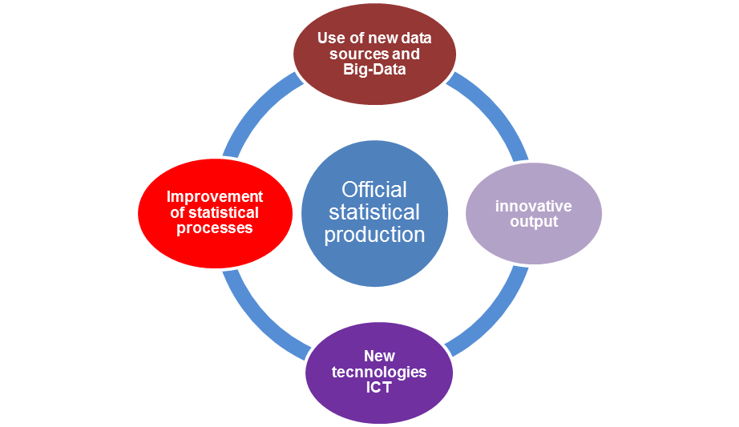
The Innovation Program
The innovation program defines the Institute innovative areas related to related to production processes (data collection, data elaboration and data dissemination)
These areas offer new innovative possibilities at the level of technological, statistical and business thematic processes.
All the innovative projects are selected because they respond to the Institute's mission: to produce official statistics for citizens and public decision-makers.

Slide 7
The Process - 1
The innovation program is implemented in the laboratory by adopting a phased approach that starts from the birth of the idea to its realization.
LabInn Call
on an ISTAT Intranet area dedicated to Call for research and innovation, every year in the period between June and September, interested colleagues can propose their ideas compiling a form.
Project selection
First, feasibility, sustainability and technological and IT needs are assessed. Afterwards, suitable projects are submitted to the final evaluation of the Istat Research Committee.

Slide 8
The Process - 2
Project Optimization
After the positive evaluation follow detailed meetings aimed at identifying all the resources necessary to finalize the project, from IT needs to professional figures.
Project Implementation
The team will work inside the Innovation Lab on the implementation of the project in order to demonstrate the validity of the idea.
Dissemination Result
The projects are presented during an institutional event of dissemination and sharing of results.
The appropriate ones are included in the institute's production processes.

Slide 9
The LabInn IT Architecture
The laboratory infrastructure based on Hyper-Converging technology from the manufacturer NUTANIX, allows to isolate the environment to make the most of the HARDWARE – SOFTWARE characteristics by multiplying the IOPS values.
Furthermore, the use of solid state storage technologies (high quality disks / SSD-NVME) and integration with dedicated GPUs (nVidia TESLA P40) guarantee high performance with deep learning and parallel computing workloads.

Slide 10
Projects Overview – First Call -1
The first three LabInn projects were developed between February and May 2018. Currently, the passage of outputs made to the production phase is under evaluation.
Proponents | Directorate | Innovation Area | Idea description
Marina Macchia, Giovanni Lombardo | Environmental Statistics Directorate | Innovative Output on Big-Data | Integrated use of cartographic data at cadastral particles level and AGEA business files for the generation of outputs useful for the general census of agriculture 2020. Expected Output: Publication on GISTAT and mobile devices of the polygons of cadastral particles of agricultural holdings.
Daniela Fusco, Caterina Viviano | Business Statistics Directorate | Innovative Output on Big-Data | Use of the BIG DATA to support the Statistical Register of active businesses through web scraping and record linkage technologies, with the aim of integrating the structured company's data with the de-structured data of the web. Expected Output: New experimental statistical output integrated to the statistical business register
Michele D’Alò | Methodology Directorate | Innovative Process and Integration sources | Development of estimation methods for the production of census hypercubes through the integration of sample surveys, census and administrative data. Production of Expected Output: Indicators for large municipalities (in collaboration with the municipality of Rome)

Slide 11
Projects Overview – First Call - 2
Three other ideas, winners of the first calls, will be developed between March and July 2019
Proponents | Directorate | Innovation Area | Idea description
Alessandro Cimbelli, Fabrizio De Fausti, Antonino Laganà | Environmental Statistics Directorate - Methodology Directorate | Innovative Output on Big-Data | Use of Deep Learning algorithms on aerial images for automatic classification of objects. Expected Output: useful for statistical production in relation to green areas.
Massimiliano Amarone | Information Technology Directorate | Innovative Output on Big-Data | Use of Web Scraping technology for the search and collection of information useful for the extension of official statistics on the labor market. Expected Output: Production and distribution of time series, monthly / quarterly, on personnel searches and their characteristics
Simona Toti, Fabrizio De Fausti | Methodology Directorate | Innovative Process | Parallelization of the Metropolis-Hastings algorithm on GPU. Expected Output: Estimation and production of confidence intervals of the population size.

Slide 12
Projects Overview – Second Call - 3
The first innovative projects selected from those received at the second call will be developed between May and June
Proponents | Directorate | Innovation Area | Idea description
Luca Mancini, Luca Valentino | Methodology Directorate | Innovative Process and Integration sources | Development of an innovative algorithm for record linkage based on MinHash with the aim of integrating large database Expected Output: Improvement in identification processes in the integrated system of statistical registers
Romina Filippini, Simona Toti, Valerio De Camillis | Information Technology Directorate and Methodology Directorate | New methodology and ICT tool for process improvement | Experimentation of neural networks within Statisical learning applied to BIG-DATA according to an innovative technique based on genetic algorithms in the archipelago research variant for the imputation of missing data Expected Output: Application in production processes related to the control and correction phases in the integrated system of statistical register
Viviana De Giorgi | economic statistics Directorate | New Data collection, Innovative Output on Big-Data | Acquisition and decryption of the financial statements of companies acquired through webscraping on the web using predictive approaches based on machine learning in application to text mining Expected Output: Increase of information coverage compared to surveys

Slide 13
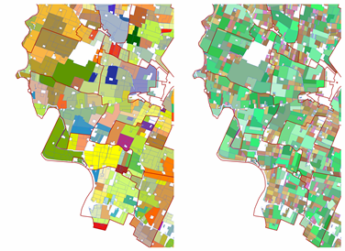
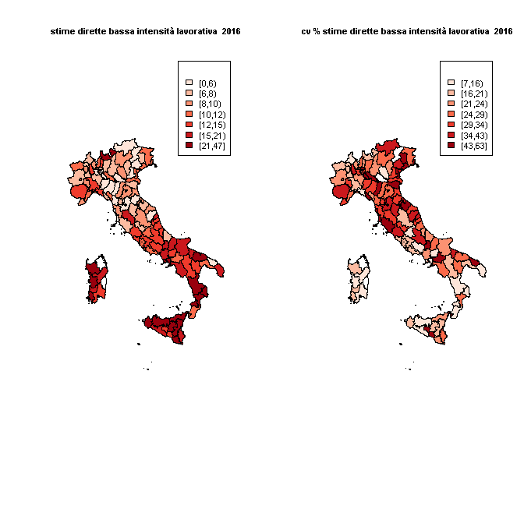
First Result: Projects
The first three projects were successfully completed, producing tangible results and proving to be mature for the production processes.
Use of the BIG DATA to support the Statistical Register of active businesses through web scraping and record linkage technologies
Integrated use of cartographic data at cadastral particles level and AGEA business files for the generation of outputs useful for the general census of agriculture 2020.
Development of estimation methods for the production of census hypercubes through the integration of sample surveys, census and administrative data
complete, verify and add information on the statistical business register
production of maps of farms by type of cultivation
new indicators relevant to the areas at risk of poverty and the inequalities of income at the municipal level
Farms
Crop Uses

Slide 14
First Result: Collaborations and Partnerships -1
The strong point both in the realization phase of the Laboratory and in the development phase of the projects, was the collaboration between the different sectors of the Institute involved.
The LabInn is a virtuous example of collaboration for the achievement of a shared output: strengthen and improve the role of research and innovation in the Institute.

Slide 15
First Result: Collaborations and Partnerships - 2
The laboratory offers the opportunity to work in a stimulating environment, equipped with an advanced technological infrastructure, in which the key aspects are the high interaction and integration of professionals, the multidisciplinary context, as well as the possibility of working side by side, dedicating institutional time to research and innovation.
An important result of LabInn is to promote collaboration and partnerships with other research institutes and universities for the development of shared projects.

Slide 16
Conclusions and Objectives
Contribute to strengthening the role of research
Improve Statistical Information (Processes and Output)
Mission: produce official statistics
Test innovative solutions
Dedicate exclusive time only to the development of innovative projects
Planning and Control Statistical and Technological Evolution
Promote Collaborations and Partnerships

