Slide 1


IT Infrastructure for a Data Science Campus
Craig Pritchard: Technical Architect
David Pugh: Senior Data Scientist
https://datasciencecampus.ons.gov.uk/
@DataSciCampus

Slide 2
Data Science Campus
a hub for the whole of the UK public and private sectors to gain practical advantage from the increased investment in data science research and capability building
Challenges
Ingesting data
Goal -> explore how new data sources and data science techniques can improve our understanding of the UK’s economy, communities & people.
Technology
Security
organisation going through significant transformation
Introduction
Notes:
Our goals can pose a challenge within the organisation – how do we ingest and store data, what technology do we want to use and how do we ensure security? How do we do this and sit within the ONS network.

Slide 3









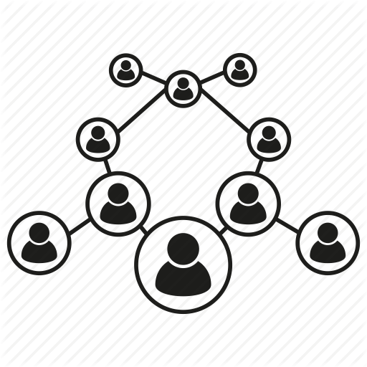

Digital Services Technology and Data Transformation
Architecture relocation to secure redundant datacentres
Corporate data migrated from Lotus Notes into secure SharePoint zones
Microsoft Office upgrade from 2007 to 2016
Operating System upgrade on laptops from Windows 7 to Windows 10
Email system upgrade
Rollout of VDI
Datacentre Refresh
Exchange
SharePoint
Office 2016
Virtual Desktop Infrastructure
Windows 10
2016
2019
Hardware Refresh
Legacy Uplift
Skype for Business
Campus Network
ONS Data Service
Replacement and upgrade of network switches, servers
Replacement of JAVA legacy applications
Adoption of Microsoft Skype for Business and replacement of legacy telephone system
Campus Network created spanning two data centres. Isolated from the corporate
Creation of ONS data service providing secure environment to ingest and process sensitive data for multiple sources
Technology and Data Transformation
Notes:
Significant technology and data transformation ongoing since 2016
Migration to Exchange, Sharepoint, Skype, Office
Hardware improvements
Development of platforms for data analysis

Slide 4



CI Pipeline
Security - Network Zones
Core network redesign and upgrade
Benefits - Increases in performance, reliability and resiliency
Services are isolated from the core network into zones
Managed under Strict change control using firewall rules
Service orientated
Isolated from core network
Secure by default
Data Ingestion
SharePoint
Exchange
Zones
Core Network
Data Service
Skype
Data Science Campus Network - Summary

Slide 5
ONS Data Service
“Enable teams to transform by providing access to support data and technology services”
Ingest data, provide technology and ensure security
Ingest and Secure Data
Platform
Standards
Methodology
Training and Support
Acquire
Ingest
Prepare
Explore
Production
Export
ONS Data Service
Notes:
Data is core to ONS
As well as technology transformation we also implemented data transformation
Key part of this is the ONS Data Service
Provides the support data and technology services and training and support to teams transform how they use data
Tools for the preparation, exploration of data

Slide 6


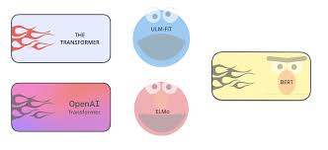

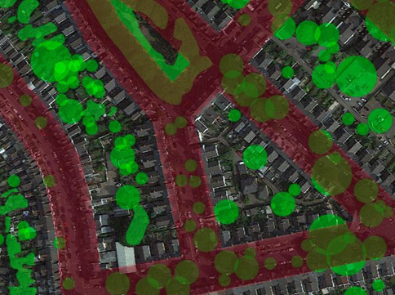
Data Science with Open Source Tools
Can provide a security risk
Can take many weeks or months for updates to be installed on corporate network
Not all packages and techniques are supported
This can limit innovation and constrains the ability for data scientists to implement and experiment with new tools and develop new techniques
The Data Science Campus network (DSCN) has been created as separate infrastructure to provide users with IT services and tool sets required to investigate more advanced techniques and produce the next generation of statistics
ONS Data Service
Notes:
Examples include NLP where having models and corpus available is an issue
Deep learning – availability of TPU, image storage and processing, geospatial
Also some data sets are better off not in a HDFS, and we can select and optimise storage as required

Slide 7

Corporate Network
Campus Network
Highly secure and controlled – sensitive data
Innovation – non-sensitive data
Internet
Internet
APIs
SFTP
Internal/External Users
Email
HTTPS
Data ingestion
Core ONS network
Scanned for viruses and malware
Ingest Zone
ONS Users
Less restrictive internet access
Remote Access
Web Proxy
Access tightly controlled and monitored
Isolated from the corporate ONS network
Data ingested into data lake
Data Lake
VDI Zone
Virtual Machines
Virtual Machines
Production Environment
Virtual desktops provide users with applications and tools
Local Admin rights, No group policies!
Why a separate network?
Notes:
ONS Data Science platform allows data science to be performed on sensitive data. It is zoned and secure, restricted access
However, the increased security also constrains and restricts libraries, models and tools that can be used
This can limit innovation and constrains the ability for data scientists to implement and experiment with new tools and develop new techniques.
The Data Science Campus network (DSCN) has been created as separate infrastructure to provide users with IT services and tool sets required to investigate more advanced techniques and produce the next generation of statistics.
Much more freedom to develop the systems and services required to develop cutting edge techniques and pipelines.
These can be refined and developed for future use on ONS Data Service.

Slide 8
Data Science Campus Network
Campus network spans 2 data centres and is isolated from the corporate ONS network. It is accessible from corporate and external networks
Equipped with many services required for Data Science, and can be easily extended to meet users needs
Users able to build their own system as required, virtual Windows or Linux instances, open source packages
Variety of storage mechanisms depending on data and need
Integration with TPUs to develop data visualisation and geospatial
Ability to create web services and APIs using a variety of coding languages, e.g. Python, R, JavaScript
Also includes a sandbox for training
10 Gbps
10 Gbps
Data centre 1
Data centre 2
20 Gbps Inter-link
Data Science Campus Network - Overview
Notes:
Campus Network spans 2 data centres.
Isolated from the corporate ONS network.
Accessible from corporate and external networks
Platform for innovation
The network is equipped with many services required for Data Science, and can be easily extended to meet users needs
Users build their own system as required,
eg, virtual windows or linux instances
variety of storage mechanisms depending on data and need
ability to use TPUs
ability to develop data visualisation and geospatial analysis
ability to create web services and APIs
different coding languages, eg, JS, C
Users free to install open source
Also includes a sandbox for training

Slide 9



Computer Vision
Natural Language Processing
OCR prototyping
Geospatial
Git
Apache Spark
Deep Learning
Natural Language Processing
Python
Machine Learning
Develop
Training
TPUs
Rapids
CAMPUS
NETWORK
Patent Data – Emerging Trends
Campus Network spans 2 data centres. Isolated from the corporate ONS network. Platform for innovation.
Data Science Campus
Green Spaces
National Accounts and Economic statistics
Mapping the Urban Forest
Data Architecture
Projects
Teams
Optimus
Rwanda
International Development
Access to Services - propeR
Sustainable Development Goals
Project and infrastructure consumption
Notes:
Used for variety of applications

Slide 10
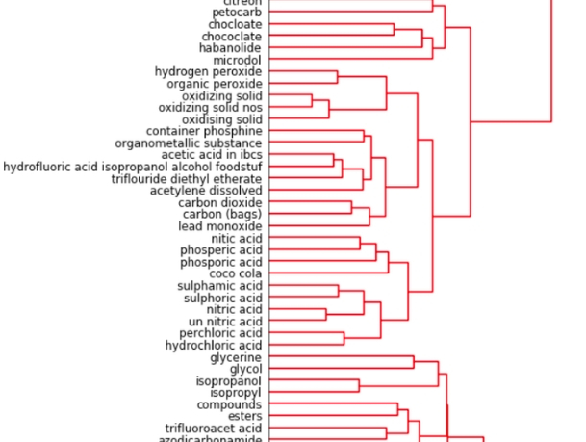
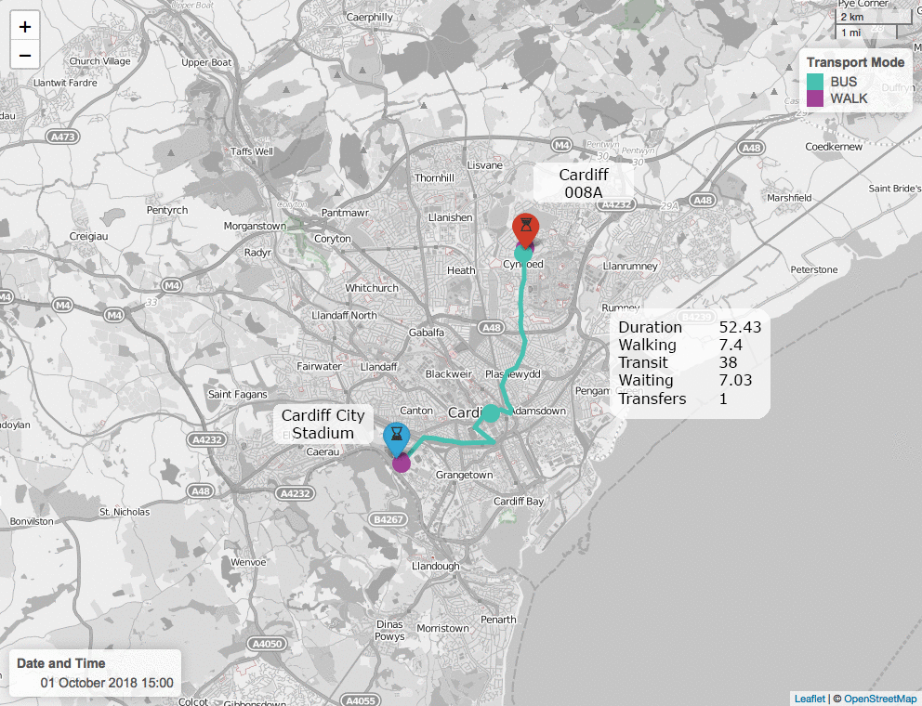
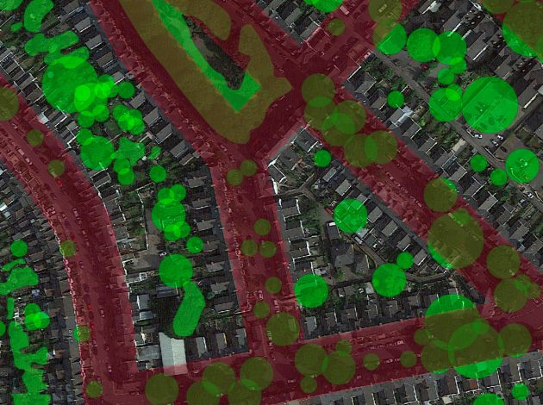
Optimus
Advanced NLP pipeline to turn free text lists into hierarchical datasets
https://datasciencecampus.ons.gov.uk/o-p-t-i-m-u-s-turning-free-text-lists-into-hierarchical-datasets/
propeR
Access to services using multimodal transport networks
https://datasciencecampus.ons.gov.uk/access-to-services-using-multimodal-transport-networks/
Mapping the Urban Forest
Estimating density of trees & vegetation at street level
https://datasciencecampus.ons.gov.uk/mapping-the-urban-forest-at-street-level/
Example Projects

Slide 11
ONS Network and Data Service
An office wide ONS Data Service provides the access to the support, data and technology services to enable teams to transform
It controls the ingestion, technology and security tools to allow data science to be performed on sensitive data
However, the increased security also constrains and restricts libraries, models and tools that can be used
This can limit innovation and constrains the ability for data scientists to implement and experiment with new tools and develop new techniques.
Data Science Campus Network
The Data Science Campus network (DSCN) has been created as separate infrastructure to provide users with IT services and tool sets required to investigate more advanced techniques and produce the next generation of statistics
Much more freedom to develop the systems and services required to develop cutting edge techniques and pipelines
These can be refined and developed for future use on ONS Data Service
A number of successful projects have been completed using both platforms
Data Science Campus Network - Summary

