Slide 1
Predictive Performance of a Hybrid Technique for the Multiple Imputation of Survey Data
HUMERA RAZZAK¹
CHRISTIAN HEUMANN²
1 PhD Candidate in Department of Statistics, Ludwig-Maximilians-Universität München.
2 Professor in the Department of Statistics, Ludwig-Maximilians-Universität München.
NTTS Conference, Brussels
13/03/2019

Slide 2

Goals
Importance of dealing with missing data in survey
MI as a general purpose solutions for missing data
General approaches for MI and related issues
Why we need combing MI approaches?
Hybrid MI (HMI)
Some evidence from simulation studies
Real data example
Results
Summary

Slide 3

Missing values
One of the more benign looking demons of data analysis.
  It seems innocent, but it can really screw things up
are everywhere: unanswered questions in a survey
response rates are generally declining in all surveys (unit nonresponse)
subjects who are willing to participate in surveys hesitate to provide all information (item nonresponse)

Slide 4
Multiple Indicator Cluster Survey (MICS)
  Main source of information on the women, child and household’s background characteristics
  Data collected at both family and person levels
  Contains items on health, demographic, and socioeconomic characteristics (e.g., income)
  Allows the study of relationships between health and other characteristics
  Missing data can lead to bias of unknown direction and magnitude
  Loss of efficiency

Slide 5
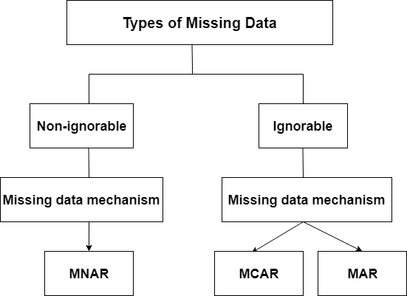
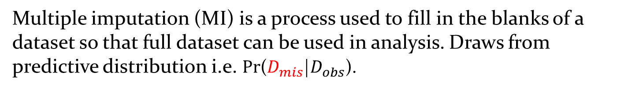
Multiple imputation (MI) is a process used to fill in the blanks of a dataset so that full dataset can be used in analysis. Draws from predictive distribution i.e. Pr($D_{mis}$|$D_{obs}$).

Slide 6
General Approaches for MI
Fully conditional specification (FCS): MICE (Multiple Imputations by Chained Equations)
FCS imputes variables one at a time from a series of univariate conditional distributions.
+ user specifies regression methods
- very time consuming
Software: MICE
Joint modeling (JM): Dirichlet process mixture of products of multinomial distributions (DPMPM)
JM draws missing values simultaneously for all incomplete variables using a multivariate distribution.
+ can detect complex structure automatically
- limited to only categorical variables
Software: NPBayesImpute

Slide 7
Why we need combing MI approaches?
DPMPM MI:
  not impute continuous variables (which MICE can)
MICE:
  complex dependencies structure can be problematic to be identified (which DPMPM can)
Therefore, it is not possible to get complete dataset when both approaches are applied separately
Need?
  a flexible and practical technique which combines properties of existing approaches to handle missing values in MICS

Slide 8

Hybrid Multiple Imputation (HMI)

Slide 9
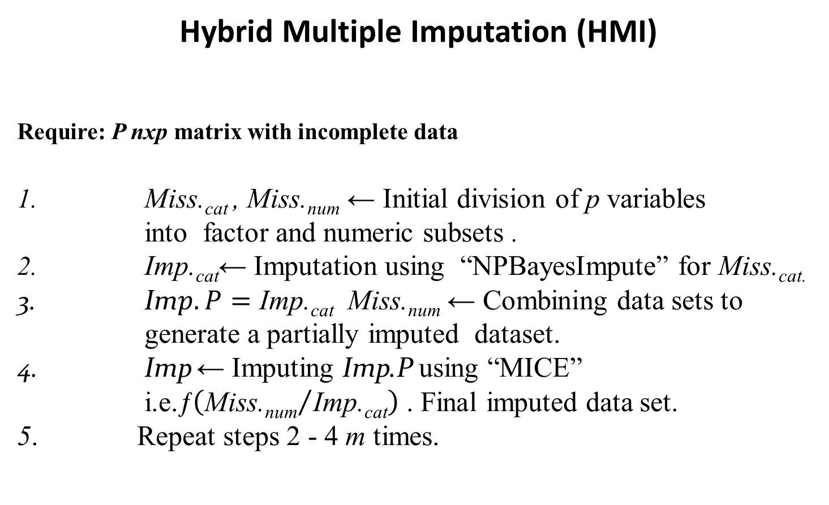
Hybrid Multiple Imputation (HMI)
Require: P nxp matrix with incomplete data
Miss._{cat} , Miss._{num} ← Initial division of p variables into factor and numeric subsets .
$\text{Imp}\text{.}\text{cat}$← Imputation using “NPBayesImpute” for Miss._{cat.}
$\text{Im}p.P=\text{Imp}\text{.}\text{cat} \text{M}\text{iss}\text{.}\text{num}$ ← Combining data sets to generate a partially imputed dataset.
$\text{Imp}$← Imputing Imp.P using “MICE”
i.e.ƒ$\left({\text{Miss}\text{.}\text{num}}/{\text{Imp}\text{.}\text{cat}}\right)$ . Final imputed data set.
5. Repeat steps 2 - 4 m times.

Slide 10
Hybrid Multiple Imputation (HMI)
MICE based algorithms:
“Imp.Cart” known as Classification and Regression Trees (Cart).
“Imp.PMM” known as Predictive Mean Matching (PMM).
“Imp.Default” which uses logistic regression for categorical and PMM for continuous variables.
HMI methods:
“Imp.Hybrid.Cart” combines DPMPM with MICE algorithm “Cart”.
“Imp.Hybrid.PMM” combines DPMPM with MICE algorithm “PMM”.

Slide 11
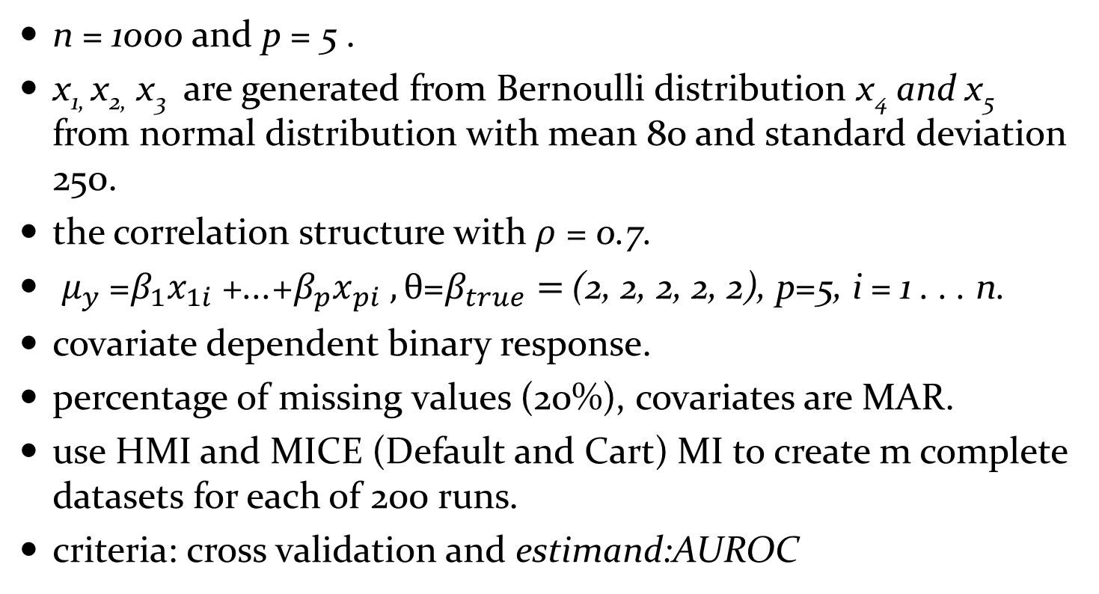
Some Evidence from Simulation Studies
n = 1000 and p = 5 .
x_{1,} x_{2,} x₃ are generated from Bernoulli distribution x₄ and x₅ from normal distribution with mean 80 and standard deviation 250.
the correlation structure with $ρ$ = 0.7.
$μ_{y}$ =$β_{1}x_{1i}$ +...+$β_{p}x_{pi} , θ$=$β_{true}=$ (2, 2, 2, 2, 2), p=5, i = 1 . . . n.
covariate dependent binary response.
percentage of missing values (20%), covariates are MAR.
use HMI and MICE (Default and Cart) MI to create m complete datasets for each of 200 runs.
criteria: cross validation and estimand:AUROC

Slide 12
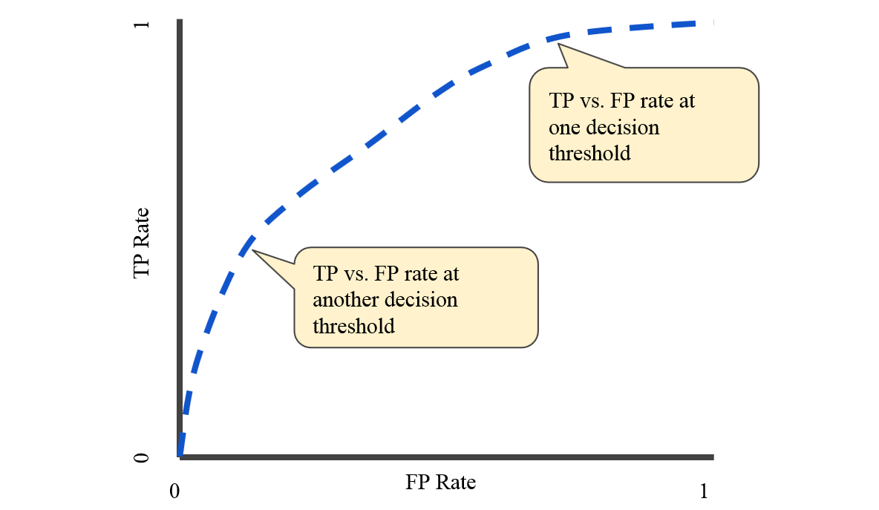
AUROC
An ROC curve (receiver operating characteristic curve) is a graph showing the performance of a classification model at all classification thresholds. This curve plots two parameters:
True Positive Rate : TPR=TP/(TP+FN)
False Positive Rate: FPR=FP/(FP+TN)

Slide 13
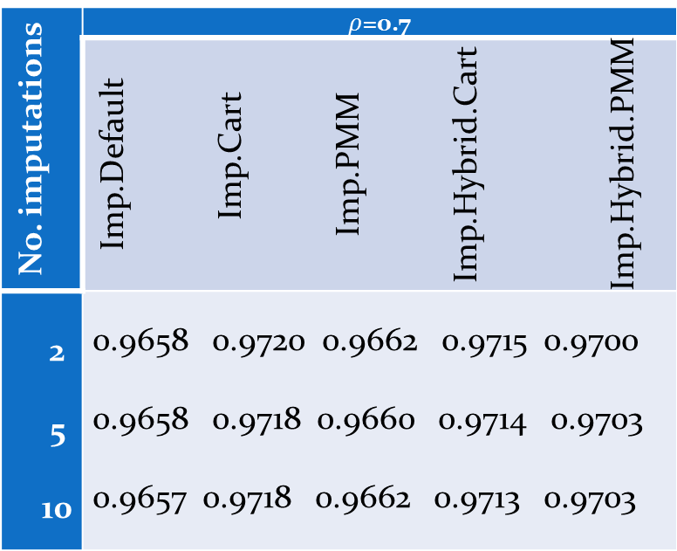
Simulated data: Median pooled AUROC curve for various MI methods.
No. imputations | $ρ$=0.7
 | Imp.Default Imp.Cart Imp.PMM Imp.Hybrid.Cart Imp.Hybrid.PMM
2 5 10 | 0.9658 0.9720 0.9662 0.9715 0.9700 0.9658 0.9718 0.9660 0.9714 0.9703 0.9657 0.9718 0.9662 0.9713 0.9703

Slide 14
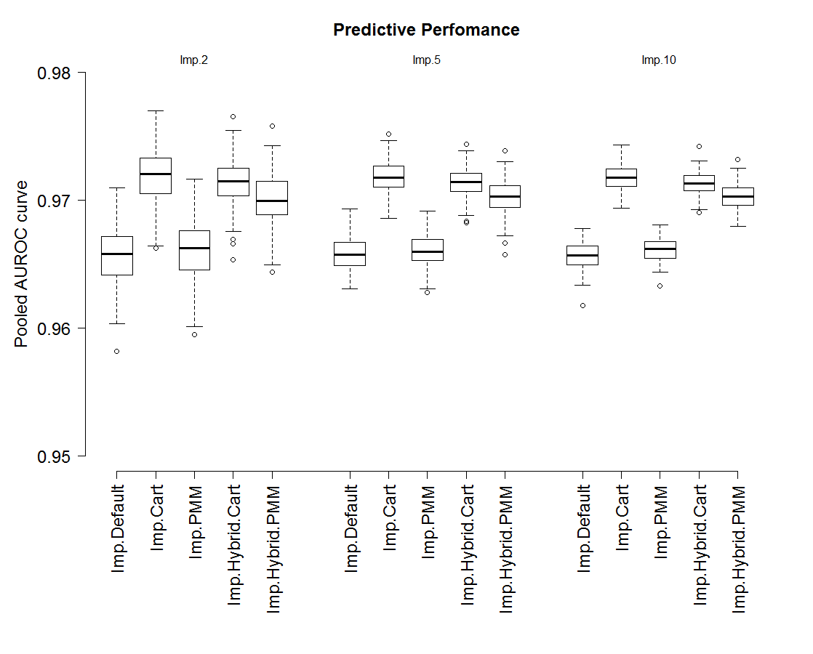

Simulation study: Boxplots of pooled AUROC, $ρ$=0.7.

Slide 15
Practical application: Imputation of MICS 2014 women’s data (2014)
Objectives of the Survey:
to assists countries to collect data in order fill the data gaps for monitoring the situation of children and women.
Conducted by:
Bureau of Statistics Punjab in collaboration with United Nations Children’s Fund (UNICEF).
The Amount of Missing Percentages:
ranges 14 - 95 per cent.
Total Observations:
61286

Slide 16
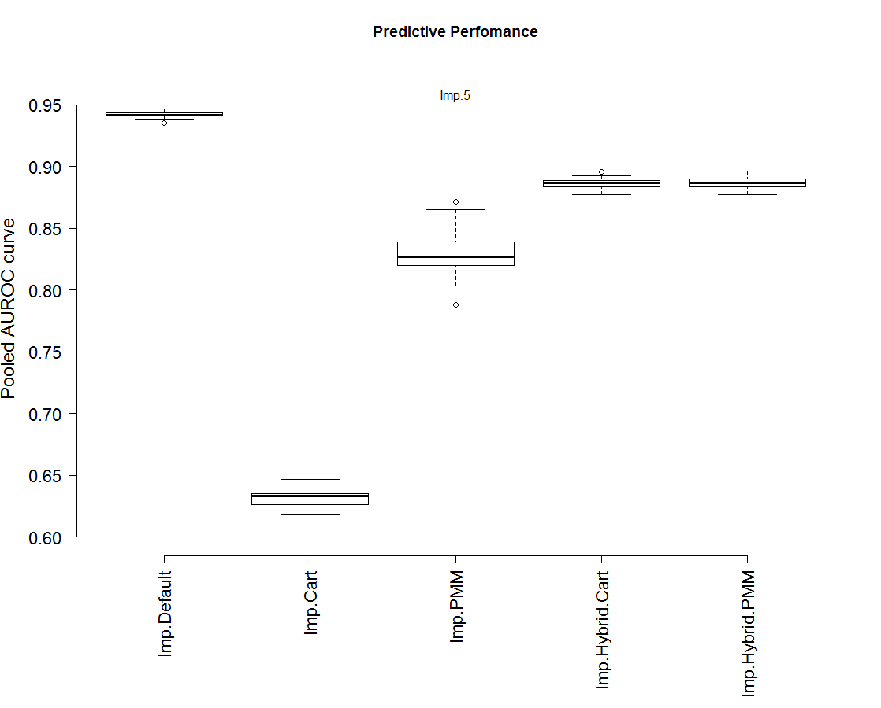
Real data: Boxplots of pooled AUROC obtained by various MI methods

Slide 17
Real data: Time taken
No. imputations | Imp.Default | Imp.Cart | Imp.PMM | Imp.Hybrid.Cart | Imp.Hybrid.PMM
Imp.5 | 1.93 days | 1.88days | 1.80 days | 10.78 hours | 11.59 hours
Real data: Median pooled AUROC
No. imputations | Imp.Default | Imp.Cart | Imp.PMM | Imp.Hybrid.Cart | Imp.Hybrid.PMM
Imp.5 | 0.94 | 0.63 | 0.82 | 0.88 | 0.88

Slide 18
Summary
this approach can prove to be very appropriate for a large number of variables with complex association structures especially coming from sample surveys.
the dependence among continuous and categorical variables can be made through an easy engine.
better predictive performance with minimum computational time as compared to the existing methods.

Slide 19


