Slide 1
UNGP Methods & Developer Services
Joni Karanka
Methods Lead - ONS / UN Global Platform

Slide 2
Intro
Sharing in statistics: CSPA
Up-to-date tech
UNGP method service
UNGP developer service

Slide 3
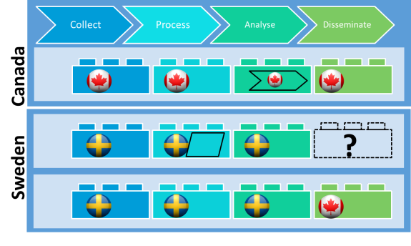
Sharing statistical services: CSPA
Industrialise approach:
Create reusable components
Drive down cost & increase speed
However:
Complex
Requires sophisticated approach and skills by NSO
NSO often has a simple and effective alternative

Slide 4
New tools & approaches
We can reinvent CSPA as:
A repository of public / private containers
A catalogue of public / private APIs to methods & functions
A set of standards for them
That’s kind of what we are doing - but deploying infrastructure & services

Slide 5
New tools & approaches
Public cloud
Containers
API-first
Serverless
Store apps, models and methods as containers
Deploy and consume them anywhere
APIs
Cloud 1
Cloud 2
Cloud 3

Slide 6
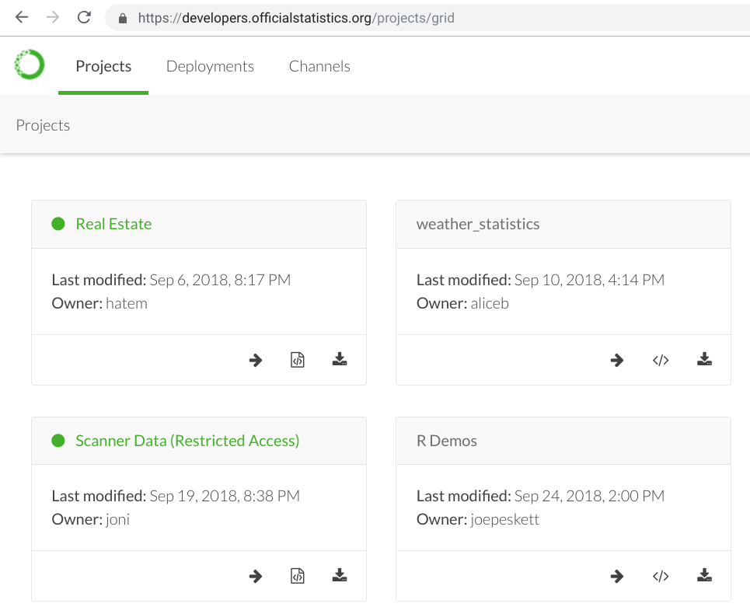
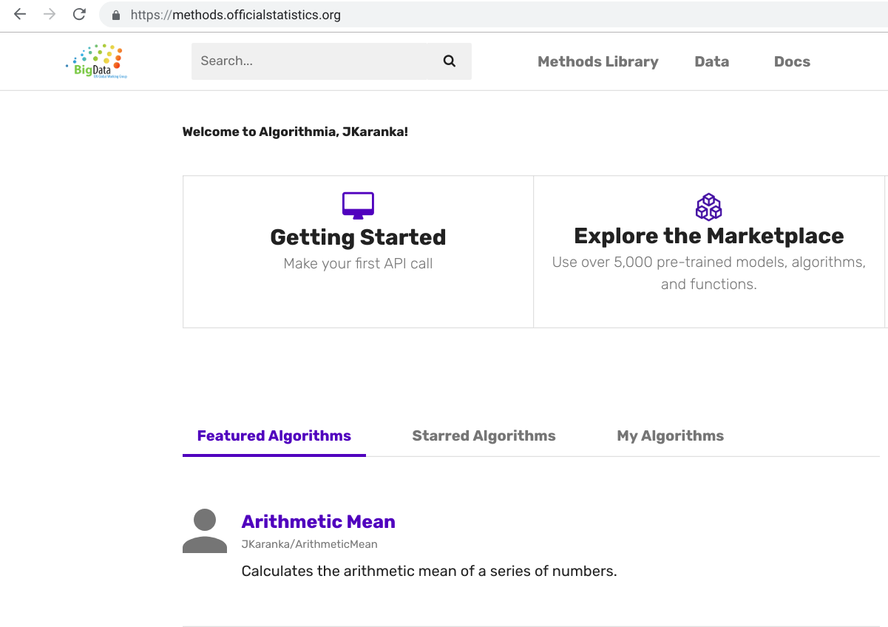
Services
developers.officialstatistics.org
methods.officialstatistics.org

Slide 7
Methods
Notes:
Let’s talk algorithms and methods now.

Slide 8
Perfect Technology Storm
APIs
Containers
Public Cloud
Notes:
The objectives that initiatives such as CSPA aspire to are much easier to achieve with modern tech patterns. Containers allow for portable solutions - onprem as well as cloud. Public cloud is elastic and available. APIs provide both transparency and constraints with regards to interoperability. A lot of these processes can now be automated as well.

Slide 9
methods.officialstatistics.org
Partnering with Algorithmia
Users contribute algorithms, methods, functions…
… and they are published with an accessible API
Notes:
We have been working with Algorithmia, who have the main algorithm hosting site in the world.
Instead of using the public algorithmia.com site we have done our own deployment on public cloud. This means that the service is available free of cost (we are billing the infrastructure), rather than paying for the use of the algorithms. In a nutshell, Algorithmia allows you to publish and consume algorithms and methods without having to deal with all the devops and continuous integration tasks.

Slide 10
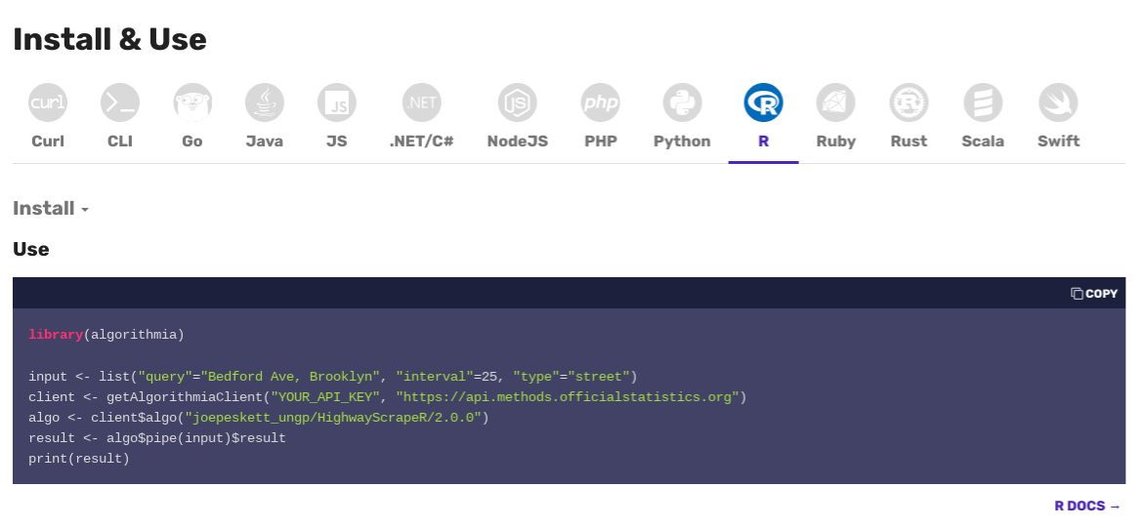
API example

Slide 11
Consume from anywhere with any client
Algorithmia manages:
Compilation
Dependencies
Containers
Testing
Documentation
Versioning
API publishing
Code store
Accreditation
Scaling
No devops needed
Commit
Code
Compile
Container
Container
Container
Container
Publish
API
Consume
Notes:
Basic pipeline of what is happening. User (data scientists & statisticians) commit code in any of the available languages (R, Java, Python, etc.). Algorithmia then compiles and tests the code, as well as maintains any library or package dependencies it might have. The algorithm is then deployed in containers (Kubernetes), which can be scaled on demand. An API is made available which is versioned (i.e., new and old versions are accessible). The APIs can be accessed by users of the platform by using their individual API keys.

Slide 12
Developers
Notes:
Let’s talk algorithms and methods now.

Slide 13
What is it?
Deployment of Anaconda Enterprise
Allows users to collaborate in projects:
Share data & notebooks
Jointly explore datasets
Produce algorithms & data processing pipelines
Can control access to data (restricted datasets)
Relies on commonly available technology: Git, Jupyter Labs, open source languages

Slide 14
Urban Forests
Developers
Methods
The Internet
Provide UI
Find location
Google Maps API
Download street view images
Street View API
Segment images
Visualise results
Estimate vegetation indices

Slide 15
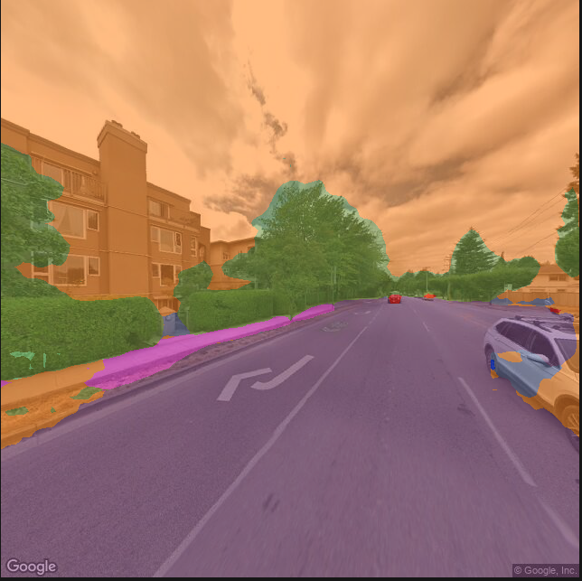
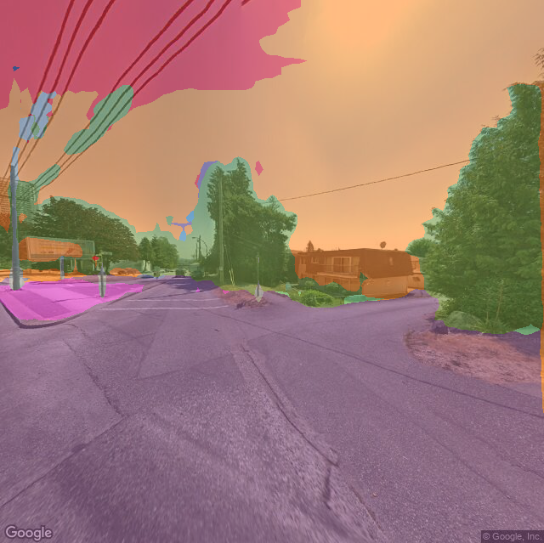
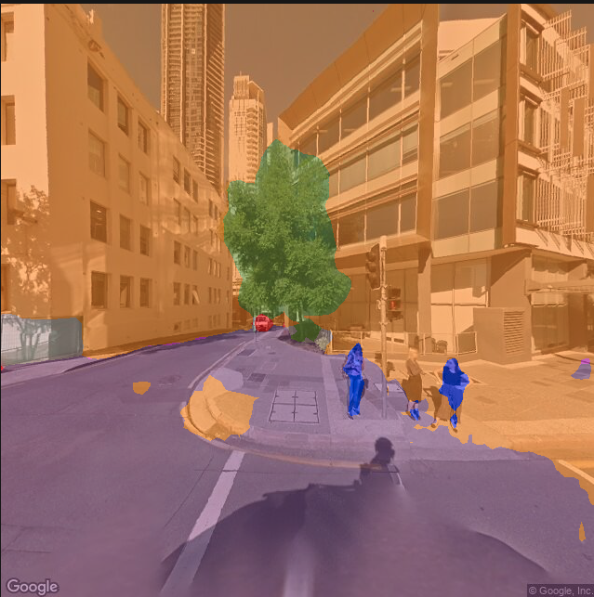
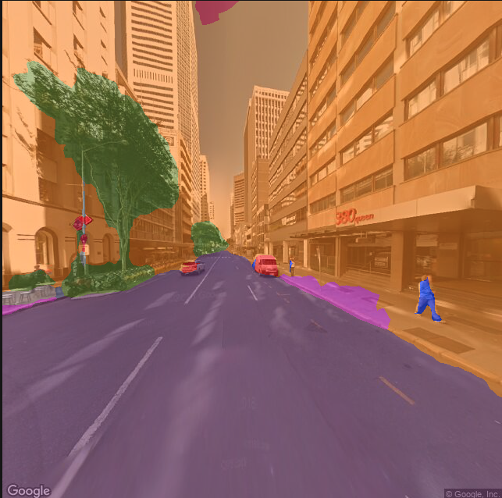
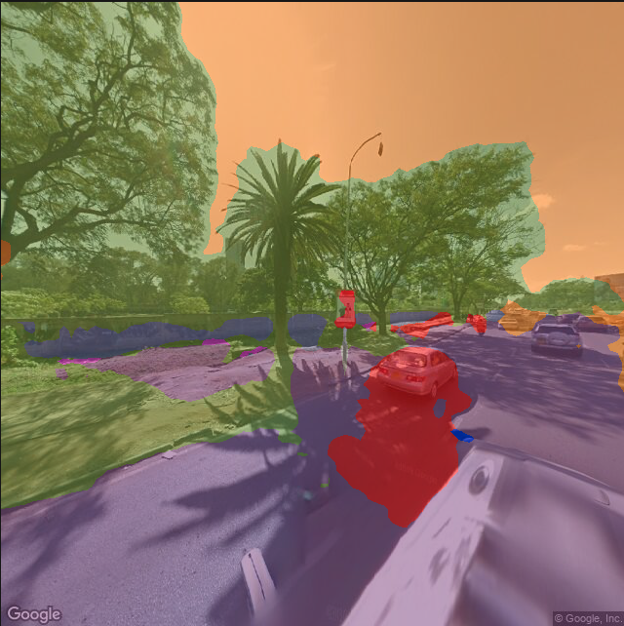
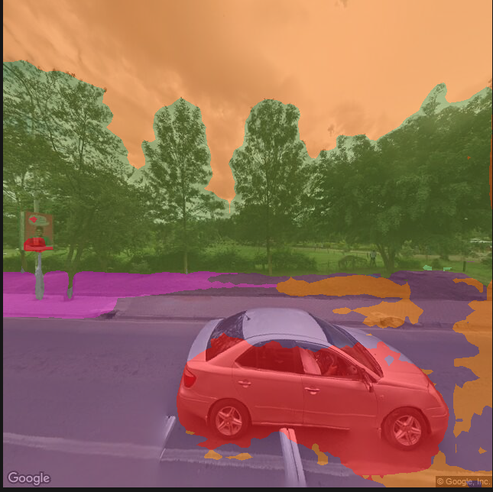
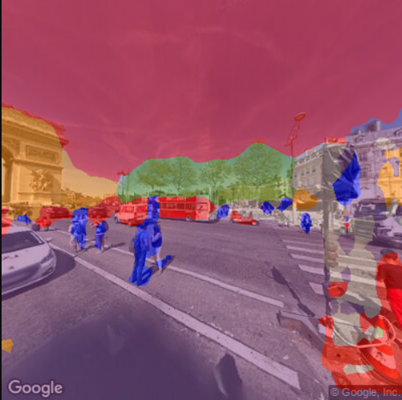
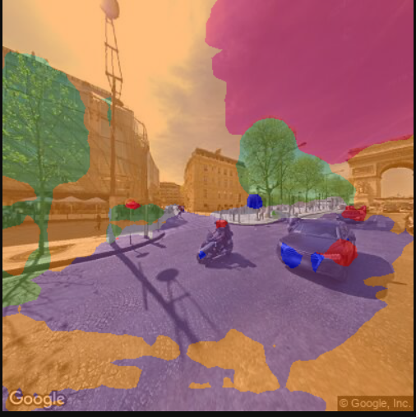
Vancouver
Melbourne
Nairobi
Paris

Slide 16
Discussion
Easier to do shareable infrastructure than ever before
Participate!
Join a UN GWG task team
Contribute algorithms
methods@officialstatistics.org

