Slide 1
ScattR – A Shiny App For
Exploratory Data Analysis
Session: Data exploration and visualisation
Philipp Leppert, Destatis
NTTS 2019
12.03.2019, Brussels

Slide 2
A calculation
The “Datasaurus Dozen” (Matejka/Fitzmaurice 2017)
  12 datasets each with two variables (x and y)
Summary statistics (3 out of 12 datasets)
Dataset | N | Mean (x) | Mean (y) | Standard deviation (x) | Standard deviation (y) | Corr(x,y)
I | 142 | 54.268 | 47.836 | 16.767 | 26.936 | -0.069
II | 142 | 54.263 | 47.832 | 16.765 | 26.935 | -0.065
III | 142 | 54.266 | 47.835 | 16.769 | 26.940 | -0.064
Calculations based on https://www.autodeskresearch.com/publications/samestats.

Slide 3
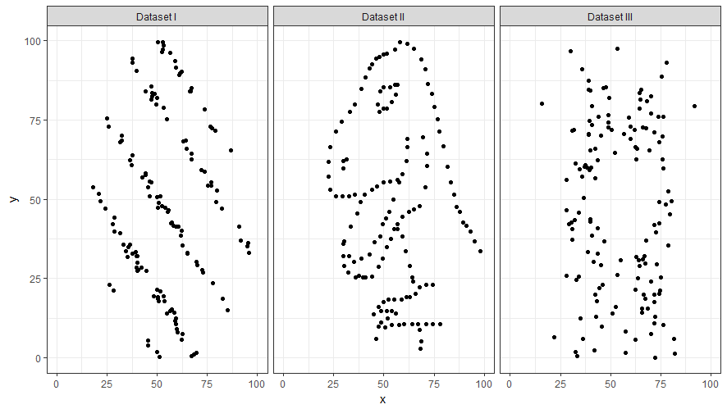
A scatterplot
Scatterplot based on https://www.autodeskresearch.com/publications/samestats.

Slide 4
Challenges of „real-world“ survey data
Many observations (“data points”)
Many variables (“relationships between X and Y”)
Existence of hierarchical structures (NACE, NUTS, …)
Exploratory data analysis requires:
  Methodological/programming skills in statistical software
  Coding effort
  Time

Slide 5
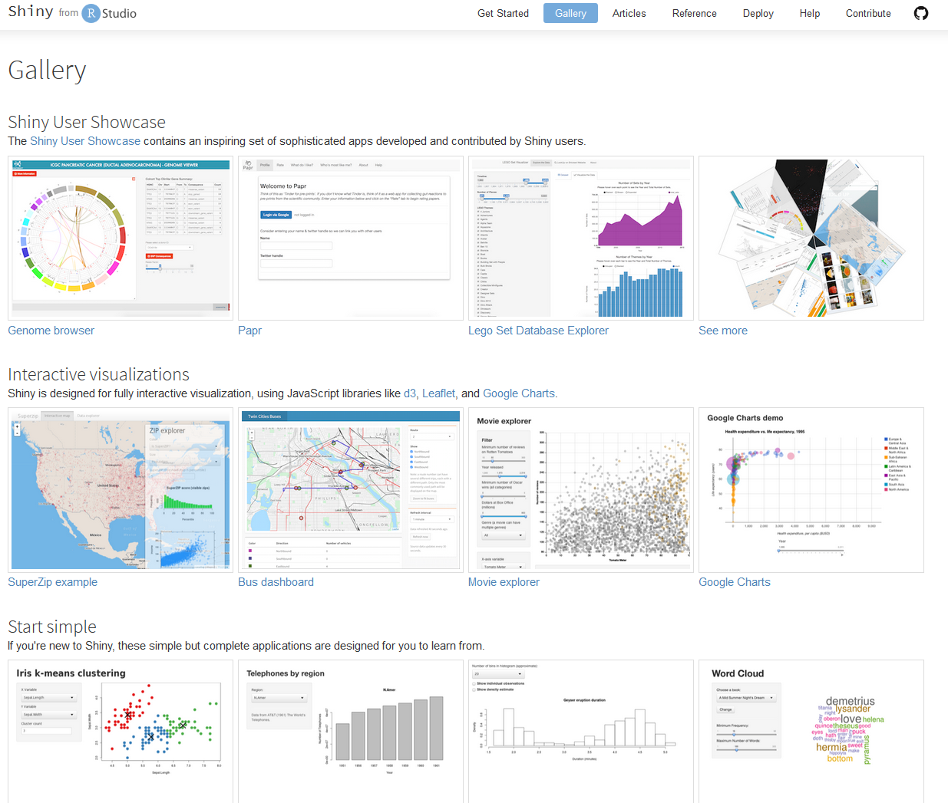

The R package „shiny“
Shiny allows for creating end-use applications
End user does not need specific skills in R
Reduces (repetitive) coding effort considerably
More time for the analysis
R code
shiny
Data
Computation (R)
GUI (Web Browser)
https://shiny.rstudio.com/gallery/

Slide 6
Workflow of “ScattR“
Data import
Data preparation
Visualisation/Exploration
Communication
Choose a dataset with supported format inside the application:
SAS, Stata, Euro-CSV
or
R-Object (Data Frame)
Automatic assignment
(encoding) of variables with respect to the application‘s selection fields
Optional:
Hierarchie definieren
Create a scatterplot
(ggplot2)
Export plot
/
Filter data

Slide 7
Access via an R package
Data import
Data preparation
Visualisation/Exploration
Communication
Choose a dataset with supported format inside the application:
SAS, Stata, Euro-CSV
or
R-Object (Data Frame)
Automatic assignment
(encoding) of variables with respect to the application‘s selection fields
Optional:
Manual assignment
Optional:
Define hierarchical
structures
Create a scatterplot
(ggplot2)
Export plot
/
Filter data
library(scattr)
input_xy()
input_mouseclick()
input_color_group()
define_hierarchy()
runScattR()

Slide 8
Demonstration
(with simulated firm data)

Slide 9
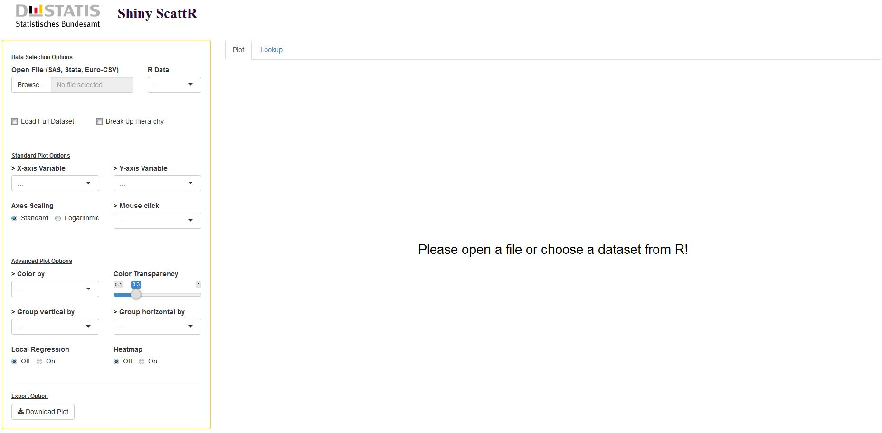
1. Start

Slide 10
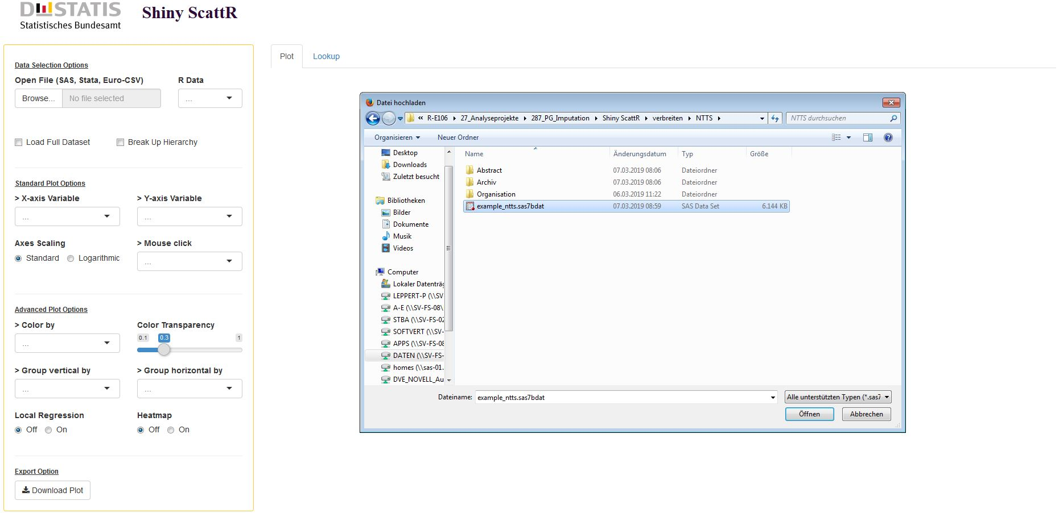
2. Import data

Slide 11
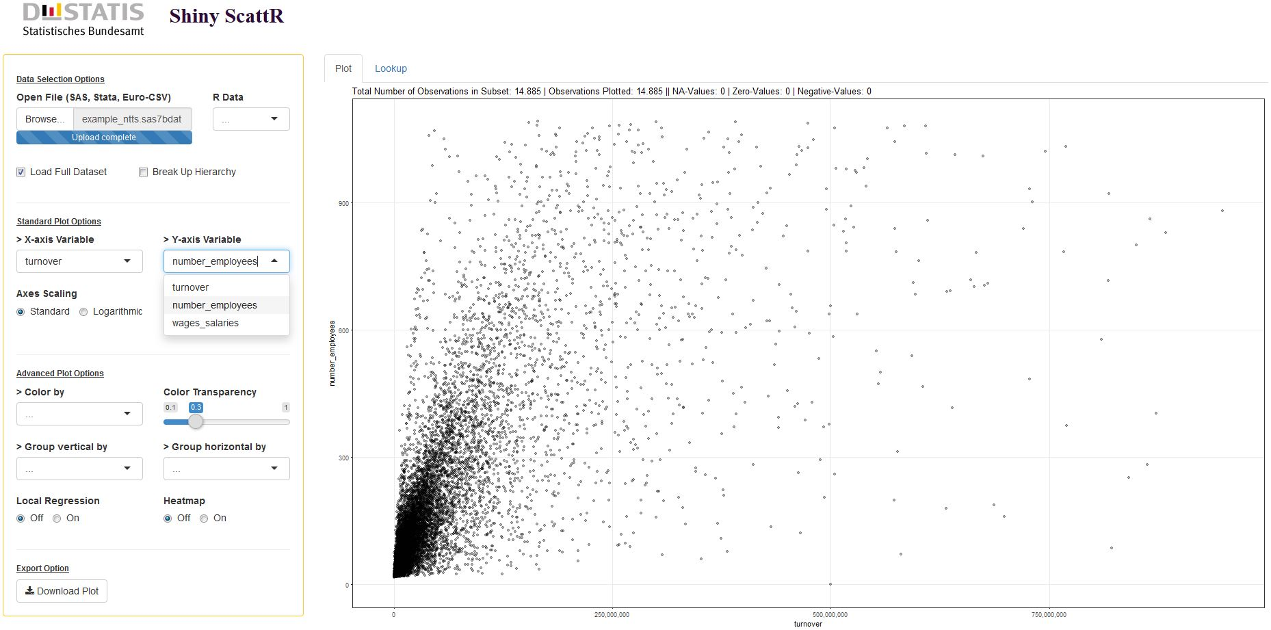
3. Scatterplot

Slide 12
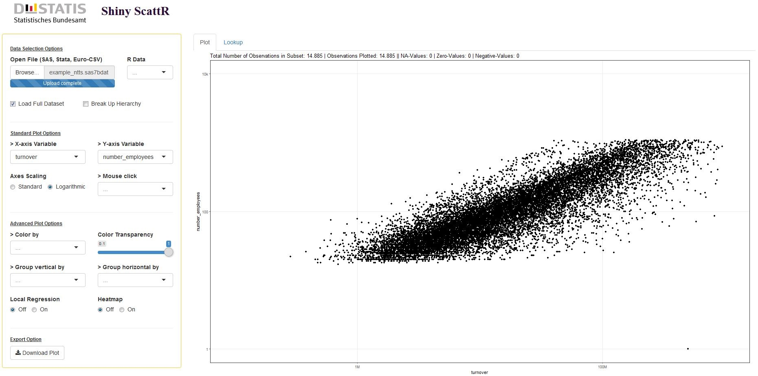
4. Outlier!

Slide 13
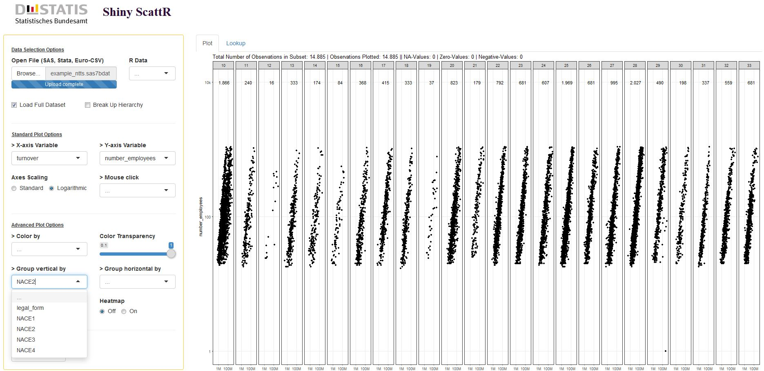
5. Which industry?

Slide 14
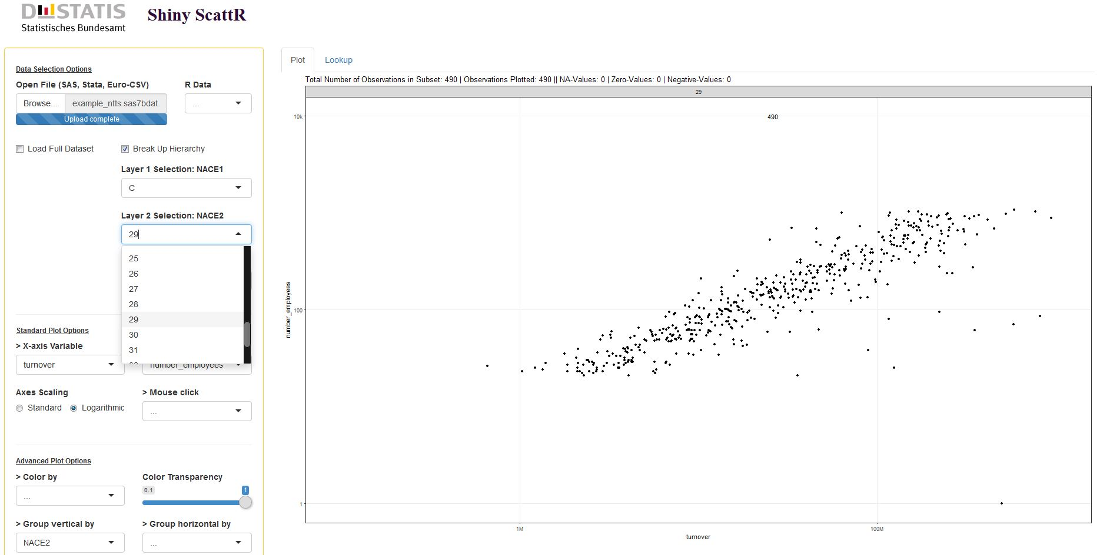
6. Filter scatterplot

Slide 15
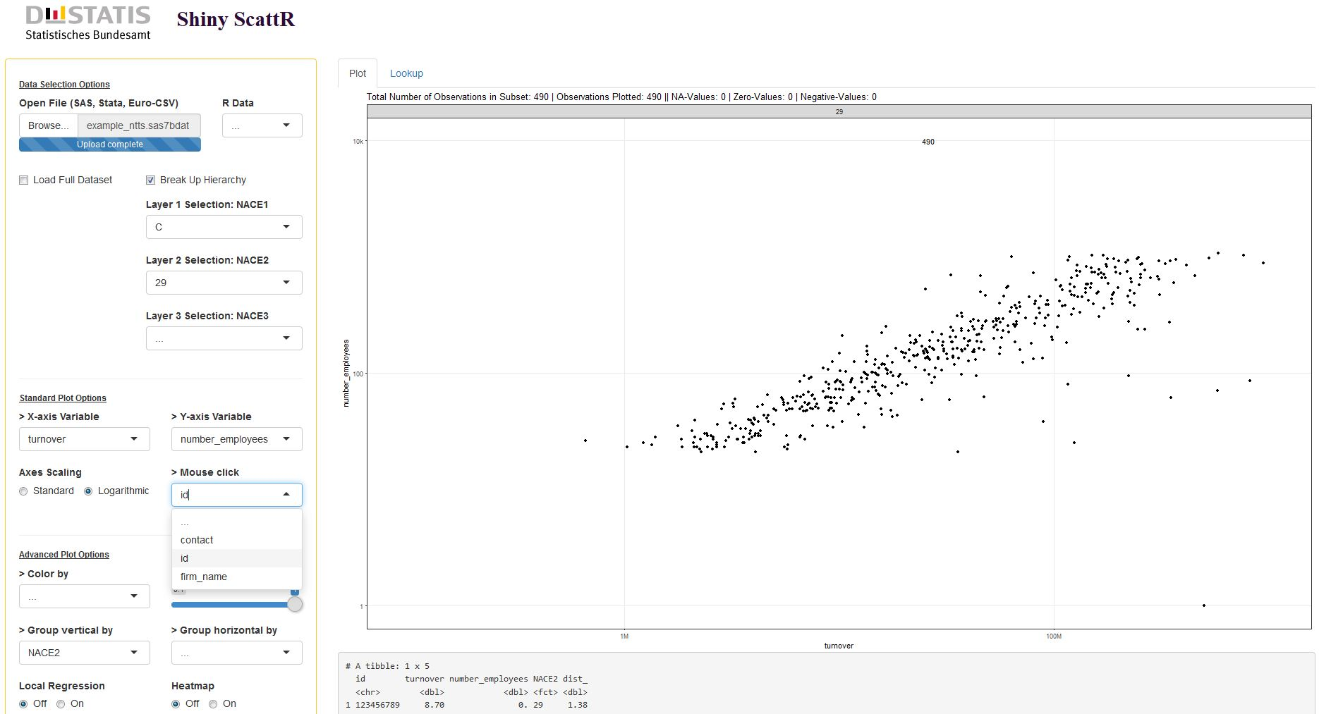

7. Mouse-click event

Slide 16
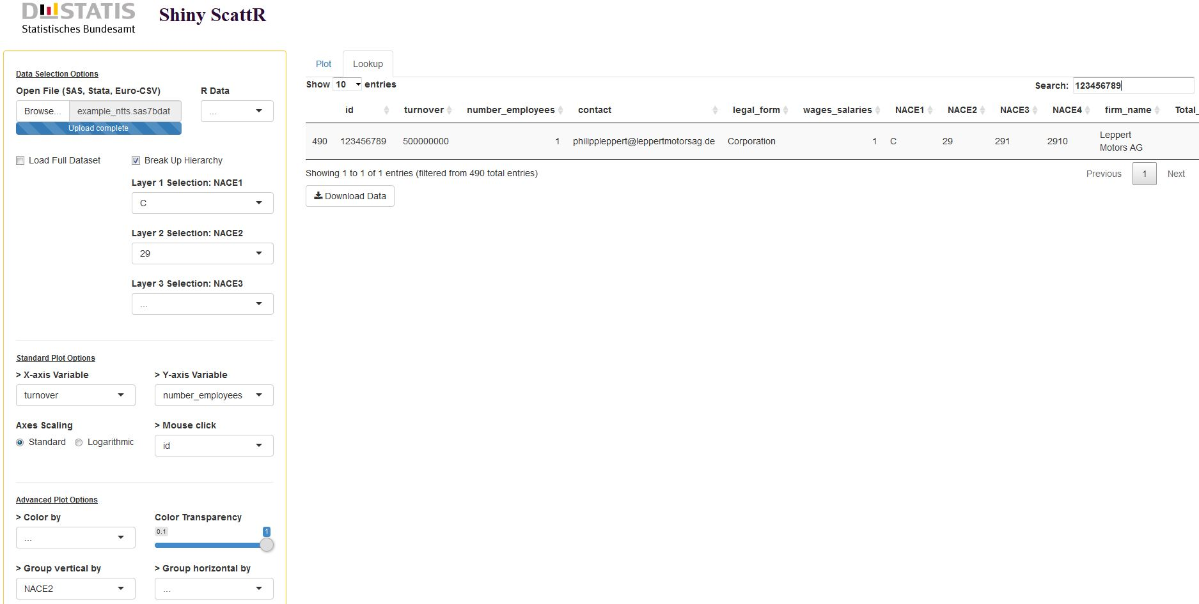
8. Filter observations

Slide 17
Conclusion
Shiny apps offer a framework for efficient exploratory data analysis
  Another useful field of application: visualisation of imputed values
Get users acquainted with the capabilities of R
Room for improvements
  The “bigger” the dataset the slower the creation of the scatterplot
  Integrating additional functions of the R package “scattr” directly into the shiny app

Slide 18























Thank You for Your attention!
Contact: philipp.leppert@destatis.de

Slide 19
References
Matejka, J. Fitzmaurice, G. (2017). “Same Stats, Different Graphs: Generating Datasets with Varied Appearance and Identical Statistics through Simulated Annealing”. Proceedings of the 2017 CHI Conference on Human Factors in Computing Systems: 1290–1294.
R Core Team (2019). R: A language and environment for statistical computing. URL: https://www.R-project.org.
Unwin, A., Theus, M. and Hofman, H. (2006) Graphics of Large Datasets: Visualizing a Million (Statistics and Computing).

