Slide 1
Perception of individual taxpayers regarding the e-invoice portal in tax compliance
Conference of European Statistics Stakeholders 2018
Bamberg, Germany • 18–19 October 2018
Alexandre Silva
Joana Leite
Daniela Costa
Cidália Lopes

Slide 2
Statistics
Literacy/ education
"Statistical thinking will one day be as necessary for efficient citizenship as the ability to read and write!"
Statistics
contributes to transparency in the exercise of citizenship,
promotes equity and efficiency in the analysis of public policies and the sense of justice,
it plays a key role in the accountability of political and administrative actors.
Quote from the presidential address in 1951 of mathematical statistician Samuel S. Wilks (1906-1964) paraphrasing from HG Wells' book "Mankind in the Making."

Slide 3
Context
IT tools
State point of view
e-governance
Quick online decision-making, data based-planning
Importance of transparency, trust, compliance.
Citizen point of view
Communication
Literacy, use of statistical information,
Impact – revenue

Slide 4
Tax system
Tax system complexity, system progressiveness, different income tax rates, stamp duty rates, taxpayers differ from one another
Influence on individual and business behavior

Slide 5
Problem
The impact of the introduction of the e-invoice portal in tax compliance
Business compliance
Citizen compliance
By means of online (real time) information tax payers promote compliance and become more aware of tax system and their own financial situation.

Slide 6
Tax Administration
Effort to go online
#of user of online platform 111.888
Quality 73%
Satisfaction ease of use 81%

Slide 7
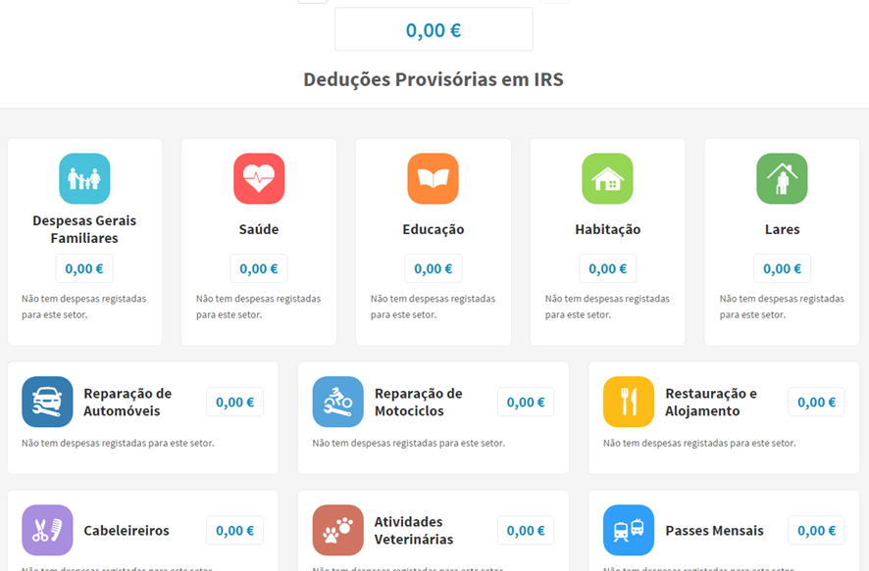
e-invoice portal

Slide 8
Year |  | 2015 | 2016
# invoices received |  | 872.579.534 | 923.949.913
Type | Family general expenses | 646.476.259 | 665.469.802
 | Health | 174.107.841 | 177.268.471
 | Education | 50.910.381 | 79.221.657
 | Property | 1.085.053 | 1.989.983
 | Homes | 1.776.585 | 2.182.756
 | Car repair | 4.025.051 | 4.169.810
 | Bike repair | 177.352 | 127.836
 | Restaurant/Hotel | 70.486.510 | 77.312.564
 | Hair/beauty salon | 4.568.773 | 5.184.495
 | Vet | --- | 1.698.762

Slide 9
Methods
A 31 questions questionnaire was made available, in April and May of 2017, to individual taxpayers
It was measured the (perceived) subjective norm, usefulness, reliability, compatibility, ease of use and attitude
A structural equation model (SEM) analysis was performed with AMOS.

Slide 10
TAM
Davis's technology acceptance model
empirical evidence on the relationships that exist between usefulness, ease of use and system use
Benefits of use
(Davis, 1989; Davis, Bagozzi, & Warshaw, 1989)

Slide 11
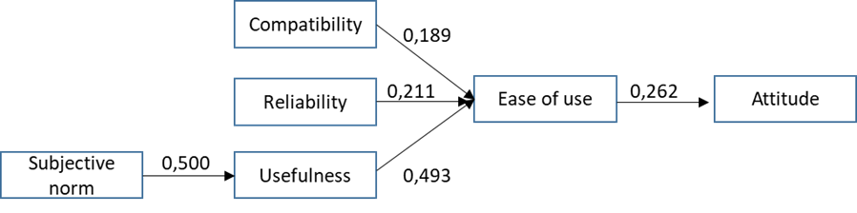
Model

Slide 12
Variables | variance | Alpha Cronbach
Norm | 86,00% | 0,919
Compatibility | 89,4% | 0,960
Reliability | 86,83% | 0,924
Useful | 80,34% | 0,916
Ease | 96,00% | 0,959
Attitude | 88,86% | 0,956

Slide 13
 | Compatibility | Reliability | Useful | Ease | Attitude
Norm | 0,647** | 0,663** | 0,612** | 0,471** | 0,277**
Compatibility |  | 0,782** | 0,756** | 0,719** | 0,307**
Reliability |  |  | 0,841** | 0,739** | 0,421**
Useful |  |  |  | 0,749** | 0,392**
Ease |  |  |  |  | 0,342**

Slide 14
Results
A total of 118 responses were obtained
Positive relation of the use of online portals and the level of compliance of individual taxpayers with tax obligations,
The quality of services provided by the tax administration is positively related to the use of online portals,
Perceived ease of use also positively influences the use of online portals,
Taxpayers considered the e-invoice portal an intuitive, practical and quite useful platform,

Slide 15
Use of info
It enables any taxpayer, with a lower knowledge of the tax, a slightly more enlightening and detailed view of the tax calculation,
It also helps with tax planning, since it allows the taxpayer to consult, throughout the year, their expenses and their repercussion on the tax.

Slide 16
Respondents state
43% visit the web page at least once per month,
52% believe to get a better tax return (credit) without knowledge,
80% use the portal as a tax planner,
88% makes easier the compliance

