Slide 1
The MIMOD project: a platform for sharing knowledge and practices in the ESS
Marina Signore
Director of Research
Data Collection Directorate, Istat
CESS 2018 / Conference of European Statistics Stakeholders 2018

Slide 2
The MIMOD project
The MIMOD – Mixed Mode Designs in Social Surveys is a multi-beneficiary grant awarded by Eurostat
Consortium:
Leader: Istat (Italy)
Partners: CBS (Netherlands), SSB (Norway), STAT (Austria) and Destatis (Germany)
Supporting Network:
INSEE (France), Czech Statistical Office (Czech Republic), Central Statistical Office of Poland (Poland), Statistic Finland (Finland) and Statistics Sweden (Sweden)
Start: 1st December 2017
Final Workshop: 11-12 April 2019 in Rome

Slide 3
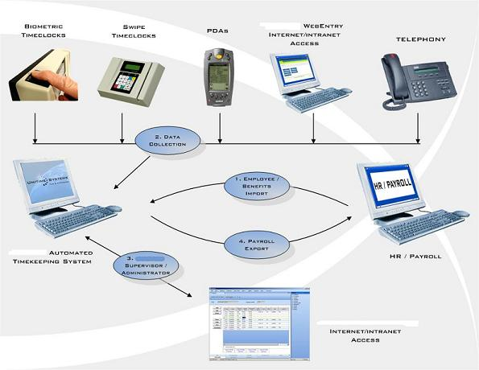
MIMOD aims and activities
State of the art in the European Statistical System
Use of mixed-mode in social surveys (which modes, which designs, contact strategies,..)
Feasibility of EU questionnaires for social surveys for mixed-mode and multi-devices, with a focus on the web mode
Research activity on mode effect
Questionnaire development and testing (adaptations to different modes, mobile phones, …)
Review of the literature
Support EU NSIs in implementing mixed-mode in social surveys

Slide 4
MIMOD aims and activities
WP1: mode organisation (concurrent/sequential mixed-mode) with the objective of providing guidelines on data collection strategies combining quality, cost, respondents’ characteristics and modes. (WP leader: M. Murgia, Istat)
WP2: mode bias/mode effect and its adjustment with the aim of providing general guidelines on methodologies to deal with (WP leader: O. Luzi, Istat)
WP3: case management with the purpose of investigating the different systems in use (technical components, organisational approaches, …) (WP leader: M. Plate, Statistics Austria)
WP4: mixed-mode questionnaire designs in order to give best practice recommendations for mixed-mode questionnaires for key ESS surveys, with an emphasis on web, and for the contact and follow-up phases of data collection (WP leader: D. Gravem, Statistics Norway)
WP5: challenges for mobile phones and tablets respondents in CAWI with the aim of investigating the use of new devices in ESS surveys and of mobile device sensors (such as GPS, camera, microphone, accelerometers) to enrich ESS surveys (WP leader: B. Schouten, CBS)
WP6: organisations of events (kick-off meeting and Final Workshop), reporting to Eurostat and overall project coordination (WP leader: M. Signore, Istat)

Slide 5
MIMOD main results so far
The survey on the state of art of mixed-mode for EU social surveys (WP1)
Updated overview on methodologies for mode effect assessment and adjustment in mixed-mode designs (WP2)
Possible Components of a Case Management System (CMS) and preliminary typology of CMS (WP3)
Mixed-mode experiences and case studies in EU NSI focusing on questionnaire design in mixed-mode surveys with a web component (WP4)
Communication strategies in mixed-mode ESS surveys (WP4)
Assessment of fitness of ESS surveys for smartphones (WP5)

Slide 6
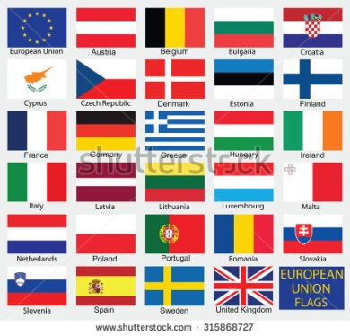
The MIMOD survey on the state of art of mixed-mode for EU social surveys
Istat coordination and supervision
Structure and contents of the survey questionnaire have been designed in cooperation with all WPs and with the contribution of some of the Supporting Countries
The web questionnaire was developed by Istat with
Possibility to provide comments and descriptions (e.g. “other- please specify); screenshot of questions and questionnaire layouts; to upload documentation (methodological papers, advance letters,…)
The survey run during end of March and May 2018
All the European NSIs replied! We do thank you for your kind cooperation!
Key inputs to the activities in all WPs

Slide 7
The survey contents
The questionnaire reflects the structure of the MIMOD project and contains the following sections:
Section A: Data collection strategies: which data collection modes are used for the main social surveys and how modes are combined, communication strategies and incentives, how concurrent and sequential mixed-mode designs are managed, the use of adaptive/responsive survey designs
Section B: Questionnaire design: how questionnaires differ over modes in mixed-mode designs which include the web
Section C: Use of smartphones and tablets: adaptation of questionnaire design to smartphones, the management of the use of smartphone by respondents (encouraged or discouraged), the use of apps, pros and cons of the use of smartphones to fill out statistical questionnaires
Section D: Methodologies to deal with mode effect: research conducted, reports available, filled in by a methodologist
Section E: Case Management Systems: technical components and organisational aspects for the management of mixed-mode data collection processes

Slide 8
The survey contents
Social surveys investigated:
Labour Force Survey waves 1 and 2 (LFS)
Survey on Income and Living Conditions waves 1 and 2 (EU-SILC)
European Health Interview Survey (EHIS)
Adult Education Survey (AES)
Survey on Information and Communication Technology (ICT)
Household Budget Survey (HBS)
Harmonised European Time Use Survey (HETUS/TUS)
Data collection modes and sources investigated:
CATI
CAPI
PAP/PAPI
CAWI
Registers
Other sources (big data, web scraping, gps, etc.)

Slide 9
The MIMOD survey: some results
Mixed-mode strategies are the ‘standard’ approach to data collection in social surveys. They are adopted by all NSIs but one.
The ‘mix’ includes the web mode for 23 NSIs out of 31.
The web mode is used by 25 NSIs out of 31
Data collection strategies used by EU NSIs | NSIs
NSIs using mixed-mode strategies | 30
NSI not using mixed-mode strategies | 1
Mixed-mode strategies with the web mode | 23
Mixed-mode strategies without web mode | 7
NSIs using web mode | 25
NSIs not using web mode | 6

Slide 10
The MIMOD survey: some results
Mixed-mode and web mode: 5-year trend in social surveys
In the last 5 years the adoption of mixed-mode strategies in social surveys has increased in 71% of NSIs
The use of the web mode has increased as well, (64.5%) especially as a component of the ‘mix’ (80%)

Slide 11
The MIMOD survey: some results
Mixed-mode in social surveys
Mixed-mode surveys (50.9%) make use of several combinations of modes.
These combinations include CAWI in 43% of cases and make a large use of modes that are computer-assisted and interviewer administered
 | Percent values¹
Mixed-mode strategies WITH CAWI | 43.0
CATI-CAWI | 7.7
CAPI-CAWI | 7.7
CATI-CAPI-CAWI-Registers | 7.0
CATI-CAWI-Registers | 4.9
Other combinations with CAWI | 10.6
Mixed-mode WITHOUT CAWI | 57.0
CAPI-PAPI | 13.4
CATI-Registers | 13.4
CATI-CAPI- Registers | 10.6
CAPI- Registers | 5.6
Other combinations without CAWI | 14.0
Total | 100
¹ Percent values are calculated on mixed-mode surveys

Slide 12
Methodologies for mode effect
Activities undertaken by 31 ESS NSIs to assess mode effects in mixed-mode designs. Each NSI could report multiple activities.
Activity undertaken to assess mode effects | Percentage of NSIs
Pre-tests, experiments on questionnaire design | 48%
Pilot surveys | 42%
Differences in distributions of socio-demographic or target variables | 39%
Pre-tests, experiments on sensitive or core questions | 35%
Differences in quality indicators | 35%
Previous and new data collection strategies running simultaneously | 32%
Separating selection, nonresponse and measurement effects | 26%
Calculation of representativeness indicators of various designs | 23%
Pre-tests, experiments on split sample approach | 19%
Subsampling of groups receiving different data collection strategies (e.g. control group) | 19%
Pre-tests, experiments on the use of different devices (smartphones, tablets, …) | 19%
Re-interview studies | 6%
Other types of pre-tests and/or experiments | 3%
Other activities | 6%
No activity conducted in recent years | 32%
Almost all NSIs reported multiple activities.
In fact, countries reporting one single activity are exceptions

Slide 13
Methodologies for mode effect
Measures to adjust for mode effects in mixed-mode designs.
Each NSI could report multiple measures.
Measure taken | Percentage of NSIs
Weight adjustments | 26%
Calibration to fixed mode distributions | 13%
Estimate measurement errors and correct responses to a benchmark mode | 10%
Other | 13%
No measure taken | 61%
Future Plans: 14 out of the 31 NSIs report to have no future plans for research into mode effects assessment and/or adjustment methods

Slide 14
Review of recent literature on mode effect
Main findings
The ESS country experiences reported in the MIMOD survey reflect the findings in the literature review: methods for mode effect assessments are more widespread than techniques on mode effect adjustment
A distinction between selection effects and measurement effects is essential to make, but this is not always done in the literature on mode effect assessment. It is easy to assess their combined effect due to the confounding of selection & measurement effects in observational studies
The two effects can be separated in experimental studies, but these are rather rare because of the associated costs. A promising line of future research is the development of mixed-mode designs that allow for separating selection from measurement effects through embedded experiments (e.g. re-interview studies)

Slide 15
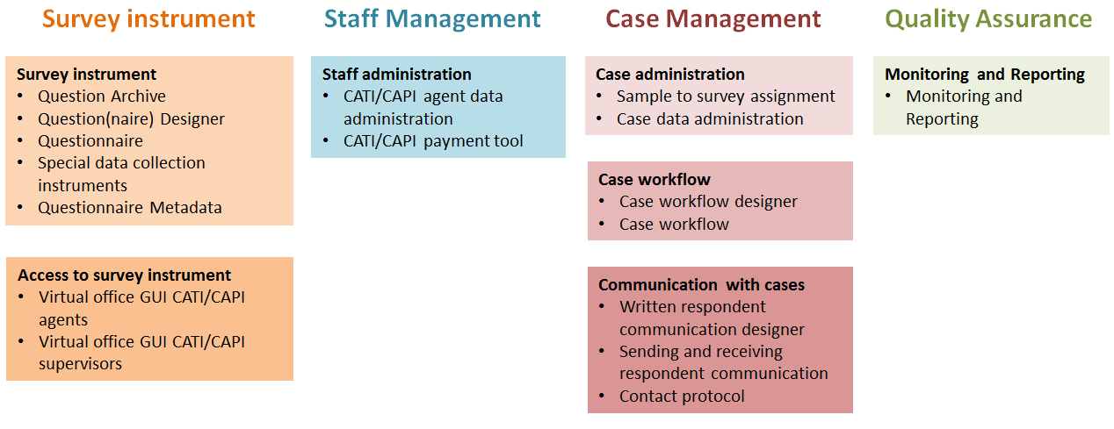
Case Management System - possible components
The domains of a Data Collection System

Slide 16
Case Management System - Preliminary Typology
Degree of component integration
I1. All 4 domains are integrated in one system:
I2. Transition from old systems of type I5 to new system of type I1:
I3. Staff-, case management and quality assurance one integrated system. Survey Instrument plugged in:
I4. Multiple survey instruments with their own staff-, case management and quality assurance systems:
I5. Most domain components are stand-alone tools:
Completeness of components
C1. All domains fully covered
C2. One or two domains partly or completely missing
C3. Most components partly or completely missing
Usage of commercial/external software tools
T1. All tools are in house products
T2. Some external tools are integrated in the in house developed system:
T3. BLAISE questionnaire supplemented by in house developed tools:
T4. BLAISE questionnaire supplemented by in house programmed external products:
Degree of survey integration
S1. One single data collection system for all surveys
S2. Systems in transition towards S1
S3. an own system for certain modes
S4. Some systems for certain modes and some for certain surveys:
S5. Some systems for internal and some for outsourced surveys
S6. An own system for each survey

Slide 17
Case Management Systems: some remarks
Preliminary findings show how heterogeneous the Case Management Systems within the ESS are. They differentiate along the following four dimensions: (1) the degree of component integration, (2) the component completeness, (3) the degree of in house developed product usage and (4) the survey integration.
In terms of data collection efficiency, systems with a high degree of component and survey integration would be aspired. One single system does not necessarily mean that every component must be an original product. Integration can also be reached by plugging in external products and developing links between the different products.
In terms of high data quality, the completeness of the Case Management System’s components is of uttermost importance.
There is a tendency towards more in house development within the ESS and this might not be the best solution in terms of input harmonisation and costs.

Slide 18
Questionnaire differences between modes
NSIs where asked to provide information on differences among questionnaires of mixed-mode surveys that include the web mode.
Differences were measured on different dimensions at questionnaire level and at question level
16 of 23 NSIs reported having differences on at least one of the dimensions.
12 of the 16 NSIs reported having differences on more than one dimension.
There are noticeable differences between countries and surveys, and in the degree of change.

Slide 19
Questionnaire differences between modes
Aggregated differences from key ESS surveys
Degree of questionnaire differences | Large | Some | Small | Sum
Questionnaire structure | 0 | 1 | 8 | 9
Number of questions | 1 | 0 | 4 | 5
Error and consistency checks | 2 | 4 | 23 | 29
Don't know options | 5 | 4 | 5 | 14
Permission of item nonresponse | 7 | 1 | 3 | 11
Amount of differing questions | Many | Some | Sum
Question wording | 0 | 14 | 14
Answer category wording | 0 | 3 | 3
Number of answer categories | 0 | 4 | 4
Placement of instructions | 2 | 16 | 18
Wording of instructions | 2 | 16 | 18

Slide 20
Preliminary conclusions on questionnaire design
The work of WP4 is still in progress (it also includes tests in different NSIs).
A lot of work is being done in questionnaire design, but also in data collection designs, trying to find the best way to do each survey and how to fit CAWI into the mix. The heterogeneity of the situation and the apparent constant change to be expected is an argument in favour of generalising the advice on questionnaire design as much as possible.
CBS’s approach called Omnimode design, which involves creating a new, mode-agnostic questionnaire rather than adapting a pre-existing one optimized for one particular mode, looks promising. In the short term, this is likely to be costly and time-consuming, but in terms of quality it appears to be superior.
In this regard, a suggestion would be to design questionnaires for mixed-mode from the start.

Slide 21
Fitness of the ESS surveys for smartphones
Inventory of smartphone option in ESS surveys by the 31 NSI’s
Survey | No web option | Smartphone blocked | Smartphone possible
 |  |  | Q not adapted | Q slightly adapted | Q profoundly adapted
LFS | 25 | 1 | 5
EU-SILC | 24 | 2 | 4 | 1
EHIS | 20 | 1 | 10
AES | 21 | 1 | 8 | 1
ICT | 16 | 3 | 10 | 2
HBS | 26 | 2 | 3
HETUS | 31
Questionnaires are usually not adapted or in few cases sligtly adapted to smartphones

Slide 22
Fitness of the ESS surveys for smartphones
Definition of a set of criteria related to smartphone screen size, smartphone navigation and interview duration
Application of the criteria to Eurostat model questionnaires and country-specific implementations of the EHIS, EU-SILC, ICT and LFS
Three dimensions are considered in the assessment:
Screen size: Smartphones have a wide variety of screen sizes, but are typically much smaller than traditional devices
Navigation: Screens are used for presentation as well as for navigation
Duration: Since smartphones can be used for multiple purposes simultaneously, can be used anywhere and anytime, and have smaller screen sizes, it is conjectured that length is an issue
Several criterion have been specified for each dimension

Slide 23
Fitness Criteria
Dimension | Criterion | Operationalization
Screen size | Introductions | Number of items with introductions
 | Grid questions | Number of grid questions Average number of items per grid
 | Question text | Number of items with > 20 words (excluding introduction text)
 | # answer cat’s | Number of items with > 5 answer categories
 | Filter questions | Number of (anticipated) filter questions with follow-up questions on the same screen
Navigation | Open question | Number of open questions
 | Many answers | Number of items with > 25 answer categories
Duration | # of items | Total number of items Average number of items asked per respondent
 | Household | Is survey a household survey? Yes/no
 | Database | Does survey require interaction with a database? Yes/no
 | Complexity | Number of (anticipated) items that require calculations by a average respondent Number of (anticipated) items that require consultation of personal documentation by a average respondent
 | Enj-Rel-Bur | Response rate to traditional online devices

Slide 24
Application of the Criteria
Scores on the three dimensions screen size, navigation and duration for each survey.
Survey | Screen size | Touch navigation | Duration
EHIS
EU-SILC
ICT
LFS household
LFS person
ICT: scores good on both the navigation and duration dimensions for the model questionnaire. Country-specific implementations may be problematic on duration. The screen size dimension is problematic due to the large number of instructions, introductions and long questions/answers.
LFS: is problematic on the screen size dimension; many questions require long texts. The navigation dimension is somewhat problematic due to open questions. The duration dimension is problematic for the household version of the LFS. On the person level, i.e. persons answering only questions that apply to themselves, the LFS may be doable. However, country-specific implementations of the LFS vary widely in length.

Slide 25
Final remarks
The MIMOD project is still running so additional and more conclusive results are being expected
The MIMOD survey provides a very rich input to the work of all WPs and gives us a comprehensive view on the state of the art in the ESS
CAWI and particularly Mixed-mode (including CAWI) are the future for Social Surveys
This calls for a redesign of existing questionnaires and survey designs. Even though it implies a lot of work let’s consider it as an opportunity for less complex and more friendly tailored questionnaires
Mixed-mode data collection calls for a greater collaboration in the ESS. Let’s MIMOD be the beginning of future joint work in the ESS

Slide 26
Save the date: MIMOD Final Workshop
11-12 April 2019, Rome
My thanks to MIMOD WP leaders: Manuela, Orietta, Marc, Dag and Barry and to all the colleagues involved in the project
Thank you for your attention!
Save the date
MIMOD Final Workshop
11-12 April 2019, Rome

