Slide 1
Reduction of complexity by means of indicators
CESS18 Bamberg
18. October 2018, STS02
Walter J. Radermacher

Slide 2
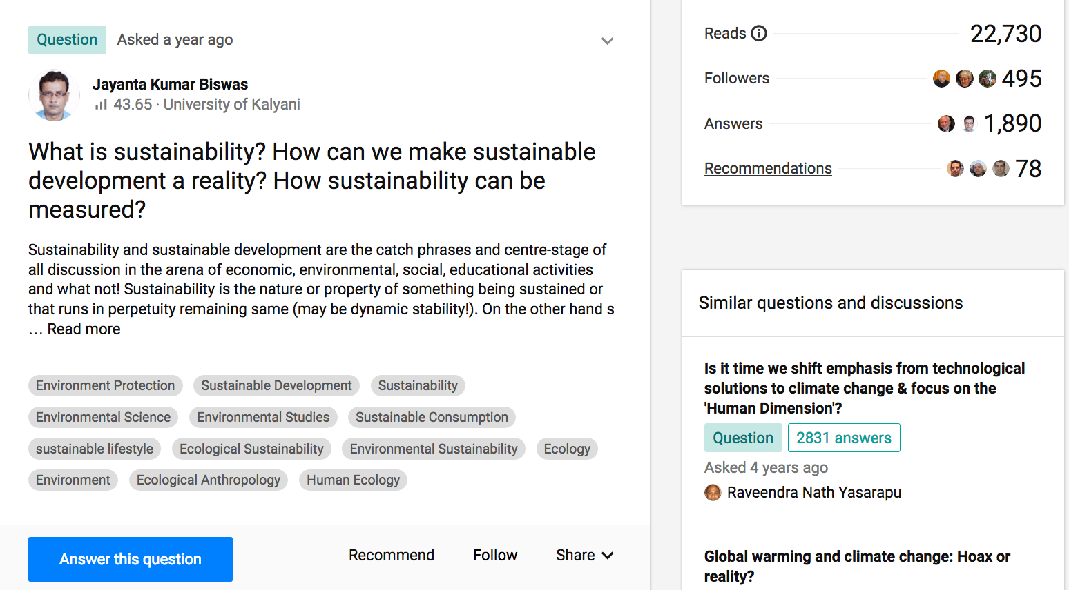
https://www.researchgate.net/post/What_is_sustainability_How_can_we_make_sustainable_development_a_reality_How_sustainability_can_be_measured

Slide 3
A two-way dynamic interaction
Indicators: from evidence to decision

Slide 4
Going beyond statistical methodology
Borderline of official statistics: Composites, dashboards etc. To be produced with the same brand?
Caution: This is a potent medication. Follow the prescribed schedule exactly to avoid the risk of potentially severe side effects!
Feedback loops: Any observed statistical regularity will tend to collapse once pressure is placed upon it for control purposes
Literacy + data culture: Poor statistical literacy becomes a serious ethical issue when data are used to determine funding or actions that impact on people's lives

Slide 5
The reduction of complexity
Indicators: from evidence to decision

Slide 6
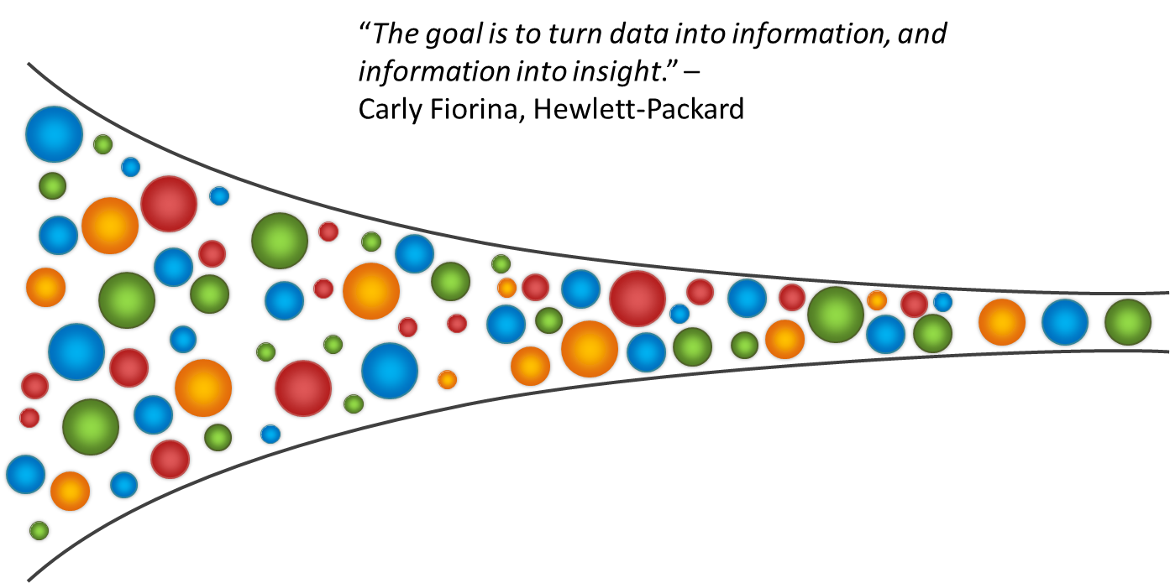
Reduction of complexity

Slide 7
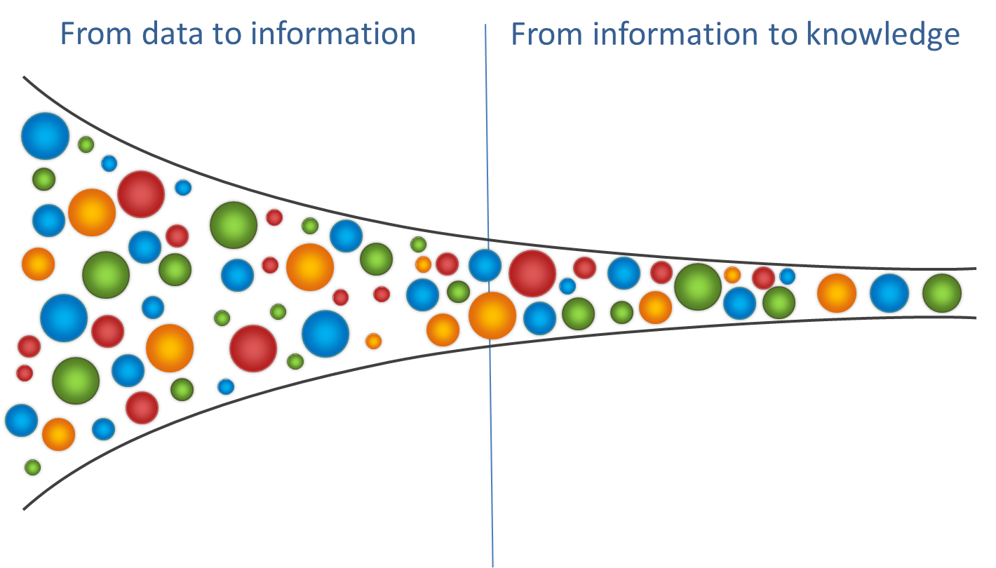
Reduction of complexity

Slide 8
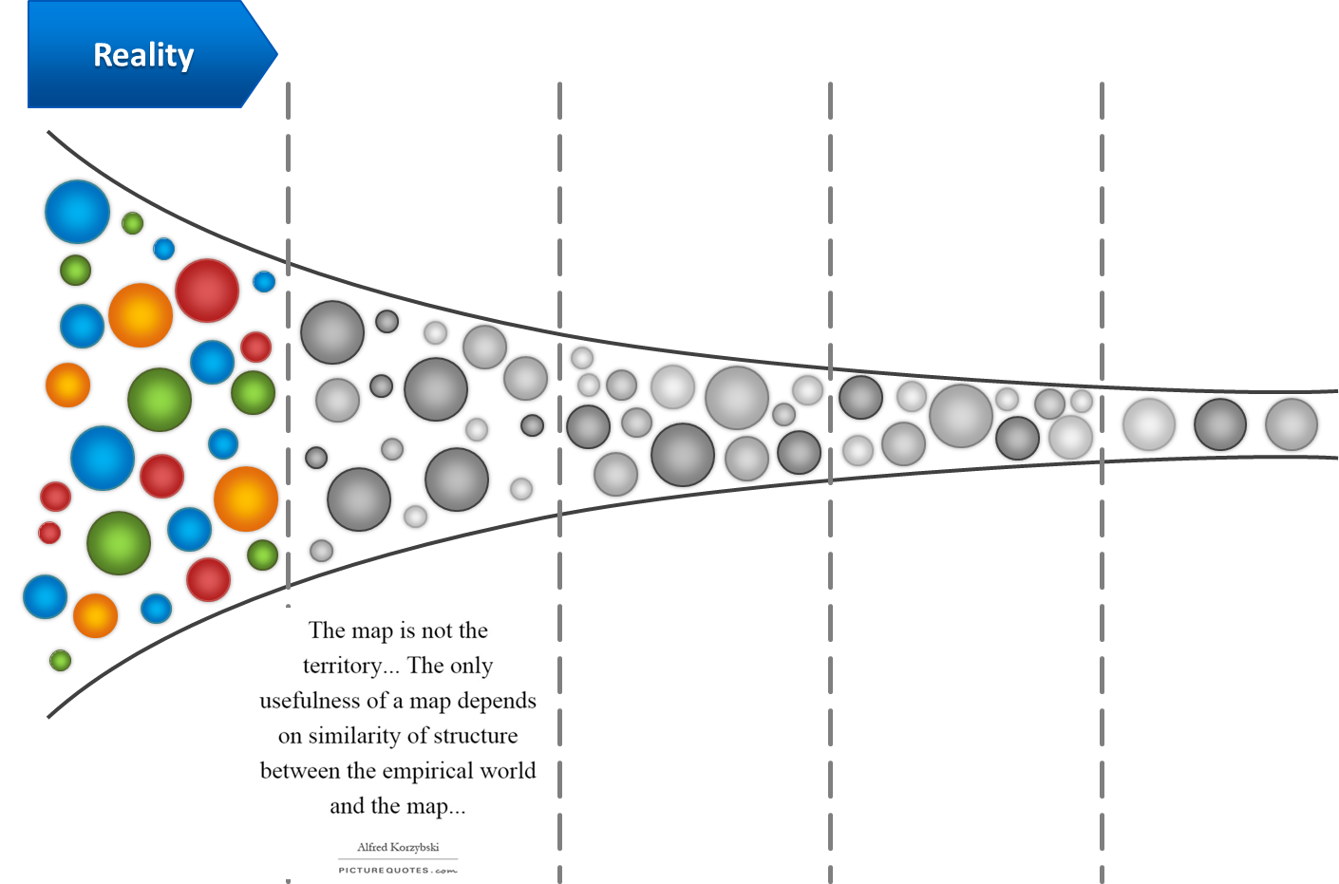
Reduction of complexity

Slide 9
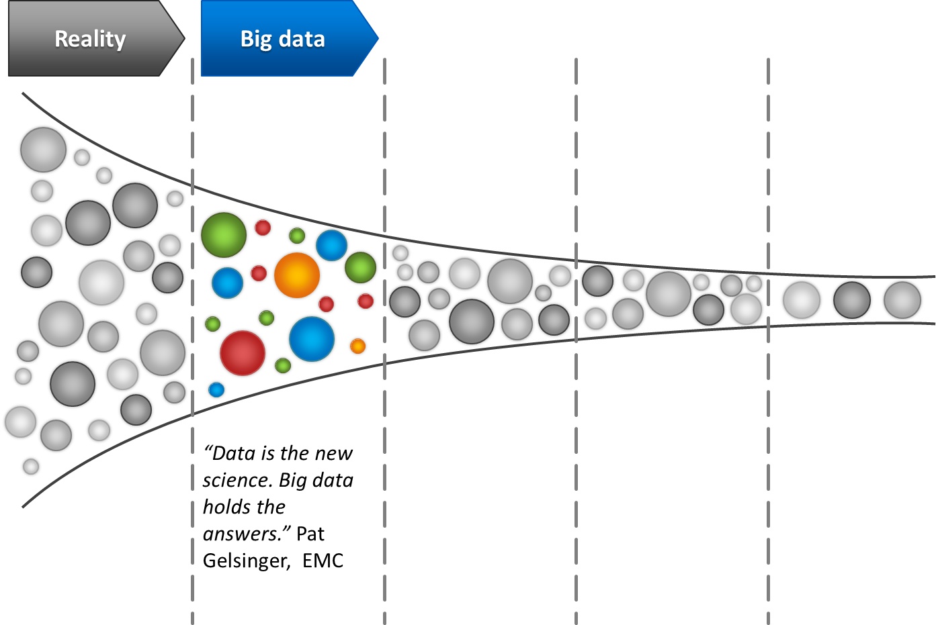
Reduction of complexity

Slide 10
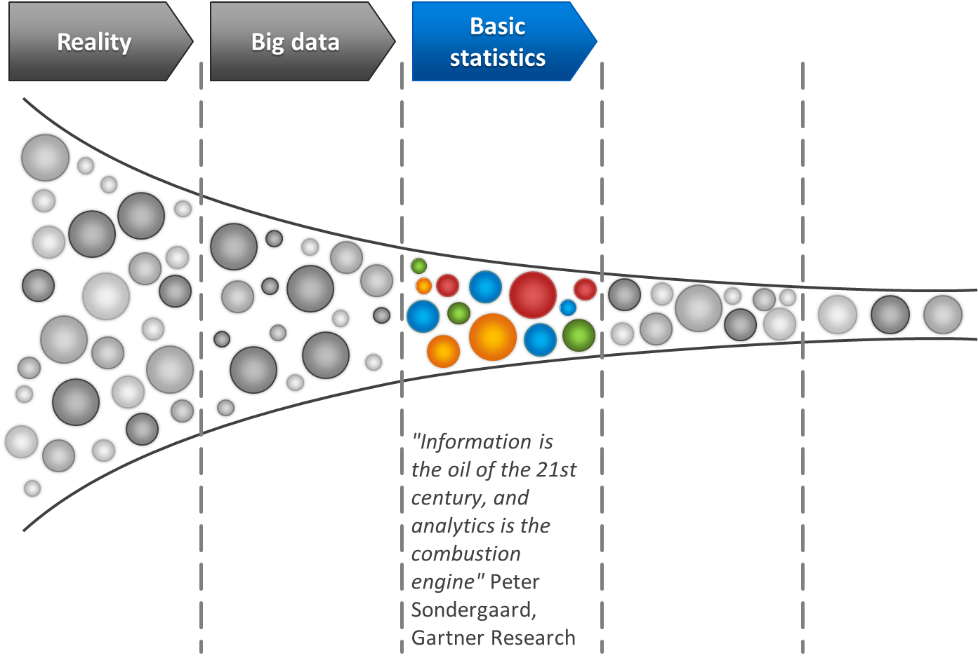
Reduction of complexity

Slide 11
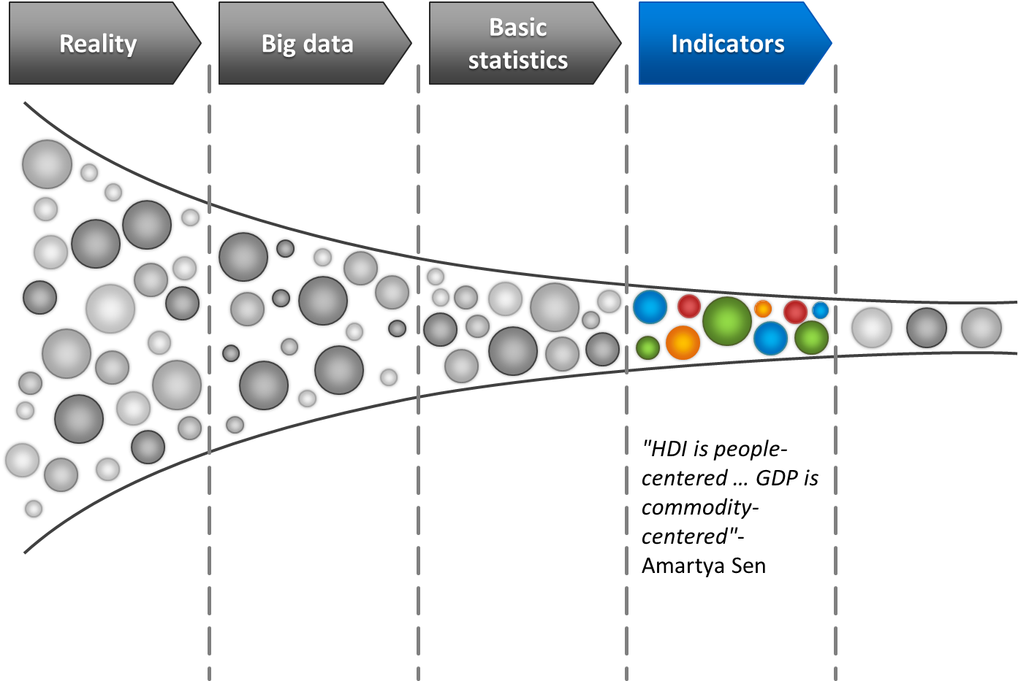
Reduction of complexity

Slide 12
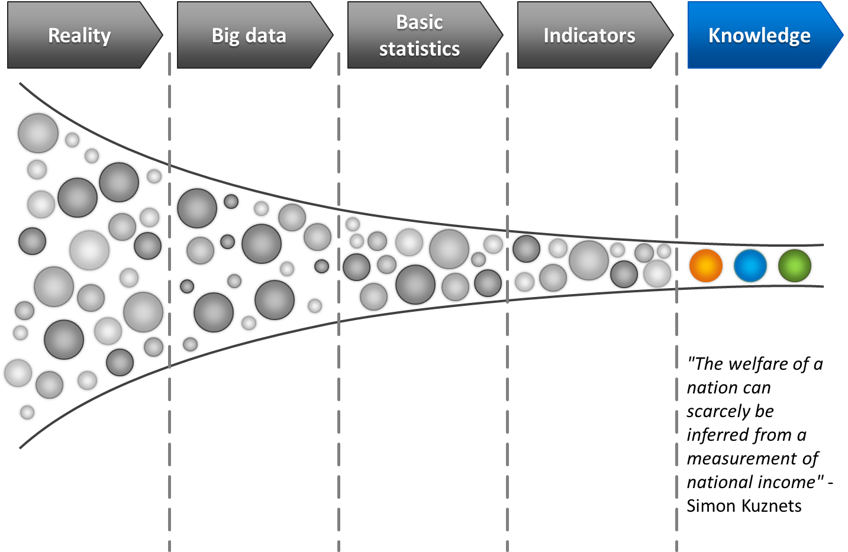
Reduction of complexity

Slide 13
Sustainable Development
The 2030 Agenda

Slide 15

The Sustainable Development Goals Report 2017
https://unstats.un.org/sdgs/files/report/2017/TheSustainableDevelopmentGoalsReport2017.pdf

Slide 16
https://en.wikipedia.org/wiki/File:Human_welfare_and_ecological_footprint_sustainability.jpg

Slide 17
The Doughnut of social and planetary boundaries
https://www.kateraworth.com/doughnut/

Slide 18
Sustainable Development
Focus of this lecture
https://en.wikipedia.org/wiki/File:Sustainable_development.svg

Slide 19
John R. Hicks
Keep Capital Intact!
https://s3.amazonaws.com/oxbridgenotes/spree/products/801/large/5._Hicks%27_Income.png?1373979054

Slide 20
Amartya Sen
http://hdr.undp.org/en/humandev

Slide 21
Stiglitz-Sen-Fitoussi 2009
Messages
  1: Measuring sustainability differs from standard statistical practice in a fundamental way: to do it adequately, we need projections, not only observations.
  2: Measuring sustainability also entails prior responses to normative questions. In this respect too, it strongly differs from standard statistical activity.
  3: Measuring sustainability raises an additional difficulty in an international context. The question is not exclusively to assess relative sustainabilities of each country taken separately. The problem is global, at least in its environmental dimension. In that case, what is at stake is rather the contribution of each country to global sustainability or unsustainability.
Recommendation
  1: Sustainability assessment requires a well-identified sub-dashboard of the global dashboard to be recommended by the Commission.
  2: The distinctive feature of all components of this sub-dashboard should be interpretable as variations of some “stocks”.
  3: A monetary index of sustainability has its place in a sustainability dashboard, but under the current state of the art, it should remain essentially focused on economic aspects of sustainability.
  4: The environmental aspects of sustainability deserve a separate follow-up based on a well-chosen set of physical indicators.
Stiglitz, J.E., Sen, A., Fitoussi, J.-P.: Report by the Commission on the Measurement of Economic and Social Progress. (2009)

Slide 22
Nicholas Georgescu-Roegen
Maximise Resource Productivity!
https://en.wikipedia.org/wiki/Nicholas_Georgescu-Roegen#/media/File:Diagram_of_natural_resource_flows.jpg

Slide 23
Johan Rockström
Operate within Planetary Boundaries!
http://www.stockholmresilience.org/images/18.587b3d0a1325af354a580001346/1459560146819/planetary-boundaries-credit-Azote+copy.jpg

Slide 24
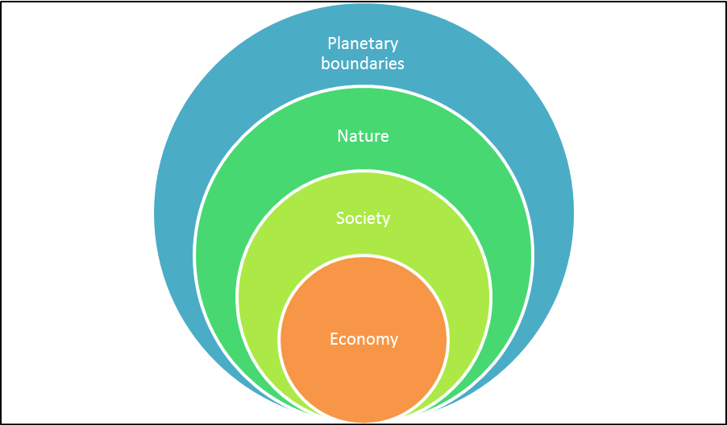
Complexity

Slide 25
E. Giovannini: Well-being and sustainability: from statistics to analytics, WSC2015, Rio de Janeiro

Slide 26
SD metrics
Helping the society to make decisions

Slide 27

Information @ Society
Citizens
making choices,
when consuming and when voting
being politically active,
…
Policy
defining goals & targets
financing implementation
accountability
…
Media
…
Information
from data to knowledge
…

Slide 28
Driving forces of change
Measurement
Science
Society

Slide 29
Complexity – mathematics of non linear dynamics
Data don’t tell us how to interpret them, and when more than one interpretation is at hand, it is the theory we adopt which makes the difference
No property of an observed system S is independent of the observing system S’
Lessons:
  the research fields are ill-defined, a nexus of phenomena that are not reducible to a single dimension, their meaning is context dependent
  there is no idealised model being able to adequately and comprehensively mirror the behavioural pattern of the system,
  research is multilevel (micro, meso, macro),
  new forms of knowledge, institutional structure, and problem solving require a new dialogue of science and humanities.
Notes:
Peruzzi, A.: Complexity: Between Rhethoric and Science. In: Maggino, F. (ed.) Complexity in Society: From Indicators Construction to their Synthesis. pp. 3-50. Springer International Publishing, (2017)
Pg 19: ”instead of efforts to make the meaning precise we frequently find mere rhetoric, opening the door for conceptual confusion. Confusion can remain even when rhetoric is avoided.”
Pg 4: “If the study of complexity is part of science, it does not justify any shift to a new-style, computer-aided inductivism (the rumour surrounding big data is a case in point)."

Slide 30
Principles
A New Enlightenment
Statistics is a key for people empowerment
  Statisticians should be aware of the power of data which lies in their transformation of information services for knowledge
Open data are fundamental for open societies
  Statisticians should ensure open and transparent access to data and metadata and measure their actual use for information and knowledge
Datacy is a key enabler for citizens
  Statisticians should proactively invest in datacy capabilities in society at large and measure the results of statistical literacy
The future is smart statistics
  Statisticians should continue to invest in methods and algorithms that enhance the quality of data for statistical services tailored to users’ needs
Users participate in the design, production and communication of statistics
  Statisticians should foster a greater involvement of civil society in all stages and processes of statistical production
More influence means more responsibilities
  It is a duty of statisticians to explore the link between statistics, science and society and lead intellectual reflections on the possible risk of reliance on data-centrism

Slide 31
SD metrics
Iteration, Learning and Evolution

Slide 32
Construction of Indicators
Indicators are in trade-off between …
Scientific consistency
Statistical measurability
Political relevance

Slide 33
Construction of Indicators
Scientific consistency
Statistical measurability
Political relevance

Slide 34
Work systems: Statistics, Science and Politics
macro
indicators
theoretical
concept
political
programme
accounts,
detailed indicators
political
topic
model
individual
actions
basic data
basic research
Statistics
Science
Politics
34

Slide 35
Work system of the actor “science”
axioms, theoretical concepts
applied models
basic research

Slide 36
Work system of the actor “politics”
political program
topic
individual action

Slide 37
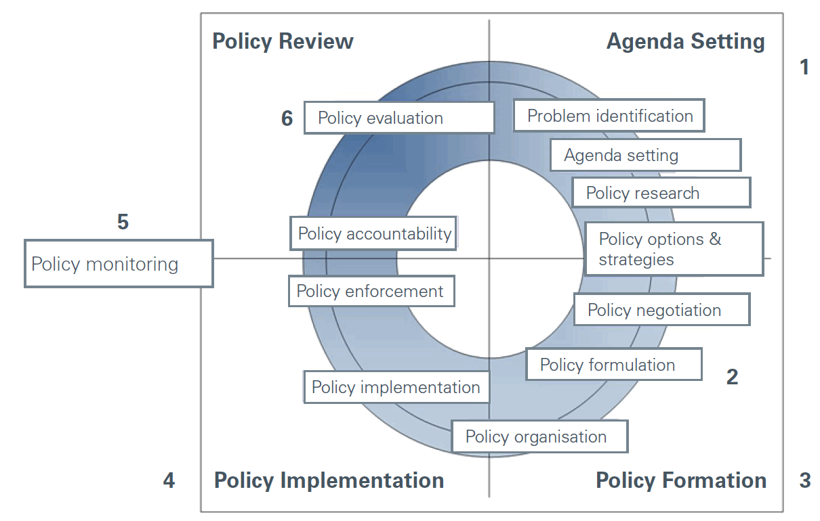
POLICY CYCLE
http://www.etf.europa.eu/webatt.nsf/0/A490BF6FDAD1B387C1257EB3005E18D9/$file/Ex-ante%20impact%20assessment.pdf

Slide 38
Work system of the actor “statistics”
macro indicators
accounts, detailed indicators
basic data

Slide 39
Statistics
Iterative decision-making process…
A: Development of basic data (after consulting users)
“laboratory” (theory)
Science
Politics

Slide 40
Statistics
…iterative decision-making process…
B: Aggregation with scientific methods
“laboratory”
Science
Politics

Slide 41
Statistics
…iterative decision-making process
C: Selection of indicators
“bazaar”
(negotiations)
“laboratory”
Science
Politics

Slide 42
Policy cycle: roles for different metrics
Problem analysis
Identifying appropriate measures
Target setting
Implementation of measures
Monitoring
Correction of targets/measures
Science, economics
Scenarios, models
Indicators

Slide 43
Conclusion
Science, society and statistics

Slide 44
Better metrics
Better decisions
Sustainable development means (in particular from an environmental perspective) living well within the boundaries of the planet
Better metrics should enable better decision making in favour of SD
To support better decisions in favour of sustainability, metrics should:
  capture the complexity of the phenomena at stake, (resilience, risks….),
  be state of the art (multiple sources, technologies, models…)
  be of sufficient quality (coverage, timeliness, comparability across space and time),
  quality depends on use (fit for purpose in policy cycle)
  allow internalising externalities (management, valuation….)
‘Better’ are decisions, if they enable societies to navigate through unknown territories towards are more sustainable way of living. This means that today’s challenges and risks (e.g. through globalisation) need to be addressed in such a way that democratic opinion making is supported through participation and communication

Slide 45
Better metrics
Better decisions
SD metrics are continuously being improved in a co-evolution (i.e. a collaborative, iterative learning process) with societal changes on the way to the long-term goal of Sustainable Development. This evolutionary perspective should be enhanced by multiple iteration in learning cycles and interaction between different actors and disciplines
  a. scientific theory/models – empirical data/models,
  b. data/information – use/application,
  c. scientific theory/models – use/application.
The learning and continuous improvement should be based on ‘evidence of evidence’ (empirical analysis of the impacts of SD metrics).
Partnership, trust and governance are essential success factors; one should
  establish platforms and channels that facilitate communication amongst scientists, producers and users of metrics,
  develop tools for empowering civil society to tackle disinformation, foster engagement with fast-evolving information technologies,
  safeguard the strengths /independence of institutions/researchers working in the area of data sciences/statistics,
  enhance transparency about the quality of information and compliance with ethical principles and good governance.

Slide 46
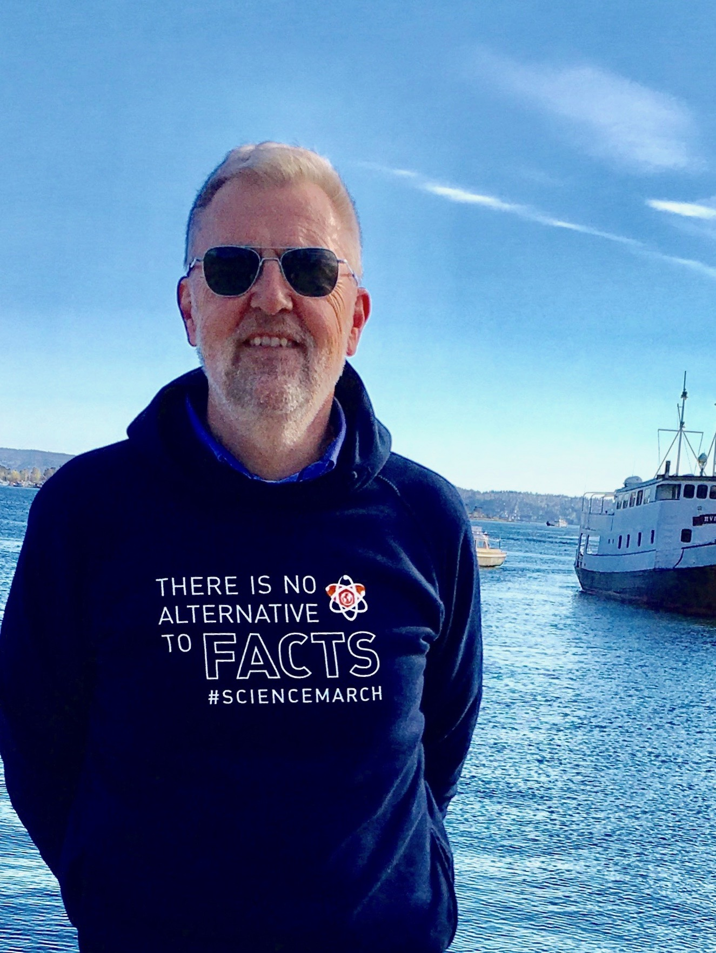
Thank you
wjr@outlook.de

