Slide 1
Financial stability work and micro data: opportunities and challenges
Bruno Tissot
Head of Statistics and Research Support, BIS
Head of the Secretariat of the Irving Fisher Committee on Central Bank Statistics (IFC)
Conference of European Statistics Stakeholders 2018 (CESS), Bamberg, 18-19 October 2018
The views expressed are those of the author and do not necessarily reflect those of the BIS or the IFC.

Slide 2
Overview
Dual micro/macro dimension of financial statistics
Opportunities: what micro data can bring
Challenges
Central bank issues
Examples

Slide 3
(1) Dual micro/macro dimension of financial statistics
The Great Financial Crisis of 2007-09
  Financial stability issues have micro & macro aspects
  “We need to see the forest as well as the trees within it” (Borio, 2013)
Data Gaps Initiative (DGI): Phase I (2009) & II (2016)
  New frameworks to combine micro- and macro-level data: “help straddle the divide between micro and macro analysis”
Financial Big Data – not just the internet!
  Large, granular, well-structured data-sets (eg registers)
  By-products of financial, commercial & administrative activities
  Increased role of private commercial data providers

Slide 4



Dual micro/macro dimension: Crisis impact + Internet= …

Slide 5
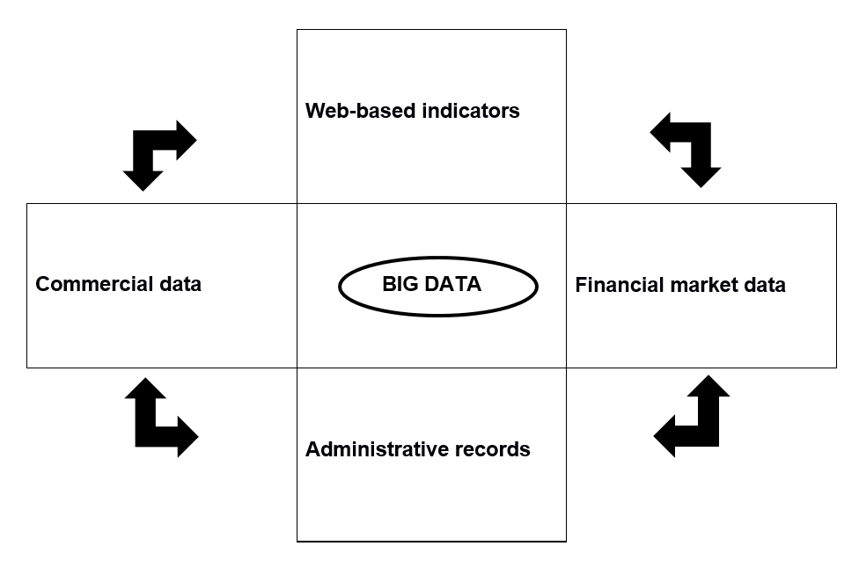
… = 4 main types of “Financial Big Datasets”

Slide 6
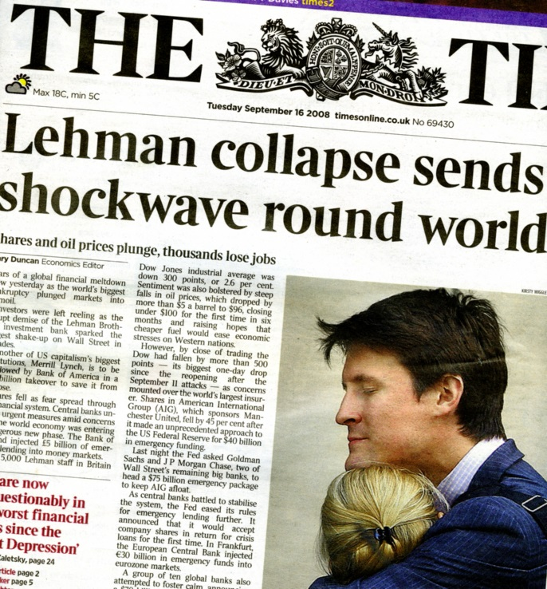
(2) Multiple opportunities: (i) Macro-relevant micro information
Micro situation with systemic importance
  Can be masked by “traditional” macro data
  Need to understand what lies behind aggregates
  Non-linearity: aggregates not the sum of individuals
Monitoring of global institutions
  Focus is not the average situation of G-SIFIs together …
  Extract micro information important for macro financial stability work
  Similar approach for other market segments: repos, derivatives etc.

Slide 7
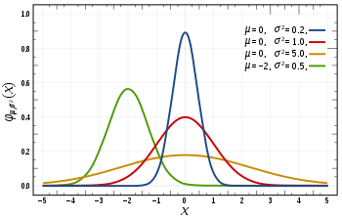
(2) Multiple opportunities: (ii) Distribution information
Focus on the distribution of indicators in the population
  Explore heterogeneity behind aggregates: tail analysis
  Distribution key for policy actions
Increased importance in the post crisis era
Example: macro prudential tools targeted at
  markets/sectors (eg property markets)
  specific groups (eg first-home buyers)
  instruments (eg mortgages)
  y

Slide 8

(2) Multiple opportunities: (iii) Better aggregates with micro inputs
Micro data to support macro compilation
  Key role of granular, “administrative” datasets
  Central banks’ interest in loan-by-loan, security-by-security datasets
Several advantages
  Large size & coverage
  Flexible & combination possibilities
  Low collecting cost if by-product of an “administrative” operation

Slide 9

(2) Multiple opportunities: (iv) Policy design & assessment
Use of micro data for policy purposes
  Micro-prudential authorities
  Also macro policies: fiscal, structural, monetary
Advantages of micro data
  Granularity: capturing multiple dimensions
  Richness: multiple users
  Flexibility: less ad hoc collections and reporting burden (?)
  Understanding feedback effects, behavioural responses, unintended consequences, cross-impacts…

Slide 10

(2) Multiple opportunities: (v) New insights
Richer view of the population of interest
  Extensive data collected, over a long period of time
  Information often available but not exploited (administrative data)
  Private sector experience in dealing with large data-sets
Granular information offers new possibilities
  New types of (big) data
  A trigger for re-thinking, new mind-set
  Example: global financial system cannot be solely analysed through aggregated, country-based statistics

Slide 11

(3) Challenges: (i) Variety…
In practice various & heterogeneous “financial big data”
  Usually not designed for a direct statistical purpose
  Indirectly, data exploited for addressing statistical needs
Several issues for statisticians
  Compilation (or acquisition) costs
  Quality: attributes values / representativeness
  Identifiers: connecting datasets / coverage of large entities

Slide 12

(3) Challenges: … (ii) Complexity…
Micro-level data universe is complex and evolving
  Use of specific sources depends on policy questions
  Example of payment systems :
  of interest for supervision / tourism analysis
  Interaction between data available, specific policy needs and actions (feedback loop)
Transforming data into relevant information for policy
  Public authorities at the beginning of making sense of these data:
  connecting the dots, not just collecting them (Caruana, 2017)
  “Smart data”: treatment of the raw, “organic” data is key

Slide 13

(3) Challenges: … (iii) time dependency…
Information needs evolve over times:
  The financial system changes… not least due to policy actions
  Assessment of how fragilities are building up typically rely on aggregated statistics to spot “abnormal patterns”
  In contrast, resolution work in the aftermath of a financial crisis will request much more timely and granular information
  → rough aggregates often OK to indicate rising imbalances
  → more granular data needed after a crisis (Carstens, 2018)

Slide 14

(4) Central banks’ issues when (i) handling financial big data…
Resources
  IT, staff, security
  Proper arrangements for managing data
New statistical production chain
  Comprehensive information management process
  Governance
Reputation risk when handling the data
  Confidentiality and trust
  Ethical issues

Slide 15

(4) Central banks’ issues when (ii) using financial big data
Accuracy?
  Unknown coverage bias (eg social medias, commercial activities)
  Large samples less accurate than (small) traditional probabilistic samples?
Reputation risk?
  Lack of transparency, poor quality of sources
  Social costs of misguided policy decisions
Altering decision-making?
  Bias towards responding to news, encouraging shorter horizons?
  Risk of fine-tuning policy communication?
  How to communicate “black box” calculations?

Slide 16
(5) Examples: (i) Derivatives reported to Trade Repositories
→ Importance of quality issues and need for harmonised identifiers

Slide 17

(5) Examples: (ii) BIS International Debt Securities (IDS)
BIS “own” security-by-security dataset (from commercial sources)
  International market: where non-residents issue
  For each security, issuer residence compared to 3 locations: registration domain/ listing place /governing law
Security classified as “international” if 1 characteristic differs
  Half of the cases: 3 characteristics provide same information
  One third: at least one characteristic differs
  Significant part is inconclusive
Quality issues
  Across sources / over time

Slide 18
(5) Examples: (ii) BIS IDS: insights from security-by-security data
Multiple indicators
  Gross/net issues, repayments, amounts
Multiple breakdowns
  Instrument, currency, maturity bands, interest rate, rating, guarantees
Very flexible, allows to address various policy questions
  Issuance both by residence and nationality (defined as the residency of the controlling parent)
  Nationality-based consolidated data to understand who takes underlying decisions

Slide 19
(5) Examples: (ii) BIS IDS: Who issues for whom?
  → Large debt issuance activity in offshore centres by foreign affiliates

Slide 20
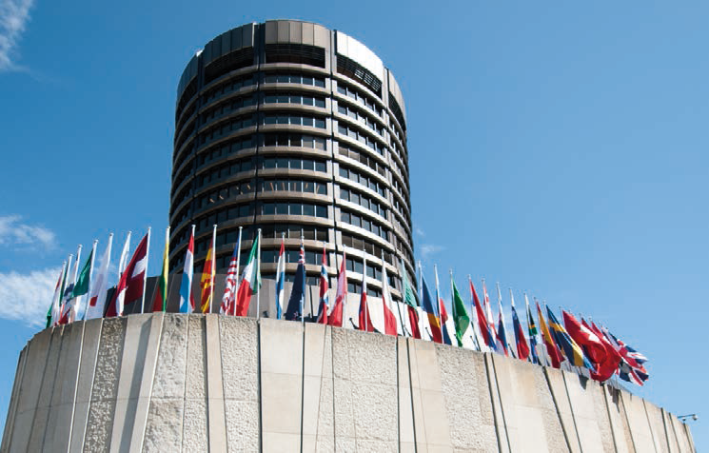
Thank you!!
Questions?
bruno.tissot@bis.org
IFC.secretariat@bis.org
BIS Statistics:
Debt securities: www.bis.org/statistics/secstats.htm?m=6%7C33%7C615
IFC Reports available on
https://www.bis.org/ifc/publications.htm?m=3%7C46%7C94

