Slide 1
High quality national financial accounts and balance of payments statistics for European policymaking
Henning Ahnert
European Central Bank
Robert Obrzut
Eurostat
CONFERENCE OF EUROPEAN STATISTICS STAKEHOLDERS (CESS) 2018
^{18-19 October 2018, Bamberg}

Slide 2
Overview
1
Uses of selected MIP indicators for policy analysis
2
European quality assurance for MIP statistics
3
Quality indicators relating to BoP/NA
High quality national financial accounts and b.o.p. for European policymaking

Slide 3
The Macroeconomic Imbalance Procedure (MIP)
Background
Definition
Rationale
Introduced in 2011, after financial crisis
Legal Background: Art. 121 TFEU
Legal Enforcement: Reg. EU 1176/2011 on prevention and correction of imbalances; Reg. EU 1174/2011 on enforcement measures
Macroeconomic Imbalance: “the (negative or positive) position of a domestic, external or financial variable...[which] may – if uncorrected over time – make the national savings-investment balance so untenable that it self-corrects abruptly, thereby causing significant adjustment shocks” (Wieser, 2011)
In an integrated economic and monetary system, economic policy is a common concern due to deep trade and financial links → spill overs and cross-borders repercussions
Both precautionary objective and corrective objective to avoid unsustainable booms in good times and unsustainable trends leading to losses of competitiveness

Slide 4
Objective: prevent the emergence of harmful imbalances and correct imbalances already in place (Sondermann, 2018)
The MIP political process
[Please select]
[Please select]
Alert Mechanism Review (AMR) by European Commission in conjunction with the annual growth survey:
i. Scoreboard Indicators
ii. Identifies which countries require further analysis
November (T – 1)
In-depth reviews (IDR), by European Commission:
i. Based on wider indicators and assessment of previous year's recommendations
ii. Surveillance missions
March (T)
- European Commission decides whether to open or not the Excessive Imbalance Procedure (EIP)
- The Council issues the specific country Recommendations
March-June (T)
High quality national financial accounts and b.o.p. for European policymaking

Slide 5
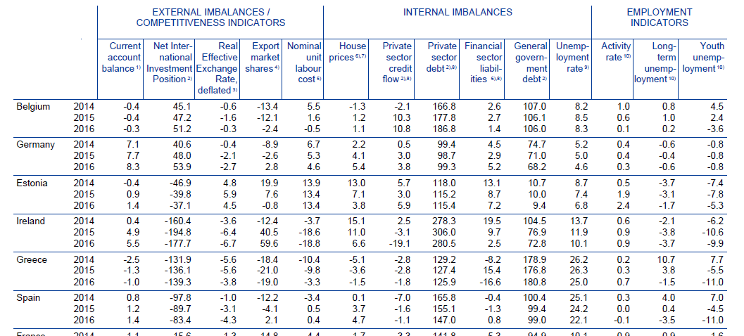
Financial Accounts & MIP Scoreboard Indicators
Financial Accounts are the main input for three MIP headline indicators:
Private Sector debt, consolidated as % of GDP
Private Sector credit flow, consolidated as % of GDP
Financial Sector liabilities, non-consolidated, 1-year % change
Figure 1: Scoreboard of MIP Headline Indicators. Source: SDW.

Slide 6
Private Sector Debt in the MIP Alert Mechanism Report (AMR)
Private Sector Debt, consolidated (annual stock as % of GDP)
Private Sector Debt ratios generally further reduced from their post-crisis peaks, but over-indebtedness continues to affect several countries (AMR, 2018).
Household Sector Debt, consolidated (annual stock as % of GDP)
Source: ECB. Notes: GDP is always at its latest value (i.e. 2017). MIP threshold is set at 133%.
Contribution of HH and firms to high private debt levels varies across EU. LU, IE and BE experience high values for NFCs; Higher debt of HH in DK, UK, CY, NL.
Source: ECB.
Notes: GDP is always at its latest value (i.e. 2017). New auxiliary indicator as of autumn 2018.

Slide 7
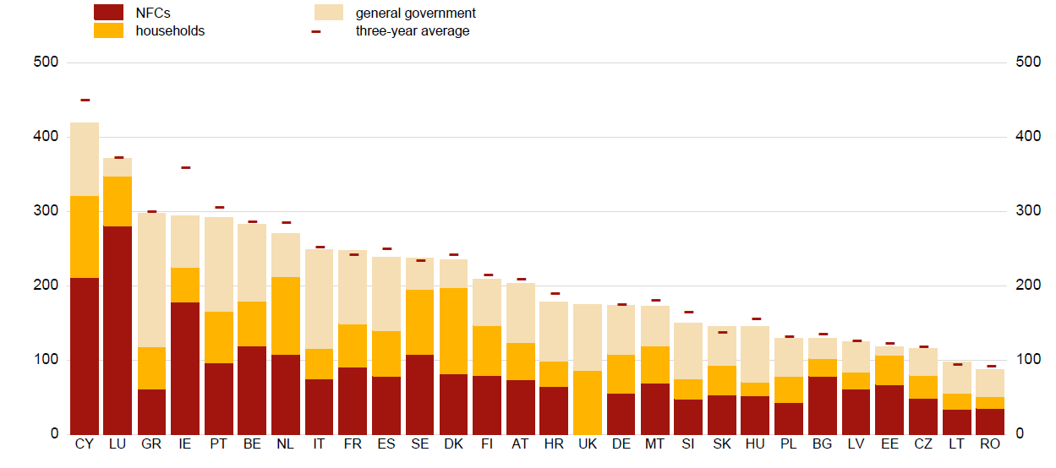
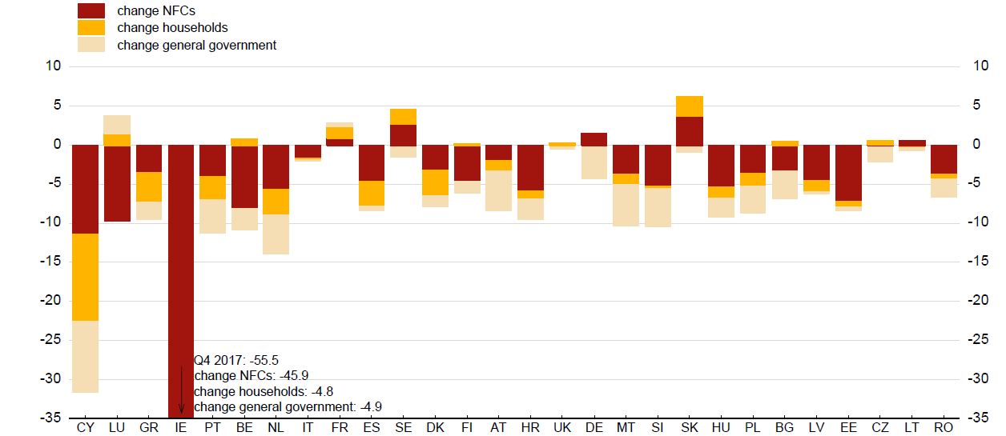
Private Sector Debt for Monetary and Financial Stability Analysis
Aggregate Debt-to-GDP (ratio)
ESRB Risk Dashboard: MIP variables contribute to assessment of macro-risks
Aggregate Debt-to-GDP (annual % change)
Essential for financial stability: monitoring of debt levels and the deleveraging dynamics
Source: ECB and European Commission. Notes: European Union countries. % values. Last observation: 2017 Q4.
High quality national financial accounts and b.o.p. for European policymaking
Notes:
About Aggregate debt to GDP LEVEL: Debt-to-GDP ratios for NFCs and general government are based on consolidated debt figures. Consolidated non-financial corporations’ debt not available for UK. Three-year average is not available for UK. For CY, aggregate debt includes debt relating to special purpose entities (SPEs); large proportion of activities of these entities are not related to domestic market and their lending comes from abroad or is secured by cash collateral. For example: Aggregate debt of non-financial corporations, excluding SPEs, to GDP ratio amounted to 141,2% as of 2017 Q2.
About Yearly change Debt-to-GDP ratios for NFCs and general government are based on consolidated debt figures. Data on changes of non-financial corporations’ debt are not available for the UK. The decrease in the debt-to-GDP ratios for Ireland can to a great extent be explained by the large increase in the official Irish GDP in 2015 mainly due to the reallocation of global operators in Ireland. For more information see Eurostat’s explanatory note (http://ec.europa.eu/eurostat/documents/24987/6390465/Irish_GDP_communication.pdf). For CY, aggregate debt includes debt relating to special purpose entities (SPEs); large proportion of activities of these entities are not related to domestic market and their lending comes from abroad or is secured by cash collateral. For example: The year-on-year change of aggregate debt of non-financial corporations, excluding SPEs, to GDP ratio amounted to -7,7% as of 2017 Q2.

Slide 8
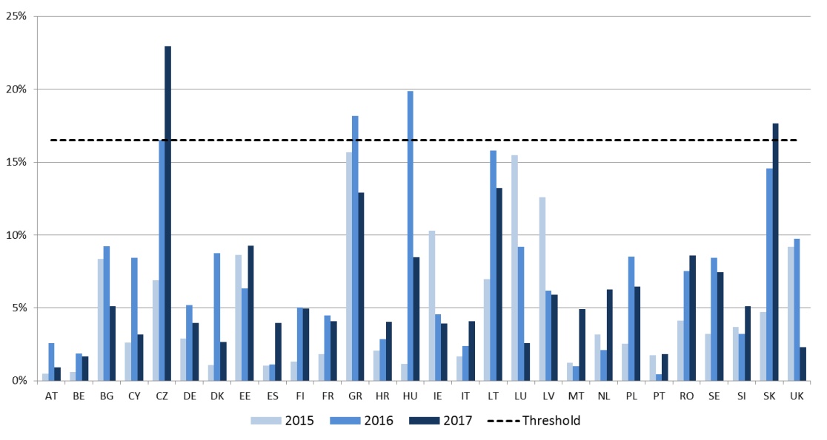
Financial Sector Liabilities in the MIP Alert Mechanism Report (AMR)
Financial Sector Liabilities, non-consolidated (annual percentage change in stock)
Source: ECB. Notes: MIP threshold is set at 16.5%.
A wide country variation of annual growth of financial sector liabilities
Increase in financial sector liabilities accelerated during 2016, but this trend reversed for most countries in 2017.

Slide 9
Financial Liabilities for Monetary and Financial Stability Analysis
Financial Liabilities of Euro Area financial corporations
Strongest growth in non-bank financial sub-sectors
Other financial institutions, investment funds and insurance now account for more than 50% of financial sector liabilities
Source: ECB.
Notes: outstanding amounts; EUR/billions; right-hand scale: % of nominal GDP. Latest observation 2018 Q1.
Changes in Financial Liabilities of Euro Area financial corporations
Essential: breakdown of ∆ into transactions and revaluations
All components have contributed to the increase in financial sector liabilities
High quality national financial accounts and b.o.p. for European policymaking
Source: ECB.
Notes: outstanding amounts; EUR/billions. Latest observation 2018 Q1.

Slide 10
Overview
1
Uses of selected MIP indicators
2
European quality assurance for MIP statistics
3
Quality indicators relating to BoP/NA

Slide 11
ECB-Eurostat Memorandum of Understanding: 6 steps on quality assurance for MIP statistics
European quality assurance for MIP statistics
ECB-RESTRICTED
Level 2 reports
(Eurostat/ECB domain-specific reports)
Level 1 report (ESS-ESCB summary report)
Country visits
Spring and autumn data cleaning
Annual metadata reports
Level 3 reports
(Country self-assessment)
High quality national financial accounts and b.o.p. for European policymaking

Slide 12
Overview
1
Uses of selected MIP indicators
2
European quality assurance for MIP statistics
3
Quality indicators relating to BoP/NA

Slide 13
Consistency: data confrontation with mirror statistics
Quality indicators relating to BoP/NA
Methodology: BPM6, ESA2010
Data: QBOP, QSA (ROW sector)
Gross/net transactions, balancing items B9/B9F
Current & capital account and financial account
Absolute and relative differences
$MAPD=\frac{1}{n}\sum_{t=1}^{n}{\left|\frac{{BOP}_{t}− {ROW}_{t}}{{BOP}_{t}}\right|}$; n = observation period (A,Q)
Challenges
Observation period and revision bias
Tackling vintage effects: release calendars, validation sector accounts
Analysing components: depth versus data gaps; different breakdowns; functional versus instrument category (FA)
High quality national financial accounts and b.o.p. for European policymaking

Slide 14
Mean average percentage deviation (MAPD) in the non-financial accounts
Quality indicators relating to BoP/NA
Relative difference between BOP current/capital account balance and ROW sector net lending/net borrowing (B9)
High quality national financial accounts and b.o.p. for European policymaking

Slide 15
Assessment of BOP/NA based MIP indicators
Quality indicators relating to BoP/NA
Causes for inconsistencies
Eurostat survey 2015/2017
CMFB Task Force BOP-ROW consistency
Phase 1 (goods+services)
Phase 2 (financial, primary+secondary income)
Trade statistics: "comparing apples and oranges"
Residence + change of ownership
Territory + physical cross-border movements
Examples:
Goods for processing
Goods under merchanting
Valuation CIF/FOB
High quality national financial accounts and b.o.p. for European policymaking

Slide 16
High quality statistics and quality monitoring
Conclusions
Financial accounts and Balance of Payments are major inputs for EU and euro area macroeconomic analyses (MIP, monetary policy, financial stability)
Eurostat and the ECB monitor quality of statistical outputs for MIP – since 2017 supported by Memorandum of Understanding
Three agreed levels of quality reporting for MIP purposes:
(1) Self-assessment; (2) Domain-specific; (3) Summary report (across domains)
Consistency and accuracy in BOP/NA
Multidimensional concept of quality
Analysing geographical asymmetries (intra-EU, extra-EU)
Coordination of parallel processing
Sharing micro data sources (e.g. CSDB, SHSDB)

Slide 17
Thank you!

Slide 18
Annex: Private and public debt and deleveraging over the past decade
Private Debt in % of GDP
Change in private debt between 2009 and 2017 and contributions
Government Debt in % of GDP
Change in government debt between 2009 and 2018 and contributions
Source: Sondermann, D. and Pierluigi, B. (2018) based on European Commission and EUROSTAT data. Author’s updates based on ECB data.
High quality national financial accounts and b.o.p. for European policymaking

