Slide 1
|SCP
Nonstandard employment and the working poor in five European countries
Prof J. Cok Vrooman
Chief Scientific Strategist, SCP
Endowed Chair Social Security and Participation, Utrecht University
Conference of European Statistics Stakeholders (CESS 2018)
Bamberg, 18-19 October 2018
www.scp.nl
c.vrooman@scp.nl
j.c.vrooman@uu.nl

Slide 2

“When a job isn’t enough”
SCP report published on 3 October 2018
Analyses working poor from three different angles:
    (1) Trends in NL since 1990
    (2) Municipal policy on the working poor in NL
    (3) International comparison:
    Working poor in NL, BE, DE, DK, UK
    Starting points:
    - Poverty is best measured through a generalised budget approach
    - Five ‘focus countries’ are institutionally different but otherwise fairly
    similar (modernisation, wealth, demographics, climate…)
    → heterogeneity of labour market institutions of focus countries
    within a set of 21 EU countries?
    English summary: C.Vrooman, E. Josten, S. Hoff, L. Putman and J.M. Wildeboer Schut (2018), When a job isn’t enough; The working poor in five European countries and twenty Dutch municipalities. The Hague: The Netherlands Institute for Social Research|SCP
    www.scp.nl/english/Publications/Summaries_by_year/Summaries_2018/When_a_job_isn_t_enough

Slide 3
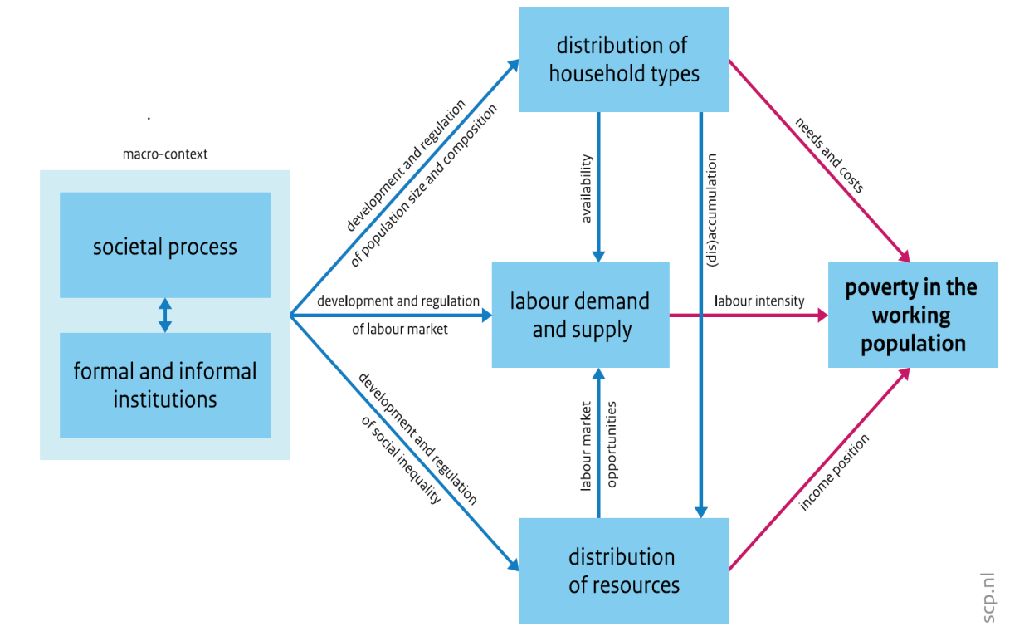
Theoretical framework
The rise of nonstandard and precarious employment is often linked to a growth in poverty among working people in the policy debate.
However:
Theoretically no straightforward relationship:
- 3 direct mechanisms: household needs, labour intensity, hourly income
- various underlying macro-factors at work: other institutions (formal/informal) may also matter, and societal contexts can be different
The trajectories through which new forms of work translate into poverty among the working population cannot be tested easily as a result of data limitations

Slide 4
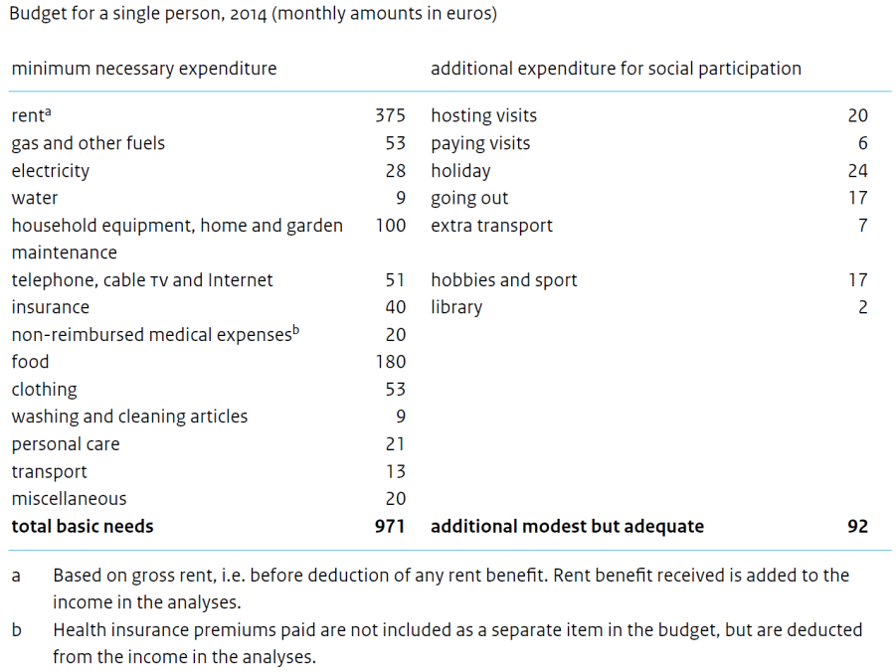
Poverty
Definition: “An individual actor is poor if he consistently lacks the means to obtain the minimum necessities of his community”*
Operationalisation: SCP’s generalised budget approach
- Unavoidable or very desirable expenditure
Two levels of expert reference budgets for a single person
Based on data National Institute for Family Finance Information(Nibud), validated by
consensual focus group study**
(1) ‘basic needs’
(2) ‘modest but adequate’
- Generalisation:
(1) other types of household (modified OECD scale)
(2) over time: index expenditure food, clothing, housing
(3) across countries: PPP (no comparable reference budgets yet)
Poverty assessment:
Disposable hh income below ‘modest but adequate’
For international comparison: EU-SILC’14, 25-64 years of age
Working poor:
(1) individuals in poor households
(2) who performed paid work for at least 7 months in
calendar year
* J.C. Vrooman (2009), Rules of relief; Institutions of social security, and their impact (p. 360)
** S. Hoff et al. (2010), The minimum agreed upon; Consensual budget standards for the Netherlands

Slide 5
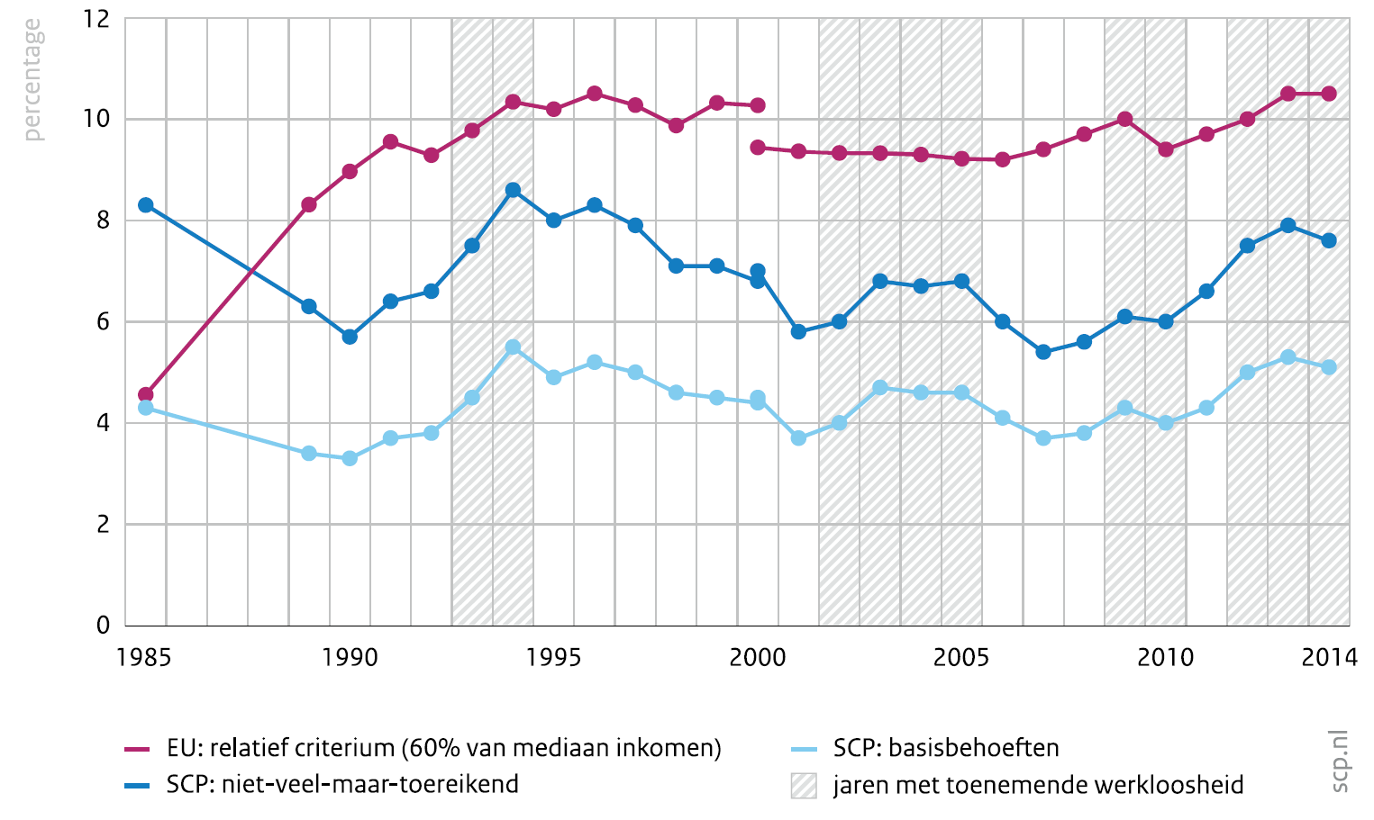
Contextual and relative poverty rates in NL
Poverty in the total Dutch population (1985-2014), SCP and EU criteria
Old age pensions/ social assistance fall below relative poverty line
SCP poverty thresholds:
Lower share of poverty than according to 60% median
More sensitive to economic cycle
EU-criterion (60% of median disposable income)
SCP-criterion (basic needs)
SCP-criterion (modest but adequate)
Years with rising unemployment
Source: Statistics Netherlands, Income Panel Survey 1985-2014

Slide 6
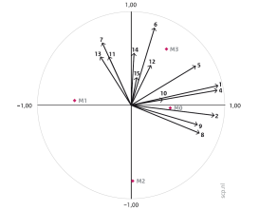
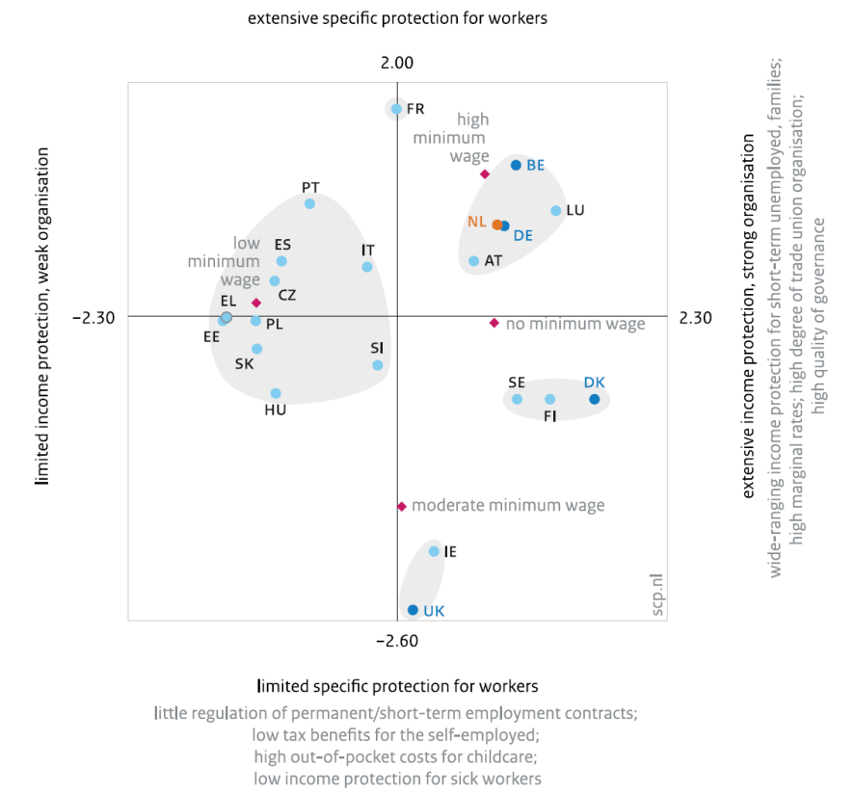
Institutional analysis (1): Formal labour market regulation (≈2013)
CatPCA component loadings
Categorical Principal Components Analysis on 16 forms of labour market regulation in 21 countries
Two main dimensions + minimum wage
Four country clusters: Esping-Andersen (3x) + mixed Mediterranean/post-communist
France is an isolated case
In five focus countries: heterogeneity
UK = liberal (moderate general protection/organisation + low specific protection for workers, medium minimum wage)
DK = socialdemocratic (high general protection/
organisation + below average specific protection for workers, no mimimum wage)
BE, DE, NL = corporatist (high general protection/organisation + high specific protection for workers, (mostly) high mimimum wage)
BE clearest case; NL, DE: equal scores but for different reasons - e.g. NL higher replacement rates in 1st year of unemployment but lower family benefits; less protection of short-term contracts yet better protection of permanent employees than DE
Sources: OECD, EC, SIED, MISSOC, The World Bank, ICTWSS

Slide 7
Institutional analysis (2): Atypical employment in five countries
Atypical work = specific forms of
nonstandard employment
(= all work that is not performed on a fulltime, permanent basis in
a bilateral and hierarchical labour relationship)
= often precarious
(= low pay, discontinuous, low control over working conditions,
limited protection in terms of social security, health, safety,
discrimination etc)
= old and new forms
(e.g. day labourers vs. gig economy)
Many small groups
→ impact on poverty rates hard to test in surveys like EU-SILC
No quantitative data for all 21
countries
Some qualitative information on 5
‘focus countries’
Sources:
Eurofound (2015), New forms of employment. Brussels: Publications Office of the European Union.
IPOL (2016), Precarious employment in Europe. Brussels: European Parliament, Directorate-General for Internal Policies.

Slide 8
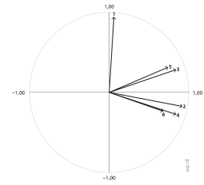
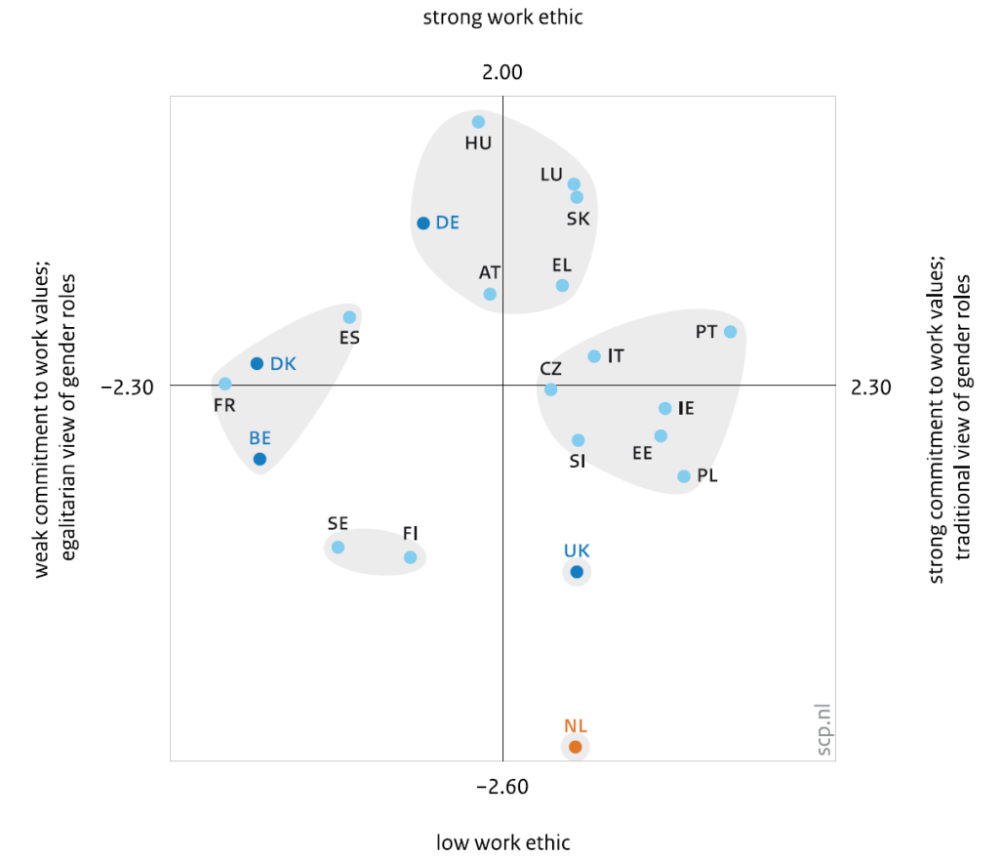
Institutional analysis (3): Informal labour market institutions, 2008
CatPCA component loadings
Categorical Principal Components Analysis on 6 informal labour market rules in 21 countries
Work ethic; view on gender roles; commitment to work values relating to (1) pay, (2) job security, (3) other extrinsic aspects (suitable hours, family-friendly…), (4) intrinsic aspects (interesting job, personal development, control, social contacts)
Two main dimensions
(1) Commitment to 4 work values + traditional gender roles; (2) Work ethic
Four country clusters, but different from formal institutions
(no Esping-Andersen; not all Mediterranean/postcommunist countries in same cluster)
UK and NL are isolated cases
In five focus countries: heterogeneity
BE + DK = weak work commitment + egalitarian gender roles; medium work ethic (with FR and ES)
DE = medium work commitment + gender roles; high work ethic (with HU, LU, SK, EL, AT)
UK, NL = high work commitment + traditional gender roles; (very) low work ethic
Source: European Values Study’08

Slide 9
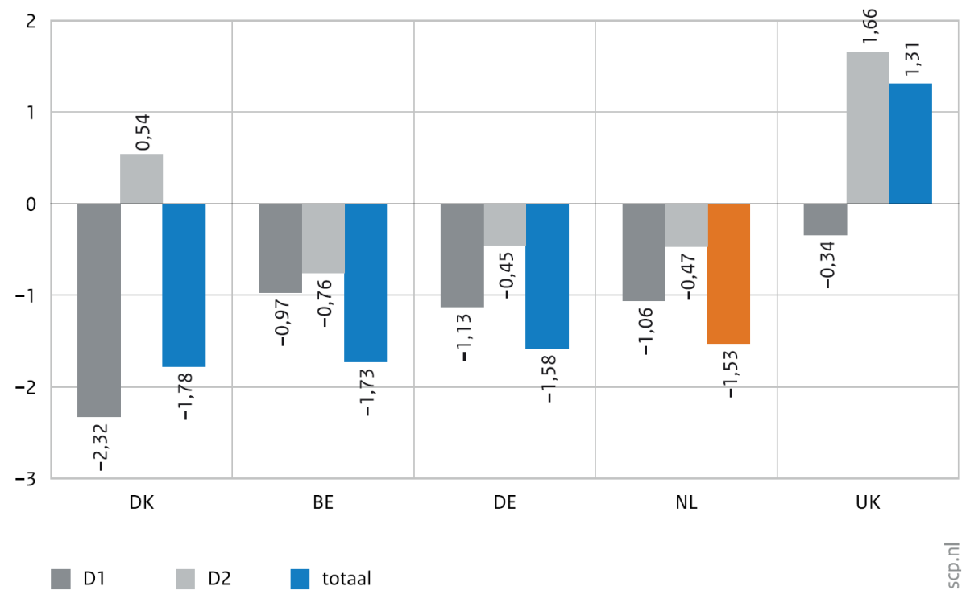
Hypotheses
Poverty boost scores based on theoretical impact of 16 formal labour institutions
+ Hypotheses on theoretical impact of 6 informal labour market institutions
+ Hypotheses based on qualitative information atypical work in five focus countries
→ Expected % of working poor:
DK < BE < NL+DE < UK
total
D1= Poverty boost score derived from first dimension of formal institutions
D2= Poverty boost score derived from second dimension of formal institutions

Slide 10
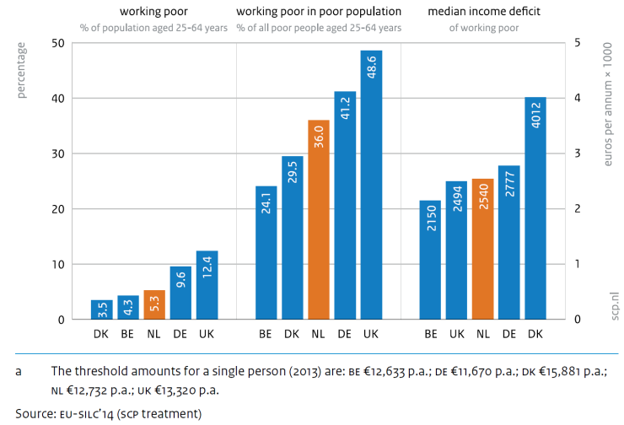
Working Poor in five countries
As expected from institutional analysis: DK < BE; UK highest share of working poor 25-64
Somewhat unexpected: NL and DE are in between, but rather far apart
All differences with NL statistically significant at p<.05, except Belgium (p<.10)
Share of working poor among all poor households: BE and DK reversed
(BE comparatively has more nonworking poor)
Median income deficit of working poor highest in DK
(selectivity?)

Slide 11
Institutional or other differences?
Additional analyses 1 (’underlying factors’ of theoretical model):
Assumption is largely borne out: 5 focus countries are institutionally different, but otherwise fairly similar
Varying degrees of in-work poverty cannot be reduced to noninstitutional differences between focus countries
Wealth, unemployment, inequality of earned income, composition of working population
Main impact on in-work poverty: first ‘formal’ institutional dimension
General income protection (short-term unemployment, family benefits); quality of governance; trade union density; minimum wage (high/absent vs low, medium)
But informal institutions also matter
Indications for independent impact of both dimensions of ‘culture of work’
Impact of second formal institutional dimension: probably overrated in policy debate
Includes type of contract; e.g. Denmark has below-average specific protection of employees yet a low share of working poor

Slide 12
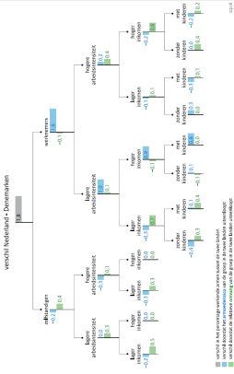
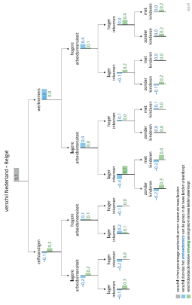
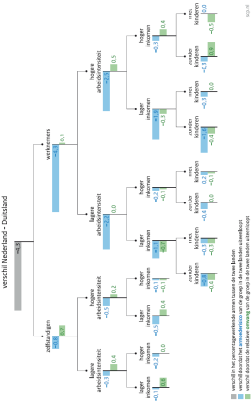
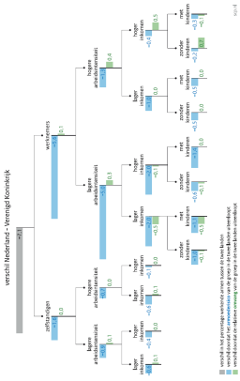
What direct mechanisms?
Additional analyses 2
’Direct mechanisms’ of theoretical model
Hierarchical decompositions Δ_{w. poor} (NL-BE,DE,DK,UK)
Advantage: impact of relative size and poverty risks of groups
(Self)employed by work intensity, hourly income, no. of children
Results:
Two extremes within five focus countries:
UK = large size vulnerable groups, high poverty risks
DK = small size vulnerable groups, low poverty risks
NL = hybrid
large vulnerable groups (≈UK), but low poverty risks (≈DK)
All direct mechanisms relevant in interpreting country
differences, plus self-employment vs waged employment
→ no single ‘cause’

Slide 13
Conclusions
Caveat: broad explorative study; more is needed to assess causality
Longitudinal data, analysis of macro/micro, simultaneous assessment of all (in)direct relationships in theoretical framework
Budget approach provides more realistic assessment of size of the working poor
However: more work needs to be done on cross-comparative reference budgets in EU countries
Institutions matter in explaining size and risks of working poor, but
No single cause: systemic differences between countries
Some systemic institutional differences are more important than others (3 out of 4 CatPCA dimensions)
Informal cultural differences also play a role → disentanglement of theoretical/empirical relationship with formal institutions
Atypical work is a blind spot
Potentially added value, but could also be correlated with institutional ‘liberalisation’ dimension
Aggregate quantitative data required from a cross-comparative perspective
In surveys: capture elements of vulnerable/precarious atypical work (low hourly wage, uncertain hours, partial/temporary
unemployment, low human capital development, discrimination, uneven work/life balance)
Enrich with administrative/big data wherever possible

