Slide 1
Nothing is more important for monetary policy than good statistics
- also in a digitalised world
Aurel Schubert
CESS
Bamberg 18/19 October 2018
03.10.2018

Slide 2
John Kenneth Galbraith
“Victorians heard with grave attention that
the Bank Rate had been raised. They did not
know what it meant. But they knew
that it was an act of extreme wisdom.”

Slide 3
Digitalization
“Conversion of analog information into digital information”
or
“Digitalization is the use of digital technologies to change a business model and provide new revenue and value-producing opportunities;
it is the process of moving to a digital business.” (Gartner)

Slide 4
Contents
The central role of “trust” for central banks
Evidence based policy making in central banks
Central banks’ communication of statistics as we used to know it
Core principles of central bank statistics communications – what should not change?
The new digital communications market
What has to change in central banks’ communication of statistics?
Challenges of communicating central bank statistics in a digitalised world
Conclusions

Slide 5
The central role of “trust” for central banks
“Finance is all about trust” (JP Morgan)
Trust is the main asset of a central bank
“The core value of official statistics is trust”
Public trust in (all) official authorities has been declining
Great Financial Crisis has dented trust in the financial sector, including central banks
“Even the actual market numbers are now open to question”
→ rebuilding trust in central banks is crucial and central bank statistics can and should contribute to that

Slide 6
Evidence based policy making in central banks
“Data are the lifeblood of decision-making”
All central banking policy decisions are (predominantly) “data dependent”
Crucial role for transparency of the decision making process in terms of content, empirical evidence
Monetary policy strategy is based on actual and expected/forecasted economic developments
Financial stability policy and deployment of tools are based on identified or expected risks
“No good banking supervision without good data”
→ Therefore, regular monitoring of large volumes of economic and financial data
→ Regular public announcements that the next policy move will be “data dependent”

Slide 7
Central banks’ communication of statistics as we used to know it
“Central bankers should be boring” (Mervyn King) – should they?
The public has a right to know/have access to the data used for policy making – “Central bank statistics as a public good”
Regular press releases
(paper based) monthly, quarterly and annual reports with statistical annexes
(Sometimes) press conferences
(Often) speeches
Hearings before (the European) parliament
Publication of accounts of the policy meetings
(Growing) Electronic databases
(very/too often): “One size fits all”

Slide 8
Core principles of central bank statistics communications – what should not change?
“ Reaching out to citizens is the key to maintaining public confidence in their central bank” (Mario Draghi, 24/9/2018)
Crucial role of statistics for accountability and therefore for the defense of central banks’ independence
Trustworthiness of and transparency about the data sources (Central Banks) crucial
Quality of the data (in all dimensions) need to be maintained and communicatec
Openness and transparency about methodologies used (metadata)
Open and free access to all interested (subject to full respect for privacy rules)
Differentiated and adequate offer for different stakeholder groups, based on their needs and knowledge (“statistical and economic literacy”)
Personal interaction with interested parties

Slide 9
The new digital communications market - trends
New technologies and channels for information acquisition and distribution
“Digital first”
“Digital tsunami” – “separating information from pure noise”
Fierce competition for the (limited) attention of the citizens
“Social media revolution” in all areas of life
Flood of (on purpose) “Fake news”
Interoperability of information – “linking everything with everything”
But also: “Openness and access to data are crucial elements of guaranteeing freedom of information…and open government”

Slide 10
The new digital communications market - tools
To raise interest:
Twitter – ECB has about 440.000 followers
Google+
To distribute/show data:
Modern visualization tools
Interactive dashboards
To distribute/explain concepts:
(YouTube) videos
Cartoons
(Topical) Explainers on webpage
To interact/two-way communicate (“audience engagement”):
Twitter
Facebook

Slide 11
What has to change in central banks’ communication of statistics?
“We are well aware that maintaining people’s trust in the ECB calls for tireless efforts on our side” (Mario Draghi, 24/9/2018)
Openness to new technologies
Agility
Differentiated and adequately targeted offer for different stakeholder groups, based on their information needs and knowledge (“statistical and economic literacy”)
No longer, one size fits all
Multichannel communication, with differentiated content and sophistication
Increasing use of (adequate) visualisation tools
Story telling and “Contextualising” - Putting numbers into context
Support and complement “forward guidance” with the relevant data (“signalling” policy intentions early on)
Increased interaction with and involvement of user groups
Pro active cooperation with “data journalists”
Put the people into the centre of communication!!

Slide 12
Challenges of communicating central bank statistics in a digitalised world
Overflow (“tsunami”) of information
Fierce competition with “Fake news”
Lack or deficit of “statistical, economic literacy”
Many central bank statistics are not perceived as (directly) relevant for the individual citizens lives
Even if relevant: mismatch between published averages and individual experiences (esp. in case of Euroarea averages)
Visualization requires adequate “graphicacy” of the targeted users
Striking right balance between explanation and simplification
Danger of “Echo chamber effect” of many social media platforms
“Sick and ugly state of social media” (John Authers)
Be aware of the digital divide – not everybody can be reached via digital channels
Availability of digital media vs. Access to digital media vs. Access to digital contents

Slide 13
Conclusions
The ultimate objective and goal of central bank communication does not change with digitalisation
But digitalisation offers new opportunities, via tools and channels to address the user audiences in a more targeted way
Digital communication of statistics requires new approaches to communication
Need to distinguish between messages to raise awareness or interest and messages with statistical content
Technology cannot replace the value of person-to-person interaction, esp. in order to generate and re-establish trust!
But digitalisation comes also with considerable challenges (HR, IT)
Central bank communication – also of statistics – is more profoundly affected by the changes in the tasks of and expectations on central banks than by digitalisation per se –
That is the REAL game changer!!

Slide 14
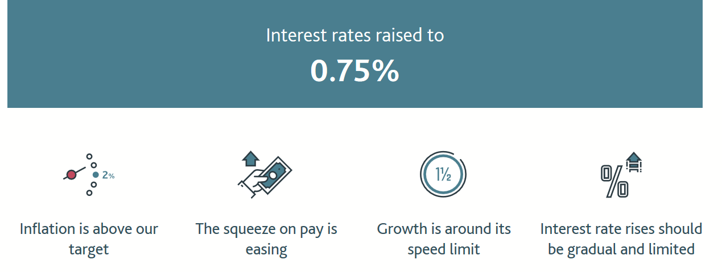
Bank of England

Slide 15
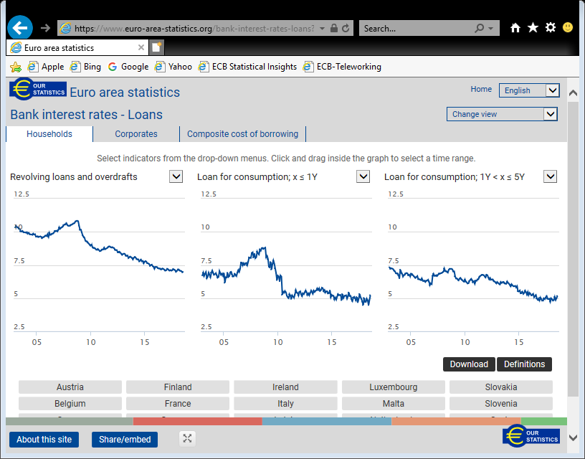

Slide 16
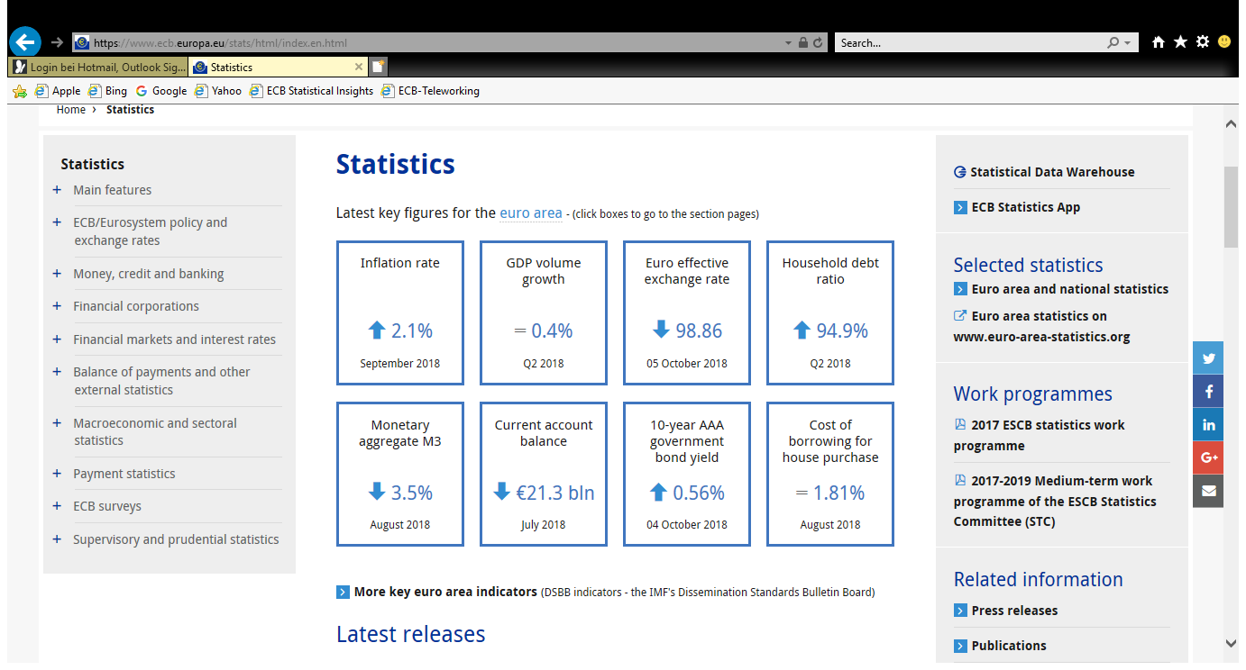

Slide 17
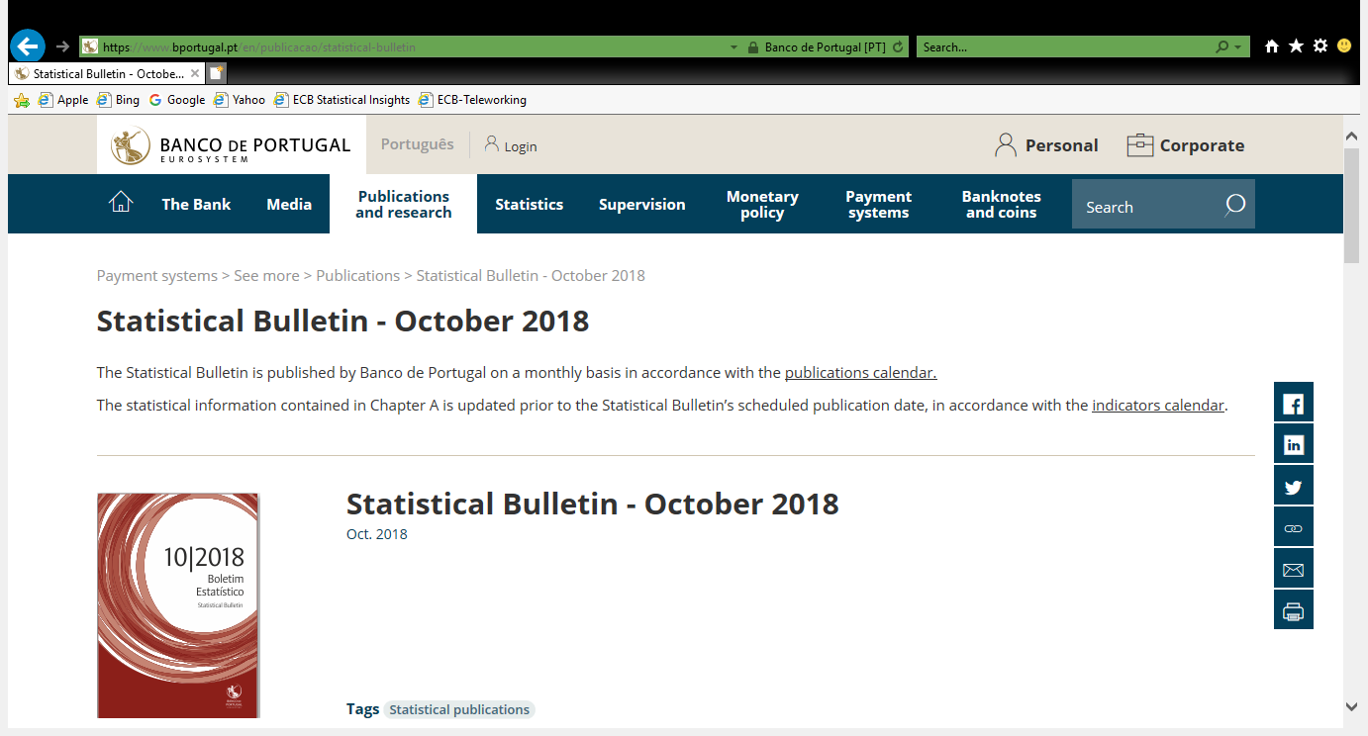

Slide 18
Jerome Powell (Chairman of the FED)
“If the public understands the central bank's views on the economy and monetary policy,
then households and businesses will take
those views into account in making their
spending and investment plans;
policy will be more effective as a result.”

Slide 19
Thank you for your attention!!

Slide 20
Aurel Schubert
Honorary Professor and Lecturer
Vienna University of Economics and Business
aurel.schubert@wu.ac.at

