Slide 1
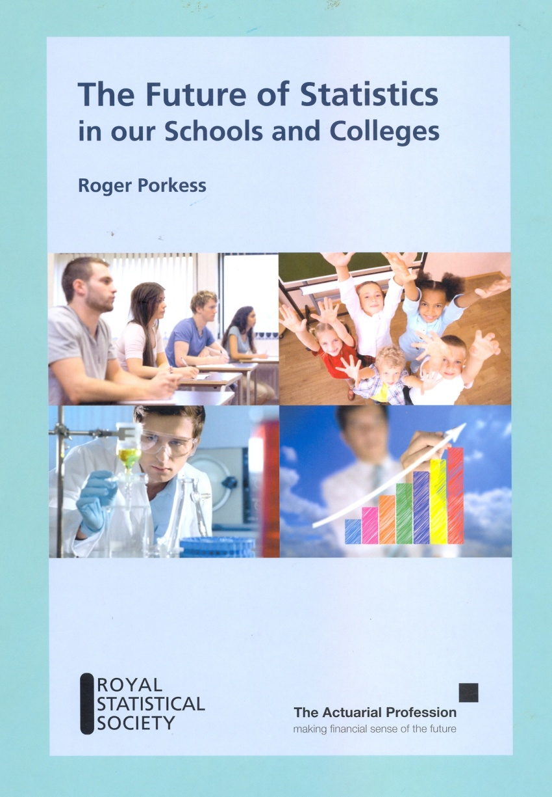
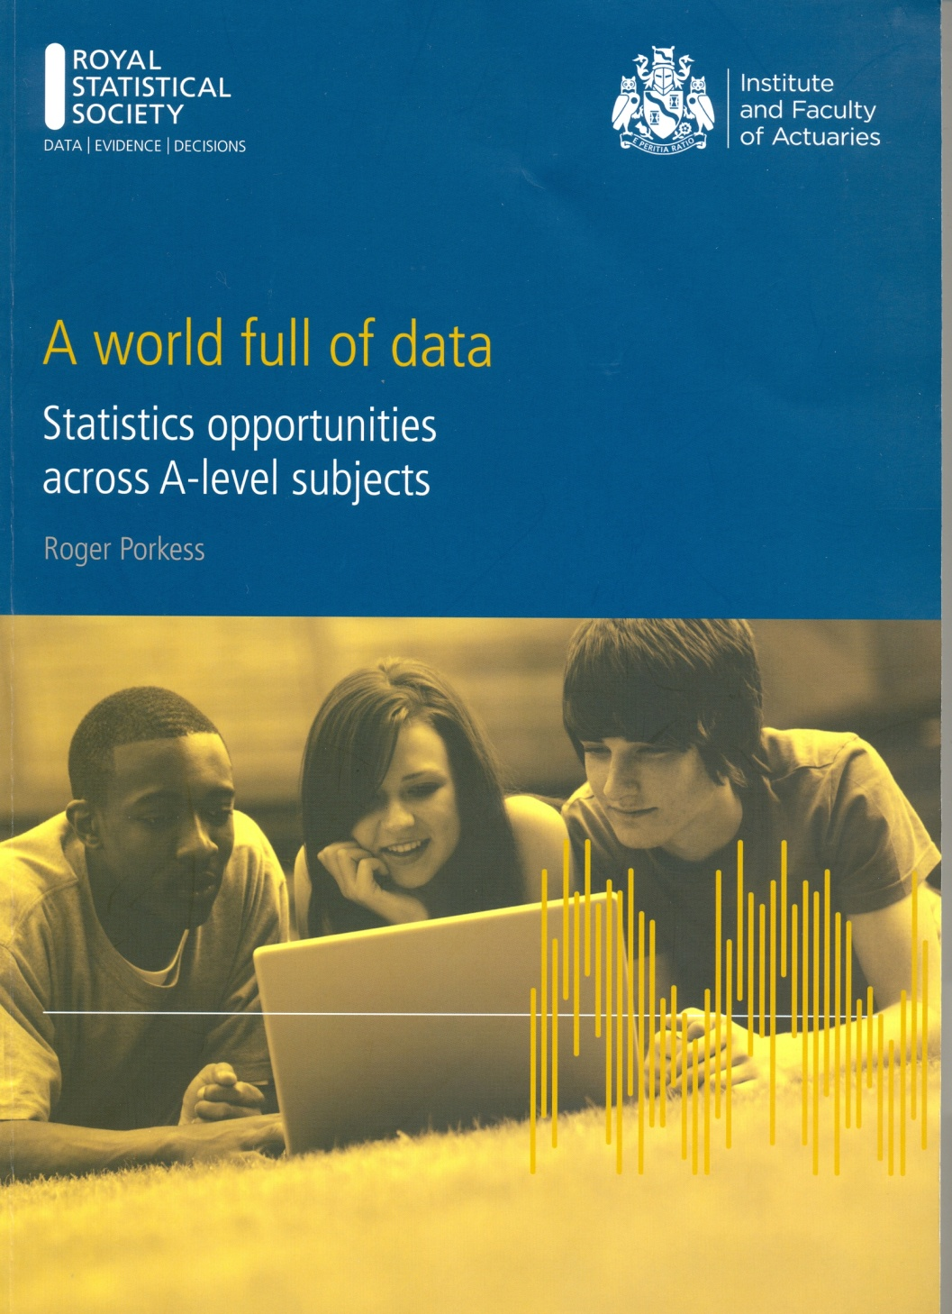
Preparing students for a world full of data
Roger Porkess
2012
2013

Slide 2
The Future of Statistics in our Schools and Colleges
A summary of statistics in UK in 2012
At 16 all students take GCSE Mathematics. Some statistics is included in it.
From 16 to 18 most students take A level in 3 subjects. About 15% of each cohort take A level mathematics; this includes some statistics.
Real data are rarely used in mathematics; contexts are almost always artificial.
In other subjects some students meet some statistics, eg psychology, geography, ...

Slide 3
The Future of Statistics in our Schools and Colleges
A key recommendation
Policy makers need to recognise that the need for statistics is not going to go away; instead it will increase as ever more data become available. They need to recognise the central role that statistics plays in the current and future economy, and its importance for decision making.
Problem solving
Throughout this report there is strong emphasis on the skill of statistical problem solving.

Slide 4
Statistical problem solving

Slide 5
A world full of data
In depth discussions about the effective use of statistics with the following subject communities
Biology Business Chemistry
Computing Economics Geography
History Physics Psychology
Sociology
Employers, universities, schools & colleges were involved.
All came up with the same list of constraints, including lack of engagement, confidence and understanding on the part of students.

Slide 6
Constraints
Many students find mathematics frightening and lack confidence in it but this is where they first meet statistics. So they are reluctant to engage with data in other subjects.
School mathematics does not treat statistics as a practical subject based on real data. So students do not develop statistical problem solving skills. Nor do they explore data.
Students needing to use statistics in their other subjects, and in the workplace, have not been equipped with the transferable skills and understanding that they need.
The situation is made worse by a lack of use of computers and statistical software so that students going on to university or employment are ill prepared for the statistics they will meet there.

Slide 7
Mathematical needs (ACME, 2011)
This report quantified the need for people who have taken mathematics up to the age of 18.
“We estimate that of those entering higher education in any year, some 330,000 would benefit from recent experience of studying some mathematics (including statistics) at a level beyond GCSE, but fewer than 125,000 have done so.”
In response, the government announced that within the next 10 years the vast majority of students would be doing mathematics up to 18.
So new mathematics courses have been developed for those who are not continuing it at A level. They are (strangely) called “Core Maths”. Statistics features prominently.

Slide 8
New Statistics courses
One of these courses is called Statistical Problem Solving. It is based on the findings of A world full of data. It places a strong emphasis on
problem solving
interpretation of data and of the outcomes of calculations.
At the start of this course students are provided with a large data set on a spreadsheet.
This is to be used as teaching material.
It is also used in the assessment with half the marks on the examination paper based on it.
In a major innovation using a large data set has now also been incorporated into A level Mathematics.

Slide 9
A large data set
The data set used so far for Statistical Problem Solving consists of the following fields for (all) the 239 countries in the world. The data come from the CIA Factbook.
Sub-region
Population, and its ranking
Life expectancy, and its ranking
Birth rate, and its ranking
GDP per capita, and its ranking
“Use your spreadsheet to draw a scatter diagram of birth rate against life expectancy for the countries of the world”

Slide 10
Life expectancy and Birth rate
Birth rate
Life Expectancy

Slide 11
In conclusion
What skills should we be giving young people?
Understanding the role of data in problem solving: the statistical problem solving cycle.
Recognition of the importance of data.
Willingness to engage with, explore and interpret data.
Techniques that will allow them to do so.
The ability to interpret the results of statistical calculations.

