Slide 1
Future challenges for institutional sector accounts and BoP statistics
Conference of European Statistical Stakeholders
Bamberg, October 18 -19, 2018
Presented by Peter van de Ven
Head of National Accounts, OECD

Slide 2
Introduction
Recent developments and user demands
Statistical response
Current availability of data
Going forward

Slide 3
Recent Developments and
User Demands

Slide 4
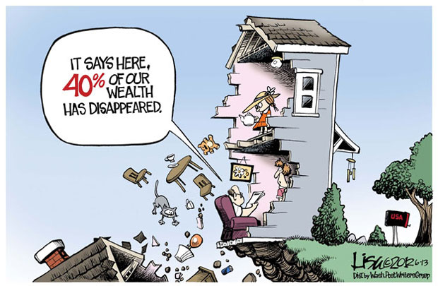
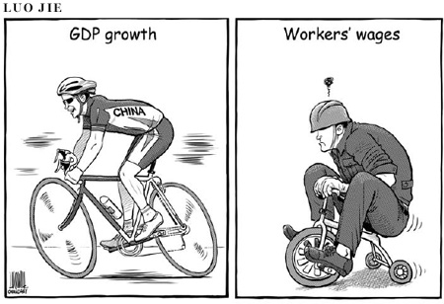
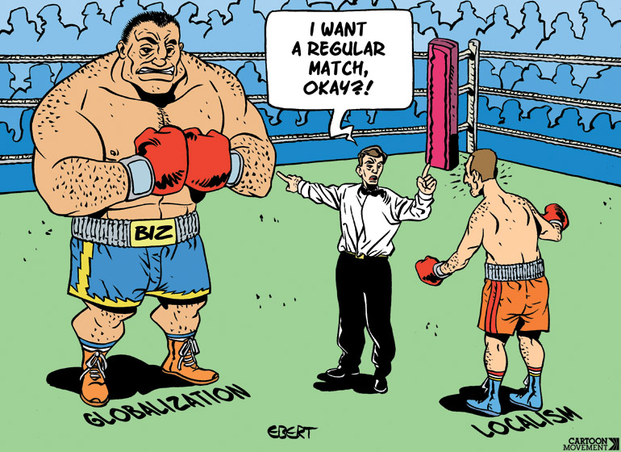
Recent developments
Economic and financial crisis
  More demand for data on (financial) risks and vulnerabilities: interconnectedness, maturity risk, currency risk, shadow banking, etc.
Stiglitz-Sen-Fitoussi Report: well-being versus GDP
  More demand for data on households, beyond GDP: income, consumption, saving and wealth (including distribution across household groups)
Globalisation
  More demand for granularity: impact of multinational enterprises (MNEs), SPEs
=> More demand for institutional sector accounts

Slide 5
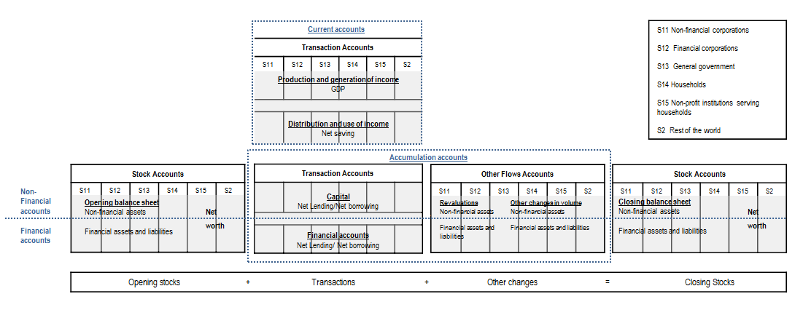
General overview of sector accounts

Slide 6
Statistical Response: G-20 Data Gaps Initiative

Slide 7
G-20 Data Gaps Initiative (G-20 DGI)
Core recommendation (II.8) on the compilation of institutional sector accounts
  Core template, including encouraged items for (sub)sectors, transactions and positions (e.g. on maturity and currency mismatches)
  More advanced ambitions:
    Accounting for interconnectedness: from-whom-to-whom data
    Accounting for risks related to new developments in the financial corporations’ sector: shadow banking

Slide 8
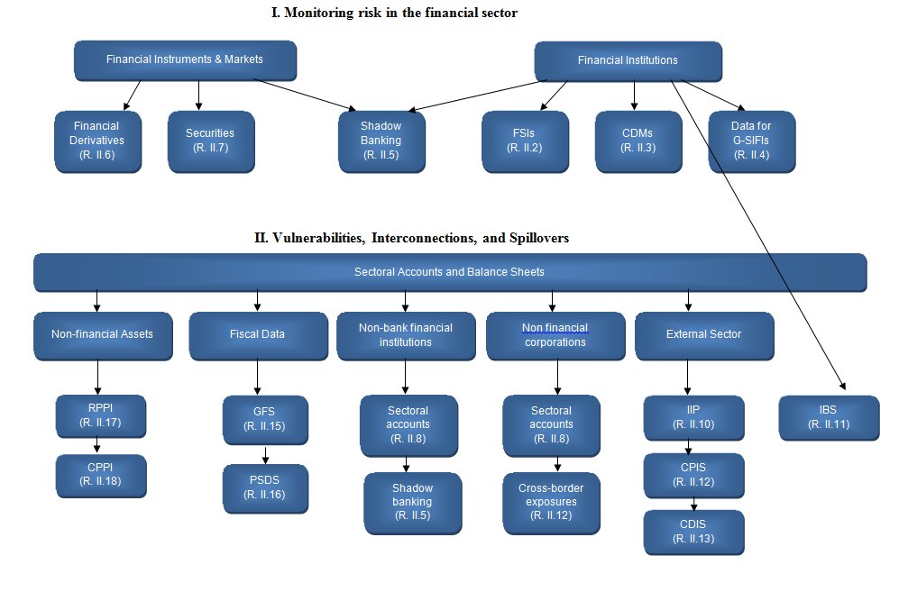
G-20 DGI: Recommendations

Slide 9
Accounting for risks and vulnerabilities
Debt and debt service ratios of households (% of disposable income) in OECD countries, 2016

Slide 10
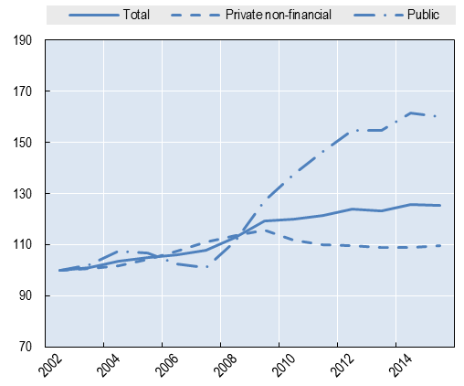
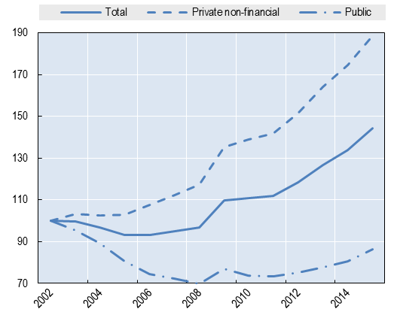
Accounting for risks and vulnerabilities
Private and public debt patterns, 2001-2015 (source: BIS)
Advanced Economies (AEs)
Emerging Market Economies (EMEs)

Slide 11
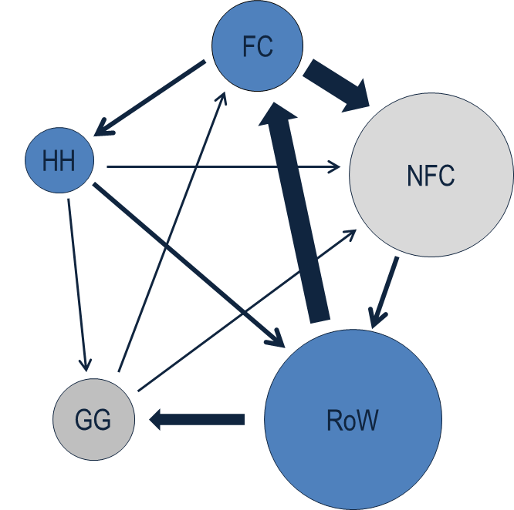
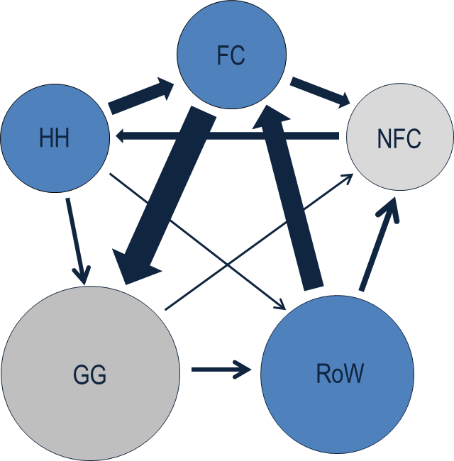
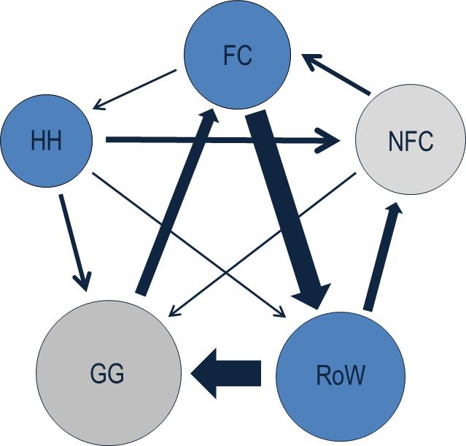
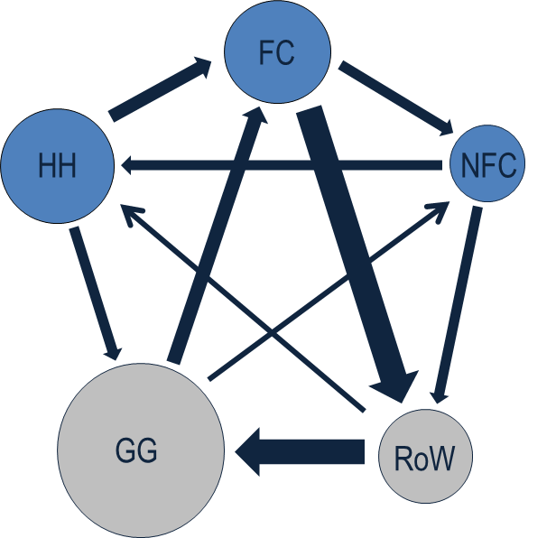
Accounting for interconnectedness
2007
2010
2011
2014

Slide 12
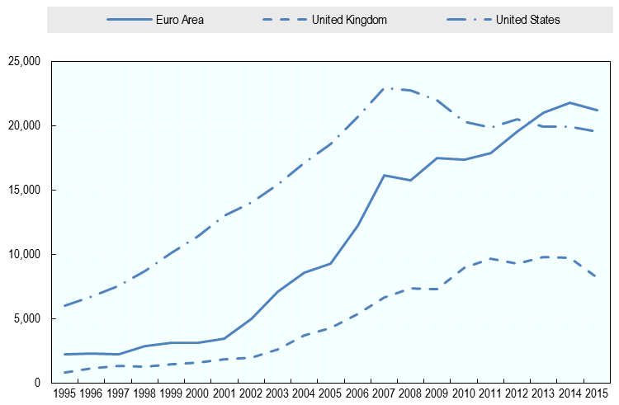
Accounting for shadow banking
Other financial intermediaries, 1995 – 2015

Slide 13
Statistical Response: It’s About Households, Stupid!

Slide 14
More focus on households
Analysis of divergences between GDP and household disposable income
OECD Dashboard on households’ economic well-being
  GDP and household income (3 indicators)
  Confidence, consumption and saving (3 indicators)
  Debt and net worth (2 indicators)
  Unemployment (2 indicators)
News releases on household disposable income
Distributional data consistent with national accounts (Rec. II.9 of the G-20 DGI)
Not only OECD, also lots of work being done by Eurostat and ECB

Slide 15
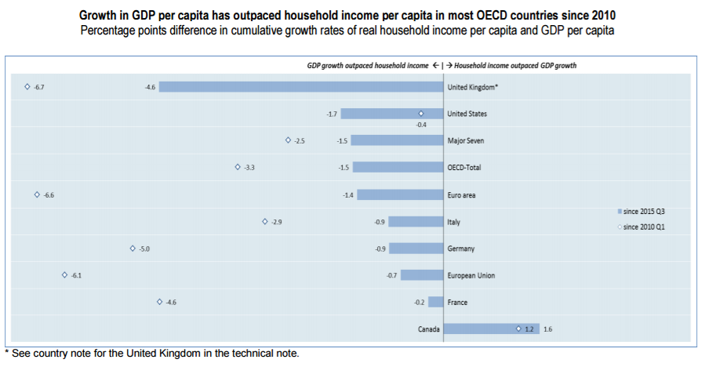
GDP versus household disposable income

Slide 16
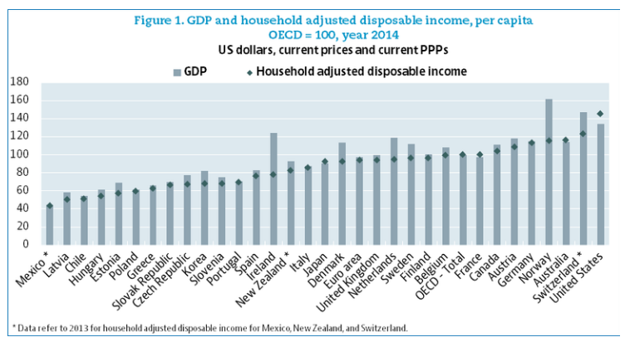
GDP versus household disposable income

Slide 17
Saving rates across household groups
France
Mexico
United States

Slide 18
Statistical Response: Accounting for Globalisation

Slide 19
Accounting for globalisation
Trade in Value Added
Databases on MNEs
More details on activities of MNEs
  Extended Supply and Use Tables
  More granularity in institutional sector accounts: distinction by type of ownership:
    Public corporations
    National private corporations, not part of domestic MNE
    National private corporations, part of domestic MNEs
    Foreign-controlled corporations
    Of which: Special Purpose Entities (SPEs) (Note: may only be relevant for some countries)
Considerable discussion on economic ownership and recording of IPPs

Slide 20
Presence of MNEs across countries
Value Added of Foreign Affiliates, share of national total 2009 (ISIC B-N, ex K)
50%
10%

Slide 21
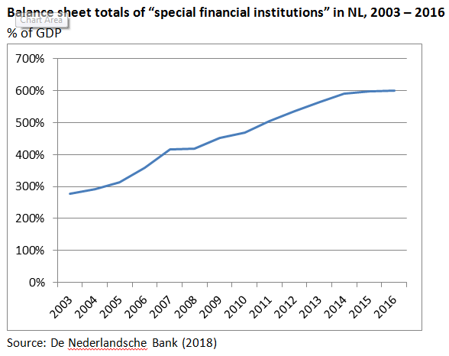
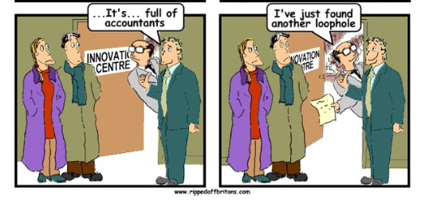
Special Purpose Entities in the Netherlands

Slide 22
Availability of Institutional Sector Accounts

Slide 23
Current availability: requirements core template
Current and capital accounts:
  Annual: Generally available for OECD, and for China, Russia and South Africa
  Quarterly: Available for OECD (except Israel, Korea, Mexico, New Zealand, Switzerland and Tukey) and South Africa
Financial accounts and balance sheets:
  Annual: Available for OECD (except Israel and New Zealand) and South Africa
  Quarterly: Available for OECD (except Israel, Mexico, New Zealand and Switzerland) and South Africa
Stocks of non-financial assets:
  Still quite some gaps, especially for non-produced assets

Slide 24
Current availability: data on shadow banking
Only a couple of countries can provide details, but for most of the respondent countries coverage is relatively low
Important to look at possible synergies with the FSB work on shadow banking, both exercises can mutually reinforce each other
Completion of the various details will focus on the main subsectors within a country which are considered relevant for tracking shadow banking and similar activities

Slide 25
Current availability: from-whom-to-whom information
Agreed to limit FWTW-data to the main sectors
Quite a lot of information available at the national level, but not (yet) disseminated (due to quality considerations) and/or systematically collected at the international level
Future potential also dependent on e.g. the development of very granular securities databases

Slide 26
Going Forward

Slide 27
Going forward
Lots of progress made, G-20 created massive momentum
Major improvements in coverage of the countries expected in the future (timeline: 2021)
Not only relevant for G-20 countries
Increasing user demands for more granular data
  Nearly impossible to cover all details in a consistent framework, such as the system of national accounts
  Importance of linking source statistics to macro-economic framework: micro-macro linkage
  Process tables describing the differences, including the reasons for these differences, may provide an important set of metadata for users

Slide 28
Thank you for your attention!

Slide 29
Additional slides

Slide 30
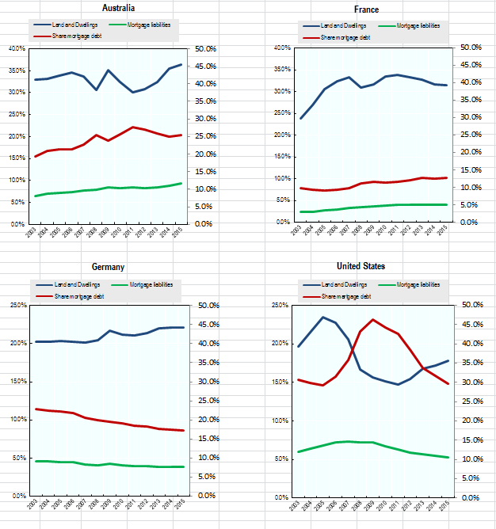
Accounting for risks and vulnerabilities
Dwellings (including underlying land) versus mortgage loans, 2003 – 2015

Slide 31
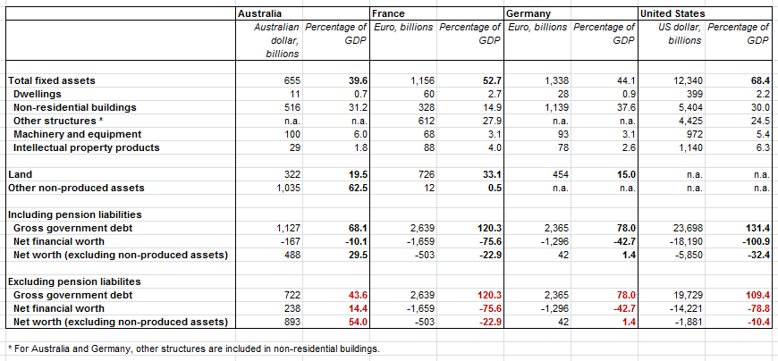
Accounting for risks and vulnerabilities
Government Balance Sheets, 2015

Slide 32
Accounting for shadow banking
Monetary Financial Institutions (MFIs) versus Other Financial Intermediaries (OFIs) in the USA, 1990-2017

Slide 33
Proposal for additional granularity of shadow banking
Additional breakdowns subsectors(tier 1):
  Insurance corporations:
    Non-life insurance corporations
    Life insurance corporations
  Pension funds:
    Defined benefit pension funds
    Defined contribution pension funds
  Non-MMF investment funds:
    Open end funds
      Bond funds
      Equity funds
      Mixed or balanced funds
      Real estate funds
      Hedge funds
      Other funds
    Closed end funds

Slide 34
Proposal for additional granularity of shadow banking (cont.)
Additional breakdowns subsectors (tier 1), cont.:
  Other Financial Intermediaries (OFIs):
    Financial vehicle corporations engaged in securitisation
    Financial corporations engaged in lending
    Security and derivative dealers
    Specialised financial corporations
    Other OFIs
  Captive financial institutions:
    Trust, estate and agency accounts
    Brass plate companies
    Special Purpose Entities or conduits
    Other captive finance companies and money lenders
Also some additional breakdowns of financial instruments

Slide 35
Why Focus on Institutional Sector Accounts?

Slide 36
Advantages and disadvantages
Complete and coherent system of all economic transactions and positions
In practice full consistency, with the exception of:
  Differences between balancing item of non-financial transactions and balancing item of financial transactions
  No full recording of stocks of non-financial assets
  Other flows (revaluations and other changes in the volume of assets) calculated as a residual
Consistency over time, and thus availability of consistent time series data
International comparability

Slide 37
Advantages and disadvantages
Ability to analyse interaction between “real” economy and finance
Ability to analyse interactions between sectors
Generally less detail available
Timeliness questionable, certainly at initial stages of development; current timeliness requirements for advanced countries:
  Quarterly: 4 months after reference period
  Annual: 9 months after reference period

Slide 38
Micro-data versus macro-data

