Slide 1
Integrating National Accounts and
Balance of Payments Statistics in Austria
Conference of European Statistics Stakeholders 2018
STS01 - Bamberg, 18th October 2018
Michael Andreasch
Oesterreichische Nationalbank
External Statistics, Financial Accounts and Monetary and Financial Statistics Division

Slide 2
Storyboard
Towards ESA 2010 - BPM6 Integration in practice
Solution in Austria
- Organisational solution
- Data integration
Pros & Cons
Analytical benefits

Slide 3
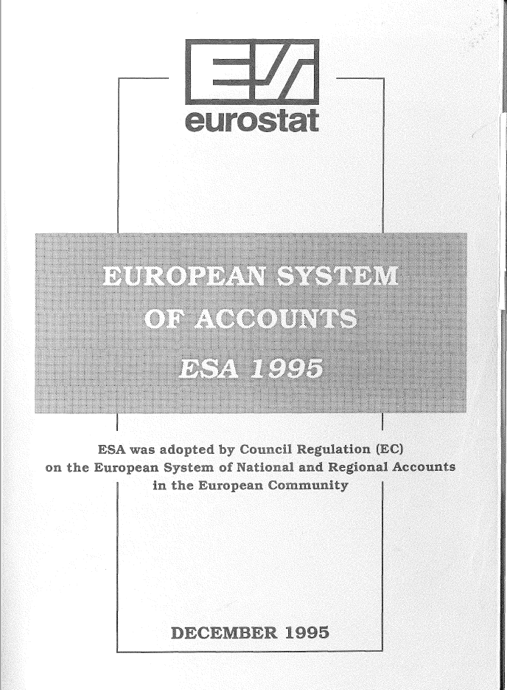
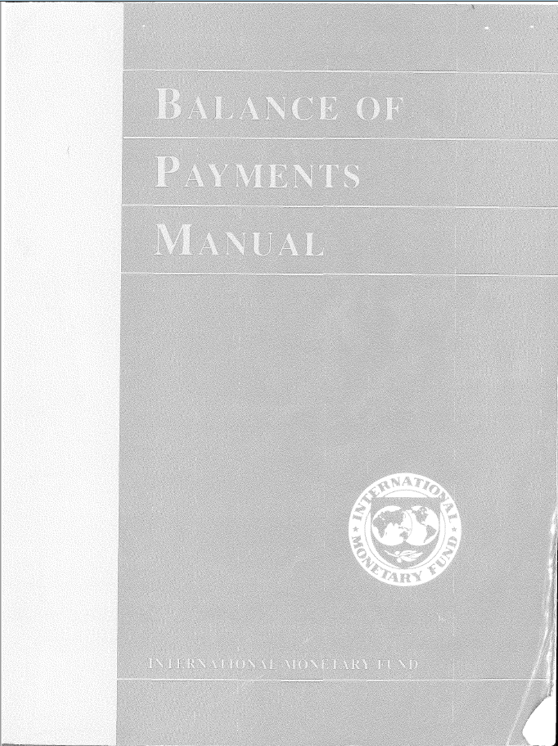
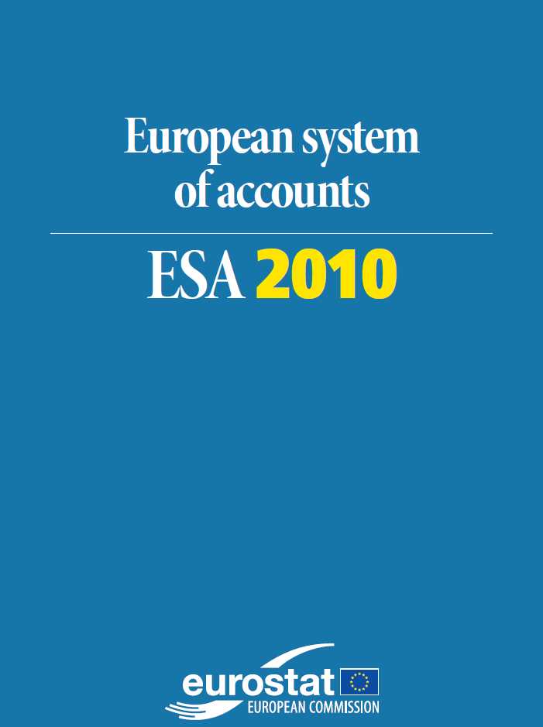

Towards ESA 2010BPM6 Integration
Harmonisation of concepts and definitions
… allows a bridging and integrating of national accounts and balance of payments!
Not only a theoretical aspect:
- net lending/borrowing vs.
current and capital account
- MIP indicators
- …
… but, how to solve in practice ?

Slide 4

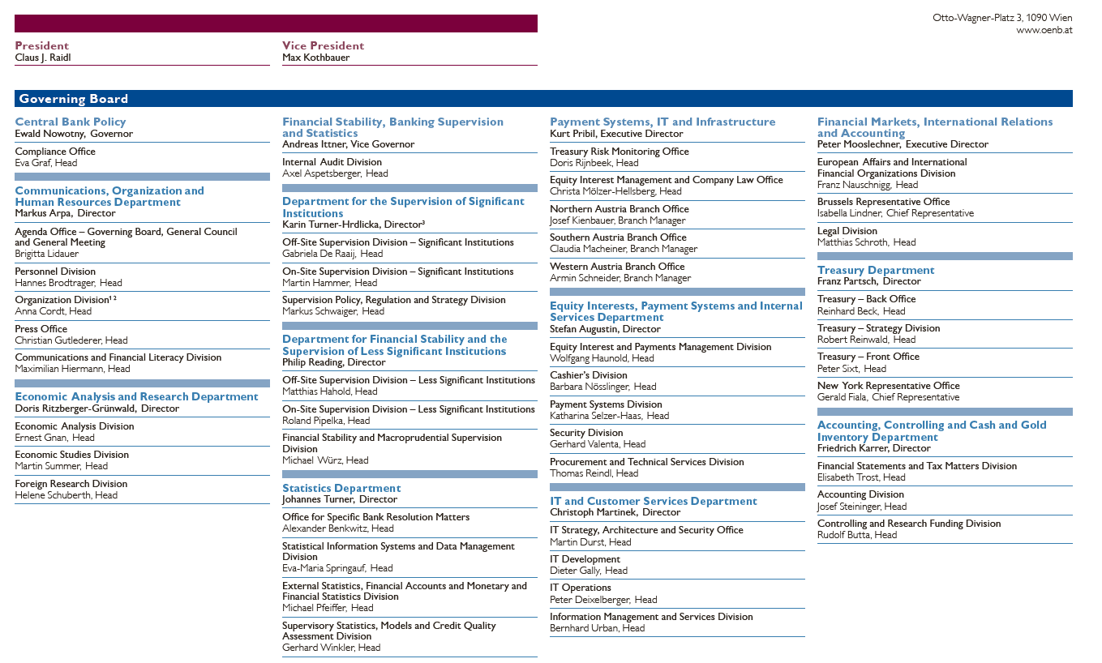
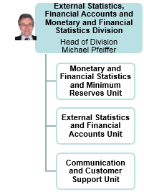
How to solve: from an organisational viewpoint
The compilation of both external statistics and financial accounts is organized in one statistical unit as part of the compilation of all relevant macro-economic statistics

Slide 5
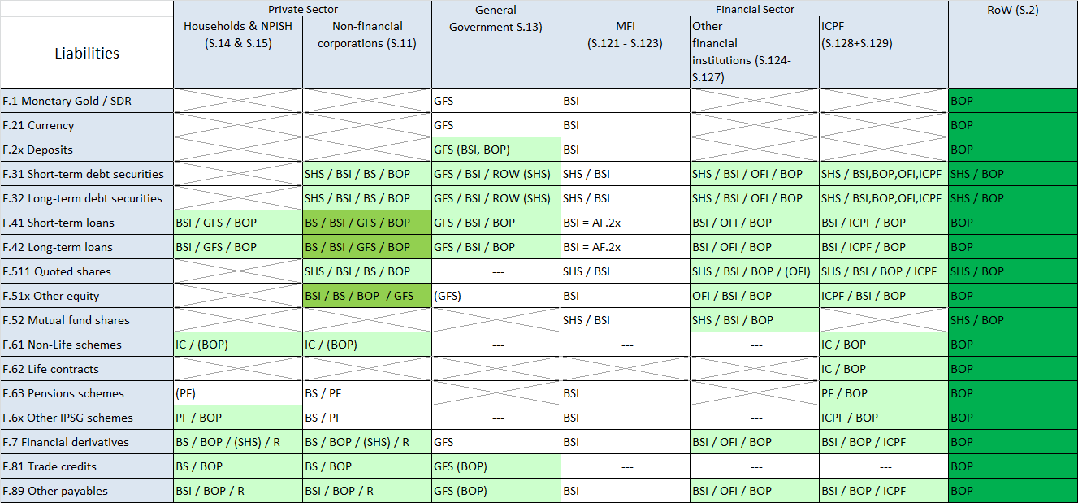
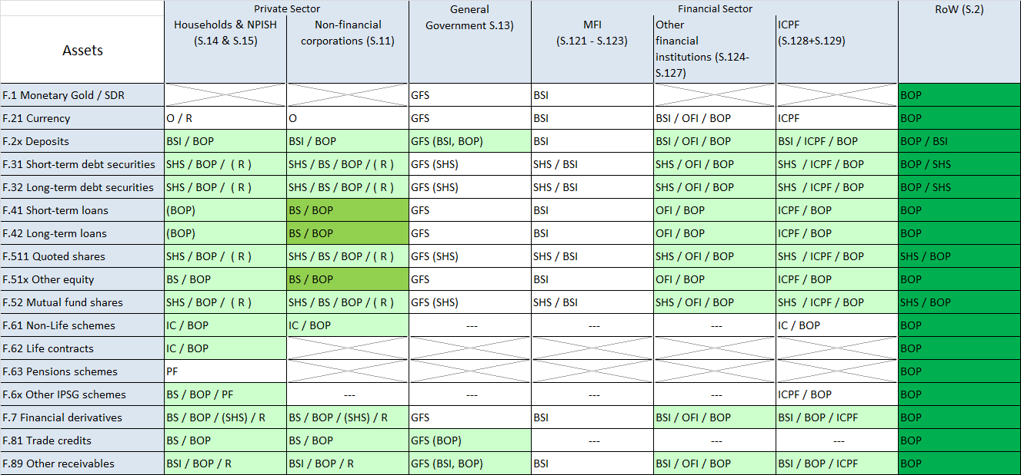
How to solve: from the viewpoint of data integration
Balance of Payments / IIP statistics data are used 1:1 for the compilation of the “rest of world sector” in financial accounts

Slide 6
How to solve: from a compilation viewpoint
Common data sources for BOP and Financial Accounts
BSI Data
Assets Liabilities
Loans to Deposits held by
- Residents - Residents
- Non-Residents - Non-Residents
….. .....
….. …..
BOP / IIP =
RoW sector in Financial Account
Assets Liabilities
Other Investment Other investment
Loans to Deposits held by
Non-Residents Non-Residents
Portfolio Inv. Portfolio Inv.
Foreign securities Domestic securities
Securities Holdings
Assets (World) Issuance (AT)
Holdings Total Issuance AT
issued by Securities held by
- Residents - Residents
- Non-Residents - Non-Residents

Slide 7
How to solve: from a compilation viewpoint
Production of BOP and Financial Accounts
Production of quarterly BOP / IIP data
prior of T+82
Compilation of already existing data (mainly BSI both domestic and nonresident, IF, SEC both data) in the FA matrix
Transformation of quarterly BOP / IIP data in the FA matrix (excluding securities and non-resident loans/deposits by domestic MFI)
Dissemination of BOP/IIP data at T+82
Compilation of a “from whom to whom” FA matrix – first assessment and transmission to ECB at T+85
Incorporation of GFS data and
horizontal analysis for each financial instrument and vertical analysis for each economic sector including RoW
Feedback-Loop, if necessary, to
production of quarterly BOP/IIP
Dissemination of BOP/IIP data at T+97

Slide 8


Pros & Cons for this solution
BPM6 = ESA 2010 (in general)
One source for both statistics
Consistency of data (based on harmonised revision policy)
Unique data quality checks,
feedback loop
Staff is working in both areas
Direct link between both statistics for analytical use
Limitation in data selection;
-> not fully consistent with
IF-/IC-Statistics
Timeliness of compilation depending on BOP (ECB reporting requests)
Feedback loop back to BOP with
a delay of one quarter (timeliness)

Slide 9
What – from an analytical perspective
Publication
✓ Separate publication of statistics in two different statistical domains
but interlinkage shown in a bridging table
Internal Analysis
✓ Functional/Financial Instrument Analysis
Functional breakdown for all financial instruments,
for all economic sector
✓ Sectoral Analysis
Contribution of economic sectors to net lending/borrowing
vs. direct cross-border net financial flows
✗ Breakdown of ROW (work in progress)
Intra Euro Area/Non-Euro Area and and by counterpart country

Slide 10
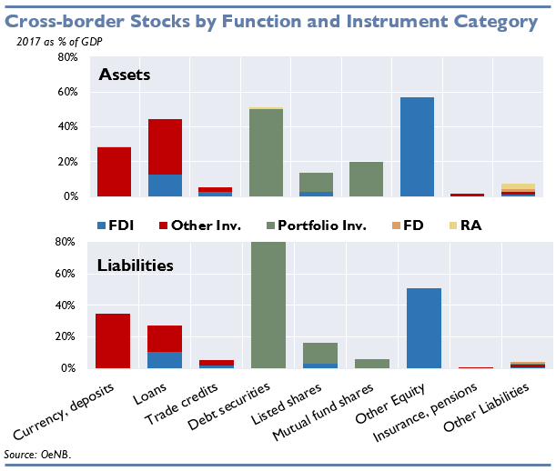
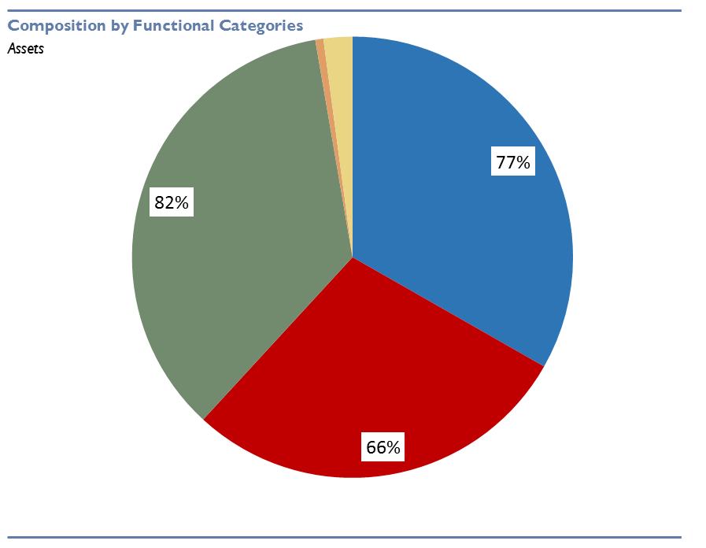
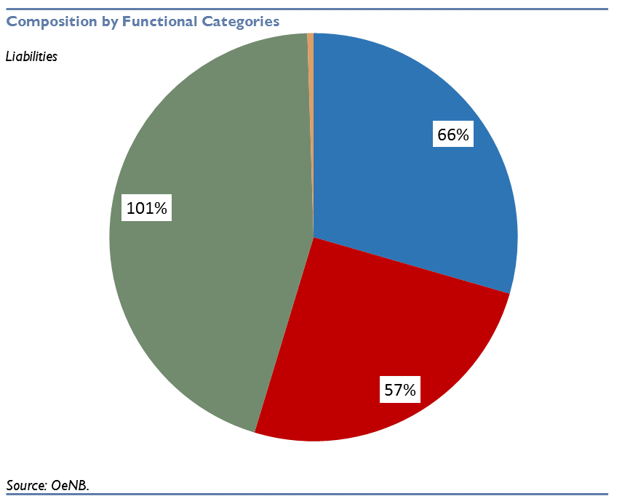
What – from an analytical perspective
https://www.oenb.at/isaweb/report.do?report=801.1.11

Slide 11
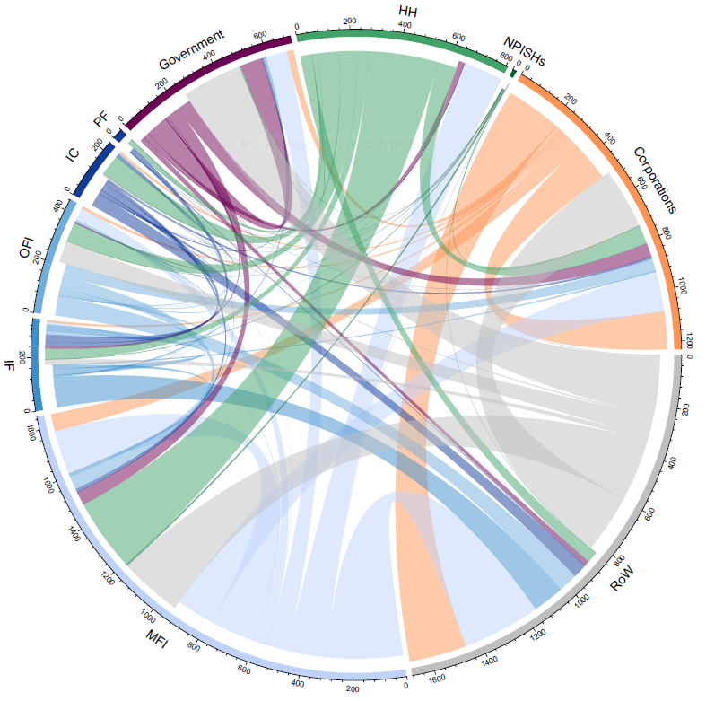
What – from an analytical framework

Slide 12
Thank you for your attention
michael.andreasch@oenb.at

