Slide 1
The role of data centres in facilitating access to data
Aleksandra Bujnowska
Eurostat

Slide 2
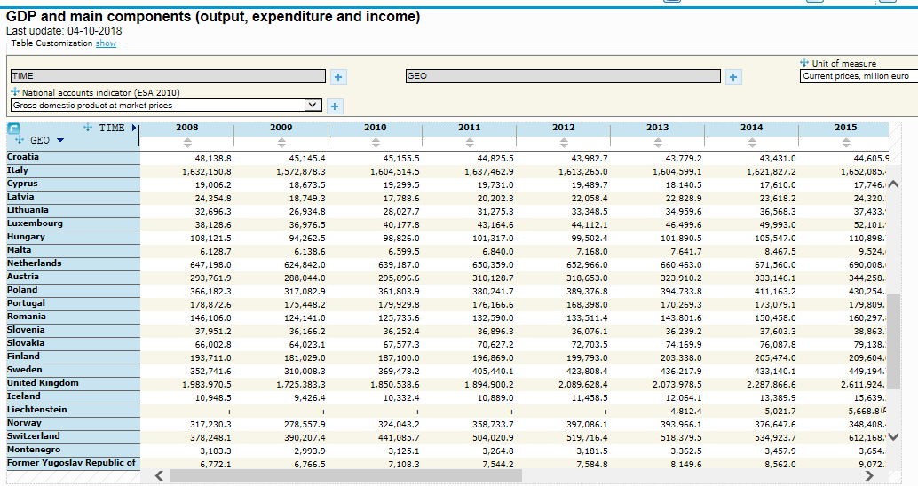
Statistics for users
user
data

Slide 3
Data centres - services
Notes:
Information
Flexibility
User-orientation
Data access

Slide 4
Data centres facilitate access to data
user
data

Slide 5
Data centres types
Data discovery centres
(Distributed) Data exploration centres
Data computation centres

Slide 6
Data discovery centre
CESSDA
INEXDA
user
data catalogue
data

Slide 7
(Distributed) Data exploration centres
Statistical offices
CASD.eu
UK Data Service
IPUMS
…
user
data catalogue
data

Slide 8
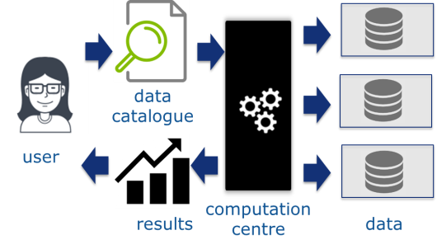
Data computation centres
Census Hub
RAIRD: microdata.no
…

Slide 9
Conclusions
Increasing role of data centres as facilitators for access to the data
Different roles of data centres
Own or independent centre for our data?

Slide 10
Thank you for your attention!
Aleksandra.Bujnowska@ec.europa.eu

