Slide 1
Creating Comprehensive Data Worlds using Standardization
Stephan Müller, Deutsche Bundesbank
Conference of European Statistics Stakeholders 2018
Session on Data Integration, Harmonization and Standardization
Bamberg, October 19, 2018

Slide 2
Are post-crisis statistical initiatives completed? - The data universe is exploding -
Demand for new statistical surveys
Exploding data supply
Banking crisis How heavily affected are investors in Europe?
Sovereign debt crisis Who holds which government bonds?
Banking union What is the degree of risk concentration?
Low-interest-rate environment How healthy are euro area banks?
Data amount is growing constantly and rapidly
Automatic recording of process data (sensors, Internet of Things)
Social networks and search engines
Mobile phones and tablets
New technological developments
Larger computing power: Big Data
New analysis techniques: Machine Learning, AI

Slide 3
“Water, water, everywhere, but not a drop to drink.”*
Yawning Data Gaps despite “Collectomania”
Data is not collected where it's needed, but where it occurs. Still painful data gaps
The Data Universe lacks Order
In IT: neither a system of order for data / information, nor a prominent standardization, nor a global identifier (“barcode for information”)
In companies: large part of the data stored in data silos; need for data integration / BI / DWH / Big Data projects / CIOs
In industry branches or countries: proprietary solutions
Using IT not Possible Without Content-Related Expertise
No longer classical statistical production of pre-defined indicators
Instead implementation of data analysis on demand
New style of data collections with hundreds of dimensions
Automation or lack of expertise could lead to comparing apples and oranges
Professional expertise crucial for evaluating and interpreting the results
* Samuel Taylor Coleridge “The Rime of the Ancient Mariner“ (1798)

Slide 4
The three steps of data integration
Semantic harmonization
Uniform data modeling method
Order system
The concepts, methods and code-lists used for the classification of the data are the same.
Thus linking the data, the actual integration of content, becomes possible.
Logical Centralization
A uniform language (the same concepts and terms) is used to describe the data. Thus a rule-based (and automatable) treatment of the data becomes possible.
The data is stored (physically or virtually) in a common system.
Common procedures can be used for administration, authorization and access.
Increasing degree of standardization
Ready to be linked

Slide 5
Challenges for those who want to introduce data integration
Challenges coming from…
…the IT industry and its customers
…within the company
…data users (researchers, analysts)
…outside
Innovation speed of IT
technology
IT projects instead of
business projects
Existing IT standards for
data integration
Individualistic mentality
Silo thinking more pronounced than interdisciplinary thinking
Researchers not interested in data integration and production process in itself but a specific result
Gap between what
analysts want and what
even well-arranged data
structures can offer
Privacy and data protection
Lack of direct incentives

Slide 6
Directorate General Statistics Value Chain
Primary statistics: Receiving the data
Primary statistics: Checking and aggregating the data
Storing aggregates of Statistics, macroeconomic indicators
Using, disseminating, publishing the data
Data exchange ECB, BIS, OECD, IMF, Eurostat, destatis,…
Banking statistics
ZIS-DB
ExtraNet for registered partners of Bundesbank
File uploads
Capital market statistics
Intranet Bundesbank, government ministries
Central Statistics Infrastructure
AMS (online forms)
BoP statistics
Administration ZEUS
Evaluation, (self-service) analysis
Excel connector time series transformations
BI-tools
Preparation for Publication
Tables, Charts
Internet Bundesbank website
Business statistics
Data bases and IT systems for primary statistics
Print publications
External organizations ECB, BIS, OECD, IMF, Eurostat, destatis,…
Commercial data sources MarkIT, Thomson-Reuters,…
Data exchange, Downloads
SDMX Platform

Slide 7
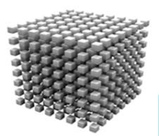
SDMX is used across domains and platforms Decentralised data sinks on various technical platforms
Metadata
Code lists
Key families
SDMX (specialist)
Technical implementation in SDMX cubes
DOTSTAT (MS SQL Server)
ZISDB (Host, IMS HALDB, DB2)
SDW
(Oracle DB)
Technical interface
SDMX (technical, web services)
Specialist interface
Content
Statistical data
Banks
Insurers
Funds
Enterprises
Prices
Interest rates
Yields
National accounts
Public finances
Securities
Financial market
Economic activity
External position
Balance of payments
Real economy
Software products

Slide 8
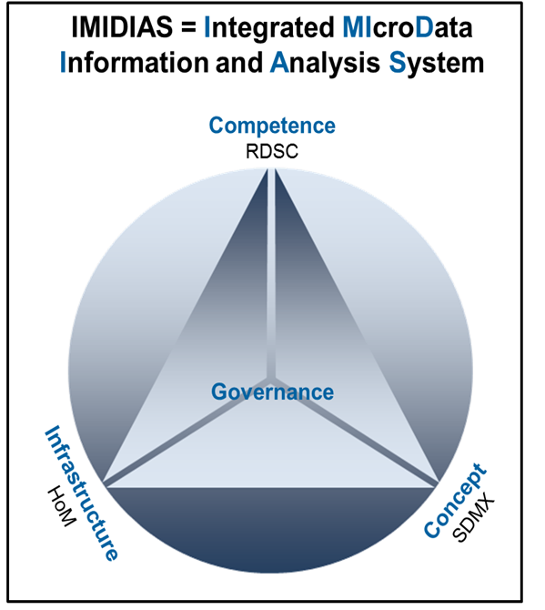
SDMX and central statistics infrastructure Basis for House of Microdata (HoM)
In 2013, the Statistics Department was mandated to establish an integrated interdepartmental information system for analytical and research purposes based on microdata for various user groups (financial stability, research, monetary policy, supervision)
This should be achieved by developing a Research Data and Service Centre (RDSC) and a microdatabase (HoM, “House of Microdata”)
This HoM is based on SDMX and the Central Statistics Infrastructure
The SDMX model can be used without any problems for microdata.
Data diversity requires standardization, SDMX provides a suitable framework
Multidimensional approach, by using uniform code lists, offers an ideal means of linking and comparing data from different sources.

Slide 9
What is there to do?
There are no globally consistent code lists yet
Is a truly global standard possible?
Open source approach for future efforts?
Do the global approach and the open source idea comply with confidentiality constraints and the legal framework?
Are we investing enough time and effort into Data Literacy?

