Slide 1

Disentangling Data Narratives: The Impact of Migrants on European Welfare Systems
Drs. Caterina Francesca Guidi and Gaby Umbach
GlobalStat, European University Institute
Conference of European Statistics Stakeholders 2018
18 October 2018, Bamberg, Germany

Slide 2
Presentation outline
The starting point: research focus
The European scenario
UK case of study: some empirical evidence
The Brexit propaganda
The impact of migrants on UK health system
Provisional conclusions

Slide 3
The starting point: research focus
Migrant health: international and European strategic area
Global Compacts on Migration and Refugees (2018)
Sustainable Development Goals (2015)
Global Consultations (2010, 2017) ruled by the IOM and WHO
Ongoing debate on the pressures on MS’ healthcare systems: conflict between ‘factual’, i.e. measurable, and ‘post factual’, i.e. perceived, realities
Key aim of this work: juxtapose factual and perceived evidence. We analyse the role of diverging data narratives and contrast ‘alternative truth scenarios’ in ‘Brexit-UK’ with the ‘real’, i.e. measurable, impact of migrants on the British healthcare sectors

Slide 4
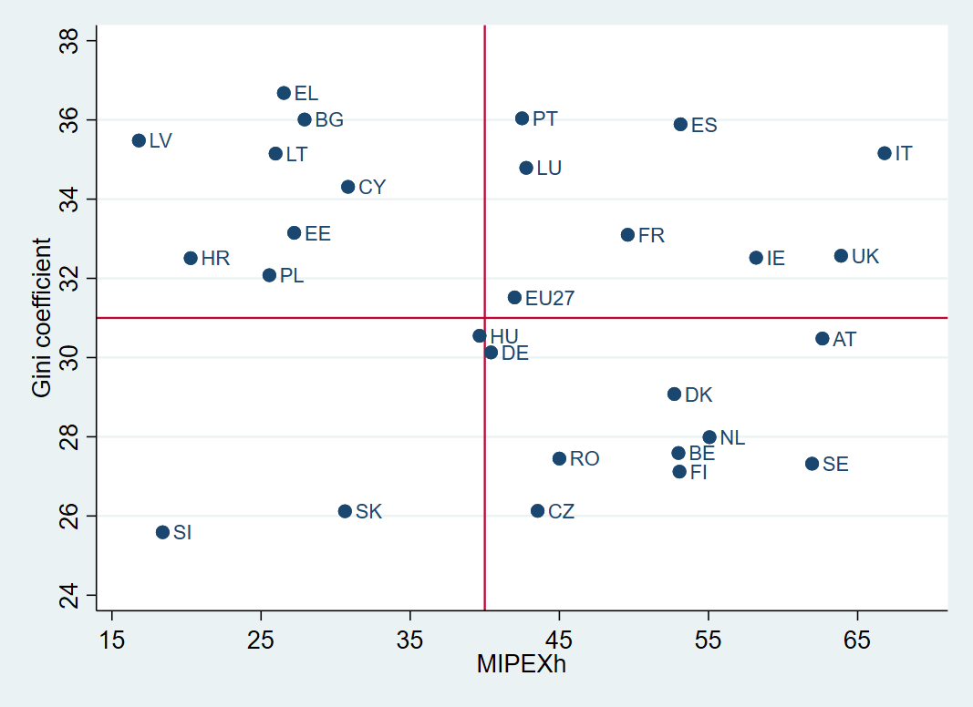
The
European Scenario
Putting in correlation the Gini Index, which measures inequality in income distribution, with MIPEX health strand scores to have a broader measurability of the health inequality suffered by migrants in the EU MS
Some country clusters are emerging
Indeed, migrant health seems to be strictly correlated with the overall healthcare system function and (health) inequality

Slide 5

UK case of study: some empirical evidence
The UK population: 65.6 million, of which 14% of the UK population were born abroad (Office for National Statistics, 2018)
Migration in the country has a positive effect on economic growth with net fiscal benefits (Boeri, 2009; Dustmann and Frattini, 2010, 2014; Nyman and Ahlskog, 2018):
  received less tax benefits, tax credits and places allocated to social housing than natives
  the net fiscal effects of hosting EU migrants have been moderately positive across the time period 2004-2015: the net fiscal effects appear to be +/-0:5% of GDP
The impact of migration on the welfare of industrialised countries turns out to be broad and heterogeneous, especially with regards to consolidated public economics
Migrants have thus largely support the local public finances, despite the healthcare rights are based on the residence status and, especially, European migrants

Slide 6

UK case of study: some empirical evidence
Migrants have thus largely support the local public finances despite the healthcare rights are based on the residence status and
In particular, the use of specialist, outpatient and hospital medicine appears to be lower among ethnic minorities than in equivalent white groups – but not consistent by gender, age, or job specialization
Due to the migrant presence very low effects are registered on NHS waiting times – emergency and outpatient
Despite these studies don’t distinguish between intra-EU and non-EU migrants, on average intra-EU migrants are younger than TCN so less likely to use health services

Slide 7

The Brexit propaganda
The impact of migrants on UK health system (IPSOS Mori Highlights, 2015):
almost 2/3 of British interviews greater restrictions on free movement
¾ mentioned pressure on public services and six in ten cite people coming to claim benefits as their reason for Brexit
Beyond the former PM, Cameron, also Johnson (Conservative Party) and Farage (UKIP) – “Leave” campaigners - claimed for too much pressures on public services, waiting lists in hospitals and in schools due to migrants
Indeed, during the referendum campaign, with a typical “post-truth” stratagem, “Leave” campaigners made repeated use of the claim that EU membership cost £350 million a week

Slide 8
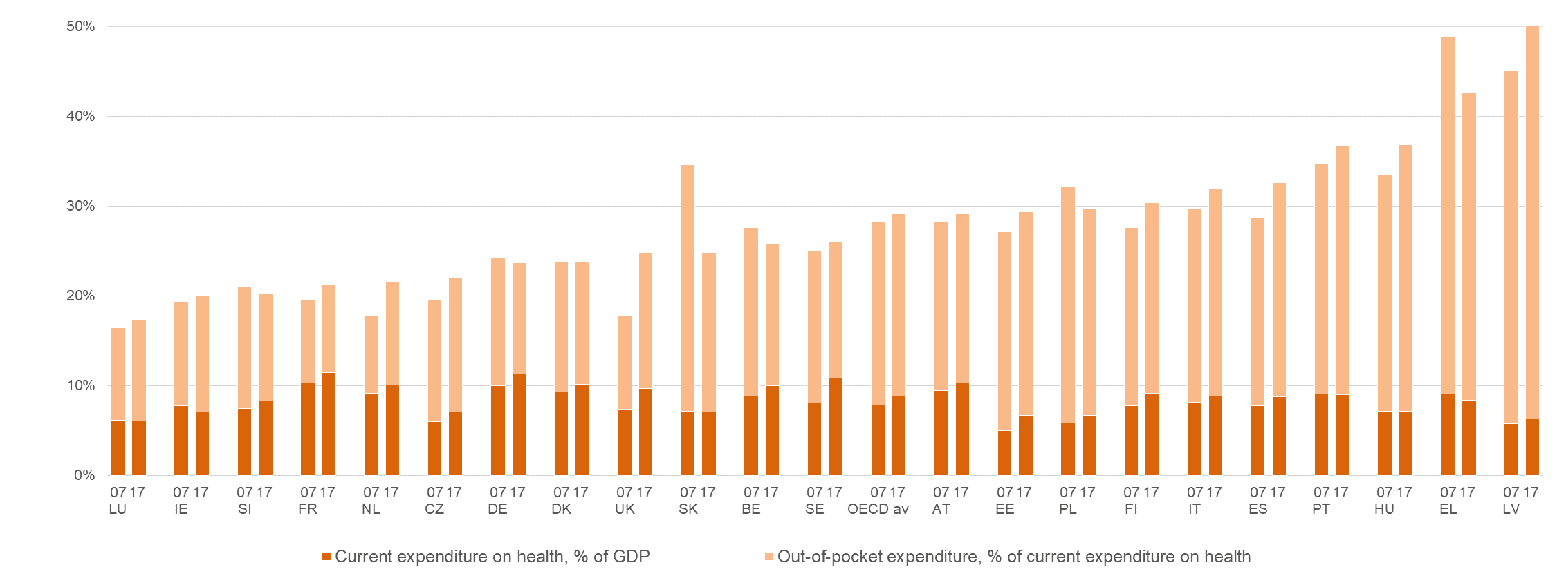
The impact of migrants on UK health system
According to the latest estimates the share of PHE/THE is stable – around 82% in UK – but the one of private payments is around 11 % despite the NHS: UK is presenting an increasing share of OOP but decreasing share of poor people declaring good (Borges and Guidi, 2018)
The effect of immigrants on medical expenses, incurred by the NHS, varies. Analysing the real impact of migrants on (British) health sector according to above mentioned scheme (Rowthorn, 2008):
  Age pyramid and aging process: about 35% of foreign-born workers aged 25-35 years old in 2015
  Fertility and mortality rates: in 2014 27% (1 in 3) of all babies were born to foreign-born mothers
  The degree of integration into the labour market: migrants helped fill shortfall of 50,000 clinically trained staff. Migration reduces the average physical burden of UK-born workers in England and Wales in 2003-2013

Slide 9

Provisional conclusions
Migration by creating more pressure on consolidated services or requiring new ones, affects the demand and supply of health goods→ sustainability of services will be target the social inequalities (Guidi and Petretto, 2018)
Migrants are facing serious inequalities in health status and public health provision as iniquities in health care access (Lancet, 2018), as shown by the British example
Health policies should continue to ensures parity of access, based on the rigorous application of research evidence, taking into account the distorted public perception of the phenomenon
Citizens vs. Voters

Slide 10

Thanks for your attention!
Comments and observations are welcome to:
caterina.guidi@eui.eu
Dr. Caterina F. Guidi
Project Coordinator of GlobalStat
Dr. Gaby Umbach,
Director of GlobalStat
www.globalstat.eu | @GlobalStat_eu
Robert Schuman Centre for Advanced Studies
European University Institute (EUI)

